Slide 1
An interesting CAuSE OF bronchiectasis
Dr.S.KADHIRVEL –VI MU
CHIEF -Dr C .DHARMARAJ

Slide 2
60Y /M presented with
C/o cough with expectoration -2 weeks
Copious yellow coloured sputum
foul smelling ,not blood stained
H/o breathlessness ,Gr II
H/o chest pain ,pleuritic type over the right hemithorax
No h/o fever
H/o abdominal pain –dull dragging type over the right upper abdomen
No h/o palpitation

Slide 3
No h/o loose stools /bloody stools in recent past
No h/o decreased urine output
No h/o altered sensorium/seizures
No h/o blurring of vision

Slide 4
Past history:
K/c/o COPD on Rx for past few years.
K/c/o hydatid cyst – right lobe of liver,operated in a private hospital in 2015.
Not a k/c/o DM/SHT/PT/BA/CAD/seizures

Slide 5
Personal history:
Mixed diet
Chronic alcoholic 350ml -3 times a week for about 25 yrs
Chronic smoker -1-2 pack beedies for 35yrs
Normal bladder and bowel habits

Slide 6
General examination
O/E
Pt conscious
Oriented , Mildly dyspnoeic
febrile(+)-100.3F
Pallor(+)
clubbing –pandigital grade II
No cyanosis
No pedal edema
No generalised lymphadenopathy
Hydration-good

Slide 7
vitals
BP:130/90MMHG
Pulse:112/min
Regular
Normal volume
Felt in all periph. vessels
RR:24/min
SPO2:96% with room air
TEMP: 100.3f

Slide 8
Systemic examination
RS: Bilateral Air Entry(+), NVBS+
Trachea in midline
Chest wall symmetrical, movements decreased in the right lower hemithorax
B/L wheeze (+) –expiratory,poly phonic
Crepts(mid inspiratory) –coarse leathery over the right mammary , infra axillary and lower inter scapular regions.

Slide 9
CVS: S1S2(+), No murmurs
P/A : soft ,Bowel Sounds(+)
Liver enlarged(17cms) ,3cms below the right costal
margin
minimal tenderness in the right hypochondrium and
epigastrium
Spleen not palpable
No free fluid.
CNS: No FND

Slide 10
Provisional diagnosis
COPD – infective exacerbation
Right middle lobe bronchiectasis
Right lower lobe pneumonia
?Recurrent hydatid cyst –right lobe of liver

Slide 11
TREATMENT
NPO ,IVF
Inj cefotaxime 1gm IV tds
Inj metronidazole 500mg iv tds
Inj deriphylline 1amp iv tds
T.Ranitidine 150 mg bd
Salbutamol nebulisation 4th hourly
Abdominal girth chart
Vitals monitoring

Slide 12
Investigations
RBS:105
RFT:
UREA-20
CREATININE-0.90
Na+ 138
K+ 4.9
Cl- 101
CBC
HB:12.6
TC:17000
DC:71/12/17
ESR:42
PCV:36.8%
PLAT:3.29LACS/CU.MM
URINE
ALBUMIN:Trace
SUGAR:Nil
DEPOSITS:0-2Pus cells
LFT
S.BILIRUBIN:0.7
SGOT:36
SGPT:23
ALP:76
S.PROTEINS:7.4
ALBUMIN:4.6
GLOBULIN:2.8

Slide 14
USG-Abdomen
Multiple cystic lesions ,largest 12.1x10.7cms with daughter cysts and areas of wall calcifications noted in the right lobe of liver(seg 6&7) with wall calcifications
Other solid organs normal in size and echoes
No free fluid in abdomen and pelvis
No pleural effusion
s/o hydatid cyst recurrence –right lobe of liver.

Slide 15
Surgery opinion:
decreased air entry –rt lower lobe
Mild gaurding , tenderness –upper abdomen
No rigidity
P/R :normal
Suggested: NPO
IVF
Xray chest and erect abdomen
CT abdomen
Abdominal girth chart
SGE (o) and review

Slide 16
SGE opinion
Suggested :
LFT
Repeat usg abdomen and pelvis
CT abdomen and pelvis
USG review
No evidence of rupture of hydatid cyst at present

Slide 17
Thoracic physician opinion
Right middle lobe bronchiectasis
Suggested : sputum AFB
HIV screening
If isputum negative for AFB – plan FOB
HIV screening – negative
Sputum for AFB isnegative

Slide 18
Cardio thoracic surgeon opinion
CXR –no e/o hydro/pneumothorax
Suggested – CT chest and review

Slide 21
CT chest
E/o hydatid cyst in the lower part of the right middle lobe and upper part of the lower lobe
Measuring 10x12cms
Associated bronchiectatic changes present
E/o liver hydatid in segments 6 and 7 measuring 8x10 cmswith inflammatory changes noted.
No fluid in the abdomen /pelvis and pleural cavity

Slide 22
Cardio thoracic surgeon review
PFT
Sputum AFB and C&S
Repeat CXR
Planned for surgery -thoracotomy and enucleation
suggested : To add
Inj ampicillin 1gm iv bd
Inj ofloxacin 100mg iv bd
T.albendazole 400mg 1-0-1
Chest physiotherapy
Vitals monitoring

Slide 23
PFT
PARAMETERS | PREDICTED | BEST | %PREDICTED
FVC | 3.39 | 2.82 | 83
FEV1 | 2.68 | 1.12 | 42
FEV1/FVC | 0.764 | 0.396 | 52
PEF | 8.01 | 1.42 | 18
IMPRESSION: SEVERE OBSTRUCTION
Planned for surgery and assessed for anaesthetic fitness
Cardiac fitness was obtained
Echo showed Right atrium compressed by a large cystic lesion.

Slide 24
Pt developed sudden dyspnoea and hemodynamic instability
Shifted to CTS ICU and monitored
CT chest was taken and it showed right hydropneumothorax and partial collapse of the right lung and left side mediastinal shift s/o rupture of hydatid lung in to pleural space
Pt was stabilized and ICD tube inserted in the right 5th Intercostal space
400ml of dirty fluid -?pus drained

Slide 25
Pt was stabilized .Taken up for thoracotomy and enucleation

Slide 26
Operative findings
Diagnosis: ruptured hydatid middle lobe of right lung with liver hydatid
Procedure: excision of lung hydatid with removal of liver cyst.
Intra op findings: excision of lung hydatid -right middle lobe with removal of liver cyst through the diaphragm. Liver cavity obliterated . Diaphragm sutured and checked for air leaks.
Right lung adequately expanded after keeping suitable drains .
Pt was shifted to IRCU and recovery monitored.
2 units of FFP and 1 packed cell unit were transfused.

Slide 27
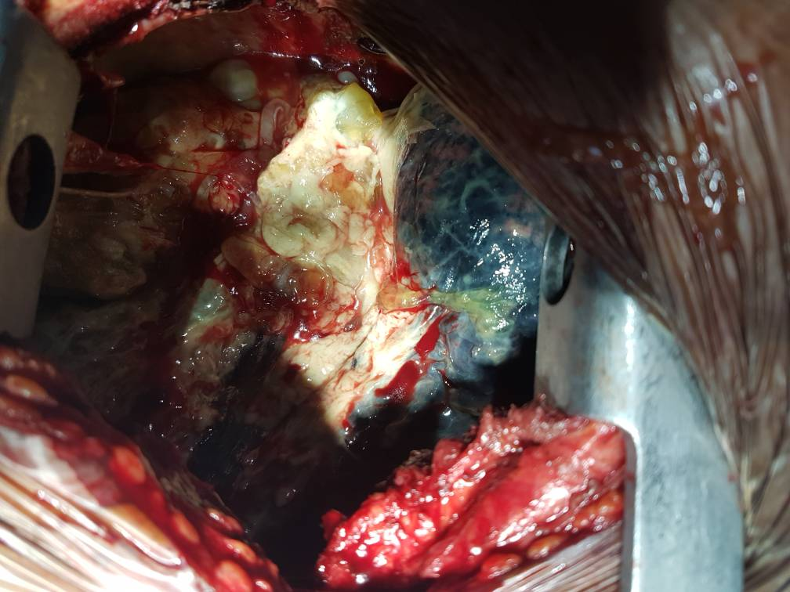

Slide 28
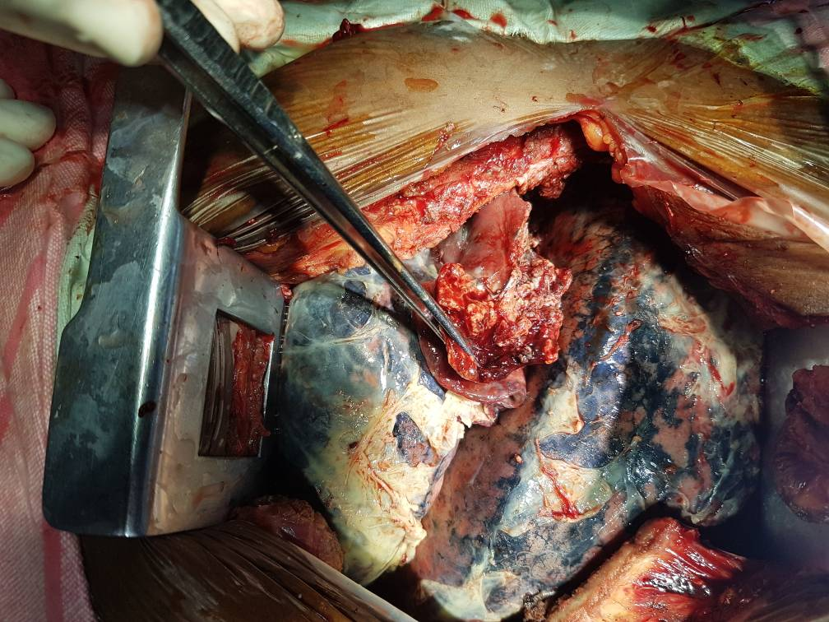

Slide 29
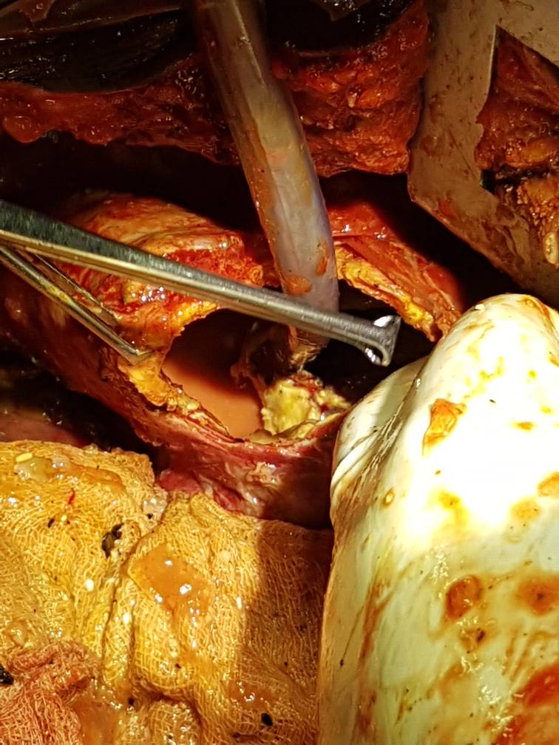

Slide 31
Pt recovered well and is discharged

Slide 32
To highlight the unusual cause of bronchiectasis
To discuss the manifestations and complications of hydatid disease
Synchronous involvement of liver and lung

