Slide 1
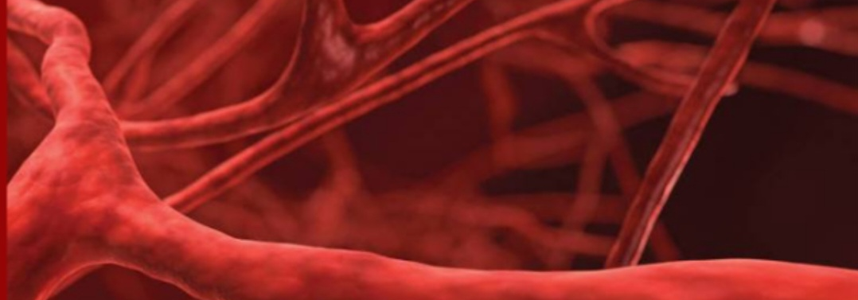
VASCULITIS
6TH MEDICAL UNIT
CHIEF:DR.M.RAJKUMAR M.D
ASSISTANT PROFESSORS:
DR.T.BALASELVI M.D
DR.MADHAN VIGNESH M.D
PRESENTOR:
DR.V.SATHIYA PRIYA
(2ND YEAR POSTGRADUATE)

Slide 2
VASCULITIC SYNDROMES
CLINICAL FEATURES AND MANAGEMENT OF
LARGE VESSEL VASCULITIS
MEDIUM VESSEL VASCULITIS
SMALL VESSEL VASCULITIS

Slide 3
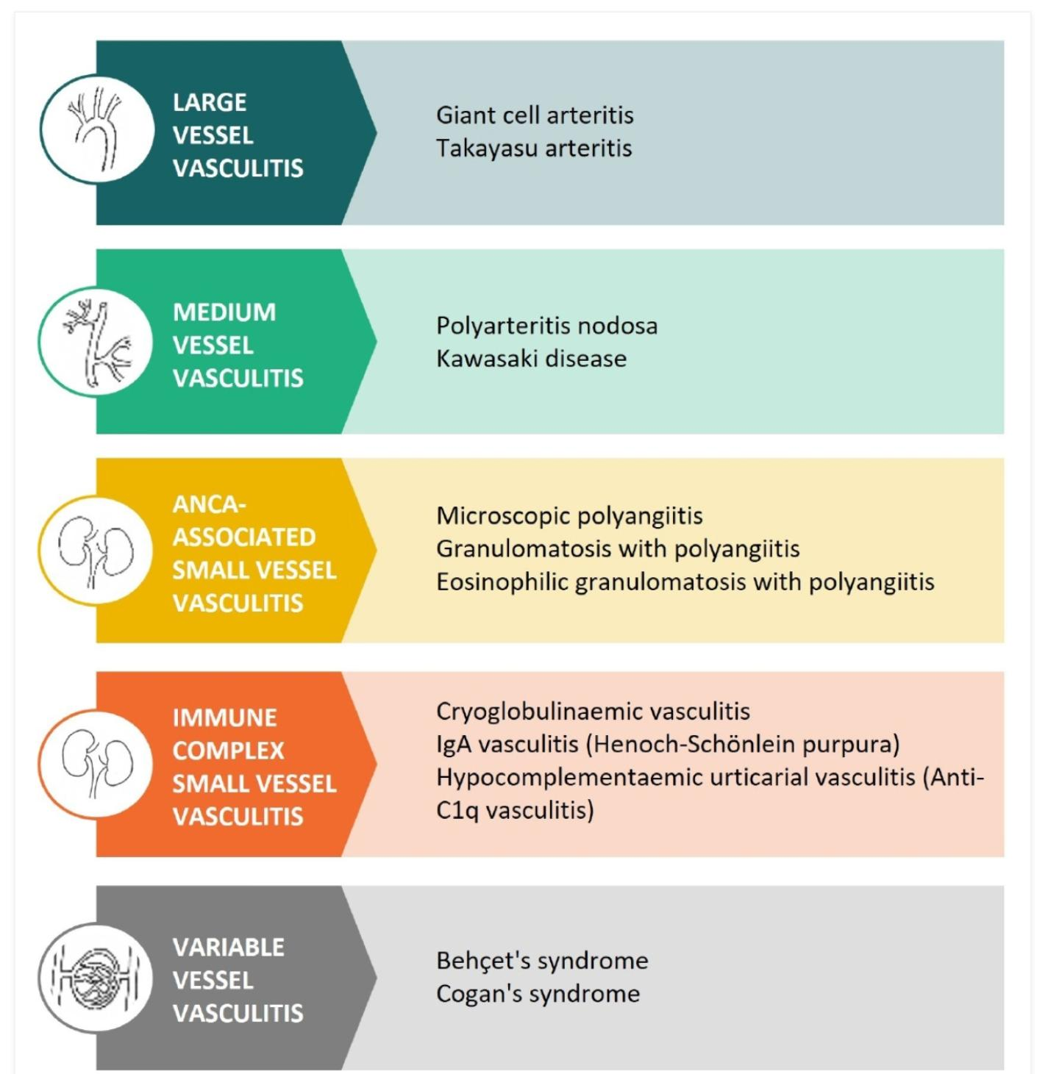
Revised Chappel Hill Consensus 2012 Classification Criteria:

Slide 4
LARGE VESSEL VASCULITIS :
GIANT CELL ARTERITIS:[Temporal arteritis]
Most common vasculitis in adults
More common in females
Occur in >50 years
Vessels involved are:
Superficial temporal
vertebral artery
Ophthalmic artery
Posterior ciliary artery

Slide 5
>50% patients with GCA have Polymyalgia rheumatica
CLINICAL FEATURES :
Headache associated with tender,thickened,nodular artery
Jaw Claudication
Visual loss
Polymyalgia
30% patients have aorta involvement and risk for thoracic aneurysms

Slide 6
Diagnosis:
INVESTIGATION OF CHOICE:3 to 5 CM long segment Temporal artery biopsy
ESR,CRP Elevated
TREATMENT :
STERIODS:40 to 60mg/day 1st line therapy
Duration:3 months
TOCILIZUMAB used along with steroids to control Flares

Slide 7
POLYMYALGIA RHEUMATICA[PMR]:
Occurs in >50 years
Clinical features:Pain and stiffness in Hip, Shoulder and pelvic gridle
Worse in morning, relieved with activity
ESR increased,RF should be negative
Treatment: Low dose Steroids

Slide 8
TAKAYASU ARTERITIS:
Most common vasculitis
Also known as aortic arch syndrome/pulseless disease
vessels involved are:
Left subclavian artery(Most common)
Common carotid artery
Renal artery
Vertebral artery,common iliac artery
Aorta and it’s branches
Pulmonary artery
Occurs in <40 years

Slide 9
American college of Rheumatology classification criteria:
Onset before age of 40 years
Limb claudication
Decreased Brachial artery pressure
Unequal arm blood pressure
Subclavian or aortic bruit
Angiographic evidence of narrowing or occlusion of aorta or it’s branches.
Presence of >3 criteria indicates diagnosis of Takayasu arteritis.
CLINICAL FEATURES:
Generalised symptoms like
Malaise
Fever
weight loss,Arthralgia

Slide 10
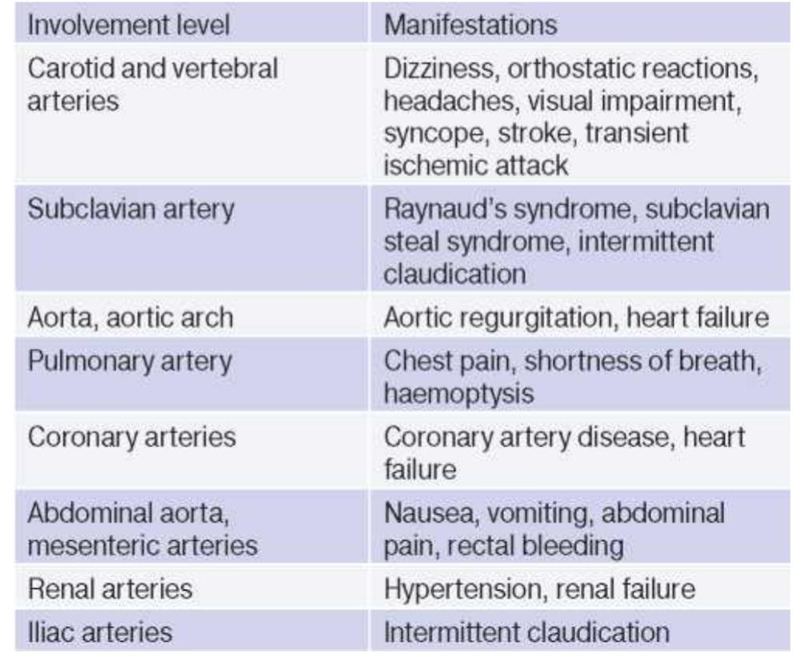
DIAGNOSIS:
aRTERIOGRAM is the gold standard.
Treatment:
Steroid
SURGICAL REVASCULARISATION

Slide 11
MEDIUM VESSEL VASCULITIS:
POLYARTERITIS NODOSA:
Multisystem, necrotising vasculitis of medium sized arteries it involves Renal and visceral artery.
It doesn’t involve Pulmonary arteries , bronchial vessels may be involved.
No glomerulonephritis will be present
PAN FEATURES:
positive hepatitis B serology
Arteriographic abnormalities
Mononeuropathy or polyneuropathy.

Slide 12
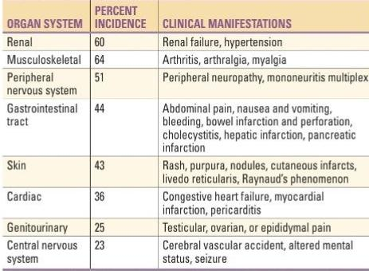
CLINICAL FEATURES

Slide 13
AMERICAN COLLEGE OF RHEUMATOLOGY (ACR)CRITERIA FOR PAN:
Weight loss >4kg
Livedo reticularis
Mononeuropathy or polyneuropathy
Diastolic blood pressure >90mmHg
Hepatitis B virus
Testicular pain or Tenderness
Myalgia, weakness or leg Tenderness
Arteriographic abnormalities
Biopsy of medium sized artery containing polymorphonuclear neutrophils

Slide 14
INVESTIGATIONS:
Elevated ESR,CRP,leukocyte count
Biopsy
Arteriogram
Treatment :
STERIODS+CYCLOPHOSPHAMIDE
In patients with hepatitis B or C +PAN Antiviral therapy plays a important role and used in combination with glucocorticoids and plasma exchange.

Slide 15
KAWASAKI DISEASE:
Also known as Mucocutaneous lymphnode syndrome
Age:<5 years
Boys>girls
Phases of the disease:
Acute phase: First 10 days
Vasculitis phase:10 to 28 days
Convalescent phase:6 to 8 weeks

Slide 16
CRITERIA FOR KAWASAKI DISEASE:
Bilateral non exudative bulbar conjunctival congestion appears after fever
Rash: Erythematous maculopapular rash
Anterior cervical non suppurative unilateral Lymph node
Bilateral symmetrical painful swelling of hands and feet with erythema of palms and sole, periungual desquamation .
Red swollen cracked lip+Strawberry tongue +erythematous oropharyngeal mucosa.
Other Clinical features:
Cardiac manifestation like:MYOCARDITIS (Most common)
Most dangerous complication:CORONARY ANEURYSM

Slide 17
Treatment:
IvIg 2g/kg single infusion over 10hr used in Acute phase reduces the risk of coronary aneurysm.
Aspirin 100mg/kg/day for 14 days followed by 3-5 mg/kg per day
Echo at 6 to 8 weeks-If normal stop aspirin
If aneurysm Occurs-Lifelong aspirin

Slide 18
ANCA ASSOCIATED SMALL VESSEL VASCULITIS:
GRANULOMATOSIS WITH POLYANGITIS:
It is the most common ANCA associated small vessel vasculitis.
Age:>40 years
C ANCA 70%Cases,P ANCA 25%Cases
CLINICAL FEATURES:
MAJOR MANIFESTATIONS:
URT[MC]
LRT
KIDNEY
MINOR MANIFESTATIONS:
Neurological,Ocular,Skin manifestation

Slide 19
UPPER RESPIRATORY TRACT MANIFESTATIONS:
Serous otitis media in adults
sinusitis
Recurrent epistaxis with mucopurulent nasal discharge
Saddle nasal deformity with crusting, ulcer formation
Subglottic Stenosis.
LOWER RESPIRATORY TRACT MANIFESTATIONS:
Diffuse alveolar hemorrhage
Thick walled with cavitating nodules
PULMONARY MANIFESTATIONS:
Hemoptysis, Dyspnoea,Cough
RENAL MANIFESTATIONS:
Proteinuria,Hematuria
SKIN MANIFESTATIONS :
Ulcers or subcutaneous nodules
EYE MANIFESTATIONS:
Conjunctivitis,episcleritis,retroorbital mass lesion
CARDIAC MANIFESTATION:
Pericarditis, cardiomyopathy
NERVOUS SYSTEM MANIFESTATION:
Mononeuritis multiplexa,Cranial neuritis

Slide 20
Histopathological Hallmarks:
Necrotising vasculitis of small arteries with granuloma formation.
Biopsy from
Lung mostly preferred it shows necrotising granulomatous vasculitis.
Upper airway biopsy shows Inflammation, necrosis, granuloma formation with or without vasculitis
Renal shows Focal and segmental glomerulitis evolve into RPGN,granuloma formation rarely seen in Renal biopsy.

Slide 21
Laboratory Investigations:
DIAGNOSIS:
Biopsy
ANCA[ specificity of positive antiproteinase 3 ANCA For GPA is very high)
Elevated ESR, CRP
C ANCA POSITIVITY

Slide 22
TREATMENT:
INDUCTION THERAPY:
STANDARD REGIMEN: GLUCOCORTICOIDS AND IMMUNOSUPPRESSANT
IV Methylprednisolone 1g for 3 days followed by oral prednisolone 1mg/kg/day for 1st month followed by tapering.
Immunosuppressant like:
IV CYCLOPHOSPHAMIDE 15mg/kg 3 infusions every 2 weeks then every 3 weeks or ORAL CYCLOPHOSPHAMIDE 2mg/kg/day for 3 months followed by 1.5mg/kg daily for 6 months.
Side effects of Cyclophosphamide:Infertility,Cytopenias
Alternative to cyclophosphamide RITUXIMAB 375mg/m2 once a week for 4 weeks.
MAINTENANCE THERAPY:
Azathioprine 2mg/kg>MMF or Rituximab 500mg for two doses followed by 500mg every 6 months+Low dose steroids
Continue for 24 months
RITUXIMAB HAS LOWER RELAPSE RATE COMPARED TO AZATHIOPRINE
RELAPSE :
RITUXIMAB
PLASMAPHERESIS INDICATIONS:
Severe Renal disease
Pulmonary hemorrhage
CNS vasculitis

Slide 23
MICROSCOPIC POLYANGITIS:
No granuloma present in biopsy
Age:>50 years
M>F
C ANCA 50% cases
P ANCA 40% cases
Skin lesion more common
Glomerulonephritis occur in 80% of patients progress to Renal failure
Upper airway and Pulmonary manifestation not present in MPA

Slide 24
CLINICAL FEATURES :
Investigations:
ESR,CRP increased
leucocytosis
ANCA positive in 75 %cases with Anti MPO predominance
DIAGNOSIS:
Biopsy and ANCA
Fever,Weight loss
Hemoptysis
Myalgia
Cutaneous vasculitis

Slide 25
EOSINOPHILIC GRANULOMATOSIS WITH POLYANGITIS :
Common in Asthma
Peripheral and tissue eosinophilia
Extravascular granuloma formation
Vasculitis of multiple organ systems
Age->45 years
F>M
P ANCA 40%Case
C ANCA 5% Case
HISTOPATHOLOGICAL FINDINGS:
Granuloma +Tissue infiltration with eosinophilia
SYSTEM INVOLVEMENT:
LUNG Involvement is common
GIT is the most common system involved

Slide 26
CLINICAL FEATURES:
INVESTIGATIONS:
Eosinophilia >1000 cells
Increased ESR
ANCA
TREATMENT:
STERIODS+ CYCLOPHOSPHAMIDE
MEPOLIZUMAB[anti IL5 antibody)
Fever, weight loss, Malaise
PULMONARY SYMPTOM:Asthma
2nd most common:Mononeuritis multiplexa
Allergic rhinitis and sinusitis
CVS- MYOCARDITIS (MC CAUSE OF DEATH)
SKIN-Cutaneous nodules
Renal involvement is less common

Slide 27
IgA VASCULITIS:
Age <5years
M>F
CLINICAL FEATURES:
Non Thrombocytopenic palpable purpura bilaterally symmetrical on lower limbs and buttocks.
Polyathralgias [KLMNO arthritis of HSP:Knee predominant large joint migratory non deforming oligoathritis]
Colicky abdominal pain
Glomerulonephritis
Most dangerous complication: Small bowel intussusception
Adult HSP cause severe Renal impairment.

Slide 28
LAB INVESTIGATIONS
TREATMENT:
PREDNISOLONE 1mg/kg/day
Normal platelet count
IgA increased .
DIAGNOSIS:
Skin biopsy shows leukocytoclastic vasculitis with IgA and C3 deposition.

Slide 29
CRYOGLOBULINEMIA:
Cold precipitated monoclonal or polyclonal immunoglobulin deposit on surface of small and medium vessels.
Age 40 to 60 years
F>M
3 types of cryoglobulinemias
Type 2 and 3 cryoglobulinemia associated with HCV
Clinical features:
Cutaneous vasculitis
Arthritis
peripheral neuropathy

Slide 30
INVESTIGATIONS:
TREATMENT:
ANTIVIRAL + RITUXIMAB
Serum cryoglobulins
Markers:C4>C3
RF POSITIVITY
HCV

Slide 31
THANK YOU

