Slide 1
Rare cause of bleeding disorder
By 3rd medical unit

Slide 2
Chief complaints
14 YEAR OLD FEMALE PATIENT
c/o Increased menstrual flow for 2 months

Slide 3
History of presenting illness :
patient was apparently normal 2 months back then she developed complaints of
increased menstrual flow for 2 months
h/o easy fatiguability
no h/o abdominal pain
no h/o yellowish discolouration of skin and mucous membrane
no h/o swelling of joints
no h/o gum bleeding
no h/o epistaxis
no h/o fever

Slide 4
Past history
h/o similar illness in the past 1 year back for which she admitted in dindugal gh and 2 packed cell transfusion done
Past history of on and off epistaxis and gum bleeding present in childhood period
No h/o any drug intake
n/k/c/o dm,thyroid disorder,seizure disorder

Slide 5
Family history
no h/o similar illness in the family members
personal history
taking mixed diet
non addictive habits
menstrual history
h/o menorrhagia 2 months lasting 10 days,
5 pads/day

Slide 6
on examination
conscious
oriented
afebrile SKIN:
no pallor NO ECCHYMOSIS,PETECHIAE
not icteric
no cyanosis
no clubbing
no pedal edemA
NO GENARALISED LYMPHADENOPATHY

Slide 7
VITALS
bp-110/70 mmhg
pr-90/min
spo2-99% in ra
Systemic examination
cvs –s1,s2 +,no murmur
rs-b/l ae present , normal vesicular breath sound +
abdomen- soft, bs +, no organomegaly
cns-no focal neurological deficiency

Slide 8
Investigation
V SERUM UREA-18
SERUM CREAT-0.6
BLOOD SUGAR-126
LFT- TOTAL BILIRUBIN-1.1
DIRECT-0.6
INDIRECT-0.5
OT-39
PT-44
ALP-125
TC | 7300
HB | 11
PCV | 38
PIT | 4.25
MCV | 86
MCH | 29
MCHC | 32
 | DAY 1 | DAY 2 | DAY 3
PT | >150 | >150 | >150
INR
APTT | 27.5 | 25.8 | 28.6

Slide 9
Cmplete hemogram
tc-10,400
rbc-4.67
hg-10.1
plt-4.13
moderate hypochromic microcytes and elongated cells present
imp- hypochromic microcytic anemia
usg abd and pelvis –no significant abnormality detected
URINE ROUTINE-
ALB-NIL
SUGAR-NIL
DEP-1-2,NO BILE SALTS BILE PIGMENTS

Slide 10
What next ?

Slide 12
Patient was diagnosed as
inherited factor vii deficiency
Recombinant factor vii replacement
DOSE OF15-30 MCG/KG EVERY SIX HOURS UNTIL HEMOSTASIS ACHIEVED

Slide 13
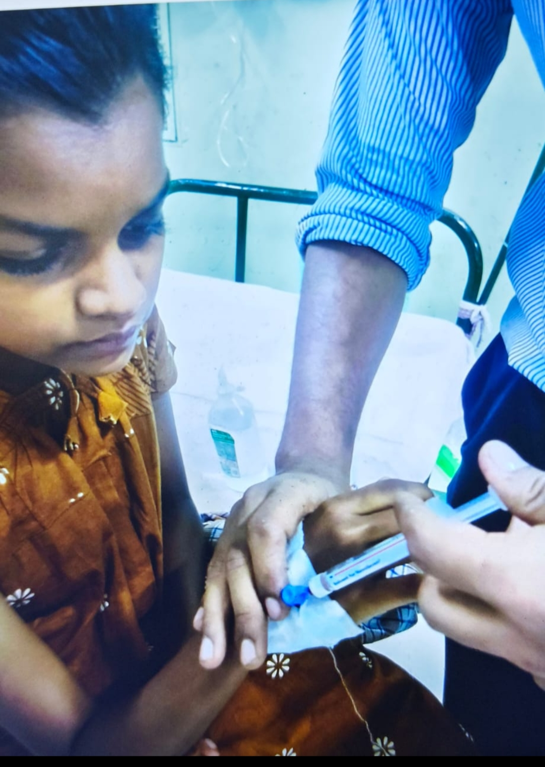

Slide 14
After factor vii transfusion patient pt inr aptt values
 | Day 1 | Day 2
PT | 30 | 15
INR | 1.0 | 0.8
APTT | 28.6 | 25.3

Slide 15
Aim of presentation is
Factor vii deficiency is rare genetic bleeding disorder
Characterised by deficiency or reduced activity of factor vii
Also known as Alexander ‘s diseases

