Slide 1
AN INTERESTING MRI FROM IMCU-1
HOD- DR NATARAJAN MD
IMCU CHIEF-DR ALAGUVENKETASEN MD
ASST PROFESSOR-DR PALANIKUMARAN MD

Slide 2
CHIEF COMPLAINTS
A 20 YEAR OLD FEMALE BROUGHT WITH
COMPLAINTS OF WEAKNESS OF BILATERAL LOWER LIMB FOR 3 WEEKS
DIPLOPIA FOR 5 DAYS

Slide 3
HOPI
Patient was apparently normal 3 weeks back , then she difficulty in using both lower limbs
Insidious onset
Initially started involving left lower limb progressed to involve the right lower limb
No aggravating or relieving factors
H/o Numbness of all lower limbs
No h/o difficulty in climbing stairs
No h/o difficulty in gripping slippers
No h/o difficulty in combing hairs
H/o Difficulty in rolling over
No h/o slippage of slippers
H/o numbness of the body below abdomen

Slide 4
h/o Diplopia for past 5 days
No h/o difficulty in chewing food
No h/o deviation of angle of mouth/ drooling of saliva
No h/o loss of taste
No h/o hearing disturbance/vertigo
No h/o difficulty in swallowing/ nasal regurgitation
No h/o band like sensation/electric shock like sensation while bending forward

Slide 5
PAST HISTORY
Nil significant
PERSONAL HISTORY
Patient takes mixed diet
Normal sleep and appetite
Normal bowel and bladder habits
MENSTRUAL HISTORY
Attained menarche at 14 years of age
Regular cycles

Slide 6
GPE
On examination patient was
Moderately built and nourished
Conscious,oriented
No pallor/icterus/cyanosis/clubbing/lymphadenopathy/pedal edema
VITALS
BP:130/70 mmHg
PR:85/min
Spo2:97 % at RA

Slide 7
Patient conscious, oriented
Right handed
CRANIAL NERVES
3,4,6 TH CRANIAL NERVE-
EOM : B/L INTERNUCLEAR OPTHALMOPLEGIA
Horizontal diplopia
Nystagmus occuring in both horizontal and vertical planes
Other cranial nerves -Normal

Slide 8
 |  | RIGHT | LEFT
BULK | MID ARM | 25 CM | 23CM
 | MID FOREARM | 21CM | 21CM
 | MID THIGH | 49CM | 49CM
TONE | UPPER LIMB | Normal | Normal
 | LOWER LIMB | Increased | Increased
POWER | UPPER LIMB | 5/5 | 5/5
 | LOWER LIMB | 4/5 | 4/5
DEEP TENDON REFLEXES | UPPER LIMB | 1+ | 1+
 | LOWER LIMB | 2+ | 2+
PLANTAR REFLEX |  | Extensor | Extensor

Slide 9
SENSORY SYSTEM
Cortical sensations-Normal
Vibration ansd joint sense intact
Able of percieve Touch,pain,temperature on both sides of the body
No Cerebellar signs
Skull and spine – no deformity
CVS –S1,S2+, no murmur
RS-BAE+,NVBS
P/A-Soft, no organomegaly

Slide 10
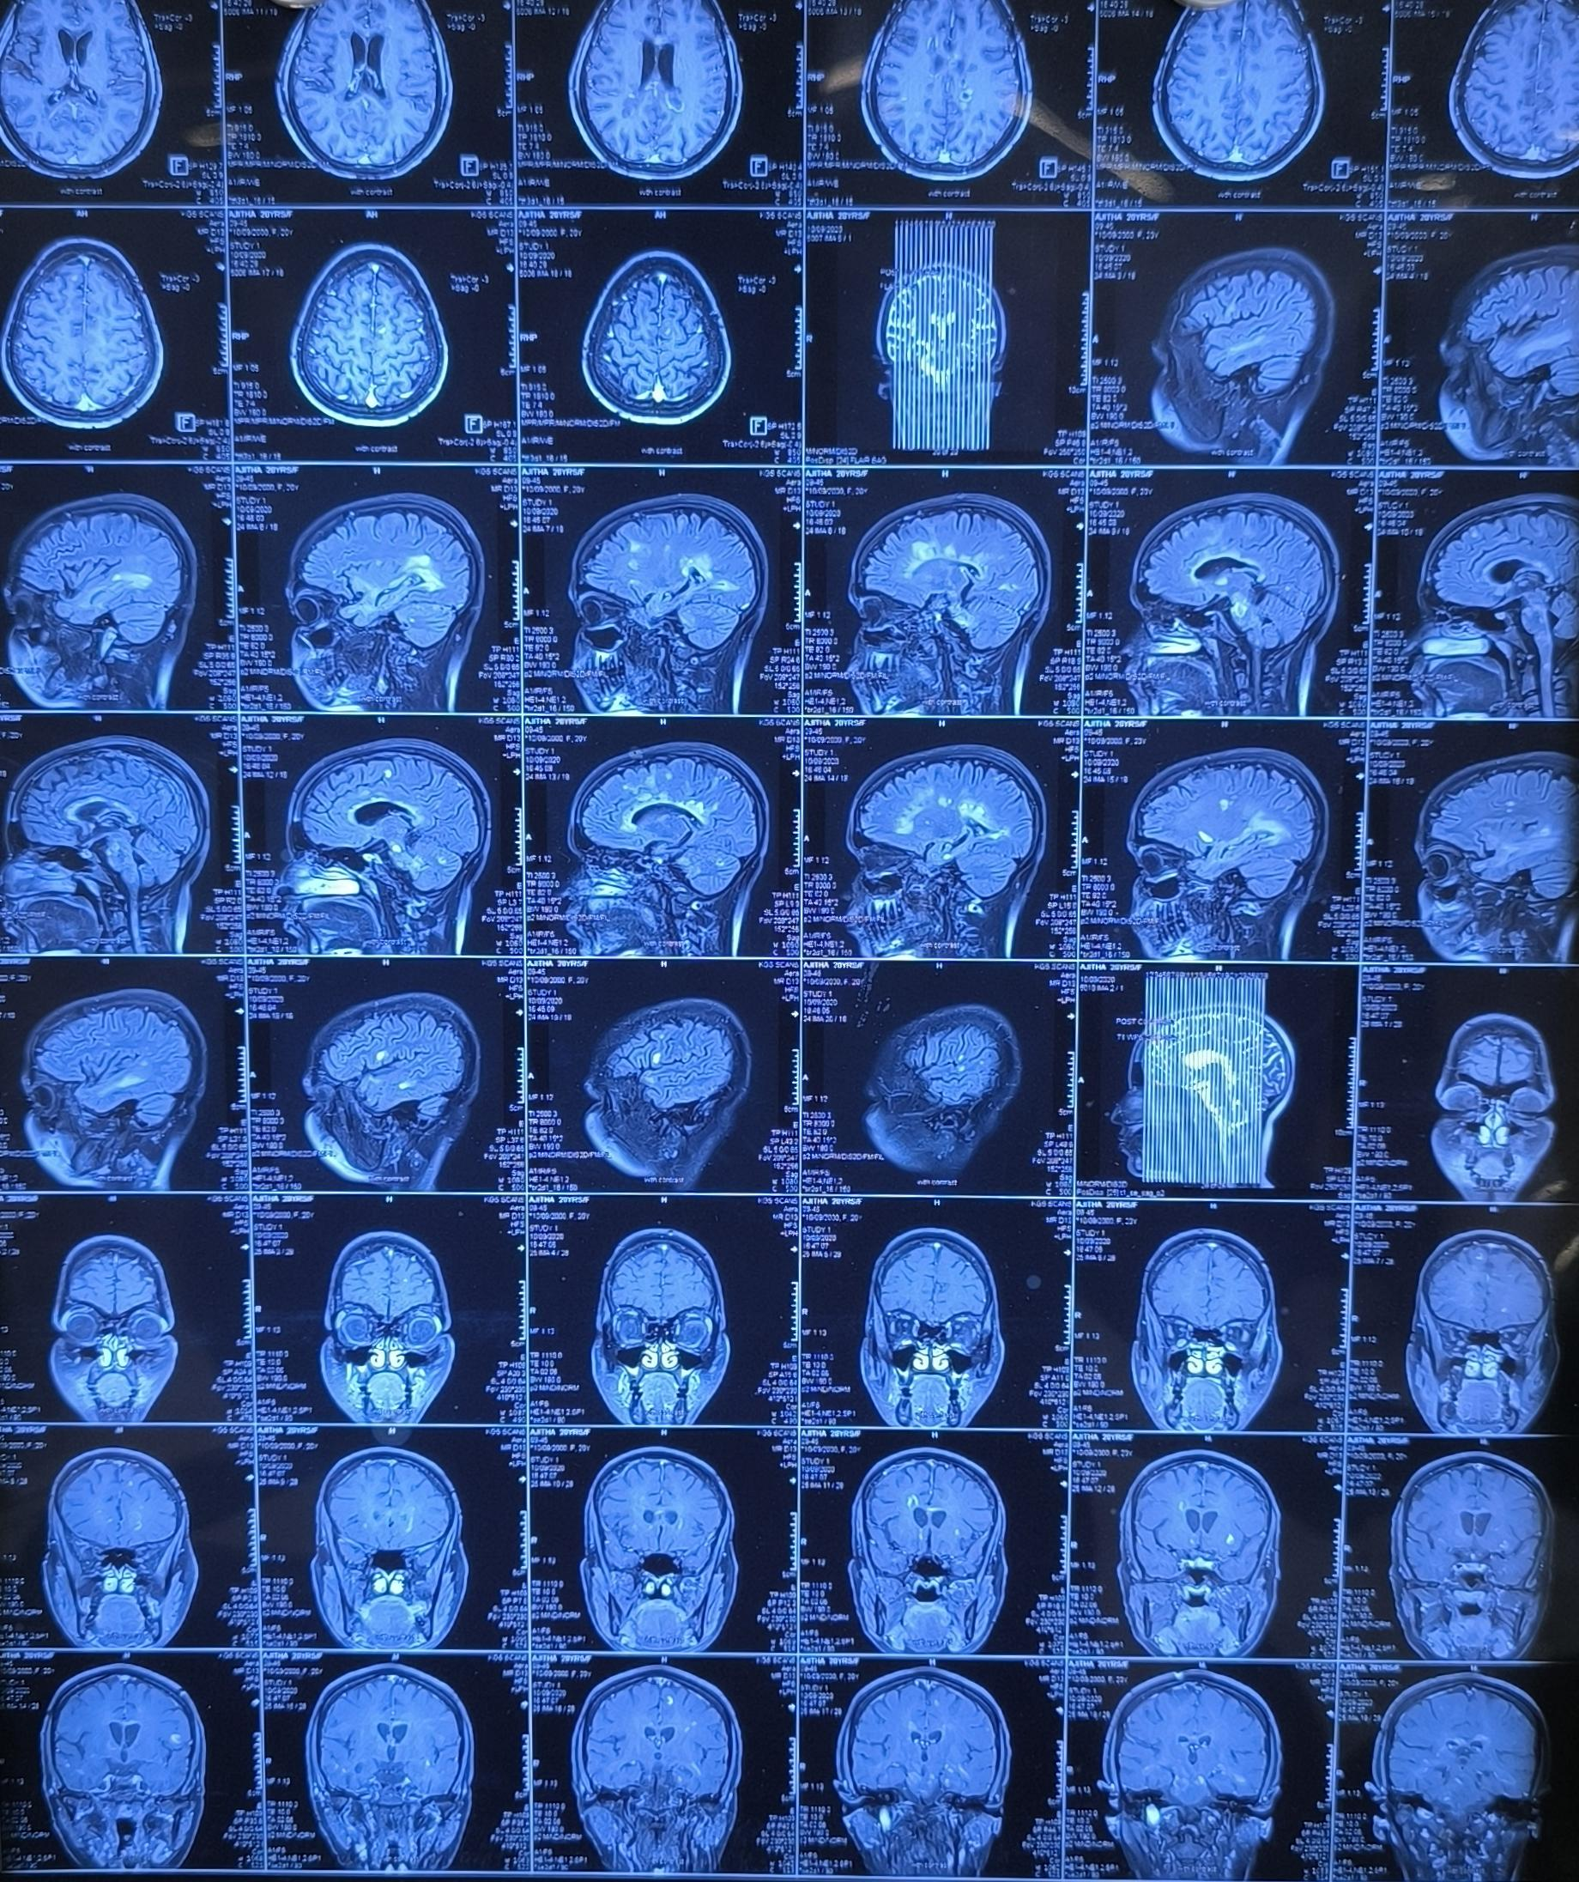

Slide 11
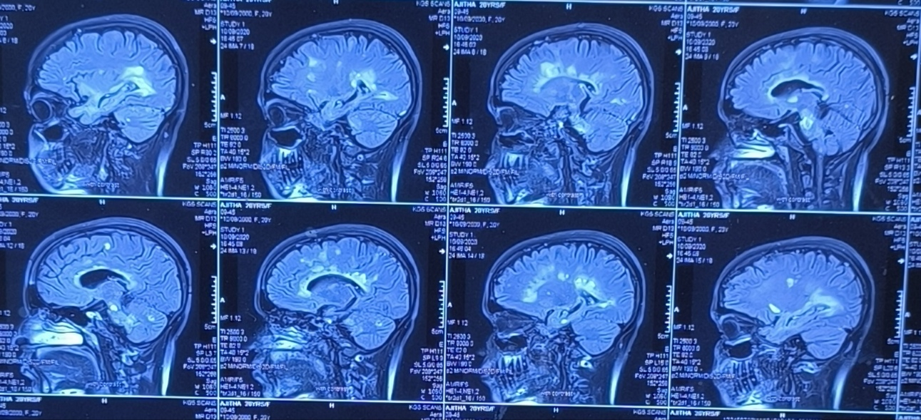

Slide 12
Let’s Discuss

