Slide 1
INTERESTING X RAY & CT CHEST FOR DISCUSSION
Prof Dr.R .Balajinathan,MD.,
Asst prof:-
Dr.V.N.Alagavenkatesan.MD.,
Dr.P.V Balamurugan,MD.,

Slide 2
Case History
Chief complaints:-
A 70yr old female k/c/o COPD came with complaints of breathlessness for past 1 week
History of presenting illness:-
Patient was apparently normal 1week back ,then she developed breathlessness insidious onset, progressive in nature, aggravated by exertion, incresed in severity since last 4days, now at class 4 NYHA, No diurnal variations

Slide 3
H/o cough since 4 days, non productive , aggravated by lying down , more in the early morning,
H/o fever since 3days, low to high grade, intermittent in nature , not associated with chills and rigor
No H/o orthopnea , PND
No H/o chest pain
No H/o syncope
No H/o hemoptysis
No H/o pedal edema

Slide 4
No H/o facial fluffiness
No H/o palpitations
No H/o abdominal distension
No H/o decreased urine output
No H/o sore throat
No H/o headache
No H/o vomiting
No H/o any bleeding manifestation and rashes

Slide 5
PAST HISTORY:-
H/O similar complaints on and off for past year. And recently diagnosed and treated as COPD /CORPULMONALE/RESPIRATORY FAILURE 4months back
No H/O DM/ HTN/ CAD/ CKD/BRONCHIAL ASTHMA/ CKD / SEIZURE DISORDER

Slide 6
PERSONAL HISTORY:-
Mixed diet
Not alcoholic or smoker
Occupation as coolie
Bowel and bladder habits normal
TREATMENT HISTORY:-
On Budesonide inhaler 200micg bd
MENSURAL HISTORY:-
Attained menopause 20years back

Slide 7
GENERAL EXAMINATION:-
Patient conscious and oriented
Dyspneic and tachypnoea at rest
No pallor/cyanosis/clubbing/ictrus/pedal edema/generalized lymphadenopathy
No external markers of TB
VITALS:-
BP - 100/70mmhg in both UL in lying position
Pulse - 108/min , regular, normal volume, no special character, no radio femoral delay, all peripheral pulse felt equally, no thickening of vessel wall
RR - 30/min, abdominal thoracic
Spo2 - 93% in room air

Slide 8
Systemic examination
CVS:-
S1 S2+, no murmur, JVP- Normal
RS :-
Trachea in midline
B/L Air entry equal, B/L monophonic wheeze heard all over the chest
Minimal end inspiratory crepitations heard in the b/l infra axillary and infra scapular area and left interscapular areas.
VF VR normal

Slide 9
Per abdomen:-
Soft, no distension, not tender
No organomegaly
Bowel sound +
CNS :-
No focal neurological deficit

Slide 10
Provisional diagnosis -
COPD/ ACUTE EXACERBATION

Slide 11
INVESTIGATIONS
Hb:- 11.8g
TC:- 10,100
DC:- P -55%, L -26%, M- 19%
ESR:- 76mm/hr
Platelet:- 2.17 L
PCV:- 35%
RBS:- 156mg/dl
Urea:-. 38mg/dl
Creatinine:- 1.1mg/dl
FBS:-. 76mg/dl
LFT:-. WNL
Urine R/E:- alb & sugar nil, 0 - 2 pus cells sputum AFB:- NEGATIVE

Slide 12
ECG :- HR -106/min, NSR, Normal axis, Lead 1sign +, No ST T wave Changes
USG :- fatty liver , increased renal echos, to correlate with RFT, P/o B/L ovarian cyst

Slide 22
DIAGNOSIS???

Slide 23
Case discussion
17-05-2017

Slide 24
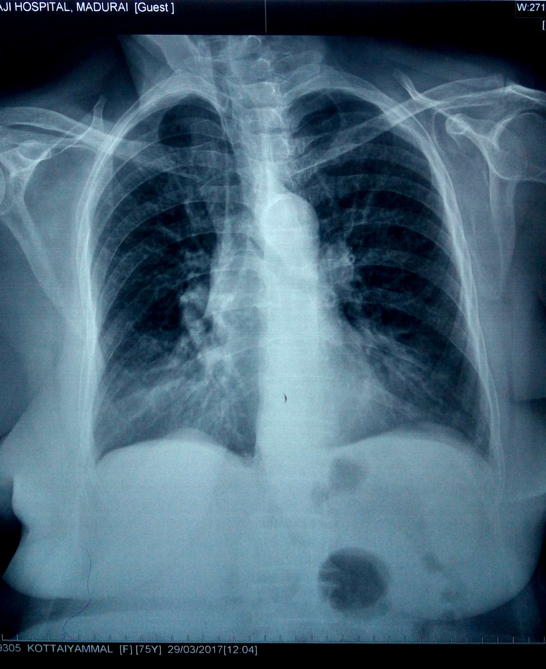
CXR PA

Slide 25
CT CHEST

Slide 26
MEDIASTINAL LIPOMATOSIS
Refers to a condition where there is a deposition of a large amount of mature adipose tissue in the mediastinum.
It is a relatively common benign cause of mediastinal widening
It is most common in the upper mediastinum

Slide 27
Mediastinal lipomas resemble other soft-tissue masses at chest radiography
Commonly categorized by location as
localized mediastinal (usually at the cardiodiaphragmatic angle),
cervicomediastinal (extending into the neck), or
transmural (penetrating the chest wall, usually in the upper anterior mediastinum)
At CT, lipomas have homogeneous fat attenuation of approximately −100 HU

Slide 28
Lesion Density
The internal composition of a soft-tissue mass may be surmised from its CT density, with fat measuring −130 to −70 HU, fluids measuring 0–30 HU, and muscle and soft tissues measuring 40–60 HU
Lesions containing fat density include benign and malignant lipomatous tumors, hemangiomas and vascular malformations, and peripheral nerve sheath tumors.
The macroscopic fatty components of classic lipomas have CT values typically measuring between −65 and −120 HU similar to the subcutaneous fat.

Slide 29
Associations
steroid use
Cushing's syndrome
Obesity
IDIOPATHIC

Slide 30
Chest XRAY
The radiographic features included
a smooth bilateral widening of the superior mediastinum,
relative lucency,
no definable mass in the lateral view,
and no pressure effects on the trachea

Slide 31
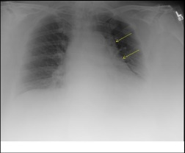

Slide 32
CT FINDING
Seen as regions of homogenous unencapsulated fat attenuating region involving the mediastinum, which will sharply outline vessels and lymph nodes

Slide 33
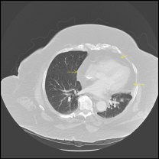

Slide 34
A chest radiograph revealed mediastinal widening with increased lucency
Computed tomography (CT) of the thorax performed after the intravenous administration of contrast material revealed posterior collections of fat on both sides of the mediastinum, extending from the superior mediastinum to the diaphragm.
The fat surrounded the heart and mediastinal structures and was present at the posterior base of the right lung (Panels B and C; all arrows point to lipomatosis in the mediastinum).
CT showed an attenuation of −125 to −100 Hounsfield units. This deposition of adipose tissue was diagnosed as mediastinal lipomatosis, a benign cause of mediastinal widening.

Slide 35
Clinical implications
Occasionally mediastinal fat can impose some challenges while cannulating internal jugular or subclavian catheters.
There are also reports describing airway compromise due to laryngeal compression secondary to excess fat in the mediastinum

Slide 36
CLINICAL POINTS
It can cause low voltage complexes in ECG.
Benign
DD for mediastinal widening especially in obese individuals
The inclusion of medial lipomatosis in the DD of widened mediastinum will help eliminate unnecessary workup

