Slide 1
Uncommon manifestations of an autoimmune disease
Chief & professor; Dr.g.bagialakshmi md,
Asst.professors; dr.saravanan md,
Dr.satheesh Kumar md, dr.ponsenthil kumar md,
presentor; dr. palraj.m

Slide 2
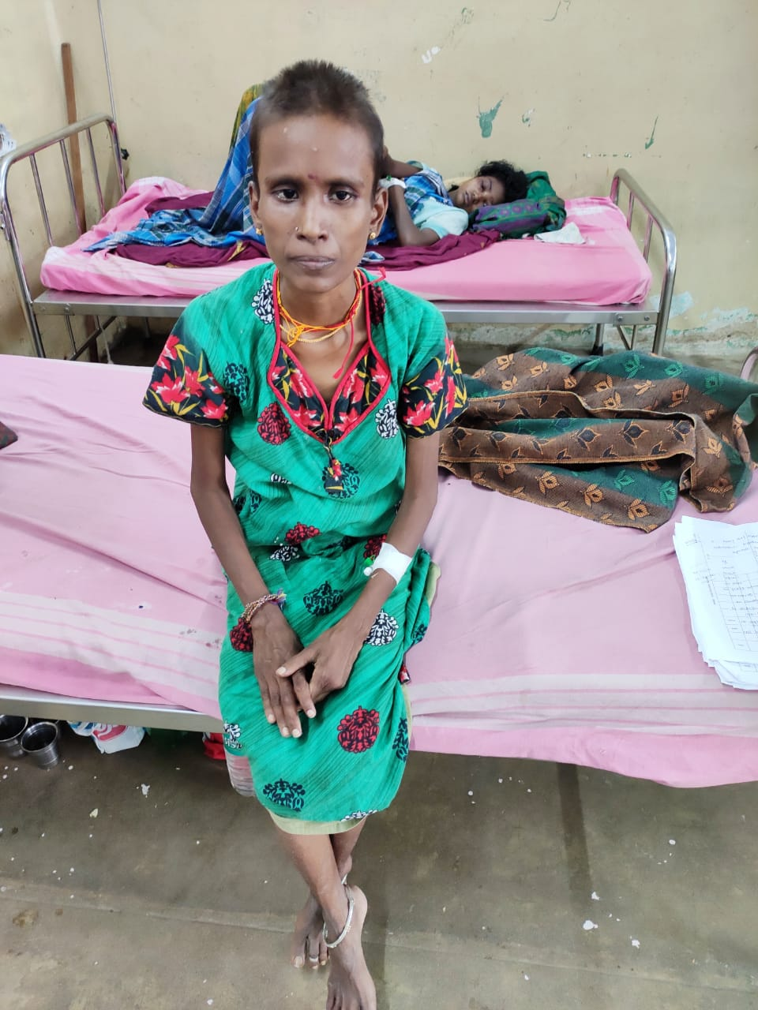
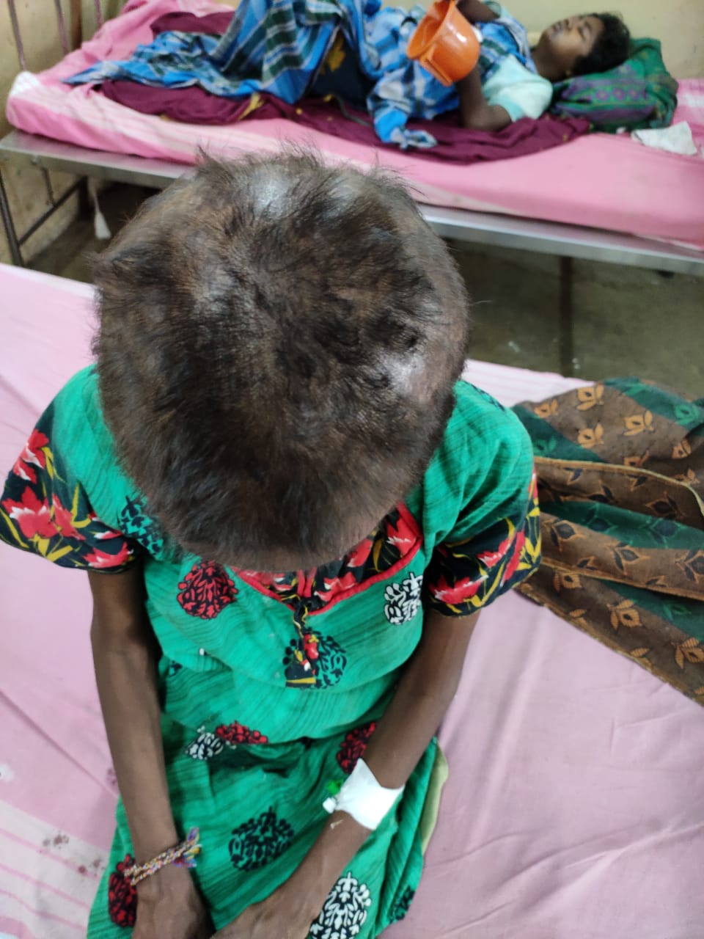
Chief complaints
28 year old female came with complaints of
Decreased sleep for past 1 month
Altered behaviour 5 days

Slide 3
History of presenting illness
Patient was apparently normal 1 month back
Developed decreased sleep for one month , abnormal behaviour past 5 days,
Joint pain for 1 month
Fever On and off for 1month
Loss of appetite
Facial puffiness, swelling of legs for past 15 days
Hairfall for 1 month

Slide 4
No h/o chest pain , palpitation,syncope,dyspnea,orthopnea
No h/o cough with expectoration
No h/o abdominal pain,loose stools,jaundice, vomiting
No h/o burning micturition,hematuria
No h/o seizures/LOC

Slide 5
Past history
History of similar complaints like altered behaviour and sleep pattern 2 months back
Evaluated and diagnosed to have autoimmune hemolytic anemia DCT+ , ANA+.
Hypothyroidsm 2 months on treatment T.Eltroxin ½ OD
Not a known case of T2DM/SHT/Asthma/Epilepsy/CAD/CKD/TB.

Slide 6
PERSONAL HISTORY
Mixed diet .
No addictive habits
FAMILY HISTORY
Nil relevant history
MENSTRUAL HISTORY
3/30 regular cycles , Nulliparous women.

Slide 7
General examination
Drowsy
Irritable
Afebrile
Pallor+
no cyanosis
No clubbing
No pedal edema
No generalized lymphadenopathy
Not icteric
Vitals : BP 110/70mmhg. Pulse rate 82/min,felt equally in all accessible peripheral vessels

Slide 8
CVS- S1S2+
No murmur
RS: NVBS
No added sounds
P/A-Soft BS+

Slide 9
CNS:
Conscious
Oriented
Right. Left
Tone Normal Normal
Reflexes present present
Power. 5/5 5/5
Plantar. flexor flexor
Fundus - normal

Slide 10
LFT | 5/9 | 27/9
Bilirubin | 0.8 | 0.4
Direct | 0.5 | 0.5
Indirect | 0.3 | 0.3
SGOT | 264 | 62
SGPT | 216 | 50
ALP | 628 | 398
CBC | 24/9 | 28/9 | 1/10
TC | 5000 | 7600 | 6000
HB | 8.1 | 8.4 | 8.5
PLT | 2.58 | 1.36 | 2.12
MCV | 84 | 85 | 88
MCHC | 29 | 28 | 30
PCV | 27 | 29 | 31
RFT
Sr .urea | 36
Creatinine | 1.1
RBS | 112
TSH | 19
Anti TPO Ab | 198 | High

Slide 11
VCTC | Negative
HCV | Negative
HbsAg | Negative
Urine culture | Negative
Blood culture | Negative
Urine routine
Albumin | Nil
Sugar | Nil
Pus cells | 1-2
RBC | Nil
Urine PCR | 1.60

Slide 12
Ana studies
ANA strong positive 4+ homogeneous cytoplasmic pattern.
1:640 by IF technique
Anti TPO antibody titre 198.60 strong positive
ANA reflux.
Anti ribosomal P antibody strong positive.

Slide 13
Rheumatology
Impression; SLE with neuropsychiatric manifestations.
Suggested :
T.prednisolone 5mg 6od
T.hydroxychloroquine 1 HS
T calcium + vitamin D 1 od
T.Mycophenolate mofetil 300 mg 1 HS.

Slide 14
Psychiatry
Mood irritable
Thought, perception normal
Impression: secondary depression with conversion disorder.
Adviced
Tablet Escitalopram 5mg 1hs
T.Lorazepam 4 mg 1 Hs

Slide 16
NEUROLOGIST OPINION
SLE with neurological manifestation.
Adviced :
T.Amitriptyline ½ HS
T.Diazepam 1 HS ,INJ.Dexamethasone 4mg IV BD
Review with MRI
Patient developed 1 episode of GTCS .

Slide 17
Neurologist opinion
MRI brain no abnormality detected.
Adviced
Injection phenytoin 100 mg IV TDS.

Slide 18
Endocrinology opinion:
SLE with alopecia .
Thyroid evaluation
TSH 19 (high)
Anti TPO antibody high(198)
Advice:
T. Thyroxine 100microgram 1-0-0

Slide 19
MGE opinion :
To rule out autoimmune hepatitis
Adviced: LKM ,Anti SMA,AMA titre.
Autoimmune hepatitis profile Negative.

Slide 20
Cardiology:
Echo done:
Normal study.
Ejection fraction 61%.

Slide 21
Clinical criteria
Renal involvement
Neurological manifestations
Hemolytic anemia
Laboratory test
Positive direct coombs test
ANA positive
Antiribosomal P antibodies positive

Slide 22
Final diagnosis
SYSTEMIC LUPUS ERYTHEMATOSIS WITH
NEUROPSYCHIATRIC MANIFESTATIONS
AUTOIMMUNE THYROIDITIS
SECONDARY DEPRESSION WITH FEATURES OF CONVERSION DISORDER

Slide 23
ADVICE ON DISCHARGE
T.Prednisolone 5mg 6 OD
T.calcium with vitamin D3 1-0-1
T.hydroxychloroquine 200 mg 1HS
T.Mycophenolate mofetil 300mg 1HS
T.UDCA 1-0-0
T.Escitalopram 5mg 1HS.
T.Amitriptyline 25 mg 0-0-1/2
T.Lorazepam 4mg 1HS
T.phenytoin 100 mg 1-1-1

Slide 24
Aim of the presentation
To discuss about the rare presentations of systemic lupus erythematosis

