Slide 1
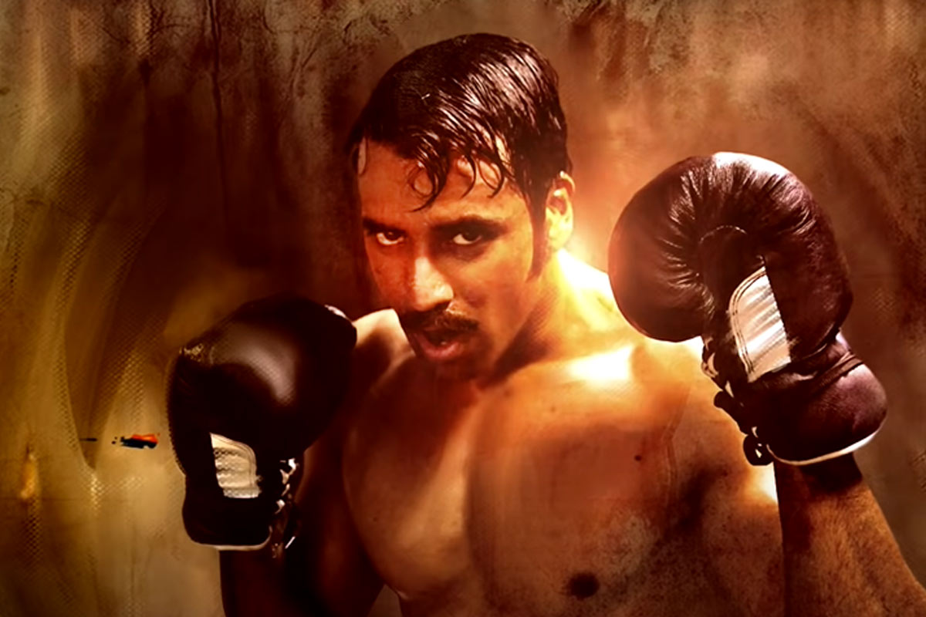
DANCING ROSE
IV MEDICAL UNIT
CHIEF : DR. DAVID PRADEEP KUMAR, M.D.,
ASST : DR. N. RAGAVAN , M.D.,
DR. M. RAM KUMAR , M.D.,
DR. R. PONRAJ , M.D.,

Slide 2
A 56 yr old lady presented with
involuntary movements involving
R upper and lower limbs for 3 days

Slide 6
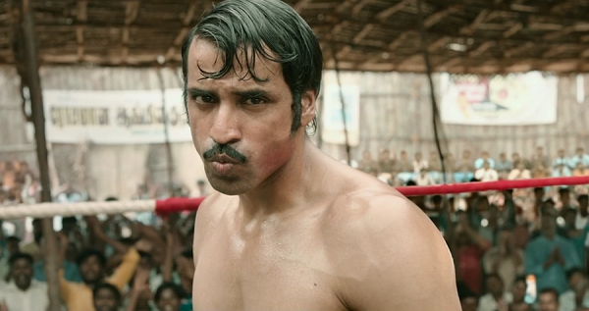
WHAT NEXT….???

