Slide 1
MAN IN BLUE
-Colours speak all languageS

Slide 2
MEDICAL UNIT I
CHIEF – PROF DR.M.NATARAJAN M.D
ASSISTANTS
DR SRIDHARAN M.D
DR VASANTHA KALYANI M.D
DR SURESH KUMAR M.D

Slide 3
Case details
A 21 year old otherwise normal male was about to donate blood where incidentally he was detected to have high hemoglobin and PCV and was referred to our department for evaluation
headache+
No h/o abdominal pain
No h/o peripheral discoloration or numbness
Non smoker
No RRTI
Non obese
No h/o drug intake
No h/o similar illness in the family

Slide 4
No bleeding manifestations
No pruritis
No h/o exertional dyspnea/fatigue
Pt lives in Plains
No h/o intercurrent illness and related drug intake

Slide 5
On examination
Pt comfortable,polycythemic,grade 1 clubbing
no skin discoloration at rest
Saturation was 93%RA
Vitals stable
Pt developed exertional cyanosis

Slide 6
S/E
CVS S1S2+ No murmur
RS BAE+ equal No added sounds
P/A- soft non tender no organomegaly
CNS No focal neurological deficit

Slide 7
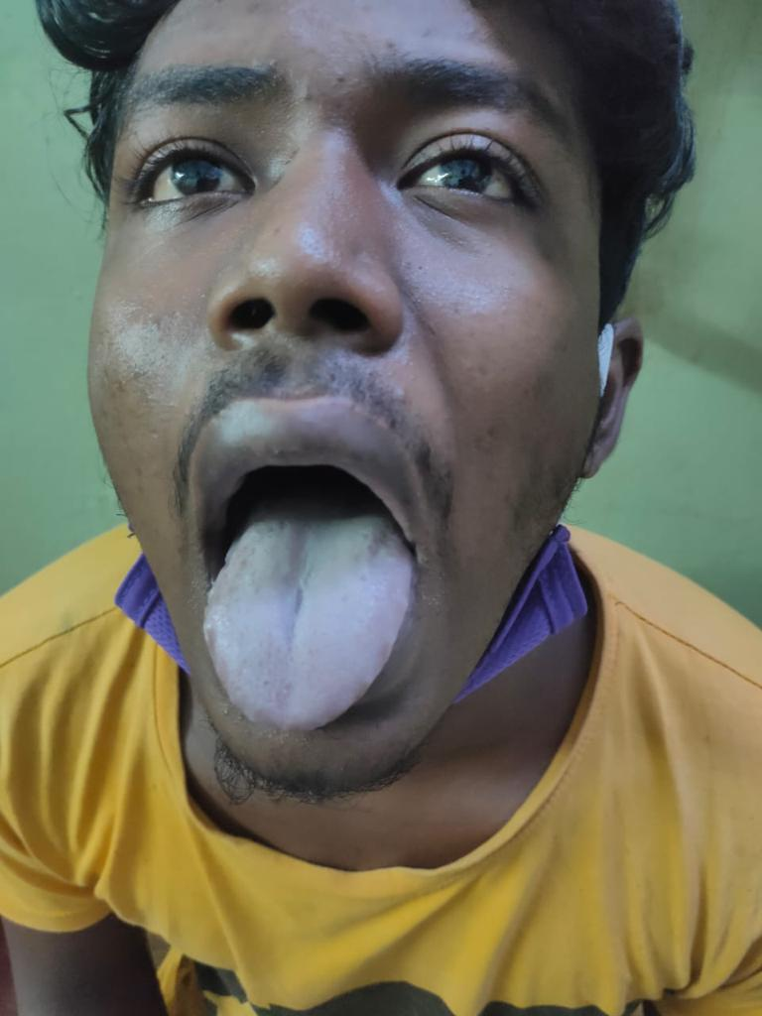
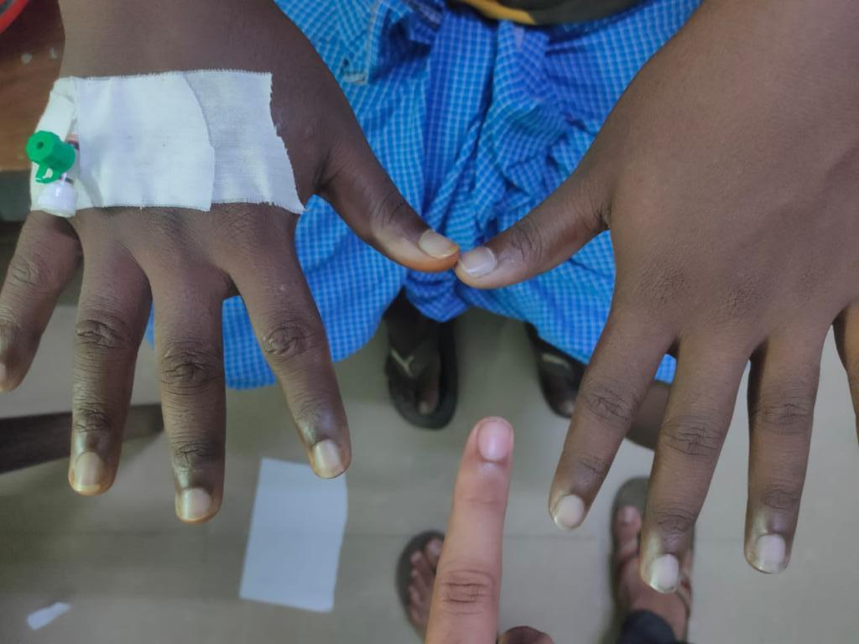

Slide 8
Increased HCT/Hb
RBC mass-Normal
EPO levels-32mIU/L
Arterial saturation/ABG 93%
Non smoker
Abnormal hb affinity
HIGH AFFINITY HEMOGLOBINOPATHY
RELATIVE ERYTHROCYTOSIS
POLYCYTHEMIA VERA
CARDIAC/LUNG DISORDERS
CARBOXY Hb
SECONDARY SOURCE OF EPO

Slide 9
Investigations
Hb-20.4gms
PCV-58%
TC-7500
PLT-3.65 lakhs/mm3
RFT-WNL
CHG WITH PS- ERYTHROCYTOSIS
EPO 32mIU/L

Slide 10
USG ABDOMEN NORMAL
CT BRAIN NORMAL
CT PULMONARY ANGIO- NORMAL
FAMILY HISTORY AND SCREENING WERE NEGATIVE

Slide 11
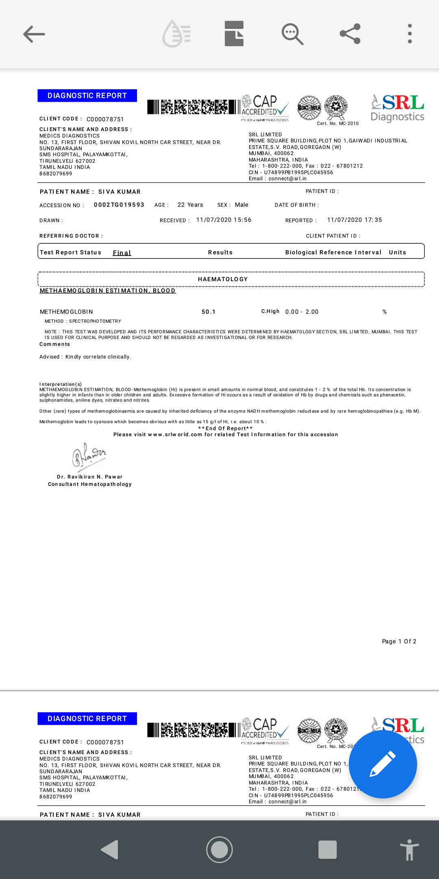

Slide 12
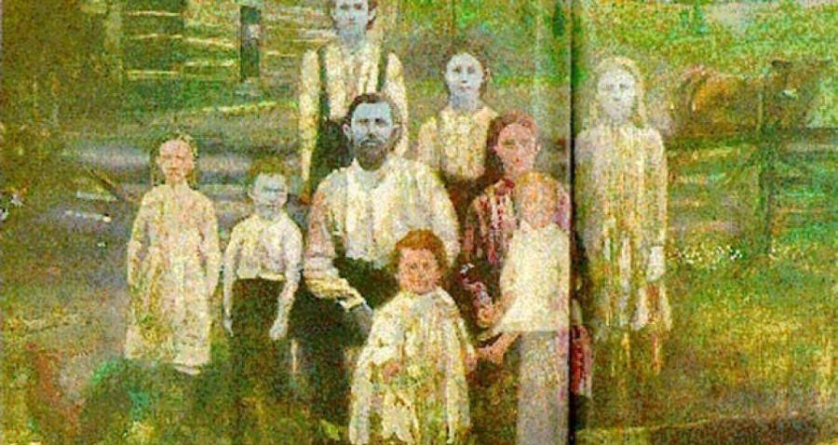
BLUE BLOODED FUGATES OF KENTUCKY

Slide 13
TREATMENT
Ascorbic acid
Enalapril
Hyperbaric oxygen
Venesection done twice
IV Methylene blue 1-2mg/kg iv every 30mins till a maximum dose of 7mg/kg is reached
Discharge Hb was 16.7gms%
Patient under follow up for Hb mutation study

Slide 14
AIM OF THE PRESENTATION
RARE BUT COMMON DISEASE
As such the incidence of MET-Hb is 0.0035% yet it is very common with usage of common drugs like nitrates,topical anesthetics,metoclopromide

Slide 15
“Life is simple, it’s either cherry red or midnight blue.” ~ Lou Gramm

