Slide 1
ECG DISCUSSION
5th MEDICINE UNIT
CHIEF : DR.K.SENTHIL MD
ASSOCIATE PROFFESSOR: DR.K.MURALIDHARAN MD
ASSISTANT PROFESSORS: DR.MANIKANDAN MD
DR.SARAVANA MADHAV MD
DR.ILAMARAN MD,DM
PRESENTOR: DR.KUGAN S K

Slide 2
CASE 1
55 Years old female Rajalakshmi was brought by her attenders to GRH Madurai with chief complains of chest pain for 2 days anginal type
No h/o difficulty in breathing
No h/o PND/orthopnea
No h/o leg swelling

Slide 3
Past history:
No known comorbidities
General examination:
No pallor,No icterus,No pedal edema
No markers of CHD,RHD,IE

Slide 4
Vitals:
BP -110/70 mm Hg,measured in right upper limb,sitting posture
Pulse-82/min,normal rhythm,normal volume,no special character,felt in all palpable peripheral vessels,no radio radial and radio femoral delay
JVP -Not elevated

Slide 5
Systemic examination:
CVS-S1,S2 + no murmur
RS-BAE + no added sounds
P/A - Soft ,non tender
CNS - conscious,moves all 4 limbs,
bilateral pulpils 3 mm react to light

Slide 6
Investigations:
RBS -121mg/dl
Urea -32 mg/dl
Creatinine-0.8 mg/dl
Sodium -136 mg/dl
Potassium-3.6 mg/dl
TC-7,800
Hb-10.6
DC-64/34/1 PLT-3,72,000

Slide 7
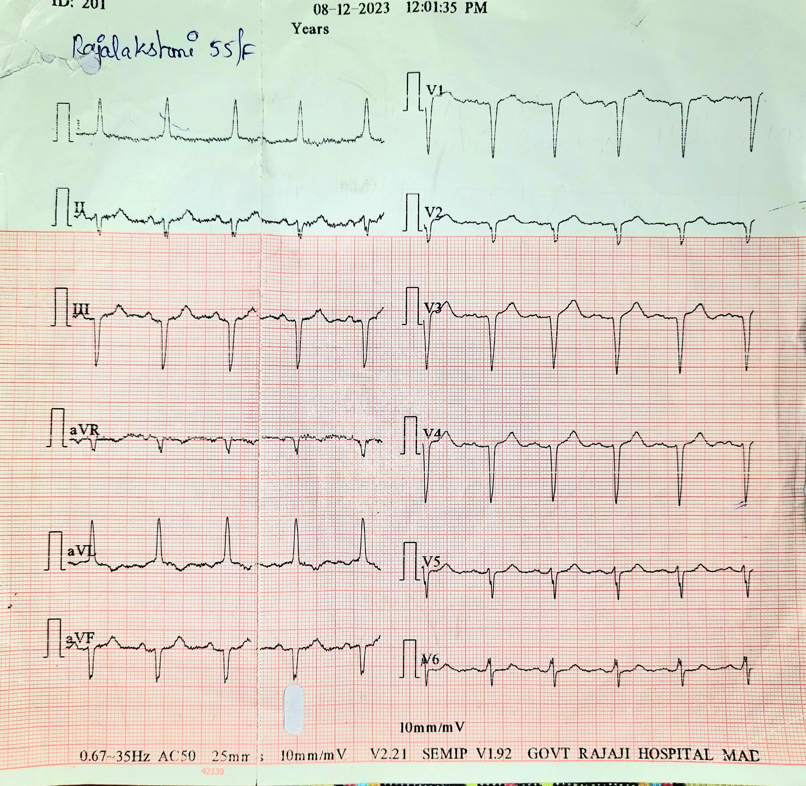

Slide 8
CASE 2
A 70 YEARS OLD FEMALE WAS BROUGHT BY HER ATTENDERS TO GRH MADURAI WITH COMPLAINTS OF BREATHLESSNESS FOR 1 WEEK ,GRADUAL ONSET,PROGRESSIVE IN NATURE, AGGRAVATED ON ACTIVITY,RELIEVED BY REST(MMRC GRADE3)
NO PND/ORTHOPNEA
H/O COUGH WITH EXPECTORATION FOR 1 WEEK+
H/O FEVER FOR 3 DAYS ,INTERMITTENT IN NATURE,LOW GRADE,ASSOCIATED WITH CHILLS AND RIGOR
NO OTHER SPECIFIC COMPLAINTS

Slide 9
PAST HISTORY:
K/C/O T2DM,SHTN FOR 2 YEARS ON REGULAR MEDICATION
K/C/O CAD FOR 10 YEARS ON REGULAR MEDICATIONS
H/O SIMILAR COMPLAINS IN THE PAST+
GENERAL EXAMINATION:
CONSCIOUS
ORIENTED
FEBRILE (100.7 F)
NO PALLOR,ICTERUS,CYANOSIS,CLUBBING,
LYMPHADENOPATHY,PEDAL EDEMA

Slide 10
VITALS
BP- 140/80 mm of Hg on RIGHT UPPER LIMB IN SITTING POSITION
PULSE: 102 /min, NORMAL RHYTHM,NORMAL VOLUME,NO SPECIAL CHARACTER,FELT IN ALL PALPABLE PERIPHERAL VESSELS,NO RADIO RADIAL/RADIO FEMORAL DELAY
SPO2: 90% AT ROOM AIR------98% WITH NRM 02
RR: 28/min
JVP: NOT ELEVATED

Slide 11
SYSTEMIC EXAMINATION
CVS: S1 S2 HEARD , NO MURMUR
RS: B/L AIR ENTRY, B/L WHEEZE+, B/L CREPTITATIONS EXTENSIVELY IN ALL AREAS
P/A: SOFT,NO TENDERNESS, BOWEL SOUNDS PRESENT
CNS: CONSCIOUS,ORIENTED,MOVES ALL 4 LIMBS,B/L PUPIL 3.5 MM REACTIVE TO LIGHT

Slide 12
INVESTIGATIONS
WBC- 10.6
HB-14.0
HCT-44.7
MCV-79.4
MCH-24.9
MCHC-31.3
PLT-225000
DC-80/10/9
RBS-162
FBS-91
B.UREA -16
S.CREATININE-0.9
SODIUM-132
POTASSIUM-4.0
T.BILIRUBIN-0.3
D.BILIRUBIN-0,2
I.BILIRUBIN-0.1
SGOT-61
SGPT-87
ALP-73
CT CHEST
AORTA ON R SIDE
IVC ON L SIDE
SPLEEN ON R SIDE
LIVER ON L SIDE
LUNGS; HYPERINFLATED LUNGS WITH GGO AND CENTRIACINAR NODES IN RIGHT LOWER LOBES

Slide 13
