Slide 1
THE ENLIGHTENED HEART
CHIEF-DR.M.NATARAJAN MD
ASSISTANT PROFESSORS
DR.PALANI KUMARAM MD,D.DIAB
DR.VASANTHA KALYANI MD,DCP
DR.SURESH KUMAR MD

Slide 2
The history…
Pt presented with history of generalized body pain & chest pain for 2 hrs
H/O near lightening injury to the patient preceeding the complaints…+

Slide 3
The NO NO’s
No h/o palpitations/breathlesness
No h/o syncope
No h/o weakness of limbs
No h/o seizures
No h/o confusion
No h/o headache
No h/o dizziness/nausea
No h/o vision loss
No h/o hearing loss

Slide 4
No h/o retrograde amnesia
No h/o burns
No h/o skin rashes

Slide 5
Past history
Not a K/C/O DM/HTN/CAD/CVA/CKD/THYROID/SEIZURE DISORDER

Slide 6
Personal history
Mixed diet
Sleep pattern normal
No bowel/bladder disturbances
P2L2 ,no h/o abortions

Slide 7
Examination…
Pt concious
Oriented
Tachypneic
pallor +
No icterus/cyanosis/clubbing
No litchenberg figures/filigree burns over the trunk

Slide 8
Vitals
BP – 80/?
PR – 103/min
Spo2- not recordable
RR – 28/min

Slide 9
CVS – S1S2 heard, no murmur
RS – B/L AE+ , b/l basaal crepts
P/A – soft,BS+
CNS – conscious,oriented
hypotonia in all 4 limbs
power- 3/5 (both prox & distal) in all 4 limbs
reflexes- depressed

Slide 10
INVESTIGATIONS.......
THE BREAKTHROUGH…!

Slide 11
Hb | 10.5
TC | 13100
PLATELETS | 2.39 lakhs
PCV | 33
UREA | 38
CREATININE | 1.1
BILIRUBIN | 0.9
SGOT | 42
SGPT | 44
ALP | 111
S.calcium | 8.9mgs

Slide 12
S.TSH – 1.42 IU/ml
Usg-abd – normal study
VCTC/Viral markers – negative

Slide 13
CPK – 1511 U/L
CPK MB – 310 U/L
Troponin I – 46 U/L

Slide 14
Serum sodium – 137 meq/l
Serum potassium – 3.2 meq/l
Urine sodium – 46meq
Urine potassium – 17 meq

Slide 15
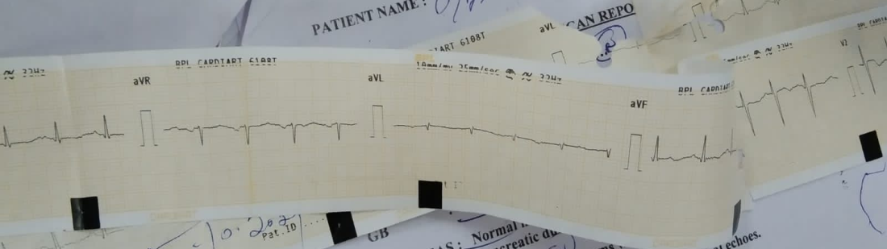
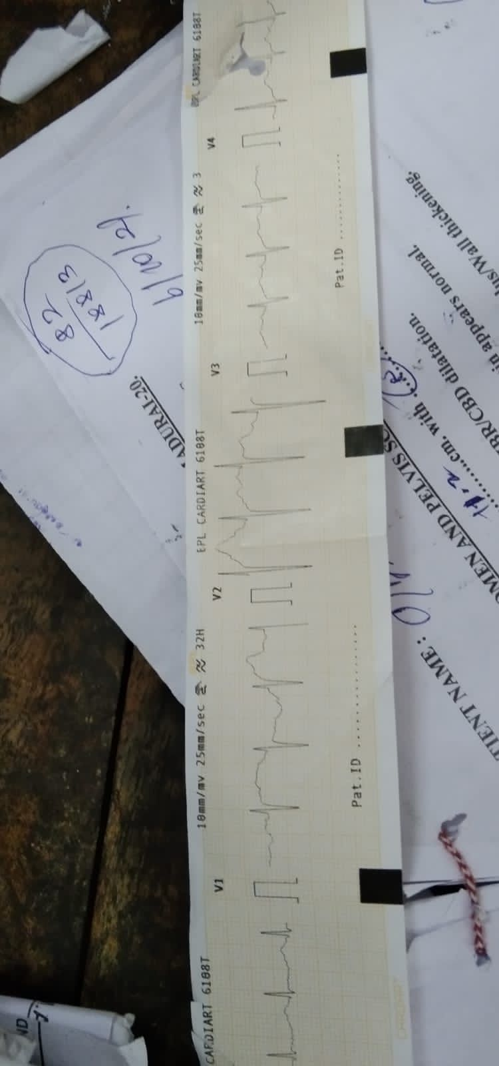
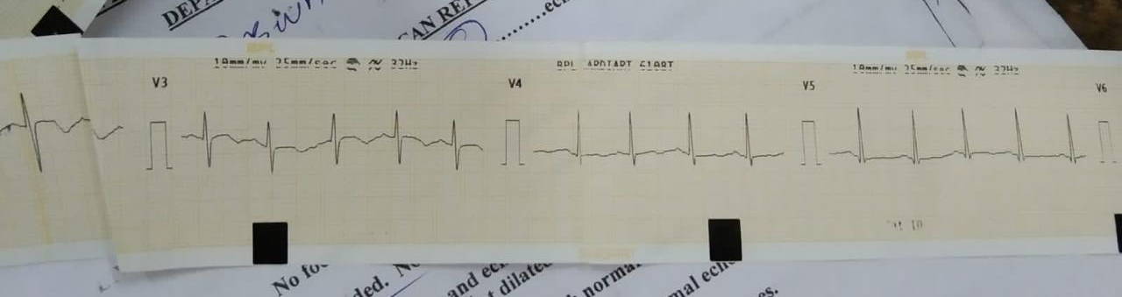
ECG..

Slide 16
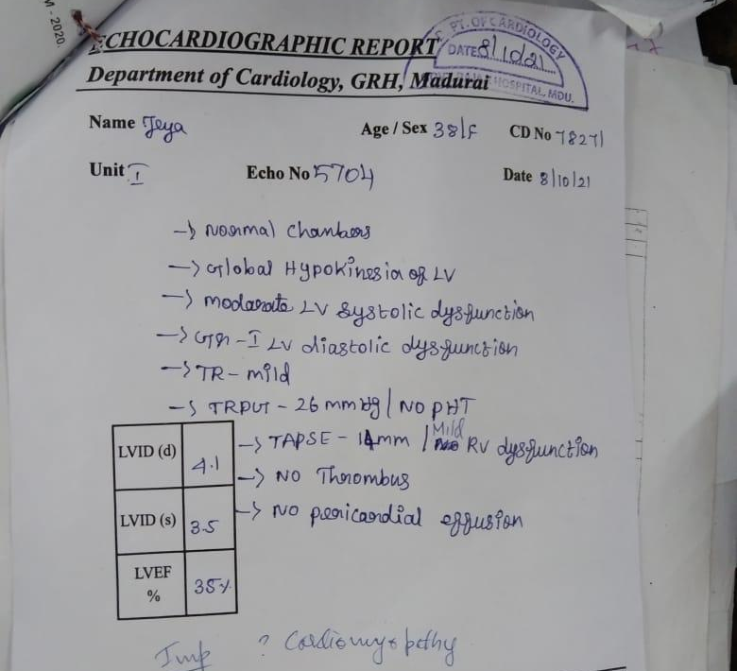
ECHO that echoed…

Slide 17
Cardiology (o)
Impression :
Cardiomyopathy ?lightening induced
?pre-existing CAD
Plan:
CAG

Slide 18
CAG ….!
Access thru rt.femoral artery
LMCA – normal
LAD – type 4 LAD, normal flow
LCX – normal
RCA – normal
IMPRESSION – normal angiogram
Plan- OMT

Slide 19
WHAT NEXT…?

