Slide 1
Clinical CaSE presentation
IV MEDICAL UNIT

Slide 2
CHIEF COMPLAINTS:
A 60 year old male came with c/o abdominal distension and swelling of legs for past 3 months

Slide 3
HISTORY OF PRESENTING ILLNESS:
Patient was apparently normal 3 months back then he developed h/o abdominal distension for past 3 months ,insidious onset ,gradually progressive,not associated with pain , not relieved by drugs
H/O swelling of legs for past 3 months, insidious onset, gradually progressive to attained present size.
H/O facial puffiness present for past one month +
H/O reduced urine output present +, improved with treatment
H/O orthopnea +
No h/o hematuria & dysuria
No h/o chest pain, palpitation, syncope
No h/o jaundice, hematemesis, malena
No h/o fever
No h/o cough
H/O hoarseness of voice +
H/O loss of appetite +
No h/o loss of weight
No h/o altered sensorium

Slide 4
PAST HISTORY :
H/O CAD /AWMI – thrombolysed on 4/2021 not on regular medications.
H/o old PTB 7 years back, 6 months of ATT completed
Not a k/c/o DM/HTN/BA/Thyroid disease/seizure disorder/CKD/COPD
No h/o previous surgery
No h/o blood transfusion
H/O tattooing present +

Slide 5
PERSONAL H/O:
Mixed diet
Bowel and bladder habits normal
Reformed smoker and alcoholic

Slide 6
TREATMENT HISTORY :
Patient was admitted on 5/2022 for similar illness at private hospital.
Diagnosed to have partial thrombus in IVC and thrombus in bilateral renal and common iliac veins
Started on T.Apixaban 5 mg bd ,not took regularly.

Slide 7
GENERAL EXAMINATION
Patient conscious
Oriented
Afebrile
Pallor +
Anicteric
No cyanosis
Grade 2 clubbing +
Anasarca +
No generalized lymphadenopathy

Slide 8
VITALS:
BP : 110/70 mm hg
PR : 96/min
SpO2 : 97 % in RA
RR : 21/mt
SYSTEMIC EXAMINATION:
CVS – S1,S2 +, no murmur
RS - BAE +, B/L wheeze +
P/A – Soft,
distended,
abdominal wall edema + , ascites +
CNS – NFND

Slide 9
INVESTIGATIONS
 | CBC 1 | CBC 2
TC | 7000 | 9900
DC | 70/21/9 % | 81/11/8
Hb | 8.0 | 7.4
PCV | 26 | 23
Platelet | 6.76 lakhs | 6.26 lakhs

Slide 10
RBS, FBS | 110 mg/dl , 90 mg/dl
Serum urea & s. creatinine | 34, 1.3
T . Bilirubin | 0.4
Direct & indirect bilirubin | 0.2, 0.2
SGOT & SGPT | 48, 10
ALP | 77
Serum total protein | 3.0
Serum albumin | 2.0
Serum globulin | 1.0
Serum NA + , K+ | 136, 3.4
Serum calcium | 6.9 mg/dl
Serum phosphorous | 8.8 mg/dl
Serum uric acid | 6.2 mg/dl
Prothrombin time | 13.5 sec
INR | 1.0
APTT | 34 sec

Slide 11
URINE ROUTINE : Urine protein creatinine ratio:
Albumin - +++ Urine protein : 75 mgs
Sugar - Nil Urine creatinine : 13 mgs
Deposit - 1- 2 pus cells + Ratio : 5.7
24 hours urine protein : 1300 mg/ day taken on 5/8/22
Urine output:1300 ml
11/8/22
24 hr urine protein 12700 mg /day
Urine output:2000 ml
ASCITIC FLUID ANALYSIS :
Protein - 125 mg / dl
Sugar - 142 mg / dl
WBC - Nil

Slide 12
ASCITIC FLUID CYTOLOGY

Slide 13
LIPID PROFILE T. Cholesterol : 184 mg/dl Triglyceride : 175 mg/dl
VIRAL MARKERS
HIV 1 & 2 | NON REACTIVE
HBsAG | NEGATIVE
ANTI-HCV | NEGATIVE

Slide 14
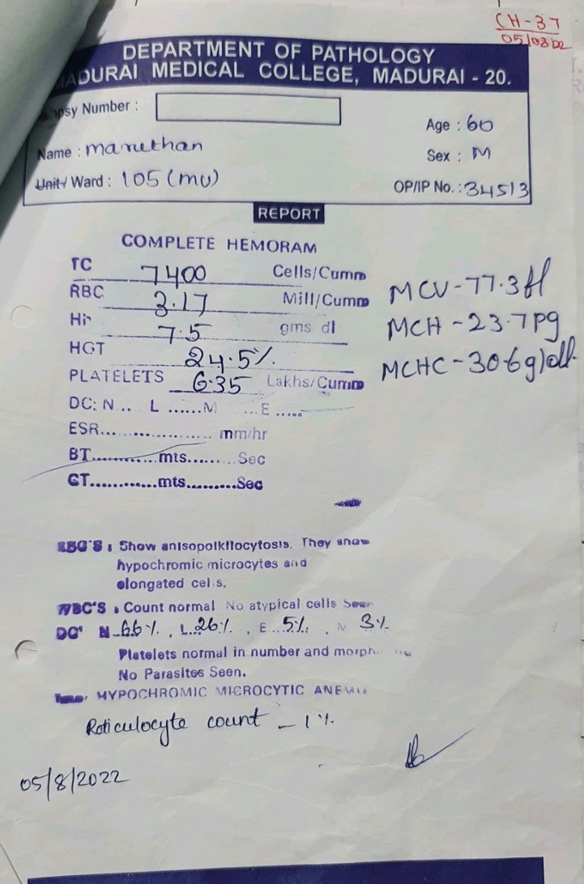
PERIPHERAL
SMEAR:

Slide 15
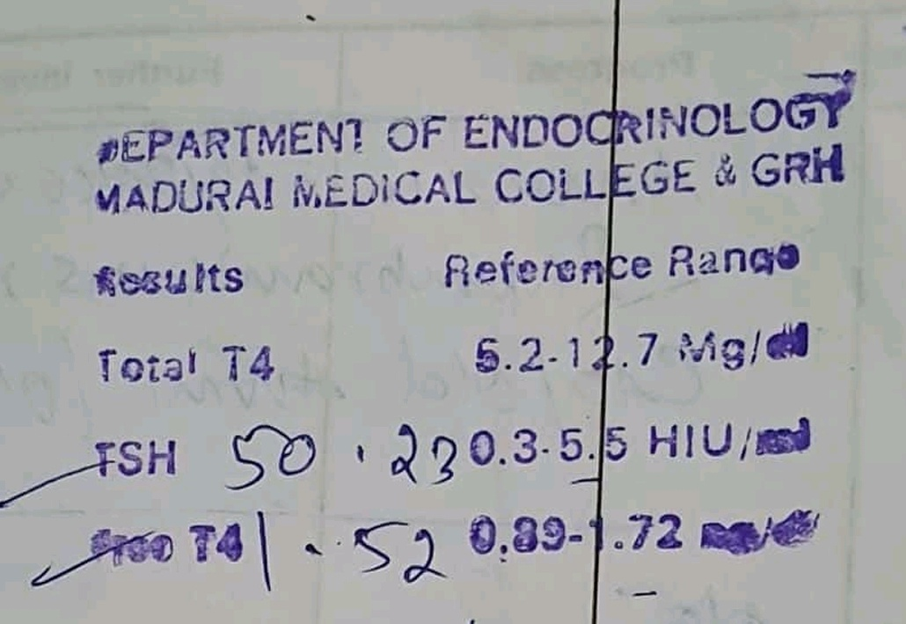
THYROID PROFILE & ENDOCRIONOLOGIST OPINION :
Advice : T. Thyroxine 100 micro gram od

Slide 16
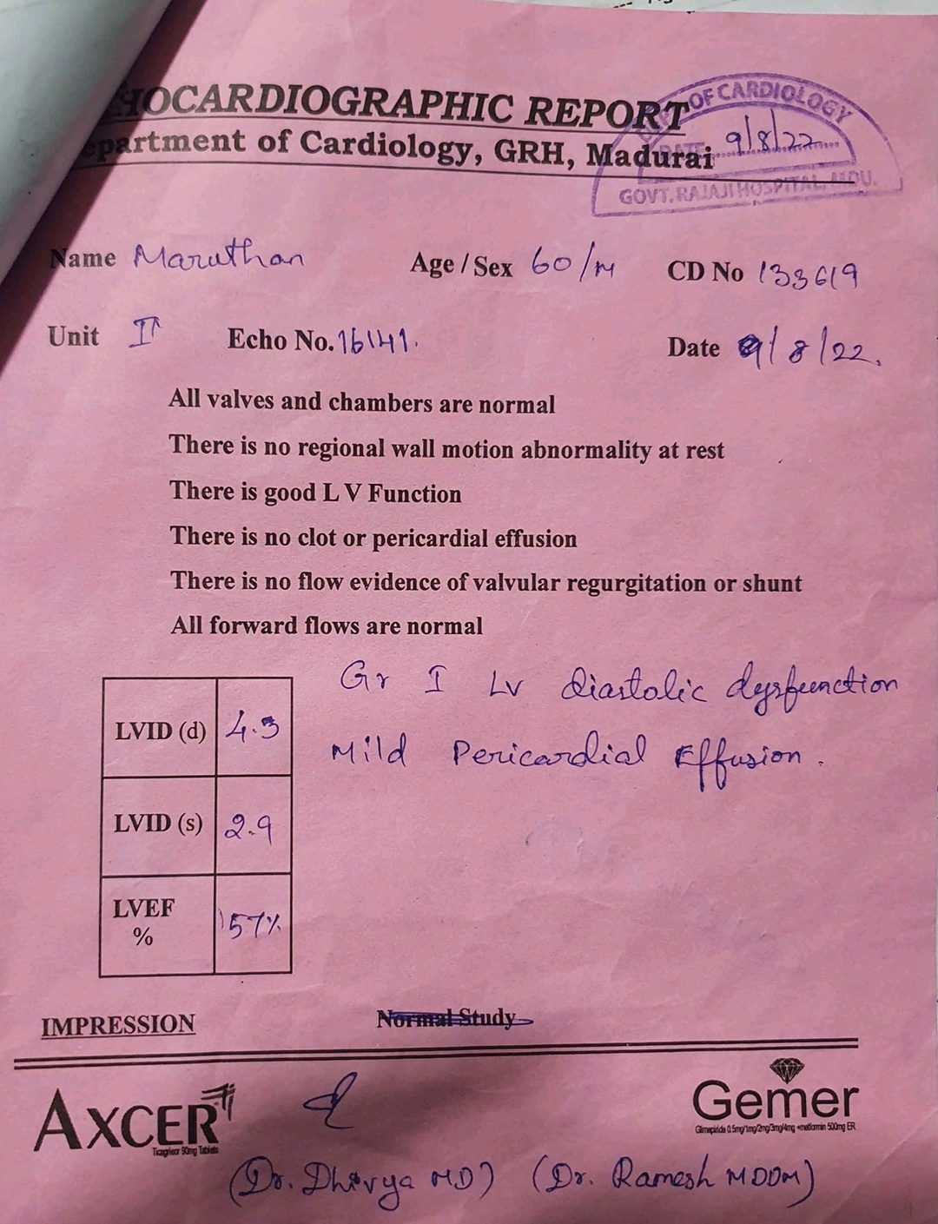
ECHOCARDIOGRAM :

Slide 17
CECT ABDOMEN ( OUTSIDE)
Impression:
Gross ascites
Partial thrombus in IVC
Bilateral renal vein and common iliac vein thrombus +

Slide 18
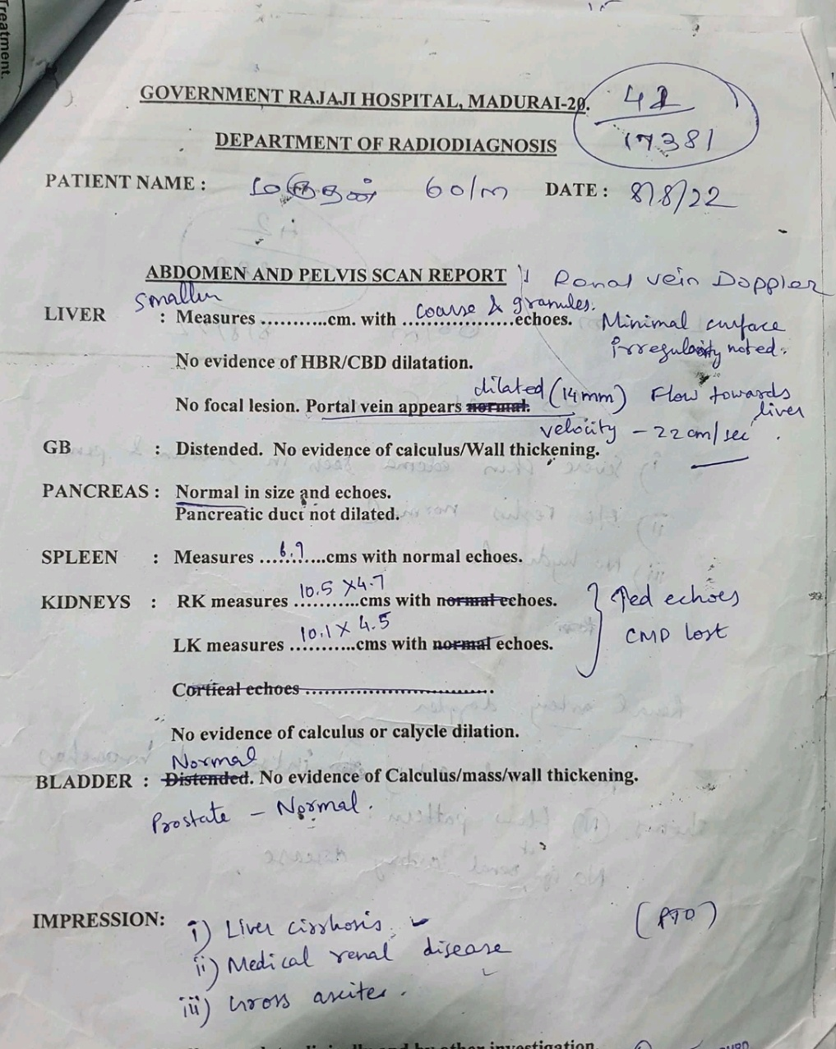
USG
ANDOMEN
& PELVIS :

Slide 20
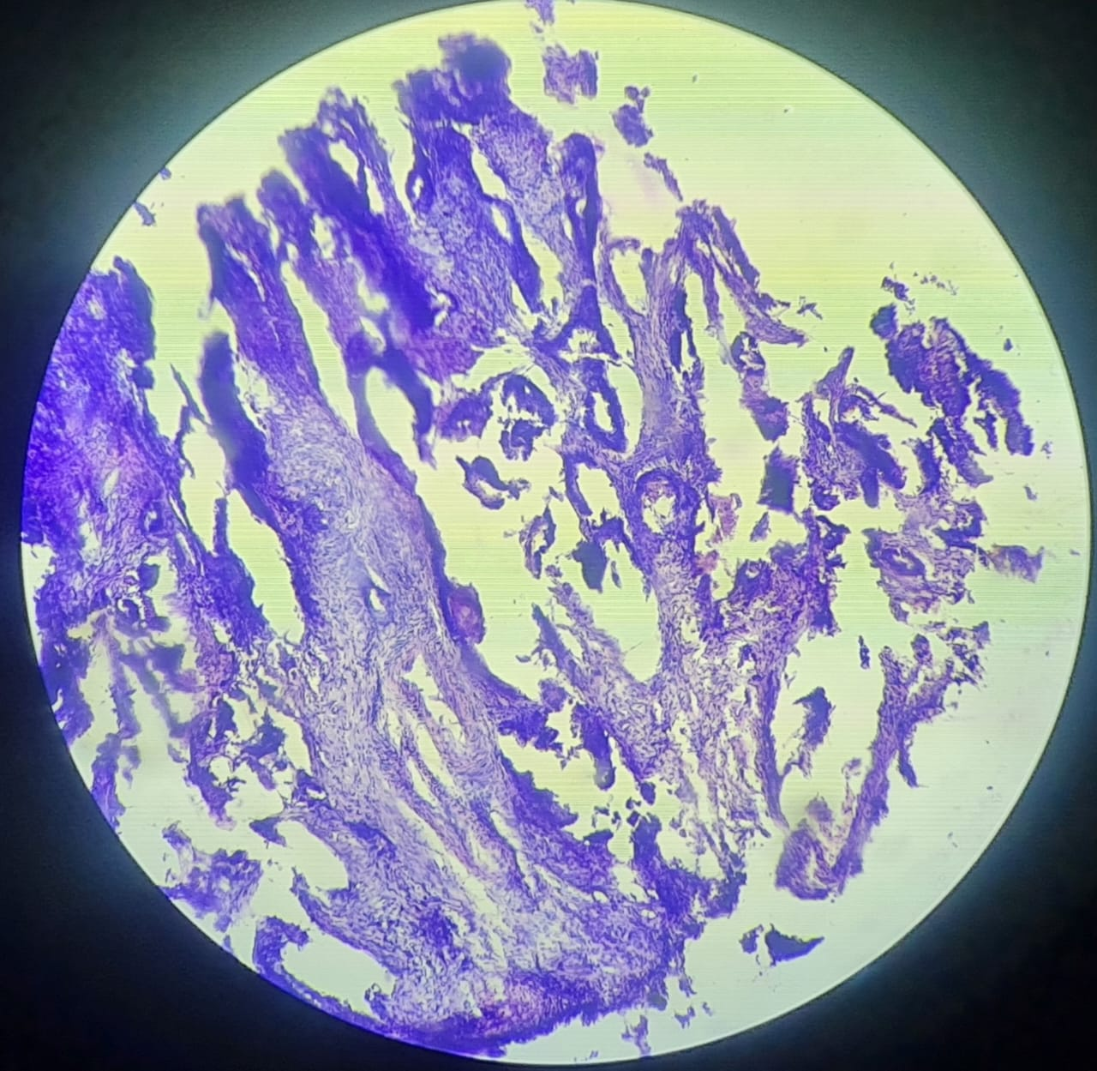

Slide 21
WHAT NEXT ?

