Slide 1
A CASE OF LUTEMBACHER SYNDROME
IV MU
Chief : Dr. G.Bagialakshmi MD
Asst Prof: Dr. N. Ragavan MD
Dr. S. Krishnasamy Prasad MD

Slide 2
17 year old male presented with history of exertional dyspnoea for the past 6 months
No h/o fever /cough / hemoptysis
No h/o chest pain/ palpitations
No h/o pedal oedema
No h/o orthopnoea/ PND
No h/o oliguria
No h/o cyanotic spells

Slide 3
h/o being kept in hospital for 2 months immediately after birth (records N/A)
H/o developmental delay +
Currently studying in plus 1.

Slide 4
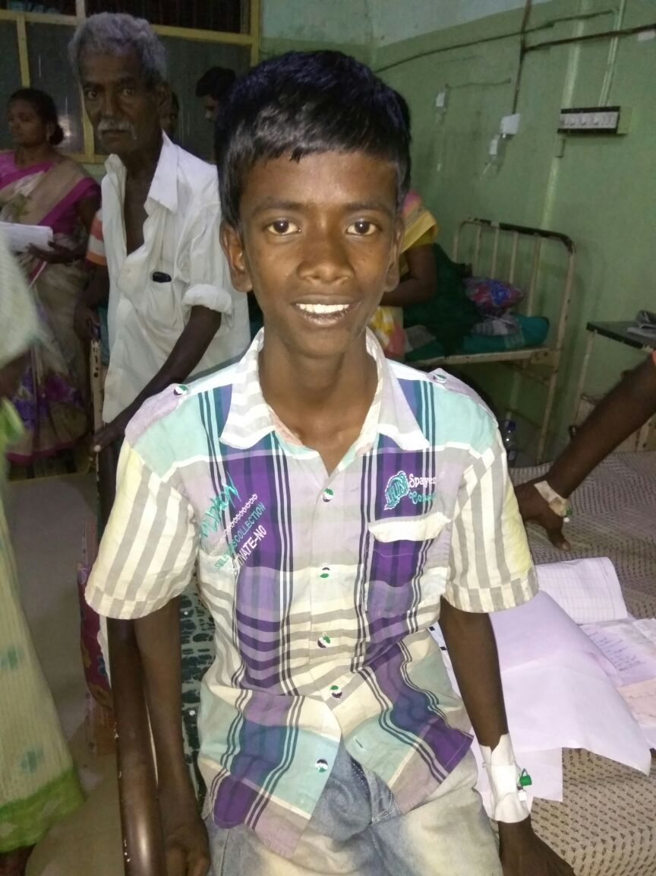

Slide 5
General Examination
conscious
poorly built and nourished
No pallor
No icterus
No cyanosis
No clubbing
No lymphadenopathy
No pedal oedema

Slide 6
low set ears +
High arched palate +
Frontal bossing +
Depressed nasal bridge +
No marfanoid features
No external markers of acute rheumatic fever/ IE
No peripheral signs of AR

Slide 7
Blood pressure: 100/60 mmhg
Pulse rate: 70/mt
Respiratory rate :18/min
Temperature : 98.6 f

Slide 8
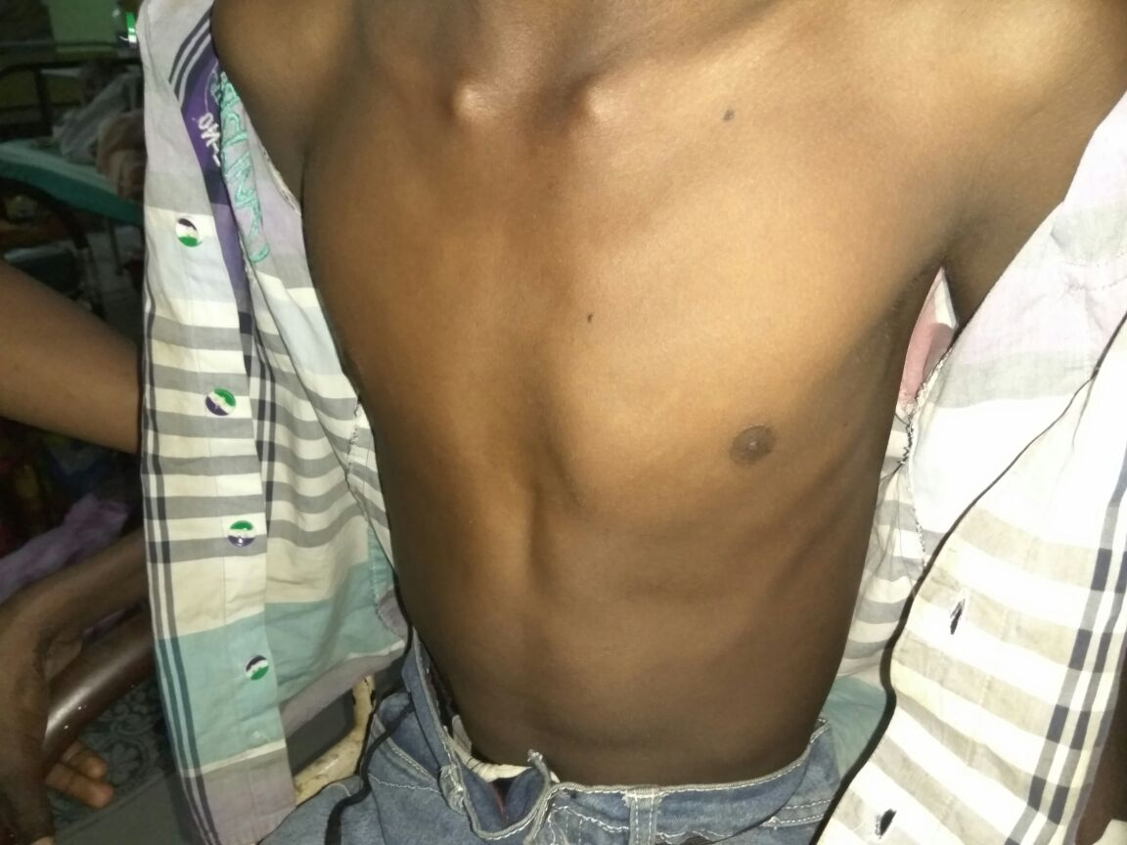

Slide 9
Cardiovascular System Examination
Inspection
Precordial bulge
JVP elevated, prominent a wave seen
apical impulse over the fifth ICS 2 cm lateral to MCL
left parasternal pulsation +
Left second intercostal space pulsation +

Slide 10
Palpation
apical impulse over the fifth ICS 2 cm lateral to MCL
epigastric pulsation +
grade three parasternal heave +
Palpable P2 +
systolic thrill over pulmonary area +

Slide 11
Auscultation
Mitral area: s1 s2+
loud S1+, MDM +
Tricuspid area : S1 S2 +
pulmonary Area : S 1 S2 +
Wide and fixed split of S2+
Loud P2 +
ESM +

Slide 12
Hb- 10.4
TC -11,100
DC- P80 L16 Mix4
ESR-28mm/hr
PLC -1.86 lakh
S.urea – 21
S.Creat- 0.6
RBS-86

Slide 13
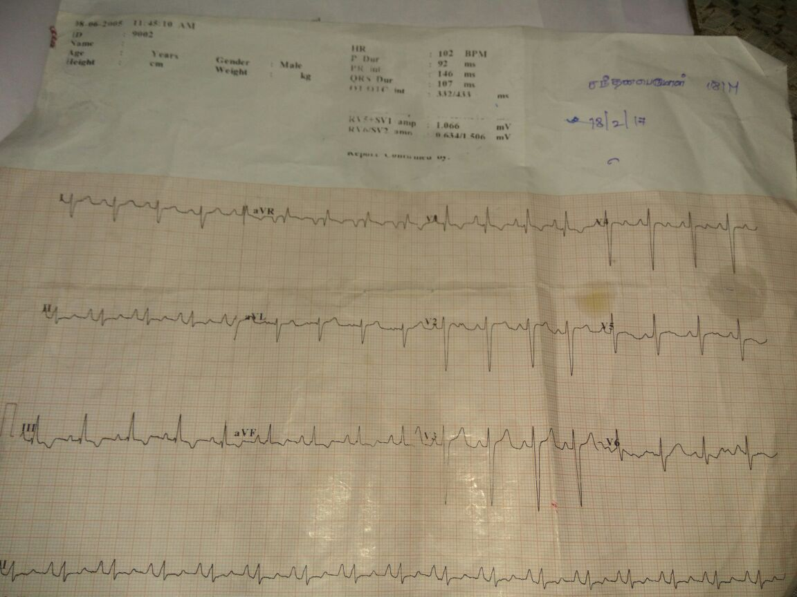

Slide 14
Provisional Diagnosis
ATRIAL SEPTAL DEFECT WITH MITRAL STENOSIS

Slide 15
ECHO
Mitral leaflets are thickened with restricted mobility
MVO- 1.9 cm2
Mitral valve forward flow gradient- 7/5 mmhg
Echo dropout of IAS at OS area – 19 mm
Doppler shows left to right shunt across ASD
IMPRESSION : OS ASD (L –R shunt) with RHD/mild MS

Slide 16
THANK YOU

