Slide 1
A case of DIABETES MELLITUS WITH CENTRAL DIABETES INSIPIDUS
Prof. DR. M.NATARAJAN MD
DR.SYED BAHAVUDEEN HUSSAINI MD DNB
DR. VALLI DEVI MD
Presentor; P. Muthukrishnan

Slide 2
63 years male known case of type 2 diabetes presented complaints of
polyuria
polydipsia 7 days

Slide 3
History of presenting illness
h/o polyuria for 7 days
urine output-15 litres
h/o polydipsia for 7 days
intake around 10 litres
h/o increased thirst +
h/o nocturnal enuresis +
h/o weight loss+
No h/o burning micturition
No h/o polyphagia
No h/o fever

Slide 4
No h/o blurring of vision
No h/o cough with expectoration
No h/o dyspnoea
No h/o chest pain/ palpitation
No h/o drug intake
No h/o trauma to head
No h/o cranial irradiation

Slide 5
Past history
Known case of type 2 diabetes 7 years on T. glipizide 5mg bd
Not a known case of SHTN,PTB,CAD, THYROID disease
Personal history
mixed diet
Not a smoker and alcoholic

Slide 6
GENERAL EXAMINATION
Conscious
Oriented
dehydrated
Afebrile
No pallor
No icterus
No cyanosis
No pedal edema
No generalized lymphadenopathy

Slide 7
Vitals
Pulse rate :82/min regular
Blood pressure : 100/70 mmhg
Respiratory rate:18/min
Spo2; 97 at room air

Slide 8
CVS
Apical impulse: left 5 th ICS 1cm medial to mcl
S1S2+, no murmur
Respiratory system
NVBS +
no added sounds
Abdomen
no organomegaly, no free fluid
Central nervous system
no focal neurological deficit

Slide 9
INVESTIGTION
HB-14 g/dl
TC-8800cells/cu.mm
DC-Neutrophils-68%, lymphocytes-20% mixed-12%
PCV-44%
PLATELET-1.35 lakhs
ESR-17mm/hour

Slide 10
albumin | nil
sugar | nil
deposits | 1-2 pus cells, no RBC
Specific gravity | 1.003
ph | 6
ketone | negative
Bile salt | negative
Bile pigment | negative

Slide 11
RBS-225mg/dl
FBS- 123mg/dl
PPBS-165mg/dl
UREA-30mg/dl
CREATININE-1.4mg/dl
Total bilirubin – 0.9 mg/dl
direct;0,5mg/dl
indirect;0.4mg/dl
SGOT;35u/l
SGPT; 44u/l

Slide 12
Calcium – 8.2 mg/gl
Phosphorus -3.01mg/dl
Uric acid -3.8mg/dl
PSA: 1.28 ng/ml

Slide 13
ELECRTOLYTES
sodium | 145 mmol/l
potassium | 3.7 mmol/l
chlorides | 105 mmol/l

Slide 14
ECG; WITHIN NORMAL LIMIT
ECHO; normal
EF:67%

Slide 15
USG ADOMEN PELVIS
Mild prostatic enlargement
Bladder- pre voidal-100cc
post voidal-25cc

Slide 16
PROVISIONAL DIAGNOSIS
TYPE 2 DM/ POLYURIA FOR EVALUATION
?uncontrolled type 2 DM
?Psychogenic polydipsia
?Diabetes insipidus

Slide 17
HbA1c level-6.6%

Slide 18
Since HbA1 c was normal ,we investigated for other causes of polyuria
psychogenic polydipsia
diabetes insipidus

Slide 19
Serum osmolality | 300mosm/kg h2o | 285-319
Urine osmolality | 115mosm/ kg h2o | 300-900

Slide 21
SERUM AVP: 0.2 pg/ML

Slide 22
MRI- PITUTARY
Reduction of bright signal noticed in posterior pituitary with thinning of anterior pituitary and thickened infundibular stalk with poorly enhancing low signal areas with in posterior pituitary

Slide 23
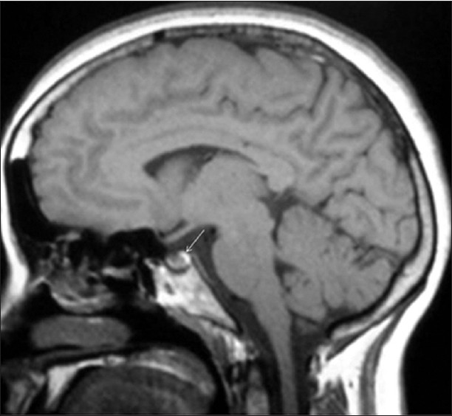
Normal pituitary bright spot

Slide 24
Absent bright spot

Slide 25
HORMONAL PROFILE
TSH; 1.06 mIU/L (0.4-4.50)
FREE T4; 1.96ng/gl (0.89-1.72)
LH; 4.37 mlu/ml (1.24 -8.62)
FSH 3.09mlu/ml (1.27-19.26)
PROLACTIN; 9.38ng/dl (2.6-20)
TESTOSTERONE; 2.96ng/dl (1.68-7.58)

Slide 26
Summary
Polyuria
Polydipsia
Sodium upper level of normal
Low urine specific gravity
Low urine osmolality
Low AVP
Absent bright spot in posterior pituitary

Slide 27
Diagnosis
Central diabetes insipidus

Slide 28
Treatment
T.metformin 500mg bd
T.sitagliptin 50mgbd
Nasal spray desmopressin10mcg 2 puff bd
T .desmopressin 100mcg bd

Slide 29
Pt symptomatically improved after 2 weeks of therapy

Slide 31
AIM OF PRESENTATION
Rarity of case
To Highlight the approach to a case of polyuria

