Slide 1
HEMOPHILIA A
2
HOD& PROF: DR.M.NATARAJAN M.D.,
ASST.PROF: DR.P.S.VALLIDEVI.M.D., DR.P.SHRIDHARAN.M.D., DR.D.VASANTHAKALYANI.M.D.,DCP
PRESENTOR: DR.V.PRAKASH

Slide 2
34 years old male patient admitted in triage on 25.7.2019 with complaints of continuous bleeding from the right leg wound for past 6 days

Slide 3
HISTORY OF PRESENTING ILLNESS
Patient is a known case of Hemophilia A sustained right leg # following RTA 2 years back - ORIF & IMN done for tibia with factor VIII back up
Then pt develop infection of Right tibial implant -treated in private hospital and Theni GH
Implant removal done 6 days back in Theni GH following he develop uncontrol bleeding from surgical site and treated with Inj.factor VIII 12 vials,2 unit of FFP,1 unit of packed cell transfusion done.Inspite of above treatment bleeding could not be stopped
Then pt referred to GRH for further management

Slide 5
HOPI
H/O Bleeding from implant exit wound +
H/O Easy fatiguability +
H/O Pain in the right leg +
No H/O Fever
No H/O Bleeding from other sites
No H/O Swelling of joints
No H/O Hematuria
No H/O Abdomen pain /Distensions
No H/O Dyspnea
No H/O Chest pain /Palpitation
No H/O Headache
No H/O LOC/Seizure

Slide 6
PAST HISTORY
K/C/O Hemophilia A since 6 years of age on Factor VIII replacement on and off.
H/O Hernia surgery done at 14 years of age.
H/o surgery done for Renal calculi at 22 & 27 years of age.
Post operatively he developed hematuria for which Factor VIII replacement done.
4 years back surgery done for urinary stricture with factor VIII back up.
K/C/O SHTN for past 8 years under regular treatment.
Not a K/C/O DM/TB/BA/EPILEPSY

Slide 7
FAMILY HISTORY
H/o similar illness in His elder sister’s son.He is known case Hemophilia A on Factor VIII treatment .
No H/O similar illness in other family members
pt

Slide 8
PERSONAL HISTORY
Occasional alcoholic
Chronic smoker
Mixed diet
Bowel and Bladder habbit normal
H/O sleep disturbances +
H/O snoring+
H/O excessive day time sleepiness+

Slide 9
GENERAL EXAMINATION
O/E Pt
conscious
Oriented
Afebrile
Obese
Pallor +
Not Icteric
No Cyanosis
No Clubbing
No Pedal edema
No GLN
Acanthosis Nigrans+
VITALS SIGNS
Pulse Rate | 96/min Normal volume Regular Rhythm Felt in all accessible peripheral vessels
BP | 120/90 mmHg in left upper limb –supine position
SPO2 | 98% in Room air

Slide 10
SYSTEMIC EXAMINATION
CVS -S1,S2 +,No murmur.
RS -B/L Air entry+,NVBS heard,No added sounds
Abdomen -Soft,BS +,No organomegaly.Scar present over Right inguinal region.
CNS -Conscious,Oriented,B/L pupil RTE.
L/E of the Right leg-wound dressing+,soakage+

Slide 11
INVESTIGATION
COMPLETE HAEMOGRAM | VALUES
HB | 6.8 Gms%
TOTAL COUNT | 27500 Cells/cumm
DIFFERENTIAL COUNT | P-88%,L-6%,E-06%
PCV | 20%
PLATELETS | 6.67 Laksh/cumm
RBC | 2.6 Millions
MCV | 76 fl
MCH | 26pg
MCHC | 34 g/dl
RDW | CV-13% ,SD-37 fl
RBS | 250 mg%
SERUM UREA | 37 mg%
SERUM CREAT | 1.2 mg%

Slide 12
INVESTIGATION
COAGULATION PROFILE | VALUE
PT | 15.36 Sec
INR | 1.16
APTT | 50.20

Slide 13
Ortho opinion
Right leg –Suture wound+
Bleeding+
Tenderness+
ROM +
No abnormal mobility
Distal pulse felt+
X-ray Right leg on 20/7/2019(outside)-
United # Both Bone Right leg.
Osteomyelitic Focus in Right tibia.
SUGGESTED
Limb elevation.
Higher Antibiotics.
Wound compressive Dressing done.
Nil active Ortho Emergency Intervention needed at present.

Slide 14
Treatment given
Intravenous fluids.
Inj.ceftriaxone 1g IV BD.
Inj.metronidazole 500mg IV TDS.
Inj.factor VIII infusion 9 vials(500 U).
T.Amlodipine 2.5mg 2OD.
Packed cell transfusion (sos).
FFP transfusion(sos).

Slide 15
DIAGNOSIS
SHTN
T2DM
HEMOPHILIA – A
OSAS
OLD #BOTH BONE RIGHT LEG
RIGHT TIBIAL OSTEOMYELITIS
SEVERE ANEMIA

Slide 16
On Next day
L/E
Wound soakage present.
FBS | 242 mg%
PPBS | 315 mg%
Rx
1.Inj.Factor VIII 12 vials (500 U).
2.Inj.HA 10-5-5 IU S/C
3. Tab.Metformin 500 mg TDS.

Slide 17
COMPLETE HEMOGRAM
WBC-30600 Cells/cumm
DC -N-88% ,L-6% ,E-2% ,M-4%.
RBC - 1.60 Mill/cumm
Hb -4.5 gm/dl.
HCT -13.0 %
PLC -7.55 Lakhs/cumm.
ESR -140 mm/hr.
PHERIPHERAL SMEAR
Imp:
NORMOCYTIC NORMOCHROMIC ANEMIA
MODERATE NEUTROPHILIA
THROMBOCYTOSIS
RETIC COUNT -4.2%

Slide 18
Pt again developed wound soakage
Rx
1 unit of packed cell transfusion done
15 vials of Factor VIII .

Slide 19
Irrespective of above treatment measures patient again developed wound soakage.

Slide 20
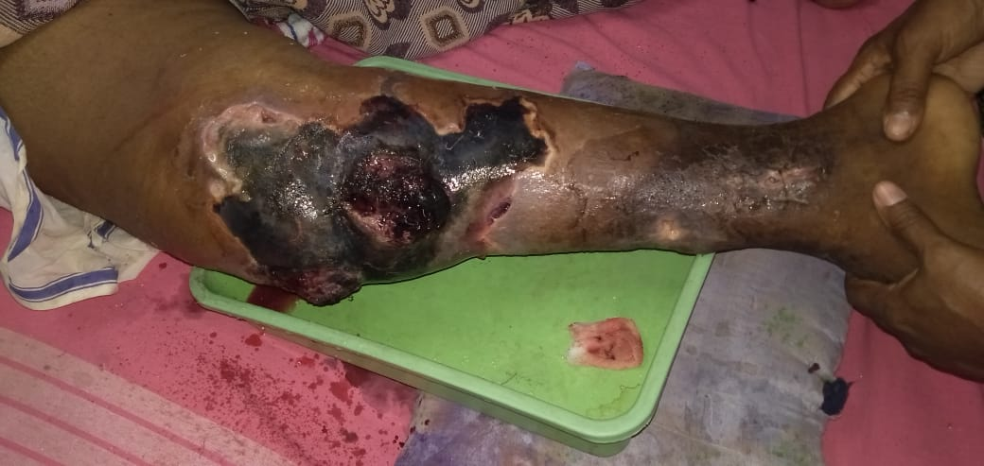

Slide 21
?
1.To R/O Local cause-
2.Severe Hemophilia
3.Sepsic foci
0rtho (o)
Vascular Sx(O)
F -VIII ASSAY

Slide 22
VASCULAR SURGERY OPINION
L/E of Right leg
Diffuse edema extending from the foot till midthigh
Hematoma collection extend from the knee joint till midleg
Foul smelling pus discharge +
Sensation intact
No active bleeding
Peripheral pulses in Left LL-Normally felt
Right LL-could not be palpable.
Due to edema.
Hand held doppler-Biphasic flow
IMP:Adequate vascularity at present

Slide 23
ORTHO OPINION
L/E RIGHT LEG
Spreading cellulitis / ?necrotizing fascitis over Right leg.
Skin necrosis +
Clots over the operated site+
Foul smelling discharge+
Distal locking site suture insitu+
Sensation intact
Thorough wound wash given and sterile dressing done.
SUGGESTED
Vascular surgery (O)
Higher antibiotics
Daily C&D

Slide 24
FACTOR VIII FUNCTIONAL ASSAY REPORT

Slide 25
DATE | 25/7/19 | 2/8/19 | 5/8/19 | 5/8/19 | 6/8/19
UREA | 37 | 160 | 152 | 155 | 132
CREAT | 1.2 | 2.4 | 2.4 | 2.4 | 2.1
USG ABDOMEN AND PELVIS
Liver-13.2 cm with Normal echoes
GB-Normal
Pancreas-Normal
Spleen-Moderate spleenomegaly{16.5cm)
Kidney=RK-8.4 4.2 cms with Normal echoes
LK-8.5 4.5 cms with Normal echoes
B/L Cortical echoes N.CMD maintained.
Bladder-Normal
Prostate-Normal
URINE ROUTINE
Alb-Trace
Sugar-Nil
Deposit-3-5 pus cells
NEPHROLOGIST OPINION OBTAINED
SUGGESTED
1. Intravenous fluids
2.Adequate hydration

Slide 26
Rx
IVF 30ml/Kg/hr,
Inj.Factor VIII 7 vials,
Inj.PIPTAZ 2.25gm iv TDS,
Inj,Metronidazole 500 mg iv TDS,
1 Unit of Packed cell transfusion.
2 Unit of FFB Transfusion.

Slide 27
CBC
DATE | 26/7 | 29/7 | 30/7 | 1/8 | 5/8 | 6/8 | 8/8 | 11/8
TC | 24900 | 37000 | 35100 | 50300 | 21000 | 16200 | 8300 | 5500
DC | 98/2/0 | 85/7/8 | 86/7/7 | 87/7/7 | 81/12/7 | 82/13/5 | 75/18/7 | 69/21/10
HB | 9.4 | 4.2 | 4.6 | 3.1 | 4.8 | 4.4 | 5.9 | 6.5
PCV | 29 | 13 | 14 | 9.1 | 15 | 13 | 18 | 21
PLT | 5.74 | 9.75 | 9.96 | 7.9 | 4.05 | 3.62 | 2.76 | 4.35
TREATMENT |  | 1 PCT | 1PCT | 1PCT | 2PCT | 1PCT | 1PCT | 2PCT

Slide 28
Even after 43 vials of Factor VIII transfusion
Bleeding not stopped
Plasma mixing study

Slide 29
PLASMA MIXING STUDY REPORT

Slide 30
SERUM ELECTROLYTE
DATE | 2/8/19 | 5/8/19 | 6/8/19 | 11/8/19
SODIUM (Meq/L) | 99 | 127 | 129 | 110
POTTASIUM(Meq/L) | 3.4 | 4.4 | 4.9 | 4.4
COAGULATION PROFILE
DATE | 25/7/19 | 27/7/19 | 30/7/19 | 2/8/19 | 3/8/19 | 4/8/19
PT | 15.36 | 14.6 | 18.5 | 22.2 | 25.12 | 18.56
INR | 1.16 | 1.11 | 1.4 | 1.68 | 1.90 | 1.41
APTT | 50.20 | 35.8 | 53.2 | 41.6 | 37.64 | 46.08
TREATMENT | 4500 U | 6000 U | 7500 U | 3500 U 4 FFP | 6FFP | 4 FFP

Slide 31
HEMOPHILIA A (SEVERE)
WITH
INHIBITORS +

Slide 32
Rx
FEIBA(Factor Eight Inhibitor Bypass Agent)

Slide 33
AIM OF PRESENTATION
TO HIGHLIGHT THE PRESENCE OF FACTOR 8 INHIBITORS IN HEMOPHILIA PTS.
TO DISCUSS THE MANAGEMENT OF PTS WITH INHIBITORS

Slide 34
THANK YOU

