Slide 1
CPC by 2nd Medical Unit
Chief-Professor : Dr Palanikumar MD
Associate Professor: Dr Palanikumaran MD
Assistant Professors : Dr Ponsenthil Kumar MD
Dr Saravana Madhav MD
Dr I lamaran MD

Slide 2
Chief complaints:
60-year-old female admitted on 1 /1 0//2025, a Known case of Type 2 Diabetes Mellitus (on treatment) Presented with:
Complaints of Abdominal pain for the past 6 months

Slide 3
History of present illness:
H/o Abdominal pain for the past 6 months
  Dragging type of pain
  Gradual onset, Progressive
  Predominantly in the left side of abdomen
  No aggravating or relieving factor
H/o weight loss for the past 6 months [52 kg to 42 kg]
H/o Loss of appetite
H/o Early satiety for the past 4 months
No H/o abdominal distension
No H/o Fever
No H/o Night sweats
No H/o Bleeding manifestations

Slide 4
Past History:
Patient is a known case of Diabetes mellitus on Oral anti – diabetic drugs for the past 10 years .
Not a known of Epilepsy/Systemic hypertension/CAD
No H/o prior blood transfusion
h/o Hysterectomy done 4 years back.

Slide 5
General Examination:
O/E:
Vitals:
Conscious and oriented
Pallor +
Platynychia +
No pedal edema
No clubbing
No generalized lymphadenopathy
BP: 1 1 0/70 mmHg at right upper limb at supine position
Pulse: 86/min
SpO₂: 98% RA

Slide 6
Systemic examination:
Per Abdomen:
  Soft , Non tender
  Bowel sounds heard
  Splenomegaly present
  Spleen palpable ~8 cm below left costal margin
  Splenic notch palpable
  No bruit/rub heard
  hepatomegaly present
  Liver palpable 6cm from right costal margin
  Liver span -13 cm
CVS: S1 ,S2 +
RS: BAE + , NVBS
CNS: conscious, oriented

Slide 7
Outside reports {prior to admission}:
CBC showed bicytopenia
Peripheral smear:
  Moderate microcytic hypochromic anaemia
  Thrombocytopenia
  Tear-drop cells present

Slide 8
CBC :
Parameter | 1/10/26 | 09/1 0/2025 | 1 0/1 0/2025 | 1 2/1 0/2025 | Reference
Total Count (TC) | 3900 | 4.3 ×1 0³/µL | 3.1 ×1 0³/µL | 4.6 ×1 0³/µL | 4–1 1 ×1 0³
Hemoglobin (Hb) | 8.1 g/dl | 8.4 g/dL | 7.2 g/dL | 1 1 .5 g/dL | 1 2–1 6 g/dL
PCV | 25% | 27.2% | 22.7% | 33.5% | 36–46%
Platelet Count | 90,000 | 86 ×1 0³/µL | 1 55 ×1 0³/µL | 58 ×1 0³/µL | 1 50–450 ×1 0³
MCV | 70 fl | 73 fL | 74.9 fL | 75.2 fL | 80 – 100 fL

Slide 9
Parameter | Value | Interpretation
RBS | 1 35 | Mildly elevated
Urea | 1 7 | Normal
Creatinine | 0.6 | Normal
Na⁺ | 1 35 | Normal
K⁺ | 3.6 | Normal
Total Bilirubin | 0.8 | Normal
Direct Bilirubin | 0.4 | Normal
Indirect Bilirubin | 0.4 | Normal
SGOT | 39 | Normal
SGPT | 26 | Normal
ALP | 242 | Mildly elevated
Calcium | 8.1 | Mildly low
Phosphorus | 3.0 | Normal
Uric Acid | 2.4 | Normal

Slide 10
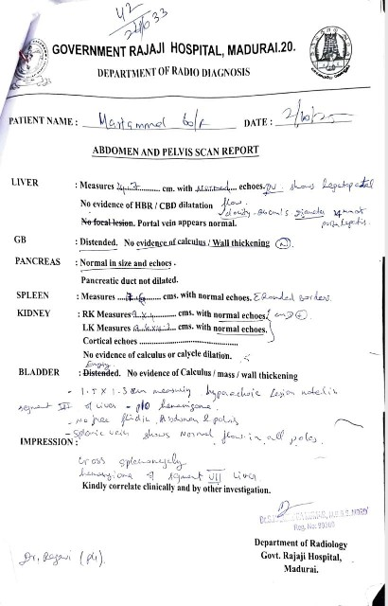
01 /1 0/2025:
X Ray - chest :
  Normal
USG Abdomen :
  Massive splenomegaly [17.6cm]
  Mild hepatomegaly
  Hemangioma of segment VI I of liver

Slide 11
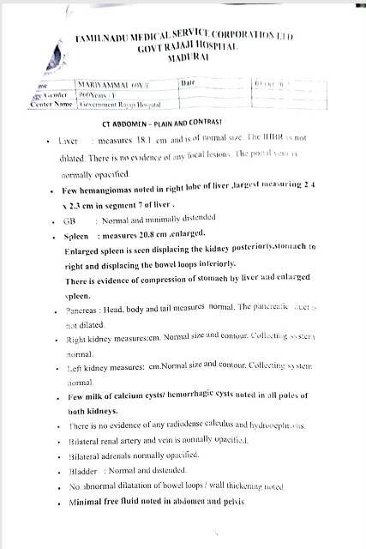
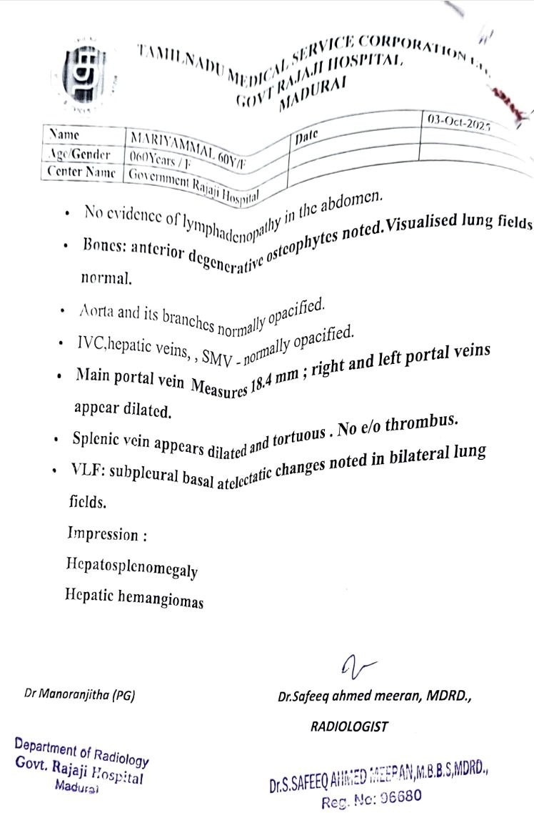

Slide 12
CT Abdomen:
  Hepatosplenomegaly present
  Hepatic Hemangioma present
CT Chest :
Normal study

Slide 13
Fundus :
Normal
Echocardiography:
  LVEF: 62%
  Trivial MR
  Mild TR
  Mild pulmonary hypertension

Slide 14
Smear for MP/MF – Negative
Rapid antigen kit – negative
Sputum CBNAAT – Negative
VCTC, VM- negative
Absolute neutrophil count- 880 cells/cu.mm
Nutritional Workup
  Vitamin B1 2: Normal
  Folic acid: >20 ng/mL (adequate)

Slide 15
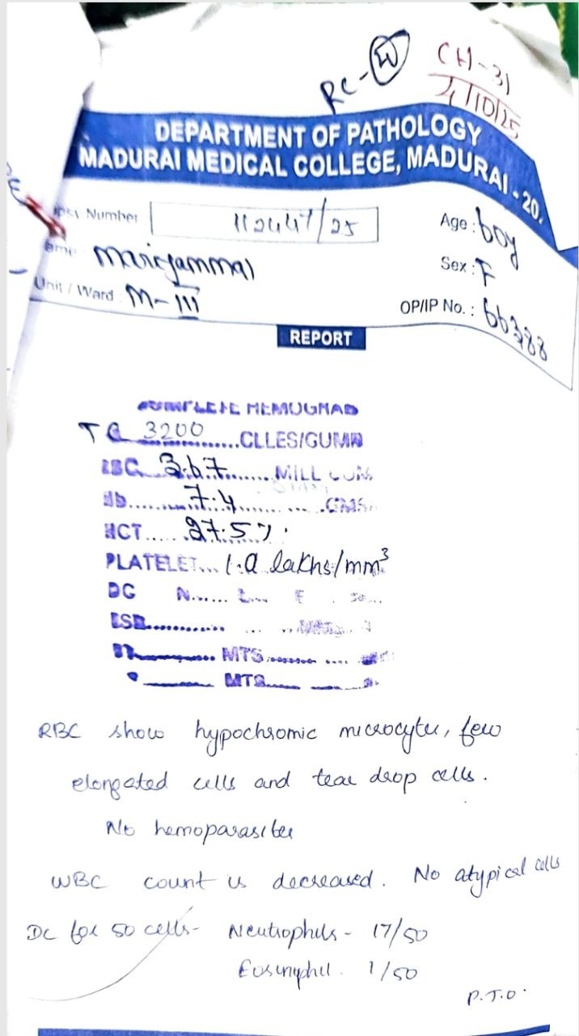
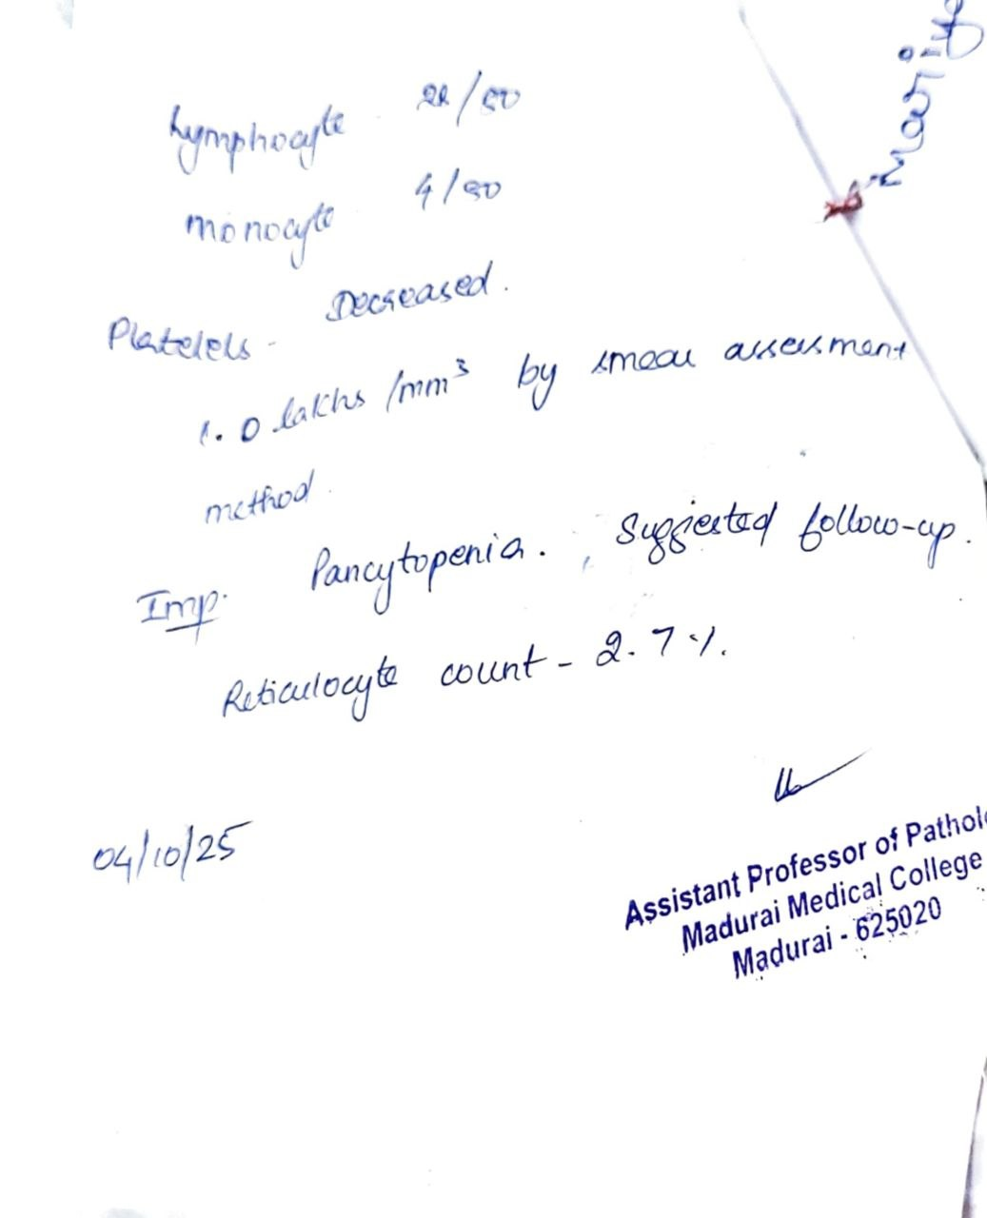

Slide 16
PERIPHERAL SMEAR:
  RBC: hypochromic microcytic, normochromic normocytes and elongated cells.
  Hemoparasites not seen.
  WBC count is decreased.
Platelet count is decreased, manual platelet count is 100000 cells/cu.mm ; few large platelets seen.
Differential count - for 50 cells:
  Neutrophils- 17/50
  Eosinophils- 1/50
  Lymphocytes- 22/50
  Monocyte 4/50
Reticulocyte count- 2.7%
IMPRESSION:
Pancytopenia - suggested follow up

Slide 17
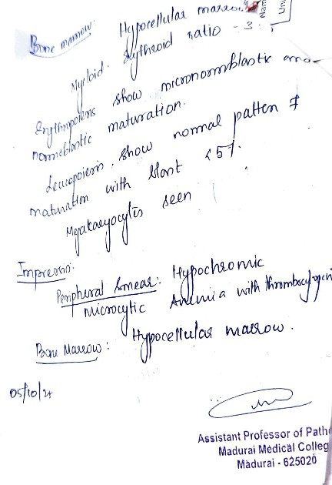
Bone Marrow Aspirate:
  Relative erythroid hyperplasia
  Hypocellular marrow
  Myeloid /erythroid ratio – 3:1
  Erythropoiesis shows micro normoblastic maturation.
  Leukopoiesis shows normal pattern of maturation with blast <5%
  Megakaryocytes seen

Slide 18
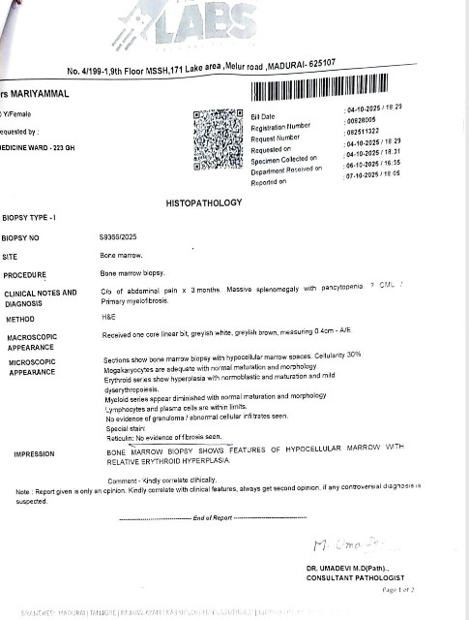
Bone marrow biopsy(4/10/26):
Microscopy:
Hypocellular marrow spaces
Cellularity: ~30%
Megakaryocytes:
Adequate in number with normal maturation and morphology
Erythroid series:
Mild hyperplasia
Normoblastic maturation
Mild dyserythropoiesis
Myeloid series:
Slightly diminished
Normal maturation and morphology
Lymphocytes and plasma cells: Within normal limits
No granulomas, abnormal cells, or metastatic infiltrates
Reticulin stain: No evidence of fibrosis
Impression:
Bone marrow biopsy shows features of a hypocellular marrow with relative erythroid hyperplasia.

Slide 19
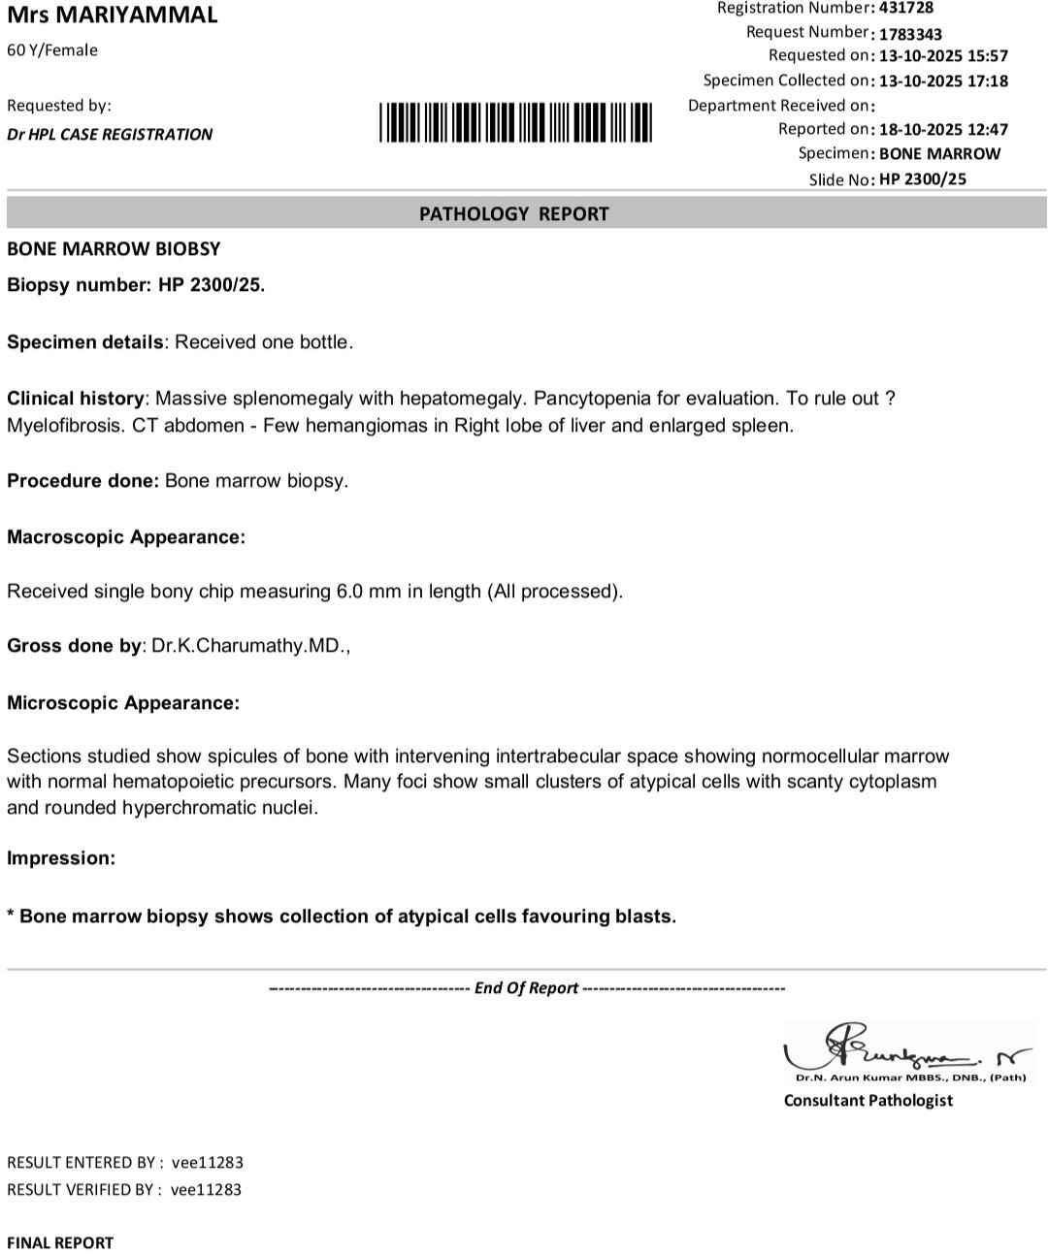
Repeat bone marrow(13/10/26):
Impression:
Collection of atypical cells favouring blasts.

Slide 20
Let’s discuss…

