Slide 1
A CASE OF RECURRENT PANCREATITIS
Professor- DR. M. NATARAJAN M.D.,
Assistant Professors:
DR.P.S.ARULRAJAMURUGAN M.D, D.M
DR.B.PALANIKUMAR M.D
Dr.P.MUTHUKRISHNAN

Slide 2
45 years old male complaints of
abdominal pain for 10 days

Slide 3
HISTORY OF PRESENT ILLNESS
H/O abdominal pain 10 days
upper abdomen
diffuse
dull aching pain
radiating to back
associated with vomiting
not billious, not blood stained, not projectile

Slide 4
No H/o abdominal distension
No H/o hemetemesis
No H/0 malena
No H/o hematochezia
No H/o yellowish discoloration of sclera
No H/o loose stools
No H/o Pruritis
No H/o burning micturation
No H/o hematuria

Slide 5
PAST HISTORY
Pt had recurrent mild abdominal pain since chilldhood, recoverd on its own
16 years back he had an acute onset severe abdominal pain suspected of Hollow viscus perforation and underwent laparotomy, records not available
Asymptomatic for 4 years, again had recurrent abdominal pain every 4-6 months, treated in nearby hospital with i.m injections & i.v fluids

Slide 6
PERSONAL HISTORY
Pt not a smoker
not an alcoholic
Bowel and bladder habits are normal
No H/o substance abuse
On mixed diet

Slide 7
FAMILY HISTORY
Younger sister found to have, hypercholesterolemia further evaluation was not done

Slide 8
GENERAL EXAMINATION
Pt .conscious
oriented
Afebrile
Well nourished
No pallor
Not icteric
No clubbing
No cyanosis
No pedal edema
No generalised lymphadenopathy
No arcus senilis
No Xanthoma

Slide 9
VITALS
PR- 90/min regular,condition of vessel wall normal
BP-120/80 mm Hg in rt upper limb in sitting posture
RR- 14/mint
No carotid bruit, felt equally on both sides

Slide 10
SYSTEMIC EXAMINATION
CVS – S1S2+ no murmur
RS- NVBS+,BAE +,no added sounds
ABDOMEN :
mid line laparotomy scar+
all quadrants move equally with respiration
umblicus normal position
soft, not tender , no organomegaly ,no free fluid
CNS- no FND, Fundus - normal

Slide 11
INVESTIGATION
Hb - 13g/dl
TC - 8900cells/cu.mm
DC - N-70%,L-28%,E-2%
PCV -34%
Platelet -3.35 lakhs
ESR-22mm/hour
Serum calcium-10.7 mg/dl
HbAIc-5.8
URINE- albumin- nil
sugar- nil
2-3 pus cells

Slide 12
RBS-132 mg/gl
UREA-24mg/dl
CREATININE-1.3mg/dl
SGOT/SGPT : 32/30 IU/L
ALP-153u/l
Total bilirubin – 0.8 mg/dl

Slide 13
USG abdomen & Pelvis
Liver echoes increased – Fatty Liver
Pancreas slightly enlarged
Kidneys – normal size, cortical echoes & CMD maintained on both sides

Slide 14
SERUM AMYLASE - 300U/L
SERUM LIPASE-1030U/L

Slide 15
MRCP
Diffuse edema and enlargement of pancreatic parenchyma with inflammatory exudates in peri pancreatic area and lesser sac
No evidence of pancreatic duct dilation or calcification and congenital anomaly of pancreatic duct
Mild hepatomegaly with grade I steatosis
No evidence of microcholelithiasis

Slide 16
LIPID PROFILE
FASTING LIPID PROFILE -8/6/2016:
TOTAL CHOLESTROL-278mg/dl
HDL-17mg/dl
LDL-26mg/dl
VLDL->50mg/dl
TRIGLYCERIDES- 2653 mg/dl
APOLIPOPROTEIN A1 - 76 mg/dl
APOLIPOPROTEIN B-259 mg/dl
LIPOPROTEIN (a) -1.1 mg/dl

Slide 17
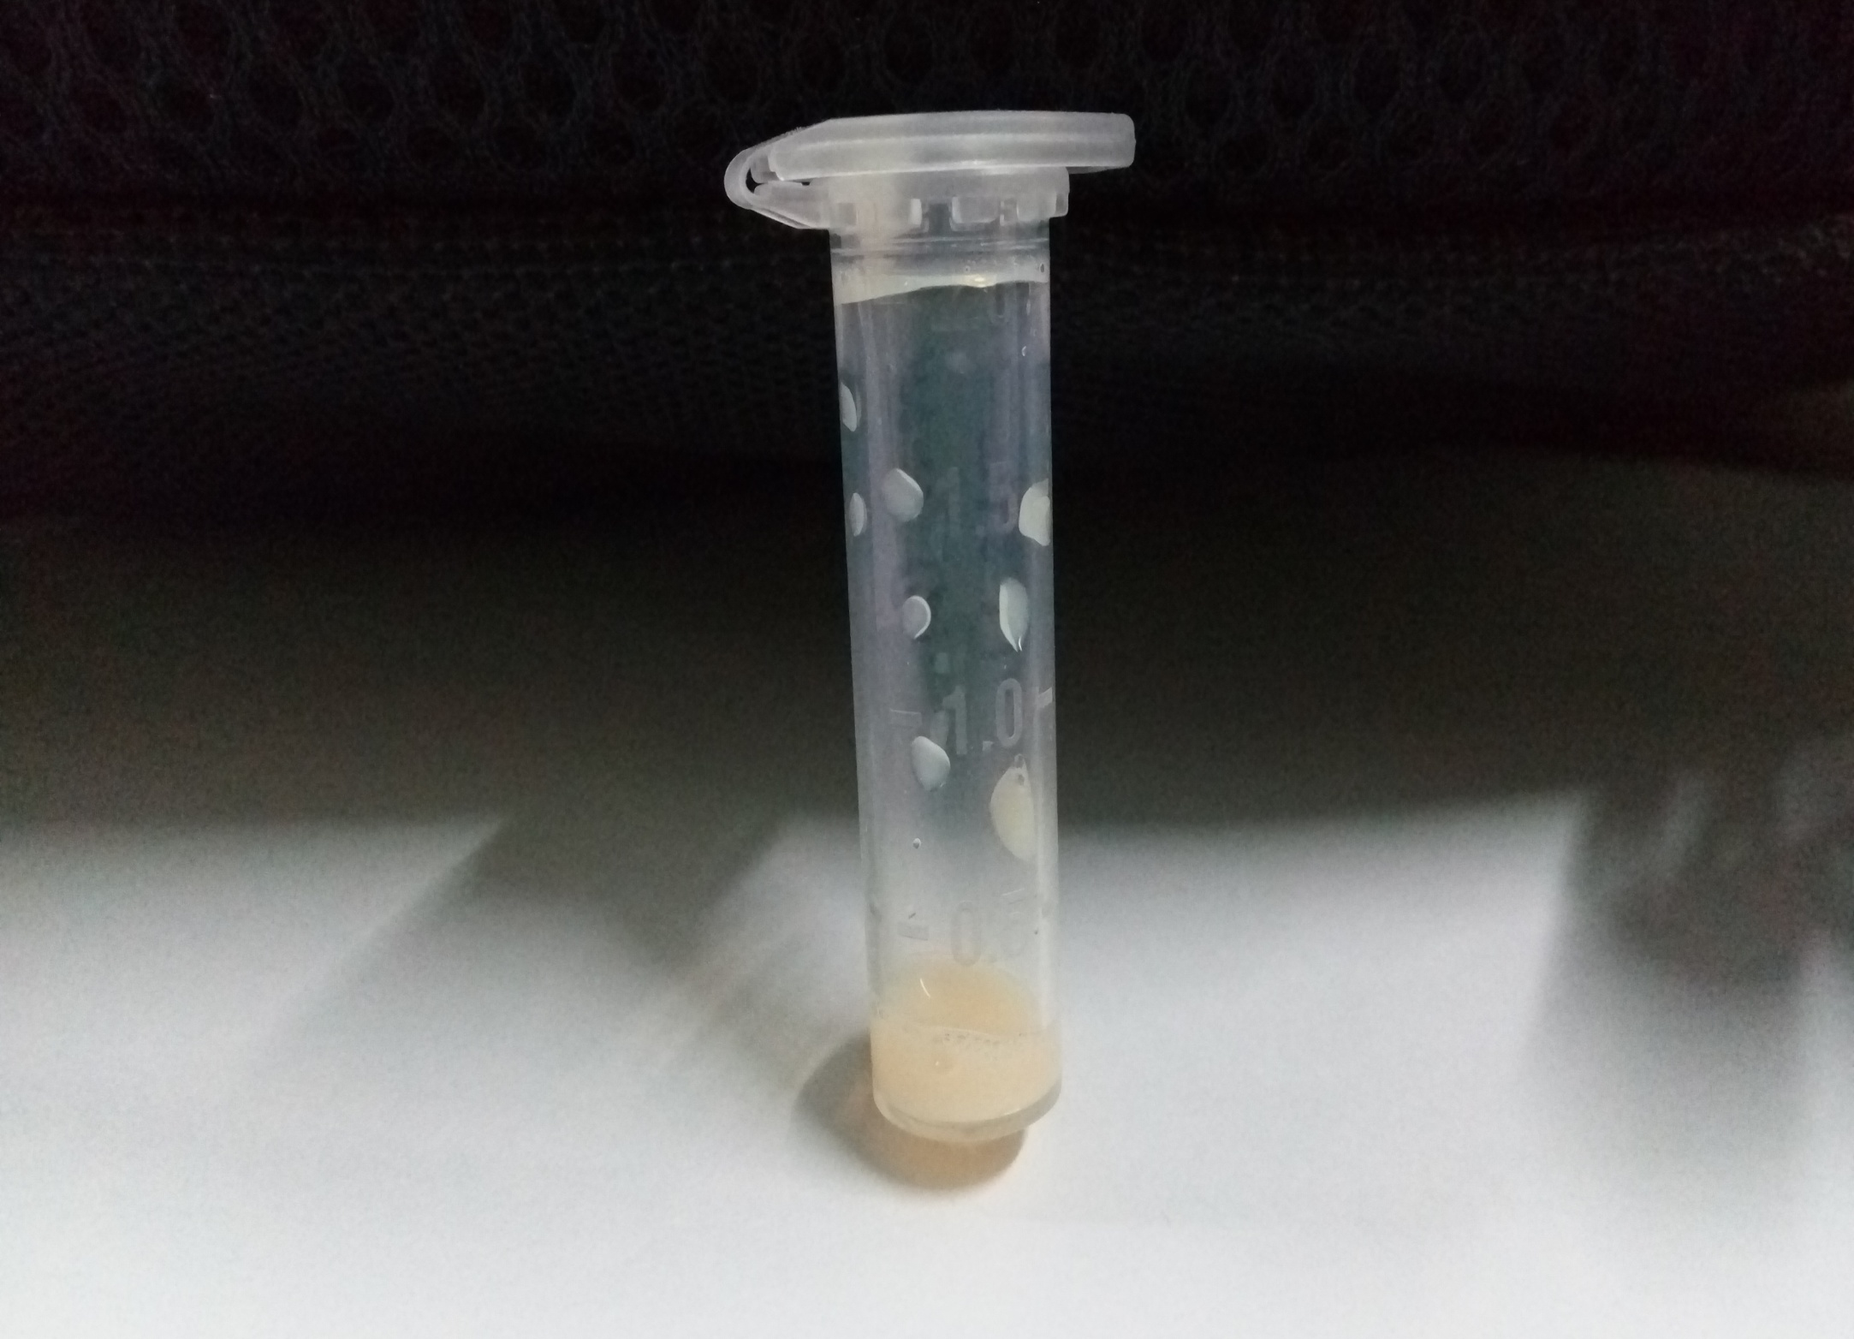

Slide 18
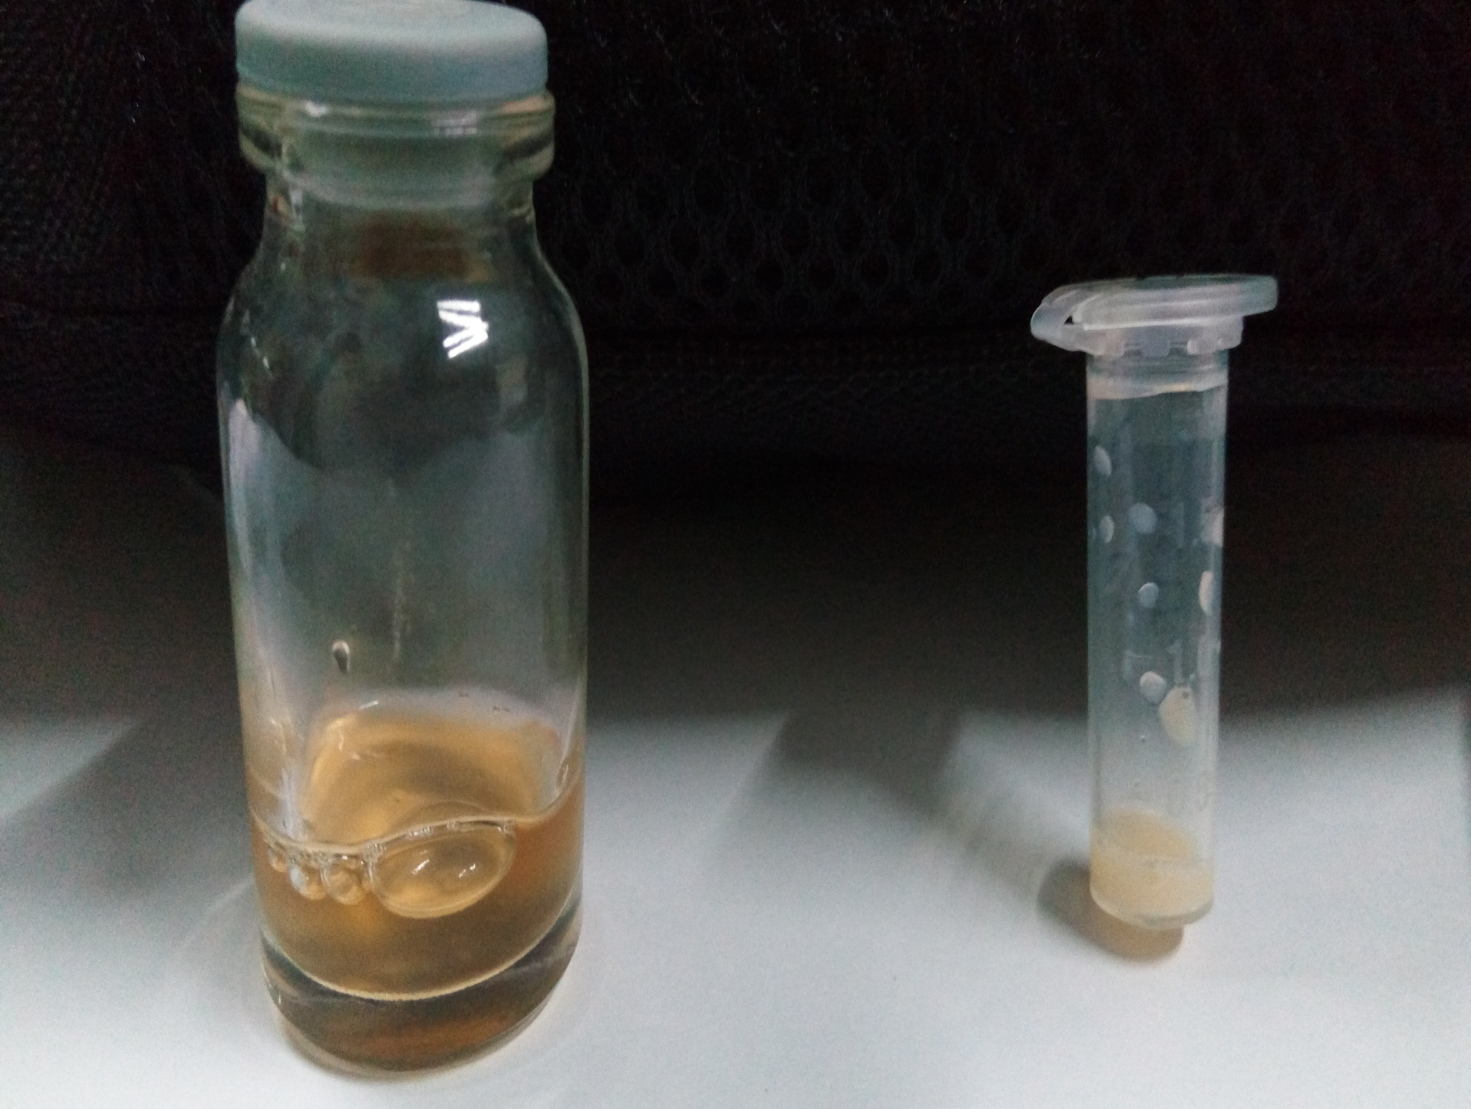

Slide 19
FT4 – 1.04 ng/dl, TSH – 1.82 mcu/ml
HIV, HbsAg, Anti HCV - negative
Carotid & vertebral doppler – normal study
ECHO – LVEF 60%, NRWA

Slide 20
TREATMENT
ROSUVASTATIN 20mg HS
FENOFIBRATE 200mg HS
Omega 3 fatty acid BD
Rifaximin 400mg Bd

Slide 21
Follow up
08/06
TC- 278 mg/dl
TGL - 2653 mg/dl
08/07
TC- 246mg/dl
08/08
TC- 240 mg/dl
TGL - 2030 mg/dl
TGL - 1183 mg/dl

Slide 22
DIAGNOSIS
Acute recurrent interstitial pancreatitis due to familial hyper triglyceridemia

Slide 23
AIM OF DISCUSSION
To discuss different causes for recurrent pancreatitis
To highlight hypertriglyceridemia one of the preventable cause for recurrent pancreatitis

