Slide 1
The national disease
IV MEDICAL UNIT
CHIEF: Dr . DAVID PRADEEP KUMAR
ASSISTANT PROFESSORS: Dr . NASEEMA BANU
Dr . RAM KUMAR
Dr . NABIL FAYAS
PRESENTOR: Dr . VIKRAM KRUSHNAA A

Slide 2
1st Admission: (5/10/23 to 14/10/23)
29 yr old female referred from private hospital as DENGUE NS1 POSITIVE with
MRI BRAIN (outside) : Minimal Meningeal Enhancement
Brainstem and Cerebellum – Diffuse restriction ? Demyelination
c/o fever 4 days – high grade, continuous, not associated with chills and rigor
h/o altered sensorium 2 days
h/o disturbed sleep 2 days
h/o hallucinations (auditory & visual) 4 days
No abdominal pain, jaundice, Malena
No cough, breathlessness, weight loss, loss of appetite, evening rise of temperature
No bleeding manifestations

Slide 3
Past history:
No past medical or surgical illness
Family history:
No fever in the family
Travel history:
No recent travel
Personal history:
Mixed diet
Normal bowel and bladder habits
Obstetric history:
LMP 1 week back, regular 3/30 day cycles
h/o spontaneous abortion (in second trimester) 7 yrs back

Slide 4
O/E
Drowsy
febrile ( temp – 103 F)
P-/PE-/I-/GLN-/CY-/CL-
Vitals
BP : 110/60 mmHg
PR : 55/ min
SpO2 : 96% in room air
CBG: 288 mg/dl

Slide 5
S/E
CVS : S1 S2, No murmur
RS : BAE, no added sounds
P/A : Soft
CNS : Drowsy
Not responding to oral commands
Tone: normal
Power: could not be tested
Reflex: present
Bilateral plantar : extensor
Neck stiffness present

Slide 6
Provisional diagnosis :
Fever with thrombocytopenia /
Dengue fever /
Acute meningoencephalitis /
New onset Diabetes Mellitus

Slide 7
DATE | TC | HB | HCT | PLATLET
5/ 10 | 5800 | 11.5 | 35.2 | 59000
6/10 | 8200 | 11.5 | 36.8 | 80000 ( Manual count – 1.10 lakhs )
7/10 | 7800 | 11.7 | 37.7 | 91000
8/10 | 7900 | 12.1 | 36.9 | 153000
9/10 | 9800 | 12 | 36.9 | 185000

Slide 8
RBS– 269
FBS– 170
PPBS- 256
RFT:
Urea: 52
Creatinine: 0.9
LFT :
Total bilirubin: 0.9
Direct Bilirubin: 0.3
Indirect Bilirubin: 0.6
SGOT: 43
SGPT: 34
ALP: 66
Na: 131
K: 4.2

Slide 9
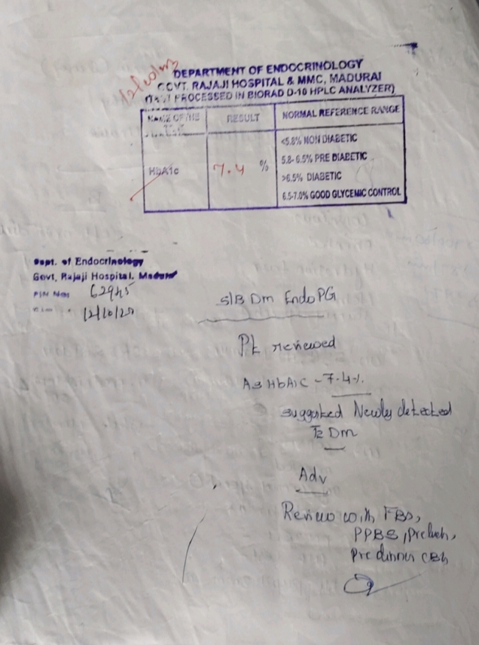

Slide 10
PERIPHERAL SMEAR:
Imp: Thrombocytopenia with relative neutrophilia
CSF Analysis:
Total count: 63 cells / 10 hpf
DC: polymorphs: 31 cells / 10 hpf
lymphocytes: 11 cells / 10 hpf
protein: 19 mg / dl
sugar: 116 mg / dl
Crp: 0.1 mg / L

Slide 11
USG ABDOMEN AND PELVIS :
Liver: 11.5 cm, normal echoes
Gall bladder: partially distended
Pancreas: normal
spleen: 8.33cm
Right kidney: 9.5 x 4.5 cm size , normal echoes
left kidney: 10.4 x 4.5 cm , normal echoes
bladder: empty , foleys in situ
uterus: normal
bilateral ovaries normal
minimal fluid in abdomen
no pleural effusion
Imp: Fatty liver
Minimal ascites

Slide 12
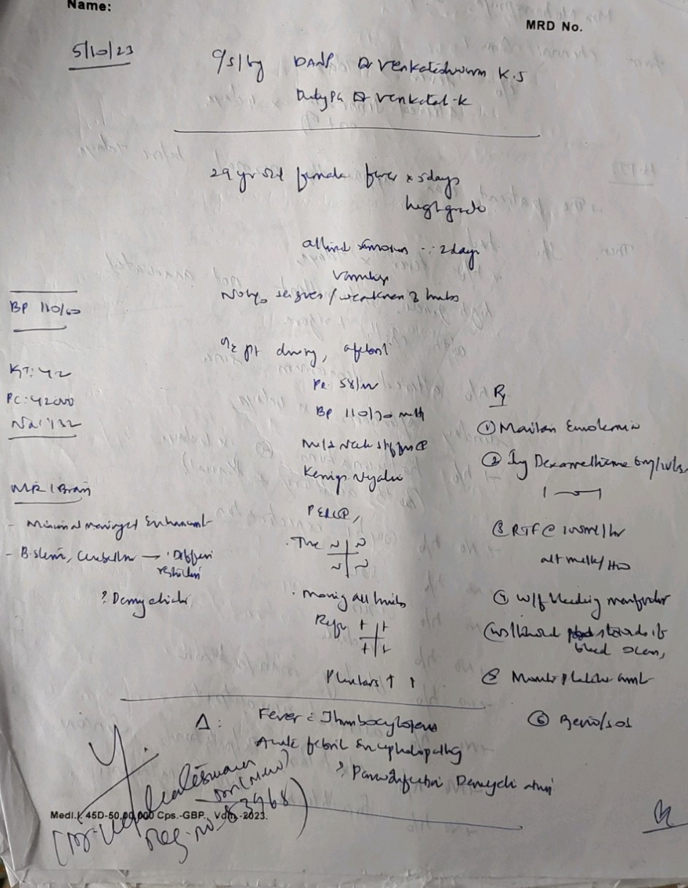

Slide 13
DANP Opinion:
Imp: Fever with thrombocytopenia / Acute febrile encephalopathy / ? Post infective demyelination
ADVICE:
Maintain euvolemia
INJ. DEXAMETHASONE 6 mg iv BD
RTF at 100 ml / hr
W/ F bleeding manifestations
Maintain platelet count
review sos

Slide 14
DANP Review:
Imp: Acute febrile encephalopathy / ? Post infective demyelination
ADVICE:
adequate hydration
continue antibiotics
platelet count monitoring
monitor vitals
continue iv dexamethasone x 5 days and then switch over to oral steroids for 2 weeks

Slide 15
Treatment given:
IV fluids
INJ . Ceftriaxone 2 gm iv BD
INJ .Ampicillin 2 gm iv QID
switched over to INJ . Doxycycline 100 mg iv BD
INJ . Azithromycin 500 mg iv OD
INJ . Dexamethasone 8 mg iv BD switched over to T. Prednisolone 5mg 8 OD
T. Metformin 500 mg tds
INJ/T . Paracetamol 500 mg 1 TDS
FINAL DIAGNOSIS:
T2DM /
DENGUE FEVER /
POST VIRAL DEMYELINATION

Slide 16
CONDITION ON DISCHARGE:
Pt GCS- 15/15
S/E
CVS and RS examination were within normal limits
CNS: conscious, obeys commands
Tone: normal
Power : normal
DTR: normal
Plantars: extensor
Cerebellar signs: absent
B/L Pupil: 3mm ERTL
DISCHARGE ADVICE:
T. Prednisolone 5mg 8 od (gradual tapering)
T. Metformin 500 mg 1 tds
review after 2 weeks

Slide 17
2nd ADMISSION: (8/11/23 to 23/11/23)
Pt Admitted in Sivagangai medical college after 10 days of discharge with
altered sensorium 2 days referred back to GRH, Madurai for further management
Duration of stay in GSMCH- 25/10/23 TO 8/11/23
Investigations (in GSMCH)
Hb: 10.4 ANA: negative (by IFA )
Tc: 19,100 CSF analysis: ADA : 39.68 U/L
Dc: 85/12/3 Tc: 2-3 cells / mm3
PCV: 25.6 Protein: 52 mg / dl
Plt: 2.63 lakhs Sugar: 48 mg / dl
Esr: 122 mm/hr
Crp: positive
Sputum AFB and CBNAAT – negative
CSF CBNAAT - negative
Pt started on ATT in GSMCH

Slide 18
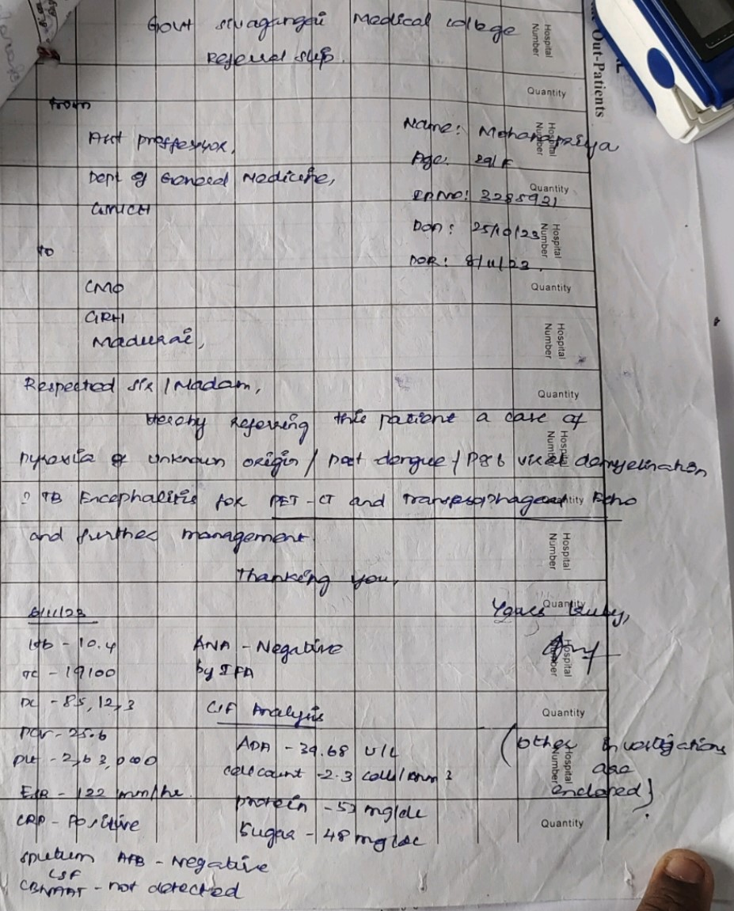

Slide 19
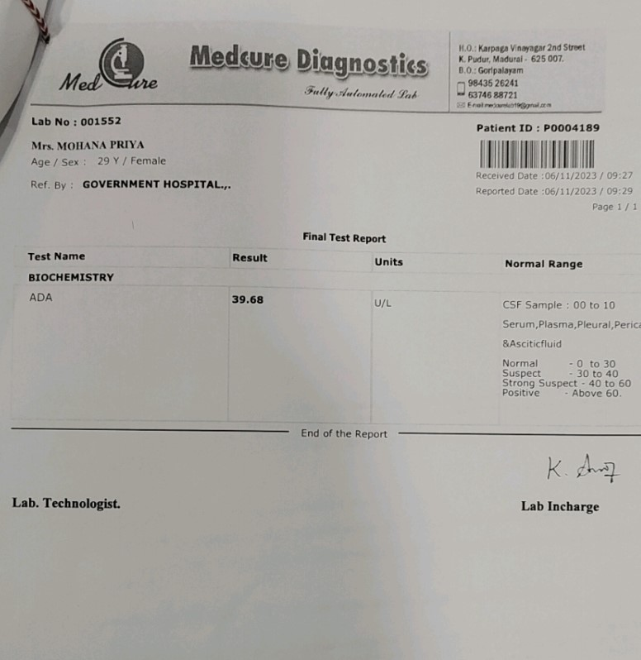

Slide 20
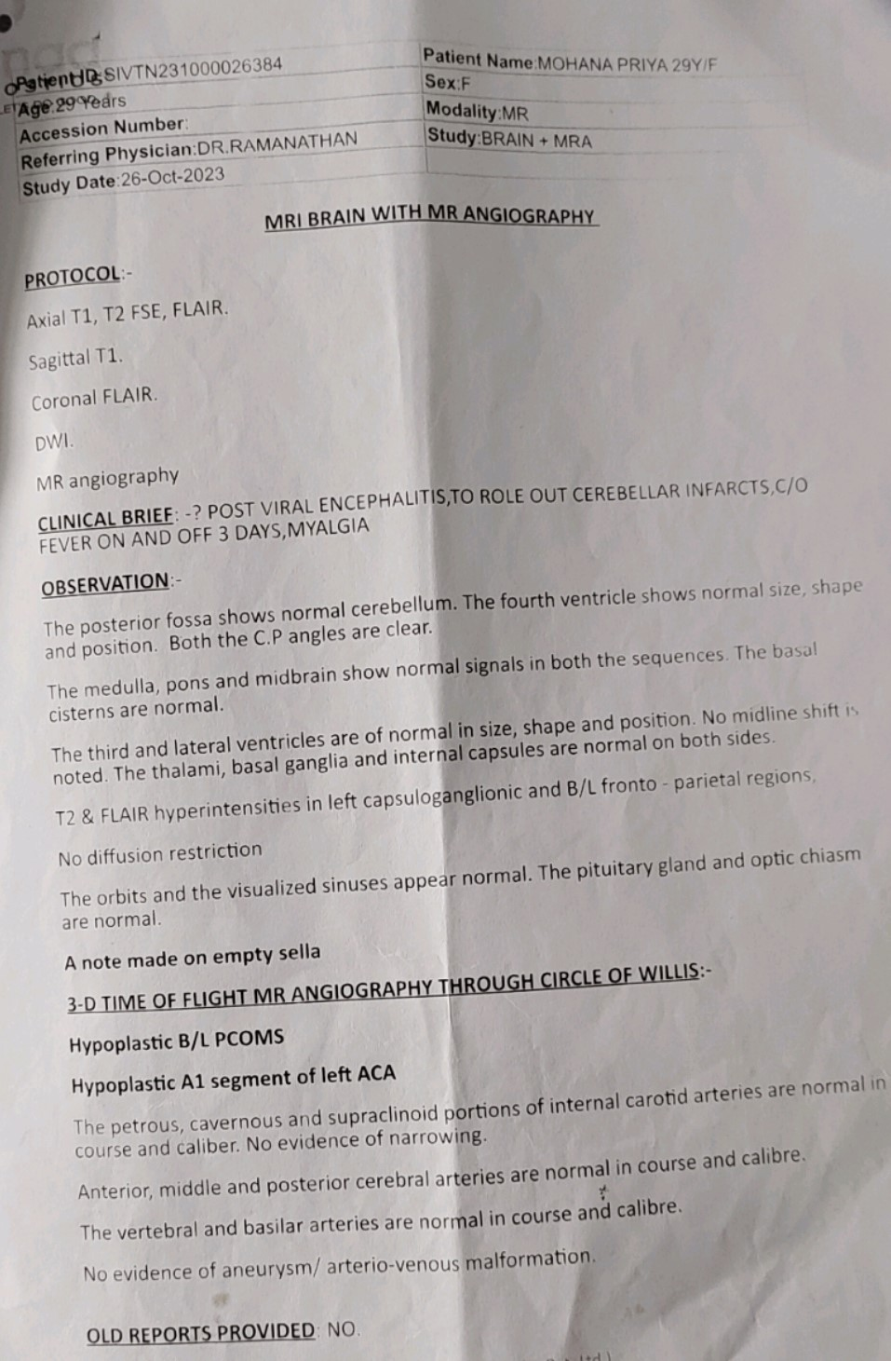

Slide 21
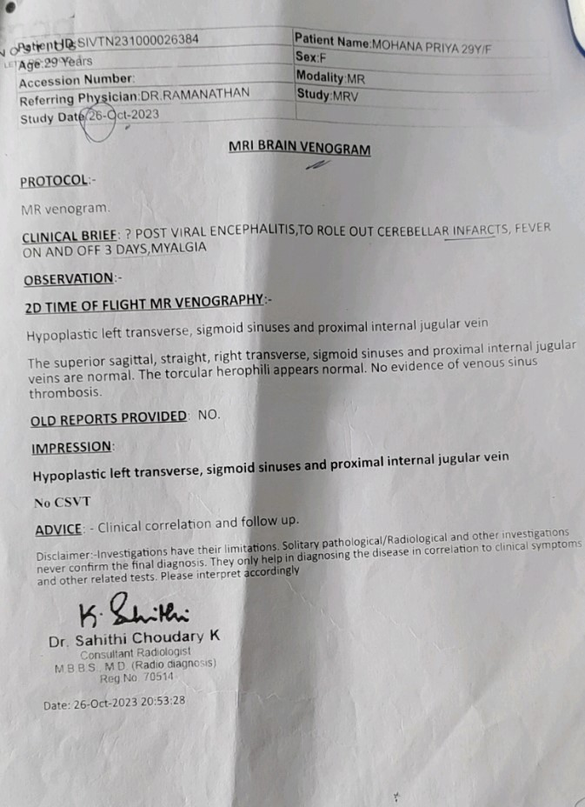

Slide 22
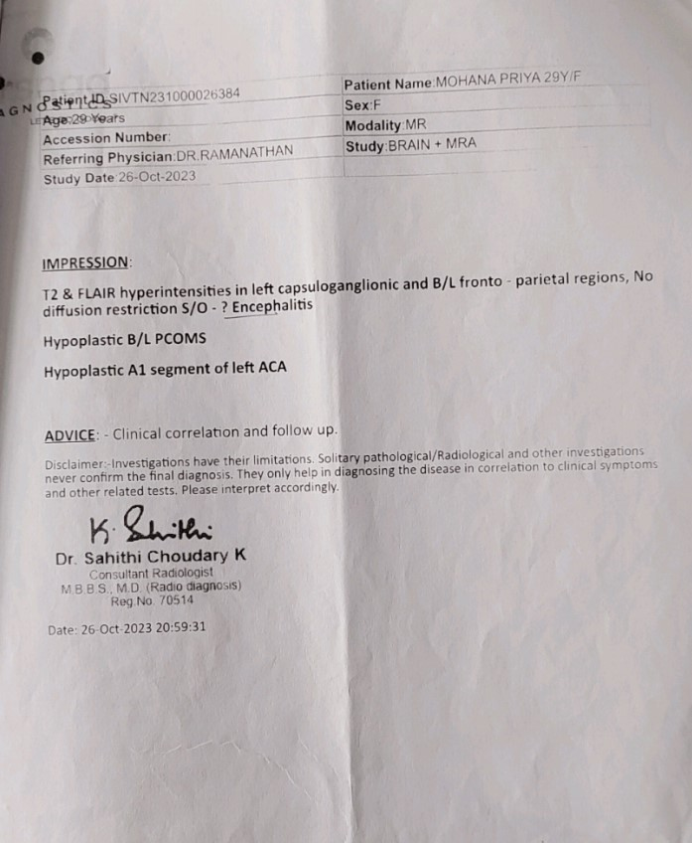

Slide 23
On admission, fever – low grade, intermittent, relieved with medications , not ass with chills and rigor
h/o headache, altered sensorium and disturbed speech
Past history:
T2DM 1 month under treatment
Obstetric history:
LMP: 20/ 9/ 23, regular 3/30 cycles (upt negative )

Slide 24
O/E
Pt
Drowsy
P-/PE-/CY-/CL-/GLN-/I-
VITALS:
Bp: 110/70 mmHg
PR: 78/ min
SpO2: 98% in RA
CBG: 91 mg / dl

Slide 25
S/E
CVS: S1 S2
RS: BAE
P/A: Soft , normal BS
CNS: Drowsy , partly responds to oral commands
Tone: N
N
Power could not be tested
DTR: exaggerated in all 4 limbs
Plantars: Left extensor
Nystagmus: present to right side
Neck stiffness present
B/L Pupil: 3mm ERTL

Slide 26
PROVISIONAL DIAGNOSIS:
T2DM /
Dengue fever - Post viral demyelination /
LEFT HEMIPARESIS /
Acute encephalopathy /
? Tubercular meningoencephalitis
To rule out ADEM

Slide 27
DANP Opinion:
Imp: Subacute meningoencephalitis
ADVICE:
To do MRI BRAIN WITH MRA AND MRV ( contrast )
INJ Ceftriaxone 2 g iv bd
INJ . Dexamethasone 8 mg iv tds
INJ . Acyclovir 800 mg iv qid
INJ . Ampicillin 2g iv qid
Monitor sugar levels
Review with reports

Slide 28
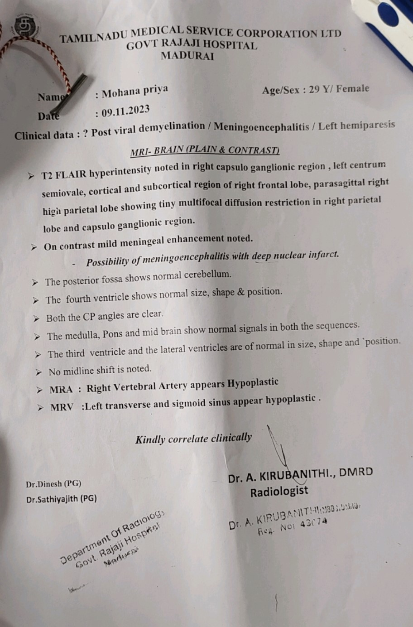

Slide 29
DANP REVIEW:
Imp: Subacute meningoencephalitis / CVA with Left hemiparesis ? Vasculitis
ADVICE:
Continue same line of management
T. Aspirin 150 mg ½ od
T. Atorvastatin 10 mg 1 HS

Slide 30
Ophthalmology opinion:
Imp: Early Papilledema
Advice:
Continue same line of management
Review sos

Slide 31
INVESTIGATIONS :
CBC BLOOD C&S: NO GROWTH
TC: 13,200 URINE C&S: CANDIDA ALBICANS
HB: 11.2 CSF C&S: NO GROWTH
HCT: 35.6
PLATELET: 3,37,000
RFT: Urea – 16
Creat – 0.6
RBS – 79 , FBS – 88 , PPBS – 118
TOTAL BILIRUBIN: 1.0
DIRECT BILIRUBIN: 0.6
INDIRECT BILIRUBIN: 0.4
SGOT: 23 SGPT:57
ALP: 118

Slide 32
Treatment given:
Ryle’s tube feeding
ATT (Category 1 )
T. Aspirin 150 mg ½ od
T. Atorvastatin 10 mg 2 HS
INJ . Ceftriaxone 2 gm iv BD
INJ . Dexamethasone 8 mg iv BD
INJ . Acyclovir 800 mg iv QID
INJ . Ampicillin 2 gm iv QID
INJ . NPH 5 – 5 U s.c ½ hr before food

Slide 33
FINAL DIAGNOSIS:
TUBERCULAR MENINGOENCEPHALITIS /
?ADEM
LEFT HEMIPARESIS -? VASCULITIS

Slide 34
Condition on discharge:
Pt GCS-15/15
CVS and RS examination were within normal limits
CNS: Conscious, obeys commands
Tone: N N
N
Power: 4/5 4/5
4/5 2/5
DTR: Normal
Cerebellar signs: Scanning speech present, FNT and FNFT Present,
Nystagmus absent, dysdiadokinesia present
Plantar: extensor mute

Slide 35
Discharge advice :
Continue ATT
T. Prednisolone 5 mg
T. Aspirin 150 mg ½ od
T. Atorvastatin 10 mg 2 hs
T. Calcium + Vit D3 1 od
Continue Physiotherapy
Review sos

Slide 36
3rd admission(30/11/23 TO 5/12/23)
Pt admitted after 7 days with c/o vomiting 8 episodes x 1 day , does not contains food particles , non bilious
h/o abdominal pain over the epigastric region
h/o fever 1 day , intermittent , not ass with chills and rigor , relieved with medications
No h/o loss of weight and appetite
No h/o of altered sensorium
No h/o cough with sputum production
No h/o LOC/Giddiness

Slide 37
O/E
pt
conscious
obeys commands ,
P-/PE-/GLN-/CY-/CL-/I-
S/E :
CVS: S1 S2
RS: BAE
P/A: Soft , normal BS

Slide 38
CNS: conscious
Obeys commands ,
scanning speech
Tone: N N
N
Power:4/5 3/5
4/5 2/5
Deep tendon reflexes: normal
Plantars: flexor
B/L 6th nerve palsy
Provisional diagnosis:
Acute Gastritis /
? ATT induced /
TB Meningoencephalitis

Slide 39
CBC:
Tc: 13,500
Hb: 12
Hct: 37.1
Plt: 2,79,000
RBS: 92
RFT: Urea- 37
Creat- 1.0
Na- 132
K- 2.8
LFT:
TB- 0.4
DB- 0.2
IB- 0.2
SGOT/PT- 56/34
ALP- 77
ESR- 59 mm/Hr
CRP- POSITIVE
Viral markers: HBS Ag- Negative
HCV- Negative
VCTC- Non reactive

Slide 40
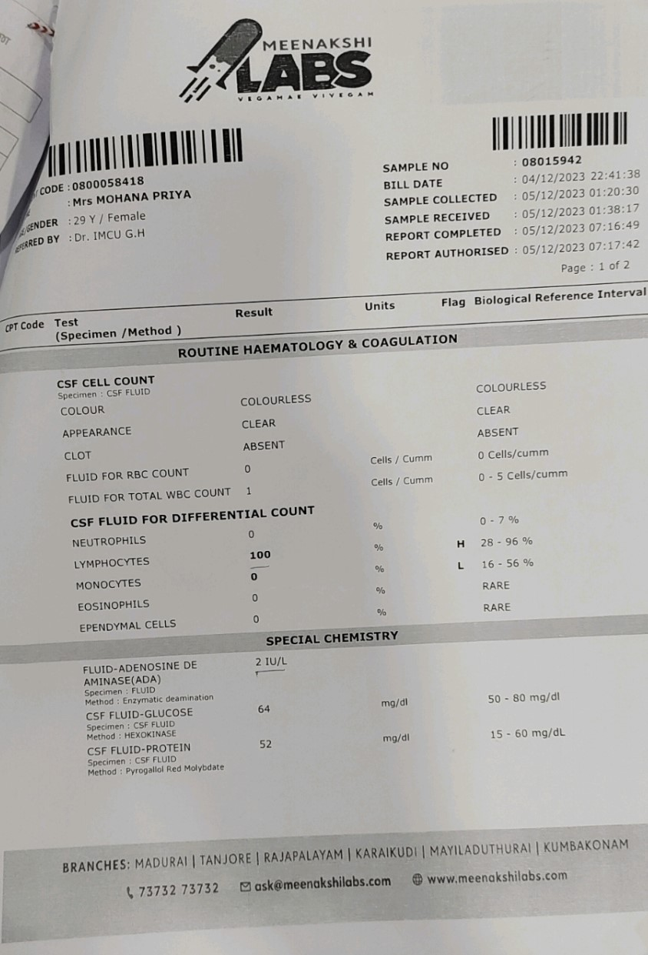

Slide 41
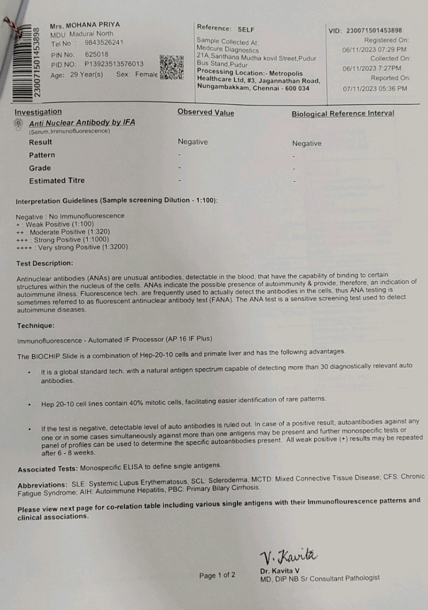

Slide 42
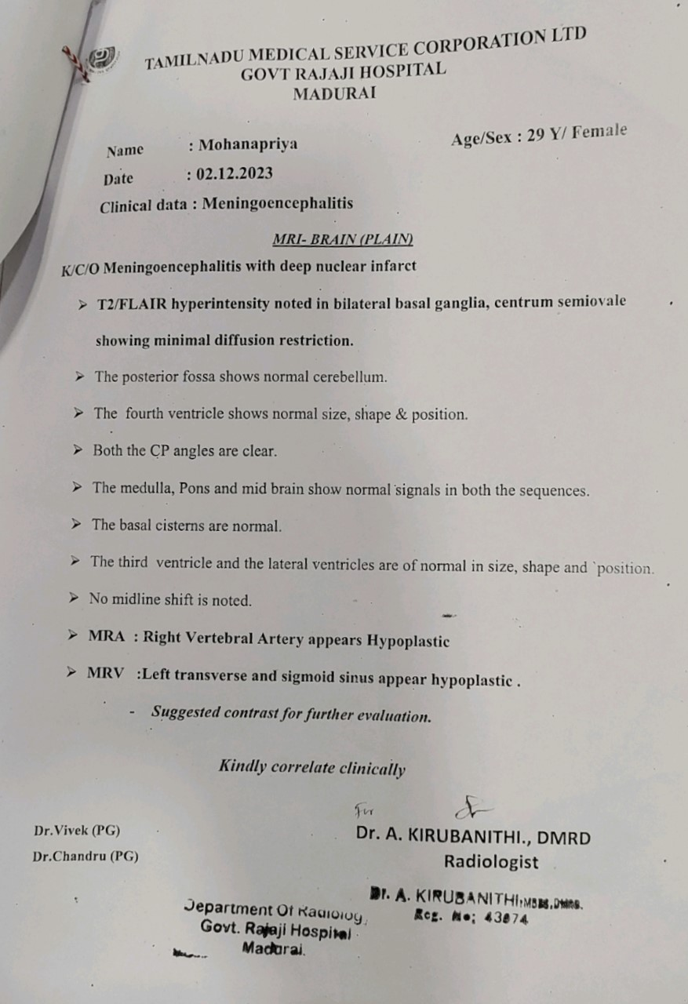

Slide 43
Ophthalmology opinion:
Imp: Normal fundus
Advice:
Continue same line of management
Review sos

Slide 44
DANP opinion:
Imp: TB Meningoencephalitis on ATT with ICT features / Acute Encephalopathy
Advice :
INJ. Lorazepam 0.1 mg /kg iv (sos)
To continue ATT
INJ. Mannitol 100 ml iv tds
Continue INJ. Dexamethasone 8mg iv tds
Continue other supportive measures
Review SOS

Slide 45
Treatment given:
INJ. Mannitol 100 mg iv tds
INJ. Acyclovir 500 mg iv tds
INJ. Ceftriaxone 2 gm iv bd
INJ. Levetiracetam 500 mg iv tds
INJ. Dexamethasone 8 mg iv bd
ATT (Category 1)
Multivitamin tablets
Inspite of all the effective treatment, patient expired on 5/12/23.

Slide 46

LET’S BEGIN THE DISCUSSION

