Slide 2
TSC 2
TSC 1
TUBERIN
RE VISITING TUBEROUS SCLEROSIS
mTOR
9/16
HAMARTIN

Slide 3
TSC 2
DEPARTMENT OF GENERAL MEDICINE
III MEDICAL UNIT
TSC 1
PROF. Dr.J.Sangumani M.D,D.DIAB
DEAN,MMC
Asst prof:
Dr.V.Palanikumaran M.D,D.DIAB
Dr.P.Sudha M.D.
Dr.M.Sureshkumar M.D.
9/16
HAMARTIN
TUBERIN

Slide 4
Brief history
A 15 yr male patient admitted with chief complaint's of fever with chills and rigor for past 5 days
No h/o loose stool
No h/o cough with expectoration
No h/o abdomen distension,swellimg of legs
No h/o decreased urine output,
No h/o headache, altered sensorium, blurring of vision
No h/o hematuria

Slide 5
past history
no h/o similar episodes in the past
patient was known case of TUBEROUS SCLEROSIS with seizure disorder on treatment
not a k/c/o DM /SHTN/TB /IHD

Slide 6
general examination
patient conscious
oriented
no pallor/icteric/cyanosis /clubbing
no pedal edema/generalized lymphadenopathy

Slide 7
systemic examination
CARDIOVASCULAR SYSTEM : S1S2 HEARD NO MURMUR
RESPIRATORY SYSTEM : NVBS+ no added sounds
ABDOMEN : soft BS+ no organomegaly
CENTRAL NERVOUS SYSTEM : no focal neurological deficit
no neck stiffness

Slide 8
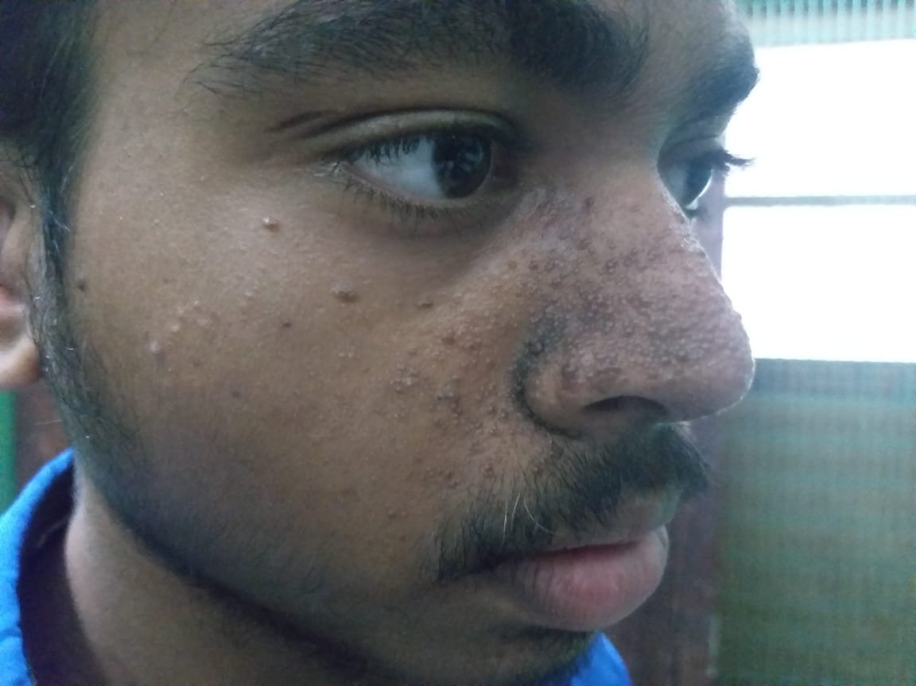
local examination
facial angiofibroma and fibrous plaque seen over forehead

Slide 9
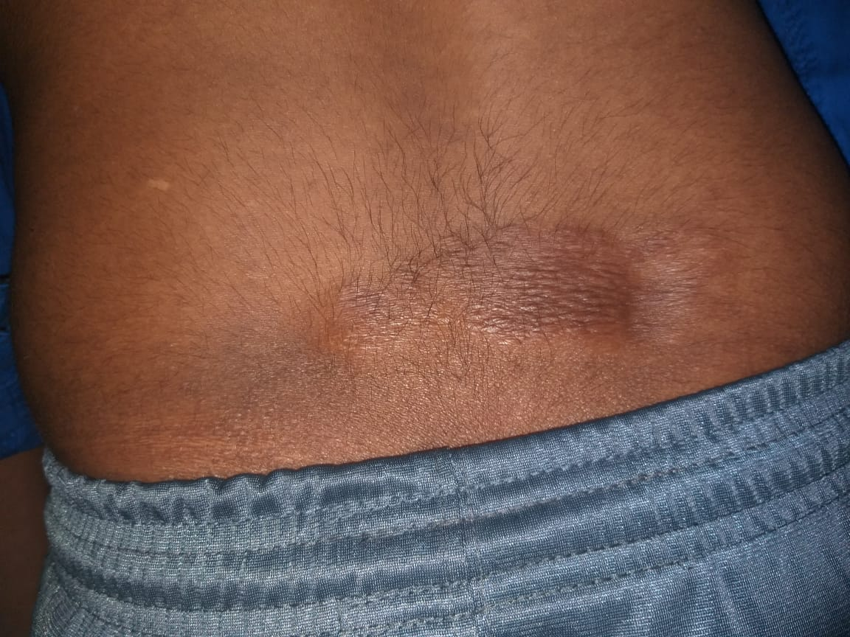
SHAGREEN PATCH AND ASH LEAF MACULE

Slide 10
Dental pits

Slide 11
CHEST XRAY

Slide 12
CT BRAIN

Slide 13
subCORTICAL AND cerebellar TUbeR

Slide 14
SUBEPENDYMAL TUber

Slide 15
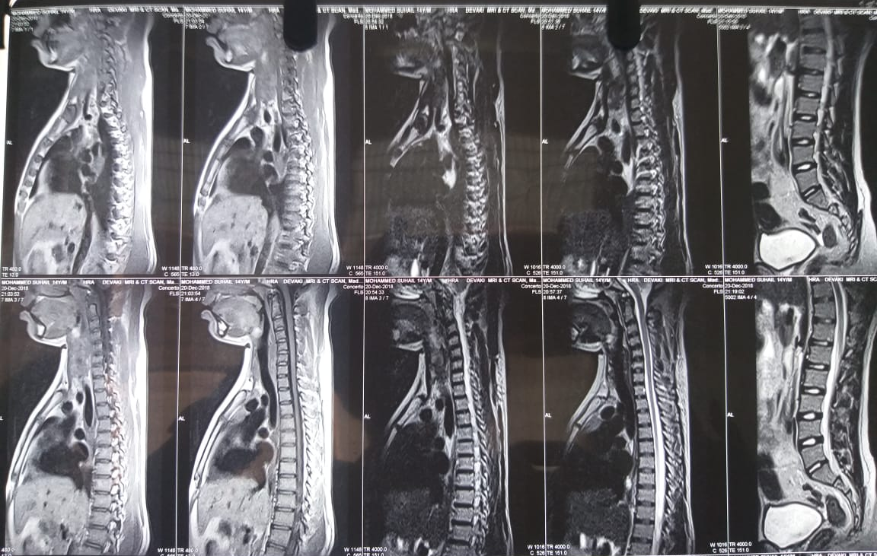
Mri spine

Slide 16
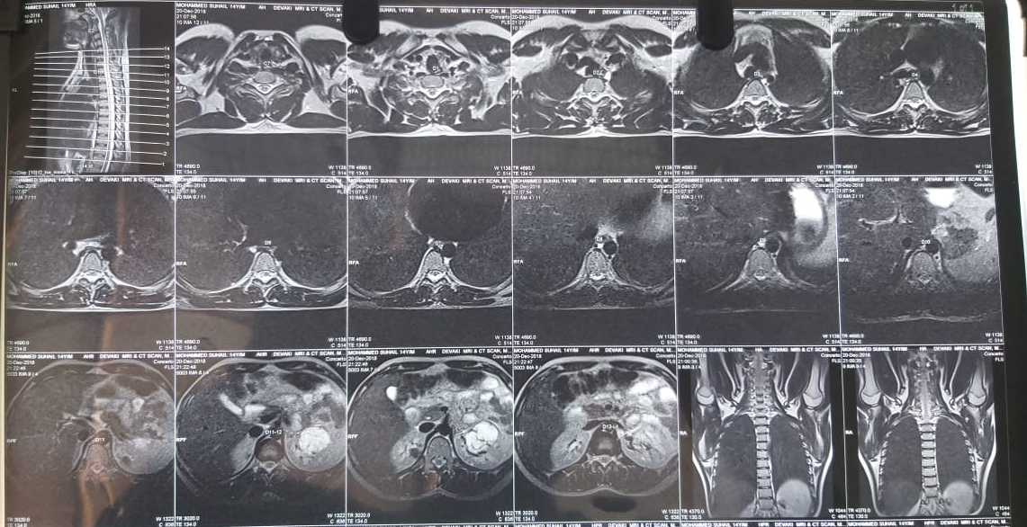

Slide 17
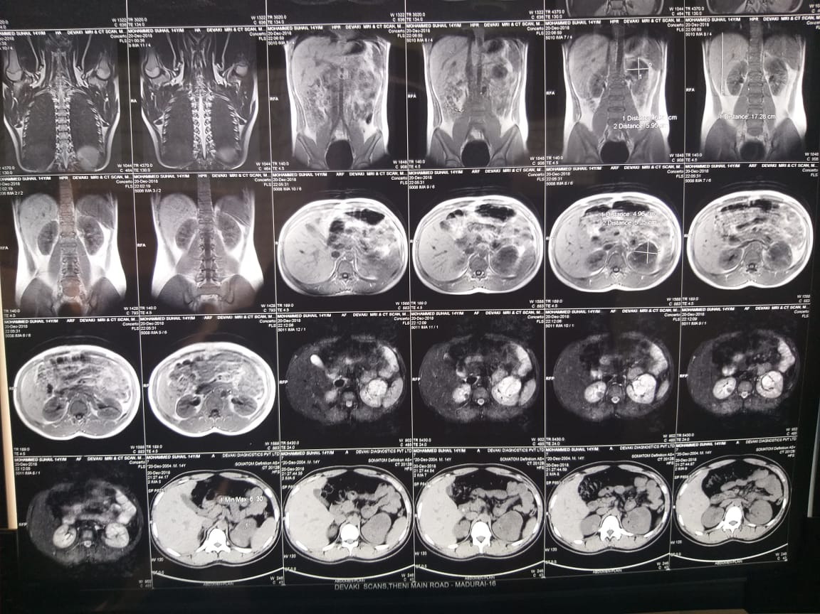

Slide 18
Renal cyst and angiomyoma
Bilateral renal cyst and mass s/o angiomyoma due to tuberous sclerosis

Slide 19
Renal angiomyoma

Slide 20
NUEROMEDICINE OPINION
NUEROSURGEON OPINION
CT Brain : subependymal calcification, no hydrocephalus
To continue same line of management
CT Brain: subependymal calcification
W/H sodium valproate and oxcarbazepine
To add: T, levetiracetam 500 mg 1bd
Continue supportive care
ENDOCRINOLOGIST OPINION
TSH 2.02 IU/ml
EUTHYROID STATE

Slide 21
DERMATOLOGIST OPINION
ON EXAMINATION
Forehead fibrous plaques, angiofibroma on face, ash leaf macules, shagreen patches
Dental enamel pits are present
IMPRESSION: TUBEROUS SCLEROSIS

Slide 22
OPHTHALMOLOGIST OPINION
LIDS,CORNEA CONJUNCTIVA,ANTERIOR CHAMBER,IRIS,PUPIL,LENS are normal on both sides
FUNDUS:
RIGHT EYE: TWO RETINAL ASTROCYTOMA seen in supratemporal and inferotemporal areas
LEFT EYE : RETINAL ASTROCYTOMA seen in supratemporal arcade
IMPRESSION : BOTH EYE RETINAL ASTROCYTOMA

Slide 24
investigation
LFT
BILIRUBIN(T) 0.5
ID 0.3
D 0.2
SGOT 101
SGPT 112
ALP 140
COMPLETE HEMOGRAM
HB 16.8
HCT 44
TC 4800
DC 52/36/11
PLT 20000
NORMOCYTIC NORMOCHROMIC ANEMIA
WITH THROMBOCYTOPENIA
RBS 97
UREA 22
CREAT 1.2
CBC 9/11 12/11
HB 15.1 15.9
TC 4300 4400
DC 51/34/15 30/51/5
PLT 34000 1.54
PCV 43 34
ECHO
LVEF 64%
NO RWMA
TRPG 14 mmHg
NO LV CLOT
NO INTRA CARDIAC MASS
NO PERICARDIAL EFFUSION

Slide 25
treatment given
C. doxycycline 100mg bd
T. paracetamol 500mg 1tds
T.Ranitidine 150 mg 1bd
T. domperidone 10 mg 1 bd
T. phenytoin 100 mg 1 bd
T.Levetirecetam 500 mg 1 bd
serial CBC monitoring
W/F Bleeding Manifestations

Slide 26
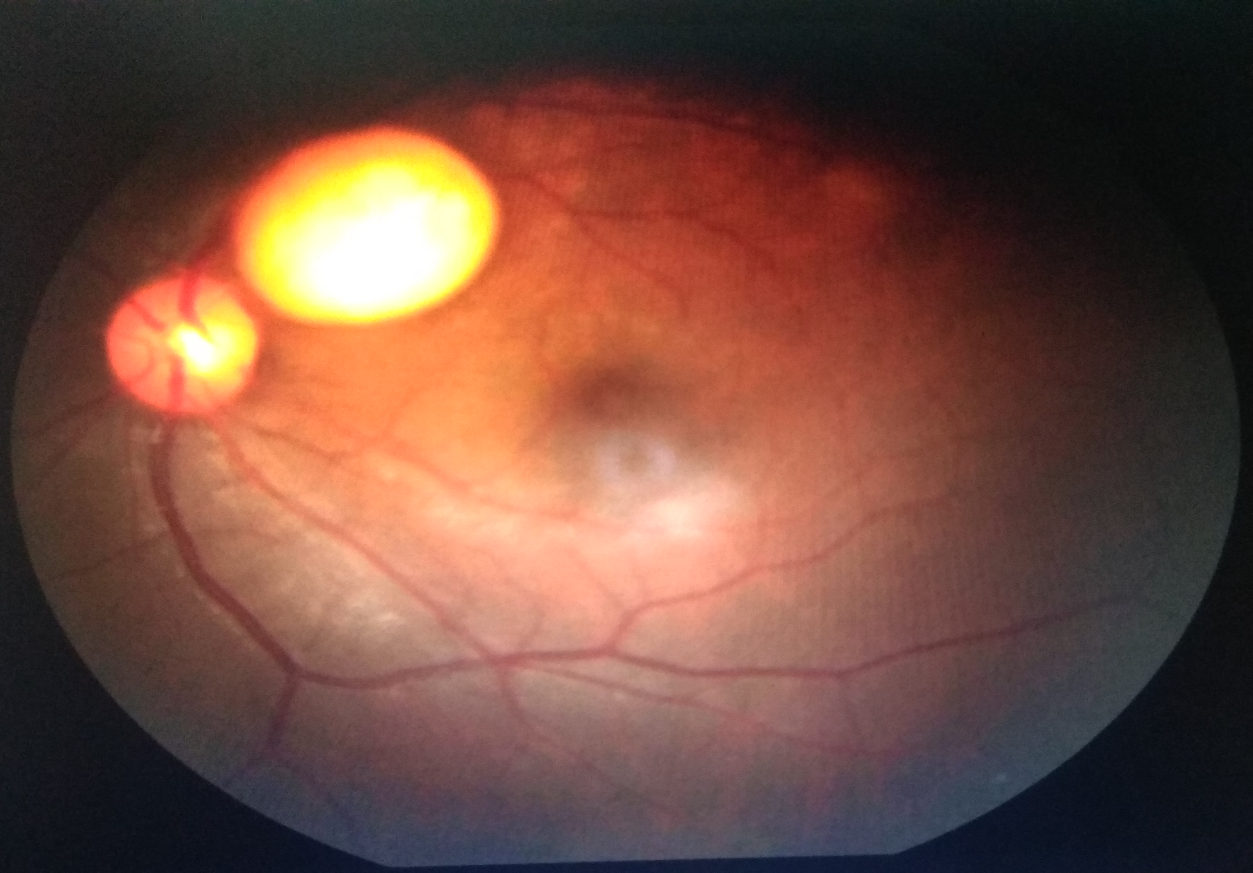
Dental pits
Adenoma sebaceum
Retinal astrocytoma
Renal angiomyoma
shagreen patch
Tuberous sclerosis
Renal cyst
Ash leaf macule
Cortical tuber
Subependymal nodules

Slide 27
AIM OF THE PRESENTATION
TO DISCUSS THE MULTIPLE SYSTEMIC MANIFESTATION OF TUBEROUS SCLEROSIS

Slide 28
TSC 2
TSC 1
TUBERIN
THANK YOU
9/16
HAMARTIN

