Slide 1
JOURNAL CLUB
CHIEF-Dr.C.DHARMARAJ M.D. DCH
ASSIST PROFF-Dr M.ARUL PRAKASH MD DA
Dr.A.PRABHU M.D
Dr.VINOTH KANNAN M.D
PRESENTOR-Dr.S.PRADEEPSHANKAR

Slide 2
Journal club "Semaglutide and cardiovascular outcomes in obesity without diabetes"

Slide 3
Semaglutide
GLP- 1( glucogan like peptide -1) receptor agonist
Enhance glucose dependent insulin secretion by pancreatic beta cells --> type 2 DM
Physiological regulator of appetite , GLP-1 receptor is present in areas of appetite regulation in brain --> obesity
Half life - 1 week
sc - 0.25mg to 2mg weekly
PO - 3mg to 14mg daily

Slide 4
Background
Semaglutide has been shown to reduce adverse cardiovascular events on pts with diabetes .
Whether Semaglutide can reduce cardiovascular risk associated with overweight and obesity in the absence of diabetes in unknown

Slide 5
Study design
Multicentric , double blinded, randomized, placebo controlled, event driven superiority trial
804 clinical sites in 41 countries
From oct 2018 to march 2021
17, 604 population

Slide 6
Inclusion criteria
More than or equal to 45 yrs of age
BMI - 27 or greater
Established cardiovascular disease
(previous MI or previous stroke or Symptomatic PVD)

Slide 7
Exclusion criteria
DM
Glycated hb ->6.5%
Treated with any glucose lowering drugs or GLP -1 receptor agonist within last 90 days
NYHA- class IV heart failure
ESRD / on HD
Within 60 days of any cardiovascular events

Slide 8
Intervention
Pts were randomly assigned in 1: 1 ratio
Group 1- Semaglutide - 0.24 mg sc once weekly , dose increased every 4 weeks ( 0.5, 1.0, 1.7, 2.4 )untill target dose of 2.4 mg was reached after 16 weeks
Group 2- Placebo
If pt become pregnant - trial discontinued

Slide 9
End points assessed
Primary end points:
Death from any cardiovascular causes , nonfatal MI , nonfatal stroke assessed in time to first event analysis
Secondary end points:
Assessed in time to first event analysis and tested in hierarchial order , were death from cvs cause , composite heart failure end point, death from any cause

Slide 10
Coming to study results..,

Slide 11
Baseline characteristics of the pts
Age - 61.6 +/- 8.9 yrs
72.3 % male , 27.7% female
Mean glycated hb - 5.8 +/-0.3%
> 1/3 - previous MI
Pts were on other drugs - 90.1% on statins , 86.2% on antiplatelets , 70.2% on beta blockers, 45.0% on ACE inhibitors, 29.5% on ARB

Slide 12
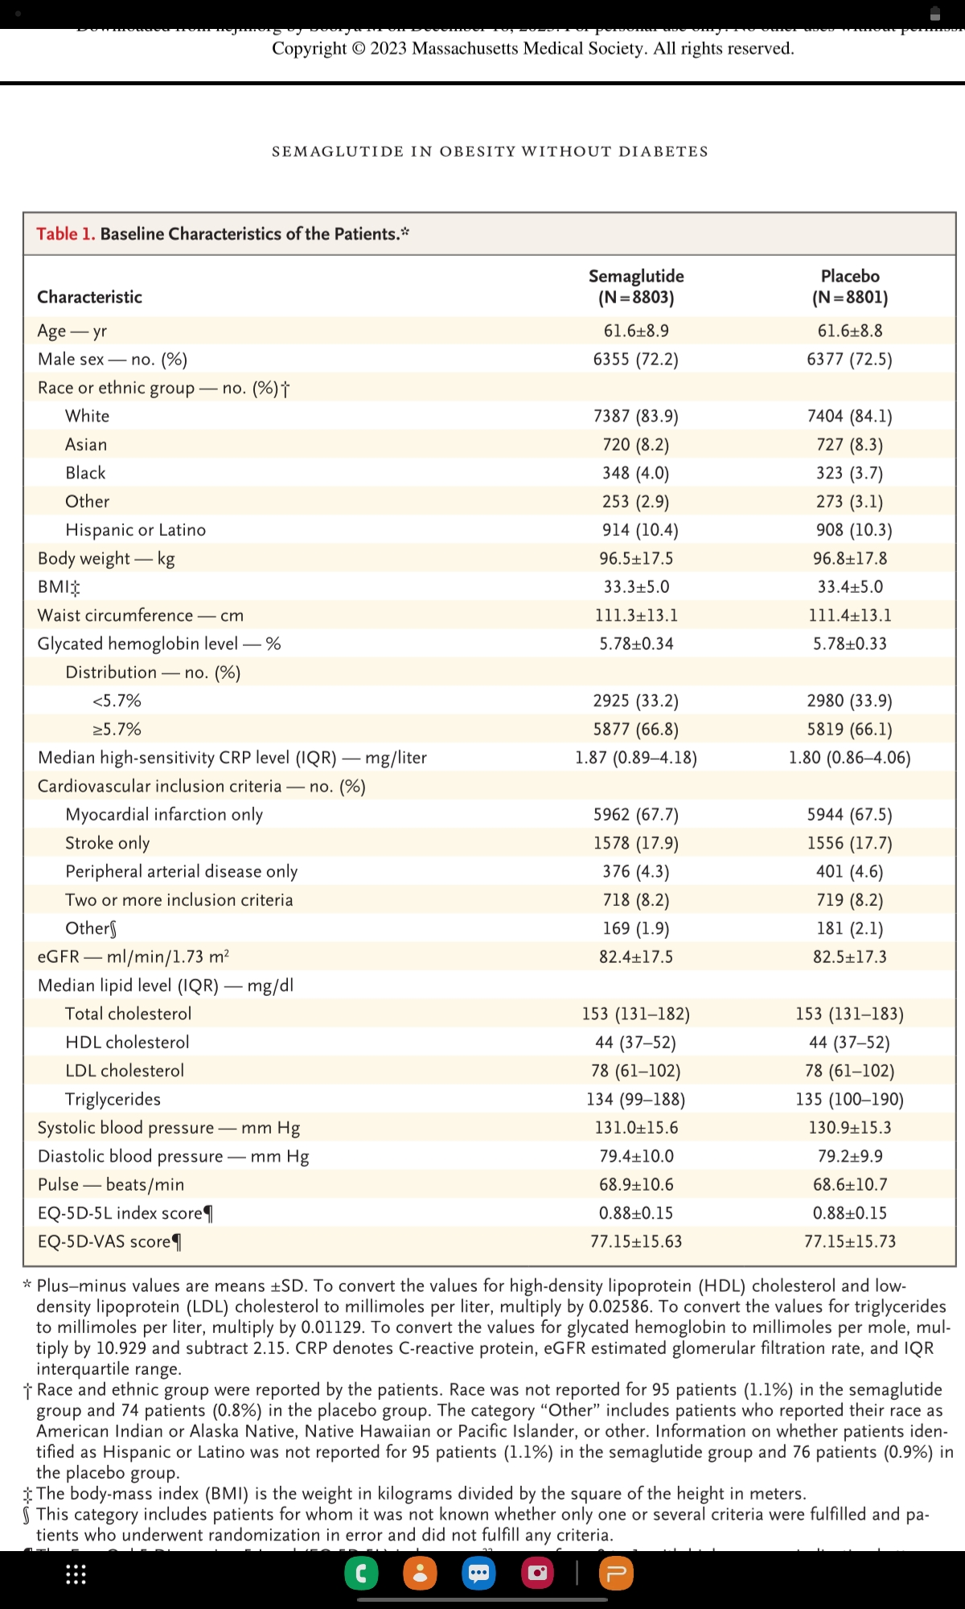

Slide 13
Efficacy end points
Primary cardiovascular end point events - occured in 6.5% (569) in semaglutide group vs 8% (701) in placebo group
Death occured in 2.5% (223) in semaglutide group vs 3% (262) in placebo group

Slide 14
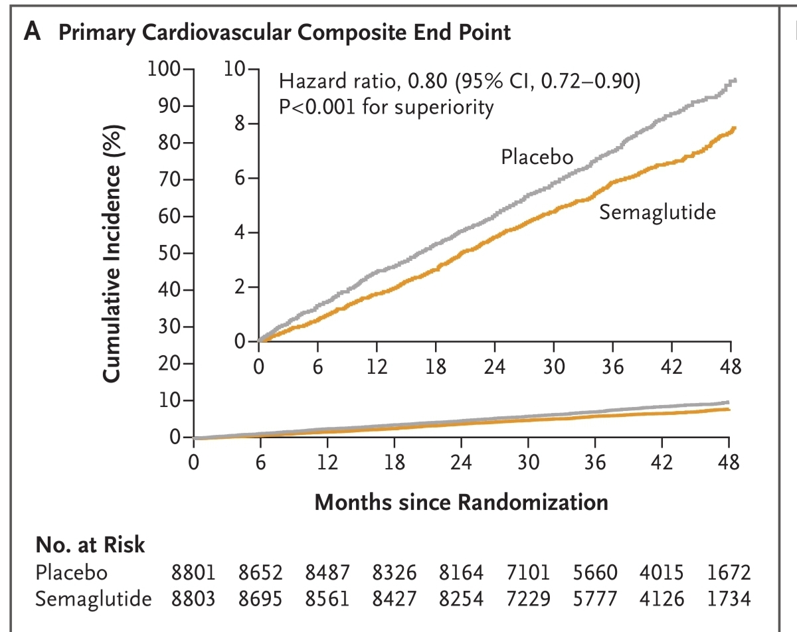

Slide 15
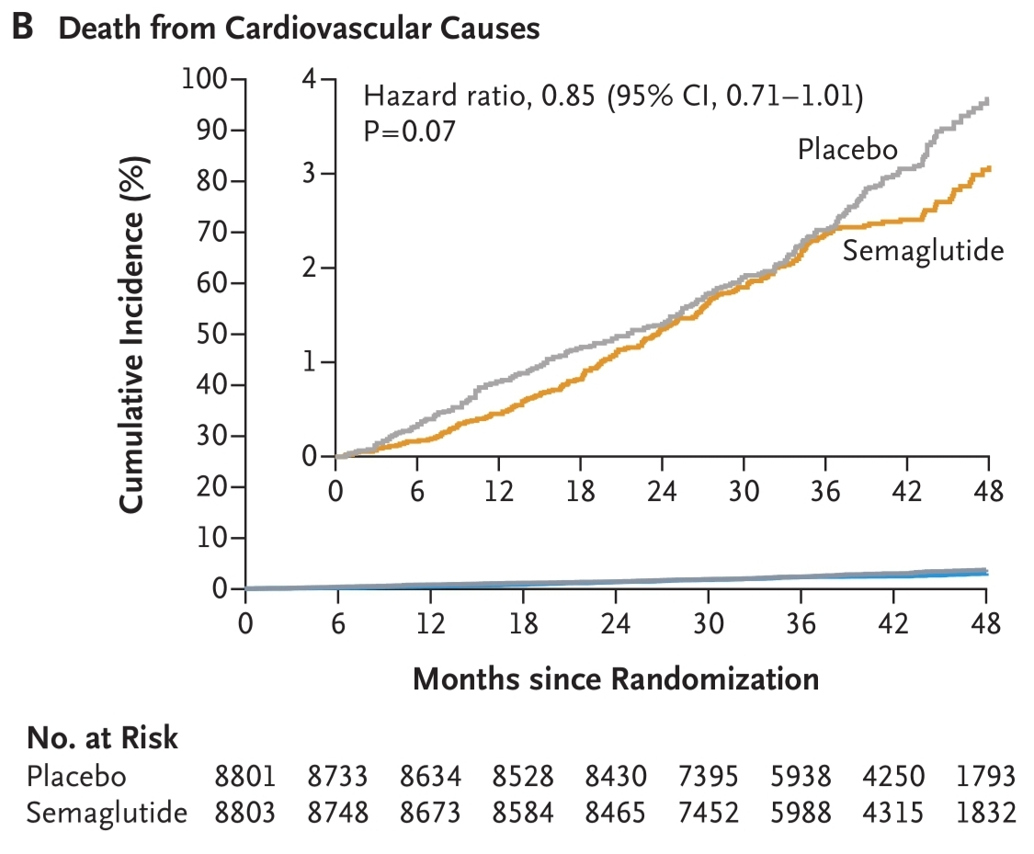

Slide 16
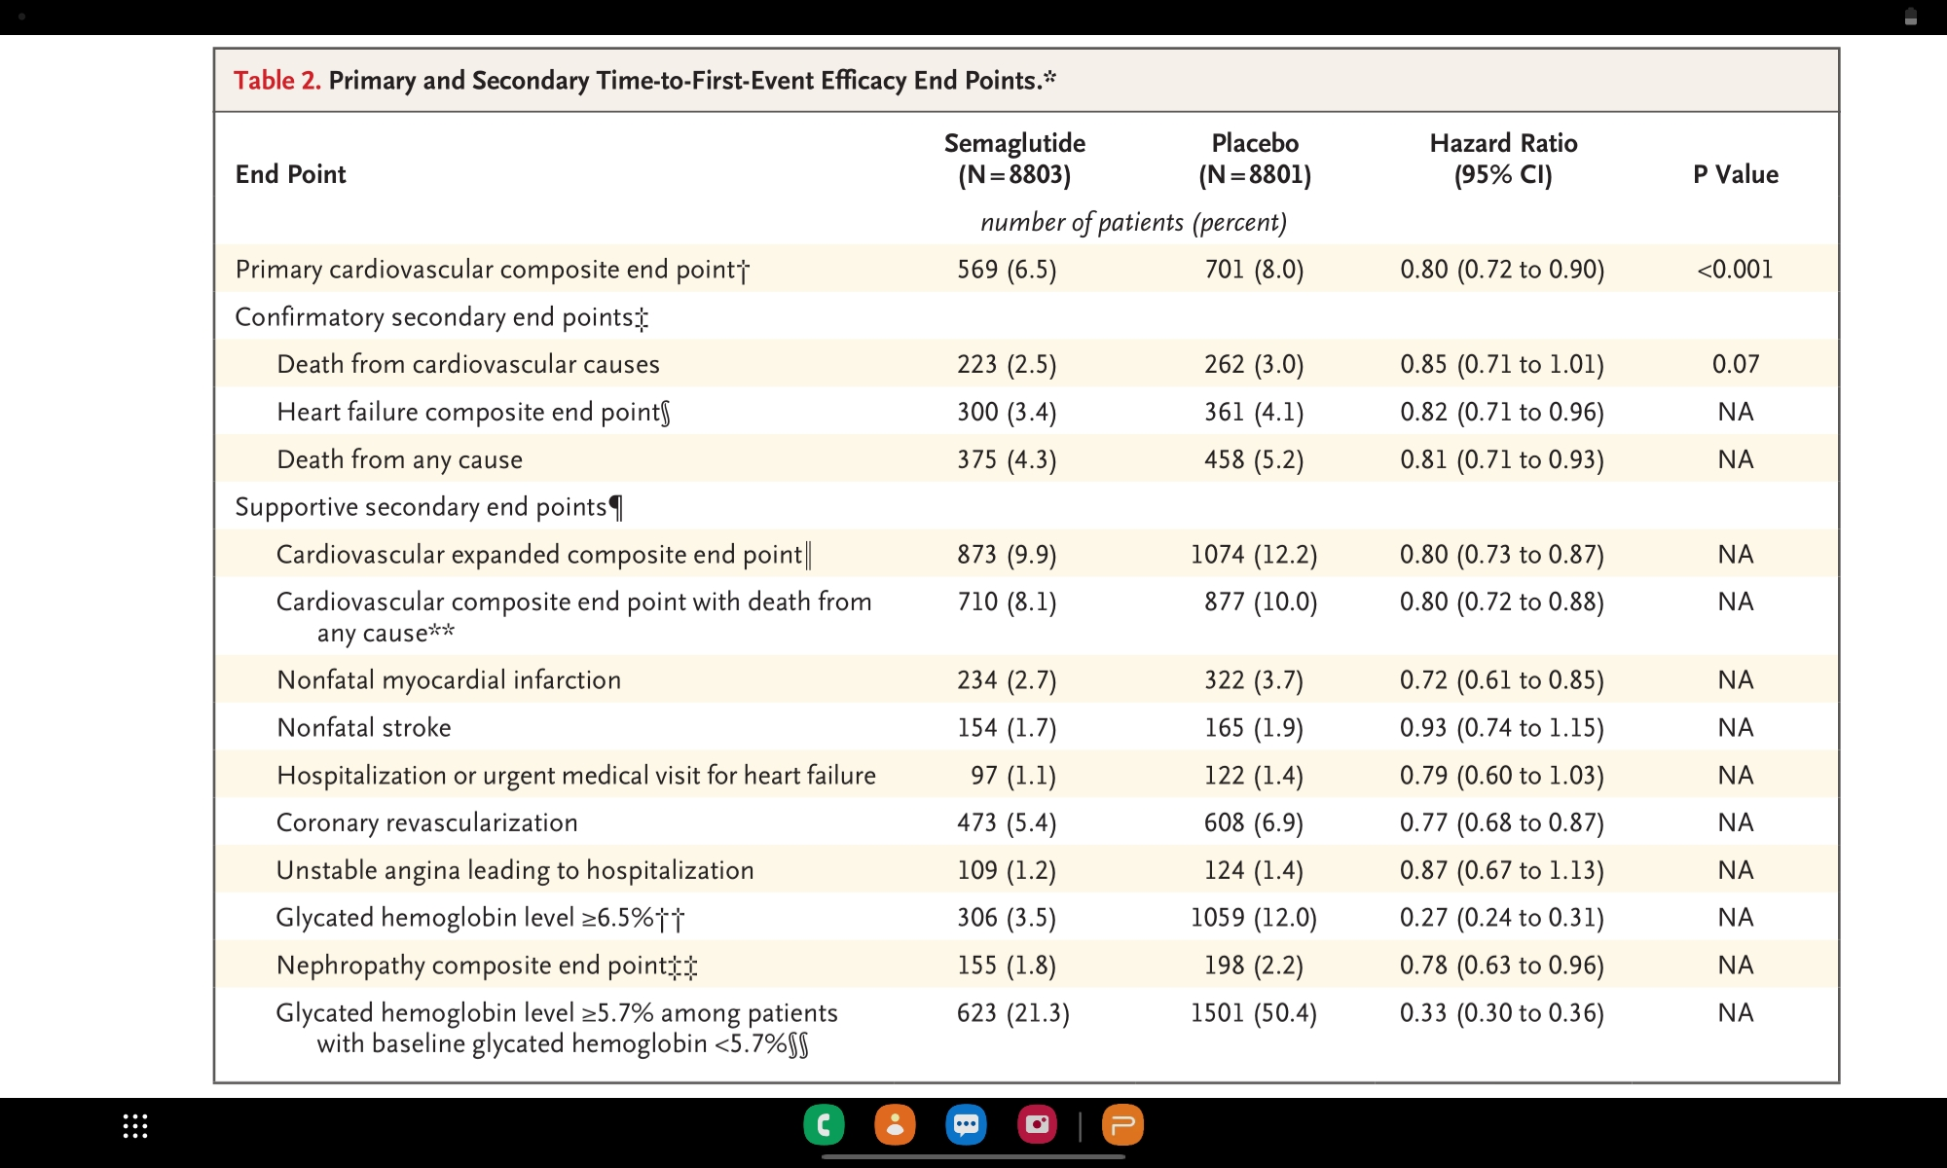

Slide 17
Adverse events occured
33.4 % in Semaglutide group vs 36.4 % in placebo group
16.6 % and 8.2 % in Semaglutide and placebo group discontinued
Major adverse events - GI disorders, gall bladder related ds

Slide 18
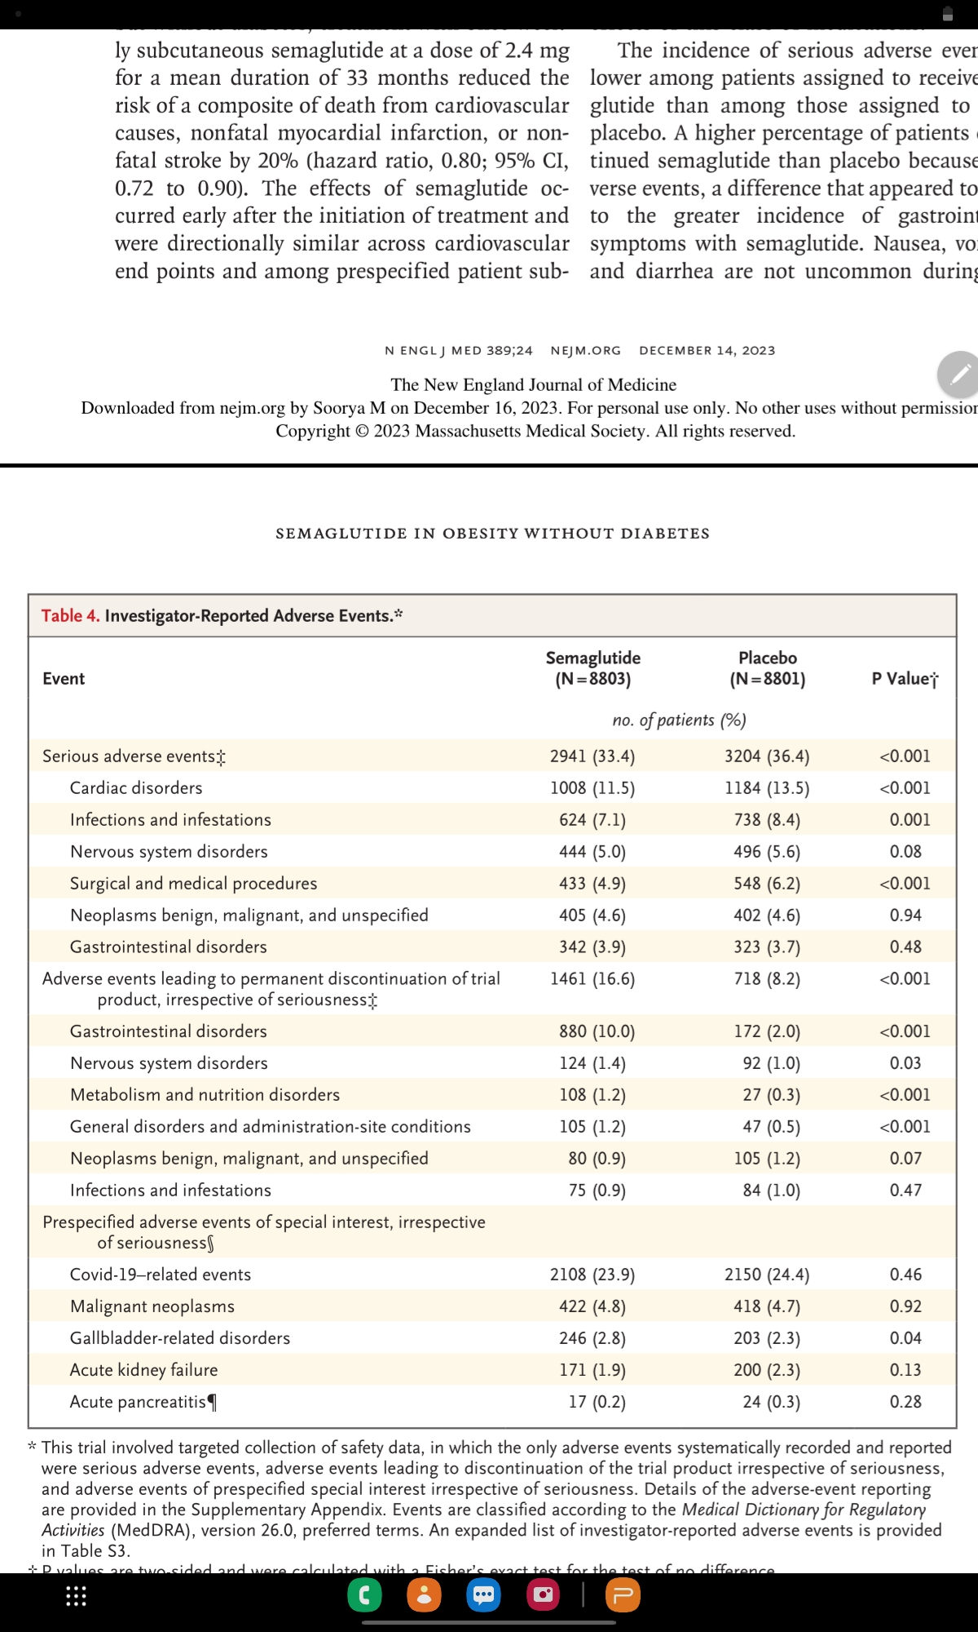

Slide 19
Discussion
Semaglutide diminish excess cardiovascular risk associated with obesity
Semaglutide decreased body weight and waist circumference
Weight loss, glycemic control --> decrease atherosclerosis --> decreases cardiovascular events
Also observed - decrease in SBP, decrease in lipids, decrease in CRP

Slide 20
Limitations
Trial included only pts with pre existing cardiac conditions
Effect of semaglutide on primary prevention of cardiac condition - not known
lack of global representation- only 27.7% were women
2/3 rd pts had dysglycemia ( glycated hb - 5.7 to 6.4% )

Slide 21
Conclusion
Patients with pre existing cardiovascular disease and overweight or obesity without diabetes , weekly sc semaglutide at a dose of 2.4 mg was superior to placebo in reducing the incidence of composite of death from cardiovascular causes, non fatal MI, non fatal stroke at a mean follow up of 39.8 months

Slide 22
Thank you

