Slide 1
CT for discussion
FROM FIRST MEDICAL UNIT HOD & CHIEF : PROF.DR.M.NATARAJAN MD
ASST PROF : DR.V.PALANIKUMARAN MD D.DIAB
DR.D.VASANTHA KALYANI MD DCP
DR.M.SURESH KUMAR MD
PRESENTER : S.K.NAGARAJAN (FINAL YEAR PG)

Slide 2
Brief history
56yr / Female
C/o easy fatigability
C/o muscle cramps
C/o involuntary movements in the upper limb
For the past 3 months
Initially taken treatment in nearby hospital then lost follow up now presented with worsening of symptoms

Slide 3
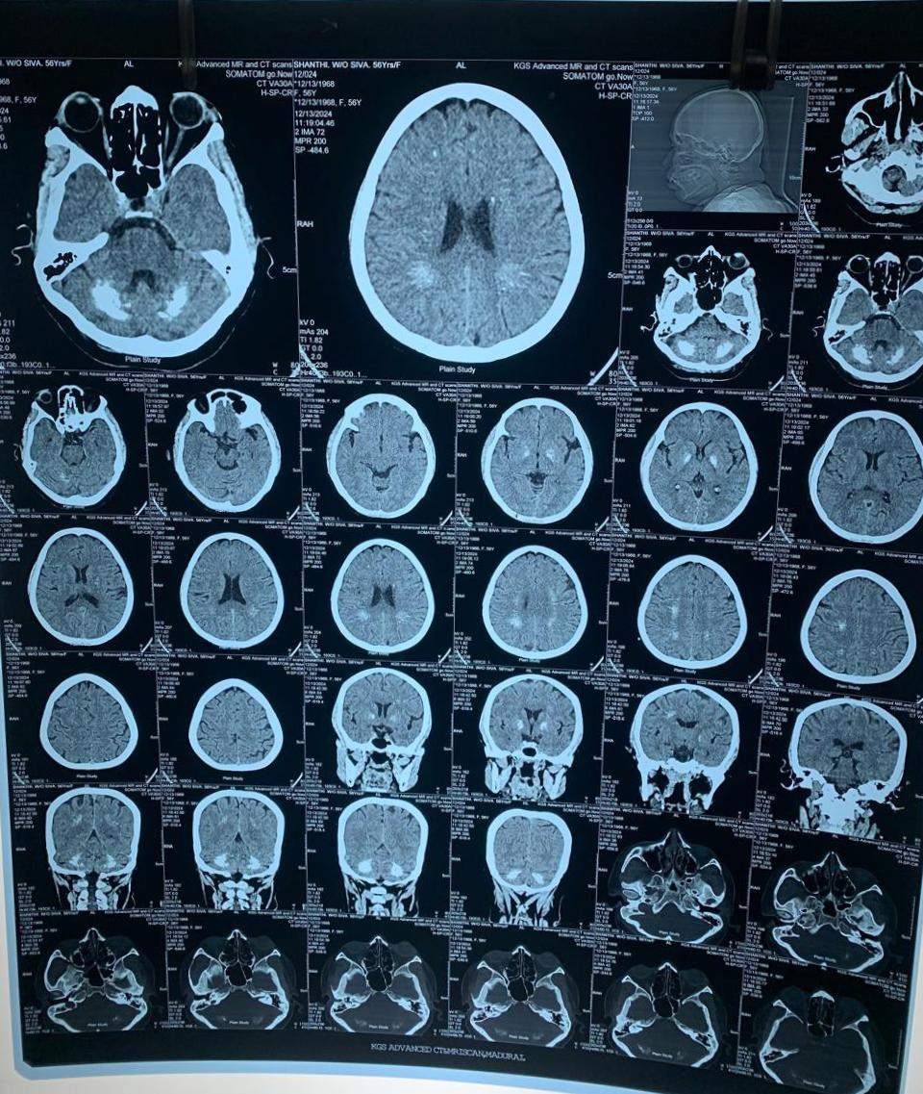

Slide 4
Let's discuss

