Slide 1
An interesting case of acute flaccid quadriparesis
SECOND MEDICAL UNIT
CHIEF : DR. BAGIALAKSHMI MD
ASSISTANT PROFESSORS :
DR. VALLIDEVI MD DR. PON SENTHIL KUMAR MD DR. ILAMARAN MD PRESENTOR : DR. G.SREE THEJA [POST GRADUATE]

Slide 2
CHIEF COMPLAINTS
37 Years old male presented with
c/o inability to move both legs followed by
Inability to move both arms for the past 3 days which was gradually progressive
H/O easy fatiguability for 3 days
H/o Vomiting 1-2 episodes 3 days back
h/o inability to hold neck for 3 days
h/o increased urinary frequency
h/o increased thirst

Slide 3
No H/O neck pain/ shoulder pain
No h/o trauma/ fall
No h/o fever
No h/o loose stools
No h/o headache
No h/o visual disturbances
No h/o seizures
No h/o chest pain, palpitations
No h/o breathlessness
No h/o bleeding
No h/o jaundice
h/o abdominal pain+

Slide 4
PAST HISTORY
Not a known case of T2DM,SHTN,CAD,CKD,TB,BA,CLD

Slide 5
PERSONAL HISTORY
Consume mixed diet
Normal bowel and bladder habits
Chronic alcoholic for 10 years
180ml brandy per day
last alcohol intake 3 days back
Smoker for 10 years 2 beedis per day

Slide 6
GENERAL EXAMINATION
Conscious
Oriented
Afebrile
No pallor
Icterus present
No cyanosis
No clubbing
No pedal edema,
No generalized lympadenopathy

Slide 7
VITALS
BP 96/60 mmHg
PR 65 bpm
RR 18/min
SPO2 99% in RA

Slide 8
SYSTEMIC EXAMINATION
CVS - S1S2 heard
no murmur
RS - BAE +
NVBS
PA - Soft
Bowel sounds present
Right hypochondrial tenderness present
liver palpable 2cm below right costal margin
CNS- conscious oriented

Slide 9
CNS
TONE
POWER
DTR
PLANTAR B/L mute
NECK MUSCLE WEAKNESS PRESENT
NO SENSORY /CEREBELLAR SIGNS
CRANIAL NERVE EXAMINATION - NORMAL
UL | decreased | decreased
LL | decreased | decreased
UL | 3/5 | 3/5
LL | 2/5 | 2/5
UL | - | -
LL | - | -

Slide 10
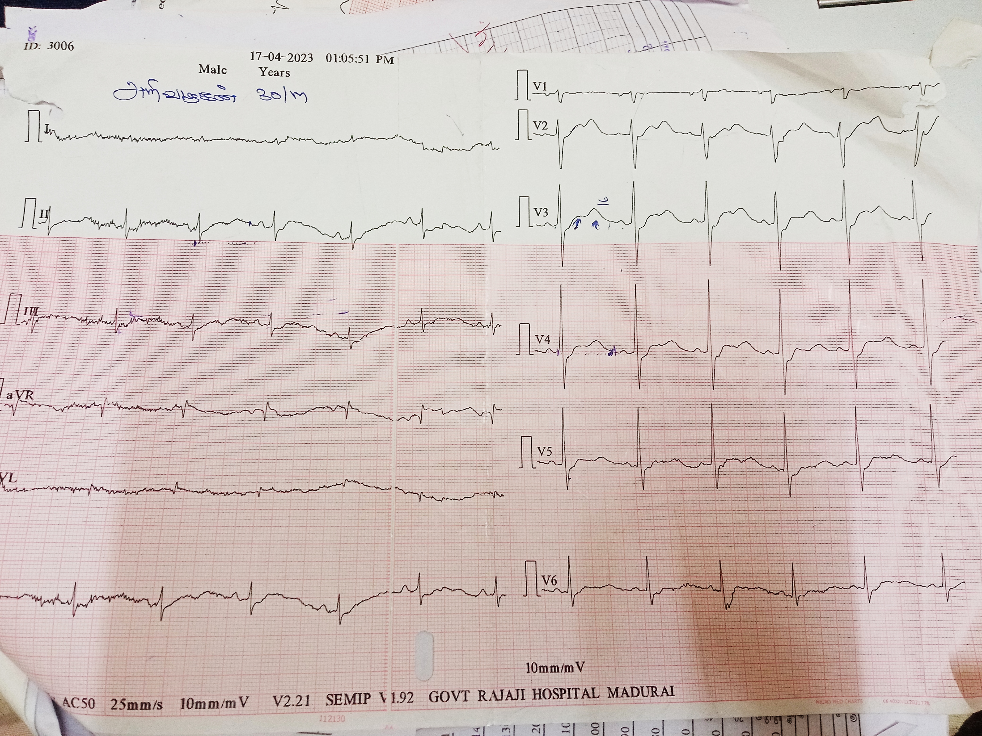

Slide 11
Any guess?

Slide 12
INVESTIGATONS
DATE
TC | 13500 | 7100
HB | 11 | 10.7
DC | 83/10/7 | 62/22/12
PCV | 28 | 29
PLT | 3.77 | 4.61
ESR | 23

Slide 13
RBS | 148 | 242
UREA | 12 | 10 | 16 | 15 | 14
CREATININE | 1.1 | 0.9 | 1 | 0.9 | 1
CPK MB | 1236.9 | 5129 | 4425 | 1096
T.PR0TEIN | 5 | 7.3
SR ALBUMIN | 2.7 | 3.4
SR GLOBULIN | 2.3 | 3.8

Slide 14
SR NA+ | 126 | 124 | 130 | 135 | 137
SR K+ | 1.4 | 2.4 | 2.6 | 3.8 | 3.9
SR CA2+ | 8.4
SR Mg | 1.2
SR PO4 | 1.3 | 3.2
URINE ELECTROLYTE
UR NA | 52.1 | 41 | 67.3 | 30.6 | 34
UR K | 16 | 9.8 | 15 | 15.7 | 17.1

Slide 15
TOTAL BILIRUBI N | 3 | 1.7 | 0.9 | 1.1 | 0.8
DIRECT BILIRUBIN | 1.3 | 0.8 | 0.6 | 0.4 | 0.5
INDIRECT BILIRUBIN | 1.7 | 0.9 | 0.3 | 0.7 | 0.3
SGOT | 388 | 567 | 499 | 267 | 129
SGPT | 98 | 154 | 207 | 174 | 136
ALP | 134 | 95 | 121 | 123 | 133

Slide 16
SR URIC ACID | 1.6 | 1.8
UR CREATININE | 4 | 10
24HR UR NA+ | 60.4
24 HR UR K+ | 12.8
24 HR UR CREATININE | 5
24 HR UR PROTEIN | 420

Slide 17
ABG
PH | 7.44 | 7.49 | 7.46 | 7.44 | 7.44
PCO2 | 34 | 29 | 31 | 26 | 31
HCO3 | 23.1 | 22 | 19.1 | 17.7 | 21
IMPRESSION | RESPIRATORY ALKALOSIS | RESPIRATORY ALKALOSIS | RESPIRATORY ALKALOSIS | RESPIRATORY ALKALOSIS | RESPIRATORY ALKALOSIS

Slide 18
TSH 1.95
FUNDUS Both eye normal
Usg abomen and pelvis : fatty liver
Ct chest normal
Echo normal

Slide 19
Diagnosis?

