Slide 1
Acute Transverse Myelitis
VI MEDICAL UNIT
PROF.DR.C.DHARMARAJ MD DCH
Dr.M.RAJKUMAR MD
DR.P.SHRIDHARAN MD
DR.A.Tamilvanan md da
Dr.A.PrabhU MD

Slide 2
Complaints
A 50 yr old female admitted with
c/o difficulty in using both lower limbs x 1 week
History:
H/o weakness in both lower limbs, progressive weakness initially in form of difficulty in wearing chappals 1week ago,
H/o difficulty in climbing stairs , difficulty in standing from sitting posture
H/o Inability to get up from bed 5 days ago
H/o feeling of heaviness in left lower limb
H/o inability to roll over bed from side to side
H/o inability to feel cloth sensation over body below upper abdomen
H/o urinary incontinence – spontaneous micturition, unable to feel bladder sensation - now catheterized
H/o abdomen pain, distension , constipation

Slide 3
History
No h/o blurring of vision, headache, vomiting
No h/o difficulty in speech
No h/o LoC, seizures, altered sensorium, sleep disturbances
No h/o difficulty in using upper limbs for combing, mixing food
No h/o difficulty in raising hand over head
No h/o difficulty in lifting head from bed
No h/o alteration of smell,double vision, hard of hearing, giddiness, tinnitus, deviation of angle of mouth
No h/o nasal regurgitation of food,dysphagia, hoarseness of voice
No h/o shock like sensation on flexing neck

Slide 4
History
No h/o neck pain, back pain, radiating pain
No h/o trauma
No h/o involuntary movements, tremors
No H/o fever, chills, rigor, skin rashes
No h/o cough with expectoration
No h/o difficulty in breathing
No h/o chest pain, palpitations
no h/o any bleeding manifestations
No h/o animal bite, recent vaccination

Slide 5
History
Past history:
H/o blurring of vision in past 10 months back for which she was diagnosed to have optic neuritis treated with iv methylprednisolone x 5 days discharged with oral prednisolone – tapered and stopped in 4 weeks
H/o Cataract surgery done in right eye 10months back
No h/o similar illness in the past
Not a k/c/o DM,HT,CAD,PTB,Epilepsy,thyroid or renal disorders/TIA
Menstrual history : regular 2/30 cycles, amenorrhea – 2 months
Married,two children, no H/o abortions

Slide 6
Examination
o/e pt is comfortable at rest
Pallor+
No icterus/cyanosis/clubbing/lymphadenopathy/goitre
BP – 110/80 right ul supine posture
PR – 96/min regular rhythm, normal volume, felt in all peripheral pulses, no radio radial or radio femoral delay
RR – 14/min thoracoabdominal
SpO2 – 97% with room air
Left lower limb pitting pedal edema+ warmth + tenderness + distal pulses+
No ulcers

Slide 7
Examination - CNS
HMF – conscious , oriented
speech – Normal
attention , memory – intact
abstract thought – normal
Cranial nerves :
1st nerve Smell – Not impaired
2nd nerve – vision re 6/9 le 6/18
Le RAPD + Fundus LE – Pale disc , RE – Minimal pallor
3,4,6 nerve - Accomodation reflex normal
Extraocular movements – not impaired
5th nerve – no loss of sensation over face, no weakness
7th nerve – intact
8th nerve – Rinnes , weber normal
9, 10 nerve – uvula midline, gag reflex +
11th nerve – shoulder shrug, turn head no weakness
12th nerve – no wasting, no deviation

Slide 8
Examination - CNS
Motor system
Power – U/L 5/5 right 5/5 left – proximal and distal
L/L 1/5 right 1/5 left – proximal and distal
Bulk – Equal
Tone – U/L Normal
L/L Increased
Sensory – touch, vibration, joint perception,temperature, pain impaired upto T6 level (midthoracic)
Reflexes UL normal
LL brisk, ankle clonus+
Plantar B/L extensor
Superficial reflexes corneal , conjunctival present
Abdomen reflex absent

Slide 9
Examination
CNS (contd)- Cerebellum – no dysdiadokinesia, finger nose test normal
LL – could not be tested
Gait – not elicitable
Spine and cranium – No kyphosis/scoliosis, no tenderness/swelling
CVS – AI left 5th ICS 2.5cm medial to MCL
S1S2 heard no murmur
RS – B/L Air entry equal, Normal breath sounds, no added sounds
P/A- soft , no tenderness, no guarding/rigidity, no palpable organomegaly

Slide 10
Provisional Diagnosis
A Case of
Acute onset Spastic Paraplegia – Non Compressive myelopathy

Slide 11
Investigations
RFT Urea – 32
Creatinine – 0.8
RBS – 104mg/dl
LFT T 0.7
D 0.3
OT – 29
PT -- 39
URINE ROUTINE - NORMAL
CBC
Hb – 6.3g/dl
TC – 11,600 cell/mm3
DC – N60% L36% M4%
PLT- 3.2 lakhs/mm3
ESR – 47 mm/hr
HCT – 22.7%
Peripheral smear – microcytic hypochromic anemia with mild leukocytosis
ECG – NSR , N axis , No ST, T wave changes
PT – 13.1 secs
INR – 0.8

Slide 12
Investigations
USG Abdomen and pelvis – Fatty liver
CXR – Normal study
ECHO – normal study
HIV screening – non Reactive
CSF – protein 32mg/dl
Sugar 62mg/dl
Globulin neg
Cell count no cells
Thyroid screening – TSH 8.65 u/ml
ANA – negative
Doppler B/l lower limb- e/o DVT in Left common,superficial,deep femoral and left popliteal vein

Slide 13
OPINIONS
NEUROLOGY:
Acute transverse myelitis
Sugg- MRI dorsal spine with whole spine & brain screening
Ophthal opinion
Inj. Methylprednisolone 1g in 500ml NS x 5 days
Ophthalmology:
Vision Re 6/9(ph – 6/6) Le 6/18
Le RAPD +
RE ACIOL +
FIELDS – BE – normal , Colour vision – LE - defective

Slide 14
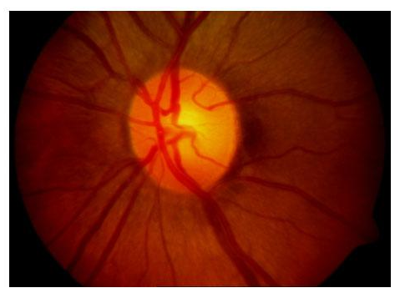
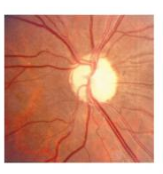
OPINIONS
Normal optic disc Optic atrophy
Source - Medscape
Ophthalmology:
FUNDUS –
Disc
LE pale – s/o atrophic disc
RE – minimal disc pallor
BE – Postneuritic optic atrophy
Sugg –
T BCT 1od
Inj. B Complex 2cc im on alternate days

Slide 15
OPINIONS
ENDOCRINOLOGY
Thyroid screening
S.TSH – 8.65 U/mL
Imp- Subclinical hypothyroidism
Suggested – T.L-Thyroxine 100mcg ½ od

Slide 16
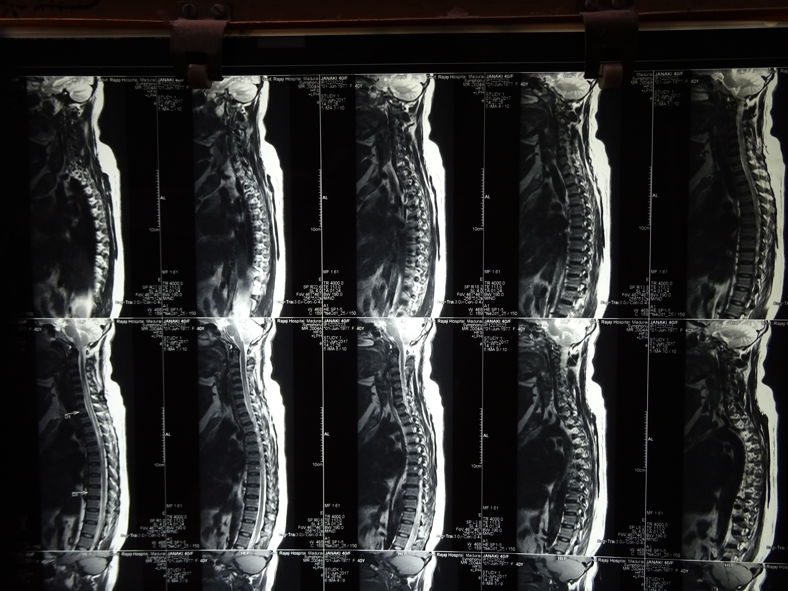
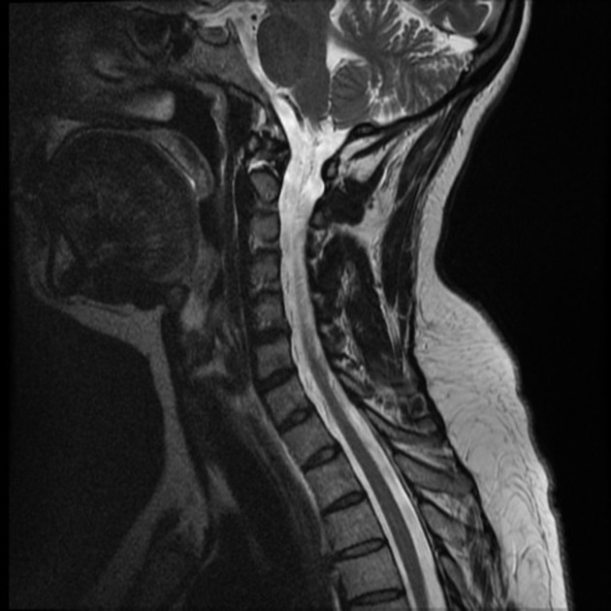
Normal mri spine t2 image
Source - radiopaedia
MRI Dorsal spine –
e/o T1 iso and T2 hyperintensity noted from c5-d8 level of spinal cord involving more than 2/3rds of cross sectional of spinal cord – variable enlargement of the spinal cord noted at that level
Feature s/o ACUTE TRANSVERSE MYELITIS

Slide 17
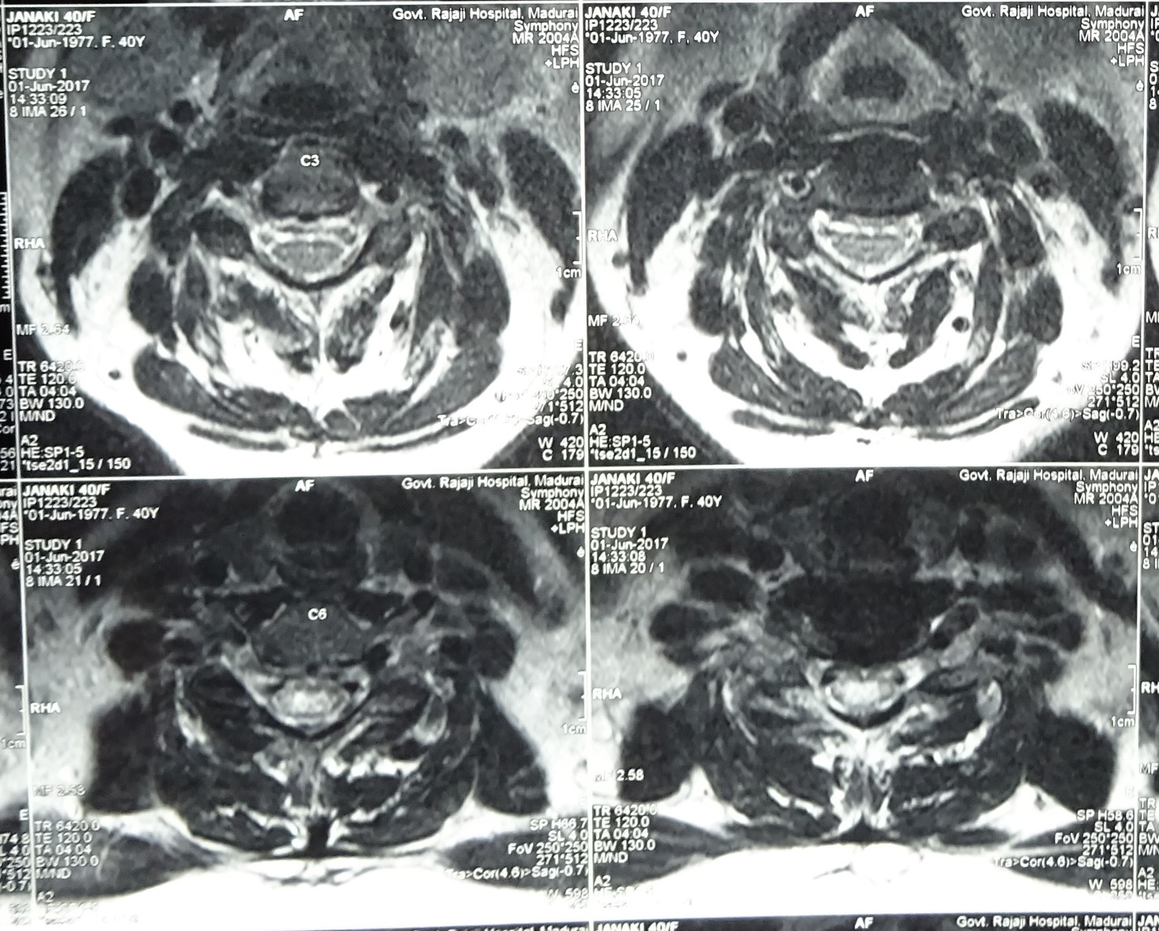
MRI Dorsal spine –
e/o T1 iso and T2 hyperintensity noted from c5-d8 level of spinal cord involving more than 2/3rds of cross sectional of spinal cord – variable enlargement of the spinal cord noted at that level
Feature s/o ACUTE TRANSVERSE MYELITIS

Slide 18
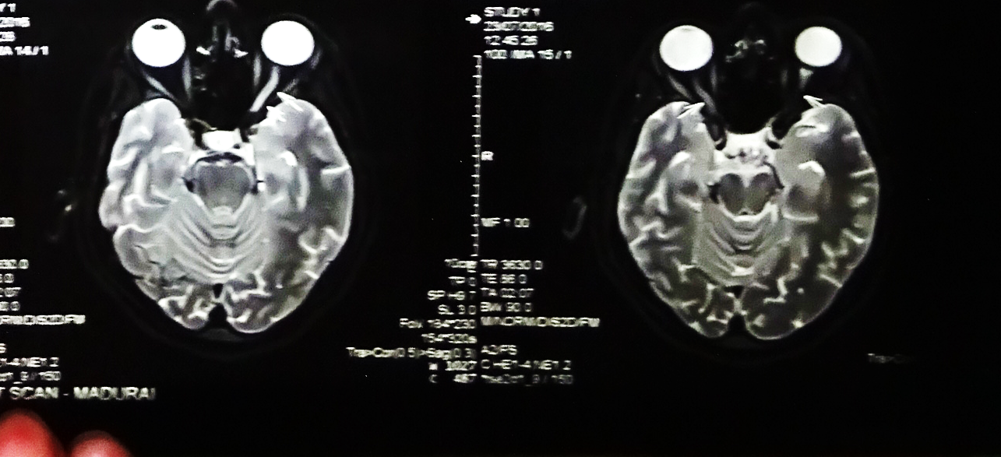
Previous MRI Brain: 7/2016
Thinning of both optic nerves with intraneural bright signals(left>right)
Thickening, edema and bright signals involving both optic tract and LGB (R>L)
Possibility of demyelination with active lesion in optic tract and LGB and atrophy of both optic nerve sheath due to retrobulbar neuritis (L>R)

Slide 19
OPINIONS
NEUROLOGY
Case reviewed
s/o Longitudinally extensive transverse myelitis ? Devic NMO
Suggested –Serum NMO antibody

Slide 20
Summary
Transverse myelitis
Optic neuritis
More than 3 longitudinal spinal segments involved
Brain screening normal
AntiAquaporin 4 Ab’s – Strong positive (1:10)

Slide 21
Diagnosis
A case of Devic’s Neuromyelitis Optica / Subclinical Hypothyroidism/Left LL DVT/Anemia

Slide 22
Treatment
Inj. Methylprednisolone 1g in 500ml NS iv od x 5days
Inj.Ranitidine 50mg iv bd
Inj. Heparin 5000U iv qid
T. Acitrome 2mg 1hs
1 unit Packed cell transfusion
T.FST 1bd
T.Prednisolone 5mg 12 – od from D6
T.Azathioprine 50mg 1 od from 3rd week
Pt is on followup

Slide 23
AIM of Presentation
Rarity of case
To evaluate the possible causes for acute transverse myelitis

Slide 25
