Slide 1
A CASE OF TROPICAL PYOMYOSITIS
CHIEF – PROF. DR.M. NATARAJAN M.D
ASST PROF
DR.P. S ARUL RAJAMURUGAN M.D., DM.,
DR.B PALANIKUMAR M.D
PRESENTED BY DR.SUMATHI (1st YR PG)

Slide 2
CASE HISTORY
55 Year old male
Pain and inability to move left upper limb - past 3 days
Swelling of left arm , chest wall , axilla extends upto left lumbar region – 3 days

Slide 3
No h/o trauma
No h/o restriction of spine movements / back pain
No h/o fever
No h/o cough with expectoration
No h/o breathlessness
No h/o seizures
No h/o intramuscular injections
No h/o decreased urine output
No h/o joint pain
No h/o vigorous exercise

Slide 4
PAST HISTORY
Not a k/c/o diabetes / hypertension / tuberculosis/ seizures/ STD’s / chronic kidney disease
No h/o steroid abuse
Not on any immunosuppressive drugs
No h/o any infections in the recent past
No h/o similar episodes in the past

Slide 5
PERSONAL HISTORY
Consumes mixed diet
Not a pork eater
Not an alcoholic / smoker
No h/o iv drug abuse
No h/o extra marital contact
Bowel and bladder habits normal

Slide 6
GENERAL EXAMINATION
Conscious
Alert
Afebrile
tachypnoeic
No pallor/ icterus/ cyanosis/ clubbing/ pedal edema
No generalised lymphadenopathy

Slide 7
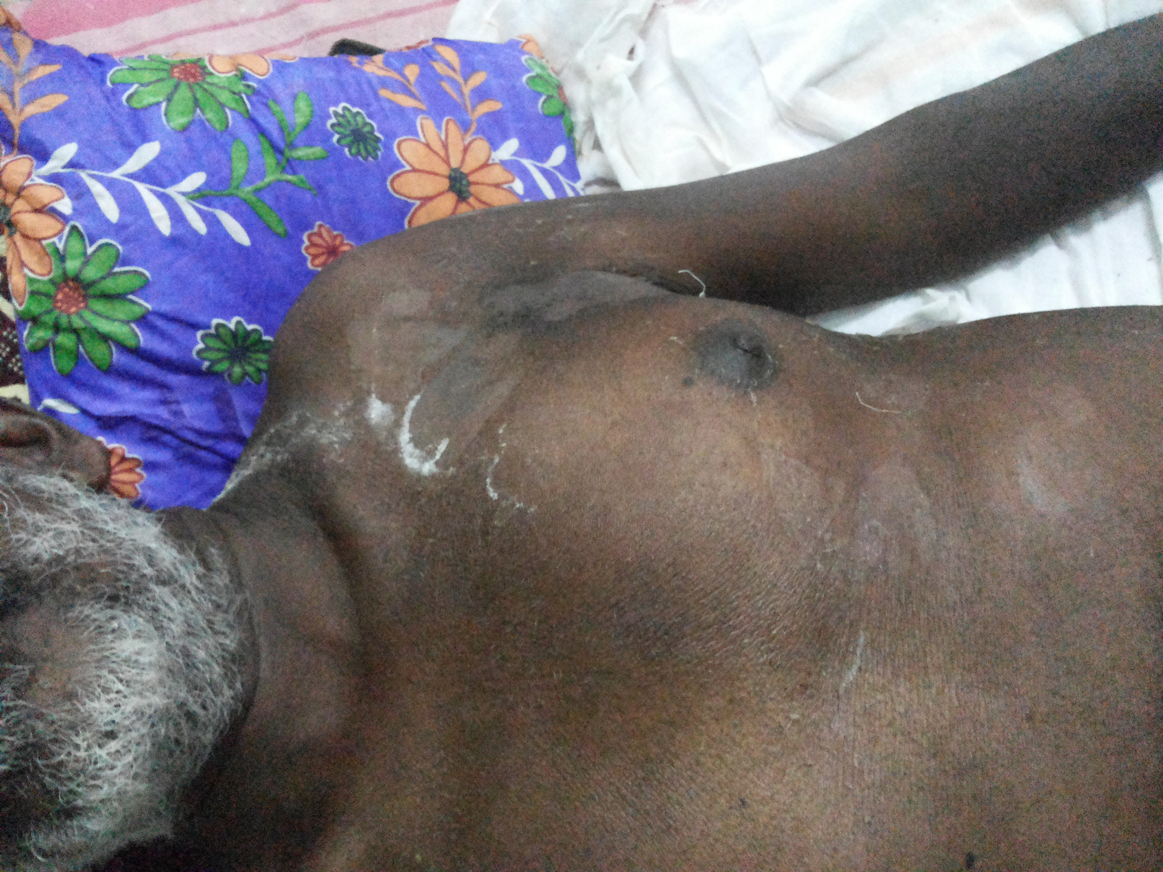
Local examination
Erythematous firm tender swelling of left arm, anterior chest wall, axillary and infra scapular region

Slide 8
VITALS
PULSE – 70 per minute, regular, normal in volume and rhythm, all peripheral pulses felt, no radioradial / radiofemoral delay
RESPIRATORY RATE – 30 per minute
BLOOD PRESSURE – 110/80 mm Hg in right upper limb in supine position
Spo2 – 98% in room air

Slide 9
SYSTEM EXAMINATION
CARDIOVASCULAR SYSTEM
JVP not elevated
Apical impulse could not be localised
Mitral, tricuspid, pulmonary , aortic area – s1s2 +
no murmur

Slide 10
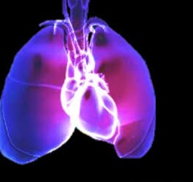
Respiratory system
normal vesicular breath sounds present
Air entry diminished in left hemithorax
No added sounds

Slide 11
ABDOMEN
soft
umbilicus in midline
no distension
no organomegaly

Slide 12
CENTRAL NERVOUS SYSTEM
No focal neurological deficit

Slide 13
MUSCULOSKELETAL SYSTEM
Tenderness and swelling of pectoralis major , deltoid and lattismus dorsi on left side
Painful restriction of left shoulder movements

Slide 14
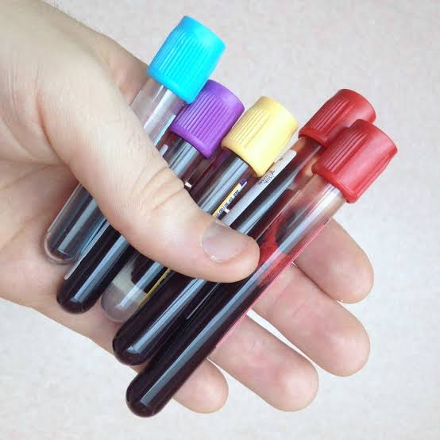
INVESTIGATIONS
COMPLETE HEMOGRAM
Hb – 15.6 gm/dl
TC – 12000 cells/cu.mm
DC- neutrophils- 85%
lymphocytes 11%
monocytes 5%
Platelets – 1.07 lakhs/cu.mm
PCV – 45%
ESR – 65 mm/hr

Slide 15
Biochemistry
RBS | 87 mg/dl
S.Urea | 27 mg/dl
S. Creatinine | 0.6 mg/dl
Serum electrolytes | Meq/l
sodium | 137
potassium | 3.8
chloride | 111

Slide 16
Biochemistry
Total bilirubin | 0.9mg/dl
Direct bilirubin | 0.5mg/dl
Indirect bilirubin | 0.4mg/dl
SGOT | 47 U/L
SGPT | 23 U/L
ALP | 165 U/L
Total proteins | 6.6g/dl
Albumin | 3.6 g/dl
globulin | 3 g/dl

Slide 17
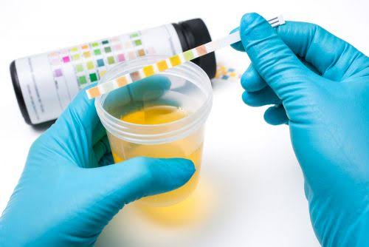
Urine - investigations
Urine albumin nil
sugar nil
deposits 2-4 pus cells

Slide 18
ULTRASOUND & Doppler study of left upper limb
Cephalic, basilic and deep veins appear normal
No evidence of any echogenic thrombus
Left pectoralis major and minor muscles show altered echogenicity with few cystic areas and internal echoes
Features suggestive of myositis
Usg abdomen – normal study

Slide 19
CT CHEST
CT CHEST – PLAIN - left side minimal pleural effusion with soft tissue edema
CT CHEST - CONTRAST - inflammatory muscular enlargement with associated edema noted on anterior and lateral chest wall of left side, associated with fat stranding and fascial thickening. No evidence of abscess formation

Slide 21
SERUM CREATINE KINASE – 109 U/L
HIV – Non reactive
BLOOD CULTURE – no growth

Slide 22
PLEURAL FLUID ANALYSIS
Pleural fluid – straw coloured
pleural fluid protein – 2900 mg%
Pleural fluid sugar – 54 mg%
Cell count – polymorphs – 80 cells/10 HPF
Lymphocytes – 20 cells/10 HPF
RBC ‘S (+)
Pleural fluid culture – klebsiella species grown

Slide 23
PUS CULTURE
Staphylococcus aureus grown – Sensitive to Erythro, Gentamycin, Doxy, Cefotaxim, Ofloxacin, Cefoperazone Sulbactam
Klebsiella – sensitive to Amikacin, Gentamycin, Doxy, Ofloxacin, Cefotaxim, Cefoperazone Sulbactam

Slide 24
Course of illness
Subacute onset of painful firm swelling
Second week of illness – fever ,warm tender fluctuant swelling of anterior chest wall on the left side
Surgical drainage of pus
Iv antibiotics
Patient afebrile

Slide 25
Diagnosis
TROPICAL PYOMYOSITIS

Slide 26
Treatment
Surgical drainage
Parenteral high dose appropriate antibiotics - all signs of systemic toxicity has resolved and the wound is clean

Slide 27
Aim of presentation
To highlight a case of tropical pyomyositis wherein early diagnosis is often missed because of lack of specific signs , unfamiliarity with the disease, atypical manifestations and a wide range of differential diagnosis

Slide 28
THANK YOU ☺☺☺

