Slide 1
ROLE OF PLASMAPHERESIS AND CORTICOSTEROIDS IN THE MANAGEMENT OF SEVERE UNRESPONSIVE SNAKE BITE
CHIEF:PROF.DR.K.SENTHIL MD
ASSOCIATE PROF:DR.MURALIDHARAN MD
ASST PROF:DR.MANIKANDAN MD
DR.SARAVANA MADHAV MD
DR.ILAMARAN MD DM

Slide 2
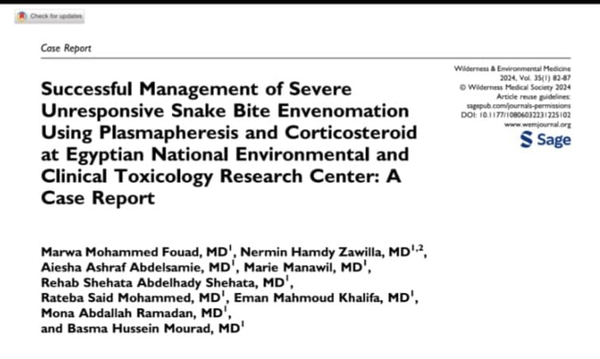

Slide 3
CASE SCENARIO (2019):1
A 70 Yrs old female had alleged h/o russel’s viper bite on the left index finger
WBCT more than 20 mins
On day 3, the renal parameter has increased(Urea 160;Creat 6.9) , prothrombin time increased ,LDH also increased
On day 5,peripheral smear showed schistocytes and occasional microspherocytes

Slide 4
DISCUSSION OF THE CASE
As the WBCT is prolonged , 20 vials ASV has been given
Her renal parameters was increasing trend so two cycles of hemodialysis has been done
As peripheral smear shows schistocytes and microspherocytes ,the diagnosis of THROMBOTIC MICROANGIOPATHY has been made
The diagnosis of TMA has been substantiated by the findings of Microangiopathic Hemolytic anemia(MAHA) in peripheral smear ,hemolysis with elevated LDH ,Thrombocytopenia and AKI

Slide 5
From the above bindings Venom induced consumption coagulopathy has been made which leads to TMA
This is mainly due to the Russel viper’s procoagulant toxins(serine proteases)
For this the patient have been treated with 3 cycles of plasmapheresis
Following this the patient’s renal parameters was improving but not returning to the normal values

Slide 6
CASE SCENARIO (2024) : 2
A56 yrs male patient had alleged h/o viper bite ,after that his WBCT has prolonged
On next day coagulation profile has increased
HB dropped from 13.9 to 4.7 in a single day and RBC count from 6.7 million cells to 2.23 millions
Platelet count dropped from 2.32 lakhs to 50000
Renal parameter was normal range

Slide 7
Hemoglobinuria was present
The patient had increased LDH
The patient was icteric
There was no e/o schistocytes and spherocytes in peripheral smear

Slide 8
DISCUSSION
From the above findings the intravascular hemolysis and coagulopathy is due to the toxin phospholipase A2
The phospholipaseA2 cleaves the phospholipid layer of RBC and leads to hemolysis
Heme derived from haemolysis has potent thrombotic properties
This is the main reason for coagulation cascade activation
As the patient has normal renal parameters and absence of schistocytes and spherocytes in the peripheral smear the diagnosis of TMA can be excluded

Slide 9
The pt was started on plasmapheresis
Combined with that 1 gram of methyl prednisolone was given for three consecutive days
ON day 6 the pt HB and RBC count was increased
Coagulation status return to normal
Icterus reduced

Slide 11
conclusion
In case 1
VICC TMA MAHA AKI
Main pathology in this case is due to PROCAGULATION TOXIN(SERINE PROTEASE)
Main stay of treatment modality is PLASMAPHERESIS

Slide 12
CASE 2
The pathogenesis of this case is due to the toxin PHOSPHOLIPASE A2
Main modality of treatment is CORTICOSTEROIDS
Complemented with plasmapheresis

Slide 13
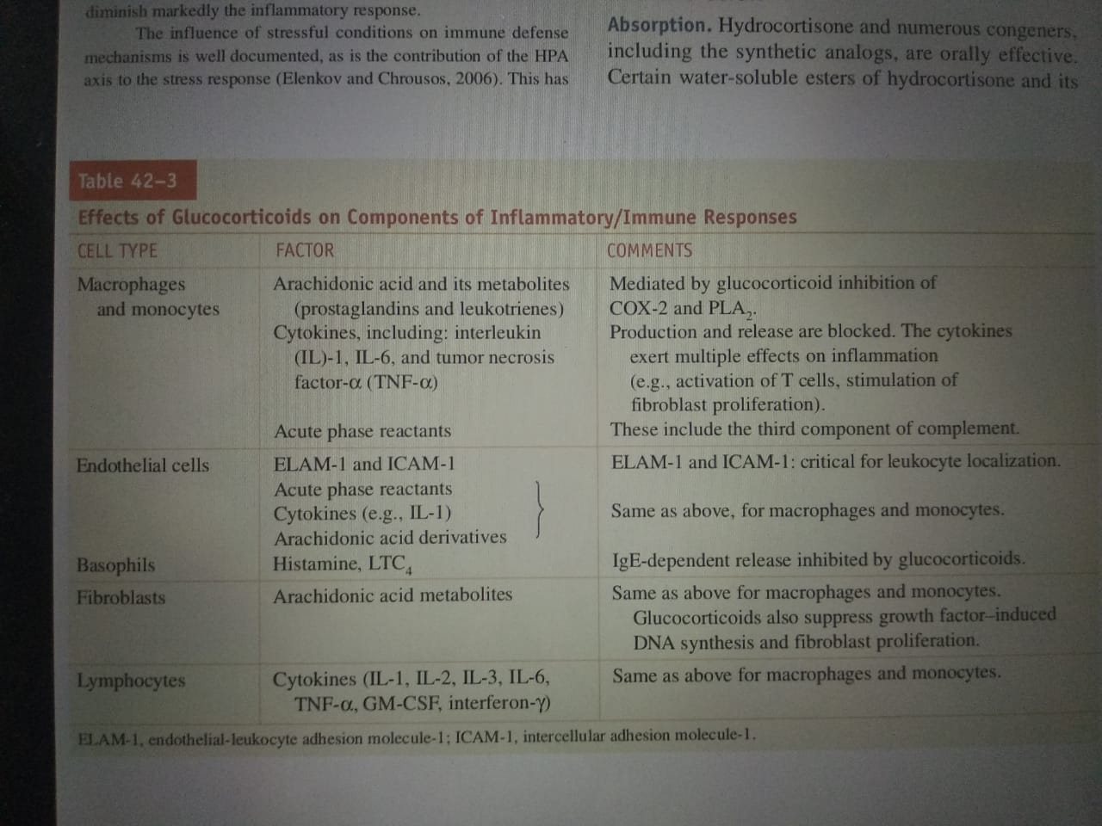

Slide 14
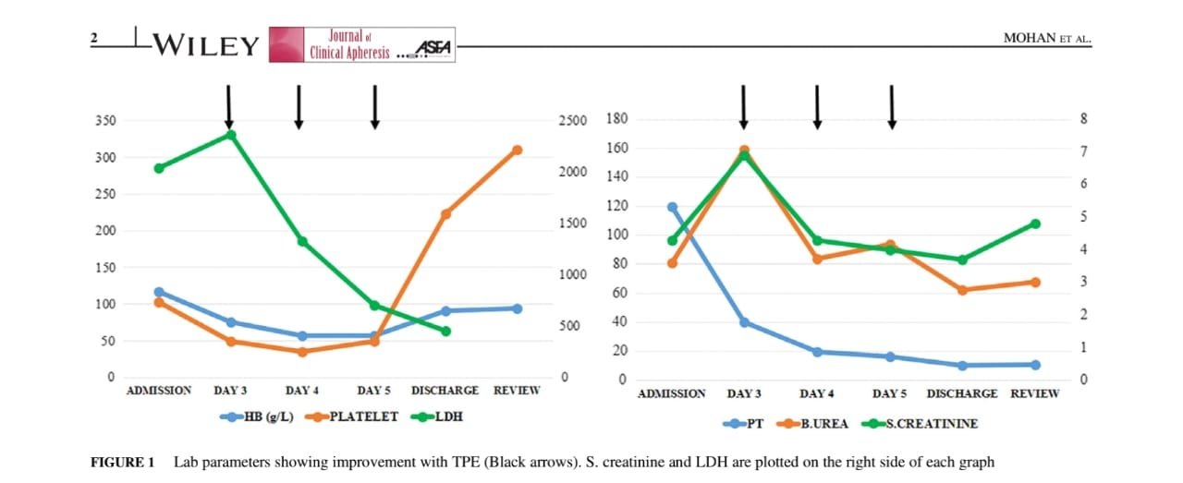
take home point
In case 1 the renal parameters of the patient after plasmapheresis does not return to the normal range
This is mainly due to late diagnosis of TMA which results in RENAL CORTICAL NECROSIS CKD

Slide 15
In case 2 as corticosteroids and plasmapheresis are started on the same day both helps in the good outcome of the patient..
CORTICOSTEROID = PLASMAPHERESIS

Slide 16
THANK YOU

