Slide 1
INTERESTING CT/MRI FOR DISCUSSION
III MU
Chief- Dr. M.Natarajan M.D
Asst - Dr. Syed bahavudeen hussaini M.D
Dr.Vallidevi M.D

Slide 2
47y/male presented with
h/o exertional dyspnoea-
-1 year
-insidious onset
-progressive
- acute worsening of symptoms +
h/o orthopnoea+
h/o chestpain +
No other significant present history

Slide 3
Past History: k/c/o MVP and MR grade II
Not a k/c/o T2DM/SHT/CAD/CKD
Personal History: not significant
Family history: not significant

Slide 4
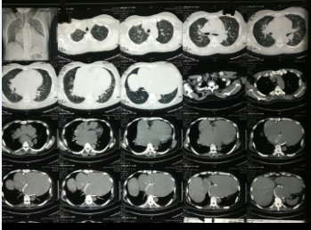
CT CHEST

Slide 5
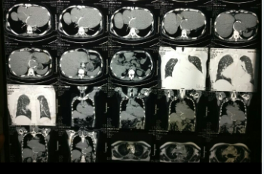

Slide 6
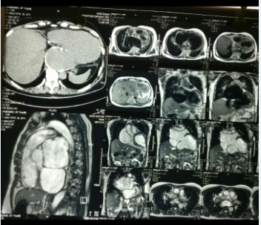
MRI CHEST

Slide 7
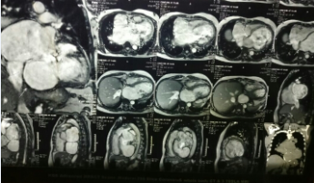

Slide 8
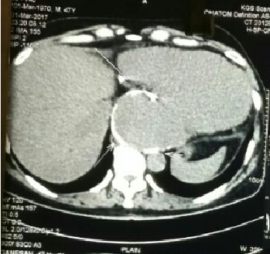

Slide 9
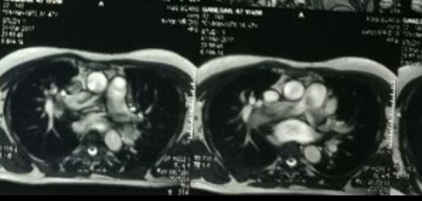

Slide 10
