Slide 1
CT /xray chest for discussion
By 3 Rd medical unit

Slide 2
70 yr old male presented with
C/o cough with expectoration for the past one month
Scanty ,mucoid in nature.not blood stained
C/o breathlessness ,insidious onset .gradually progressive
Of grade 2 NYHA progressed to grade 3
H/o back pain +
H/o fever low grade intermittent not associated with chills and rigors

Slide 3
Past history:
Known c/o diabetes mellitus for past 30 yrs on treatment
N/K/C/O HTN/TB/BA/CAD
Personal history:
Tobacco chewer
Non smoker
Alcoholic reformed

Slide 4
On examination
Comfortable at rest
Afebrile
No pallor/cyanosis/clubbing /icterus
No pedal edema
No generalised lymphadenopathy

Slide 5
CVS –S1 S2 +.No murmur
RS-BAE+.B/l scattered crepts+
P/A –Soft
CNS-NFND

Slide 6
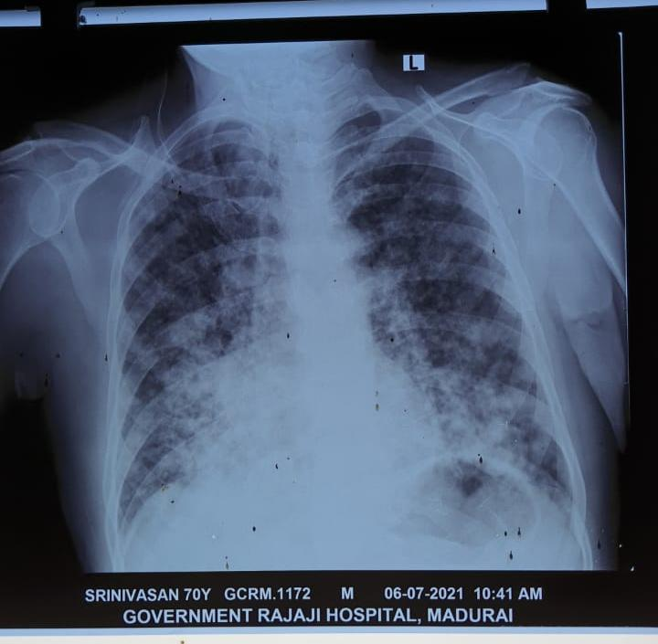

Slide 7
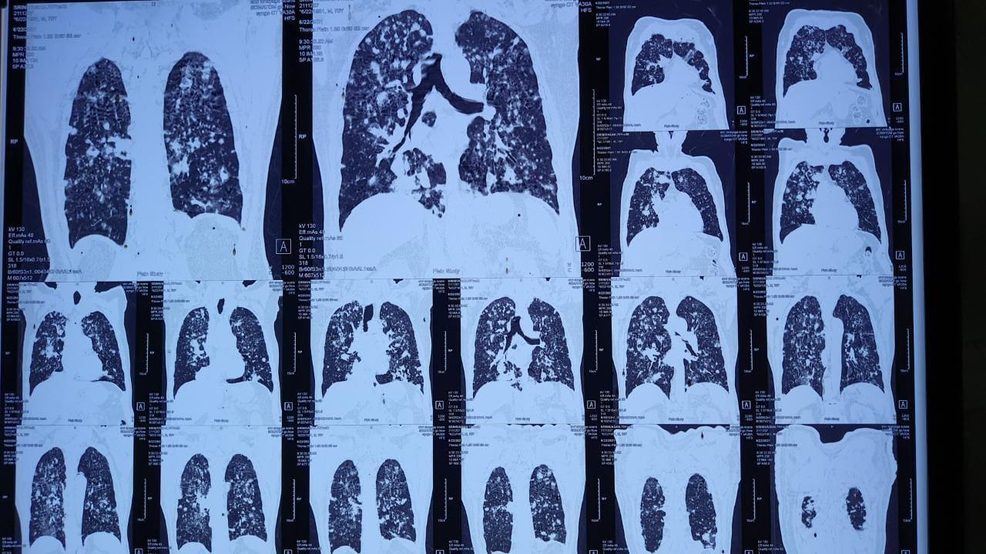

Slide 8
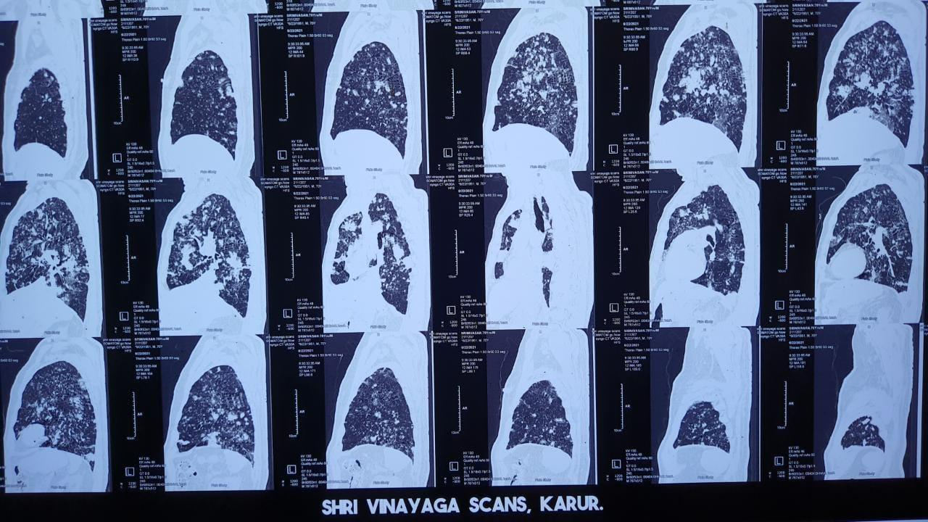

Slide 9
THANK YOU

