Slide 1
MOTOR NEURON DISEASE
CHIEF
Prof Dr P.V Balamurugan MD
ASSISTANT PROFESSORS
Dr. C Vignesh MD
Dr P Sonapriya MD
PRESENTATOR
Dr Ravitheju S

Slide 2
INTRODUCTION
Motor neuron disease (MND) refers to a group of progressive neurodegenerative disorders characterised by selective degeneration of motor neurons
It involves both upper motor neurons and/or lower motor neurons

Slide 3
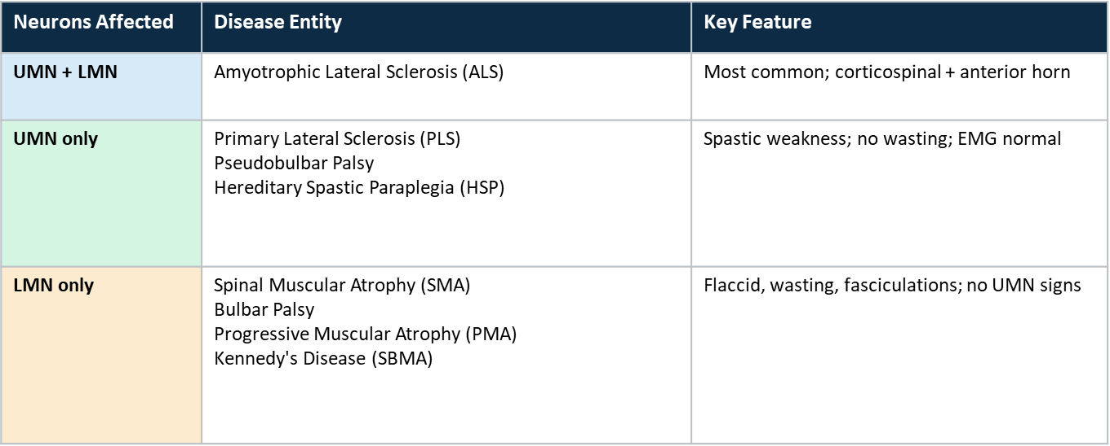
Classification of motor neuron disease

Slide 4
EPIDEMIOLOGY
1 – 3 per 100000 incidence
3-5 per 100000 prevelance
1 in 500 Deaths in North America
Median survival – 3 – 5 years

Slide 5
RISK FACTORS
• Pesticides & insecticides exposure
• Silica, smoking
• Military service
• Men slightly > women (global)
• Endemic foci: Guam, Papua New Guinea

Slide 6
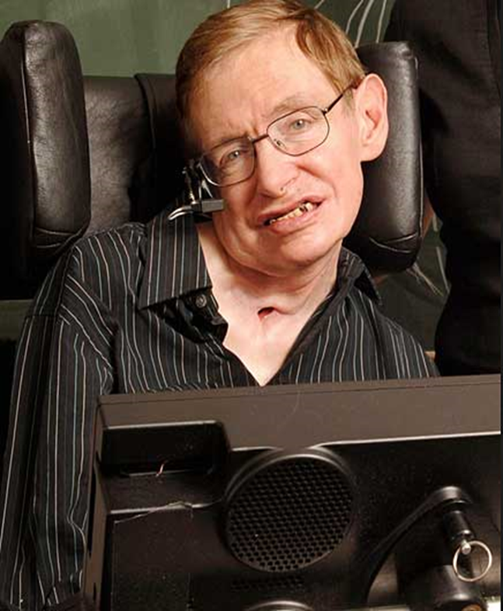
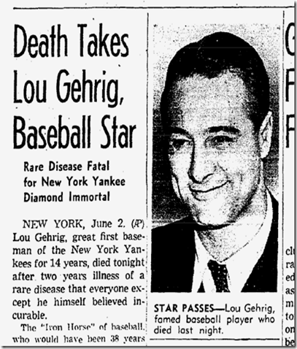
AMYOTROPHIC LATERAL SCLEROSIS
Amyotrophic lateral sclerosis (ALS) is one of multiple degenerative motor neuron diseases that are clinically defined, based on the involvement of upper and/or lower motor neurons
ALS is the most common form and includes upper motor neuron (UMN) and lower motor neuron (LMN) pathology

Slide 7
CLINICAL FEATURES — ALS
↓` LMN Signs
↑ UMN Signs
▸ Progressive asymmetric weakness
▸ Hyperreflexia (brisk tendon jerks)
▸ Muscle wasting & atrophy
▸ Spastic resistance (passive movement)
▸ Spontaneous fasciculations
▸ Extensor plantar response (Babinski)
▸ Cramps (especially morning)
▸ Spasticity predominant in hands
▸ Flaccid tone, absent reflexes (late)
▸ Pseudobulbar affect — emotional lability
▸ Bulbar: dysphagia, dysarthria
▸ Dysphagia + dysarthria (corticobulbar)

Slide 8
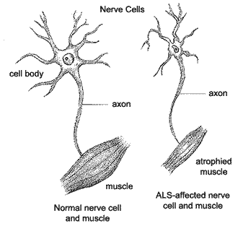
A-myo-trophic Lateral Sclerosis
Amyotrophic: no muscle nourishment
Lateral: refers to the the areas in a person's spinal cord where portions of the nerve cells that signal and control the muscles are located
Sclerosis: scarring of the affected nerves

Slide 9
ETIOLOGY
Gene | % of FALS | Mechanism
C9orf72 | 40–50% | Hexanucleotide repeat expansion (GGGGCC) → RNA toxicity, nucleocytoplasmic transport disruption
SOD1 | ~20% | Superoxide dismutase — toxic gain of function; protein aggregation
TDP43 | ~5% | RNA-binding protein; ubiquitin-positive aggregates; pathogenic in sporadic ALS too
FUS/TLS | ~5% | RNA processing, transport & metabolism disruption
NEK1, TBK1, KIF5A, TUBA4, PFN11 | ~1% each | Multiple pathways; axonal transport, autophagy, neuroinflammation

Slide 10
HEREDITARY VS SPORADIC ALS
Feature | Hereditary ALS | Sporadic ALS
Males:Females | 1:1 | 1.7:1
Age distribution | More younger | More older
Mean age | 46 years | 56 to 63 years
Bulbar features | 20% to 30% | Unusual
Involvement of Legs | Common | Occasional

Slide 11
PATHOLOGY
ALS is characterized by motor neuron degeneration and death with gliosis replacing lost neurons.
Cortical motor cells (pyramidal and Betz cells) disappear leading to retrograde axonal loss and gliosis in the corticospinal tract.
The spinal cord becomes atrophic.
The affected muscles show denervation atrophy.

Slide 12
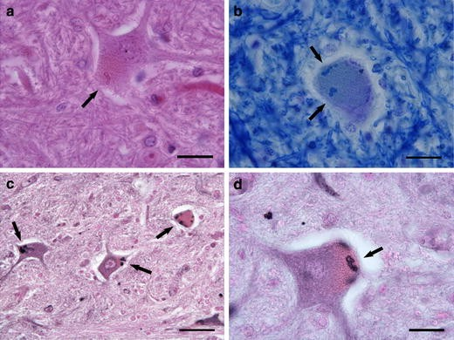
Intracellular inclusions —
Bunina bodies are unique to ALS and consist of eosinophilic aggregates that are positive for cystatin C, a cysteine protease inhibitor.

Slide 13
SOD1-MEDIATED TOXICITY
Superoxide dismutase type 1 (SOD1) is a metalloenzyme
catalyzes the conversion of toxic superoxide radicals to oxygen (O₂) and hydrogen peroxide (H₂O₂)
Protein misfolding —
> Another hypothesis is that mutant SOD1 induces protein aggregates that are potentially toxic to motor neurons

Slide 14
Microglial activation — Microglia are immune-modulating cells of the CNS.
Their presence was observed in ALS tissue .
Excitotoxicity —
The excitotoxicity hypothesis postulates that excessive levels of the excitatory neurotransmitter glutamate may initiate a cascade resulting in cellular death of motor neurons in ALS.

Slide 15
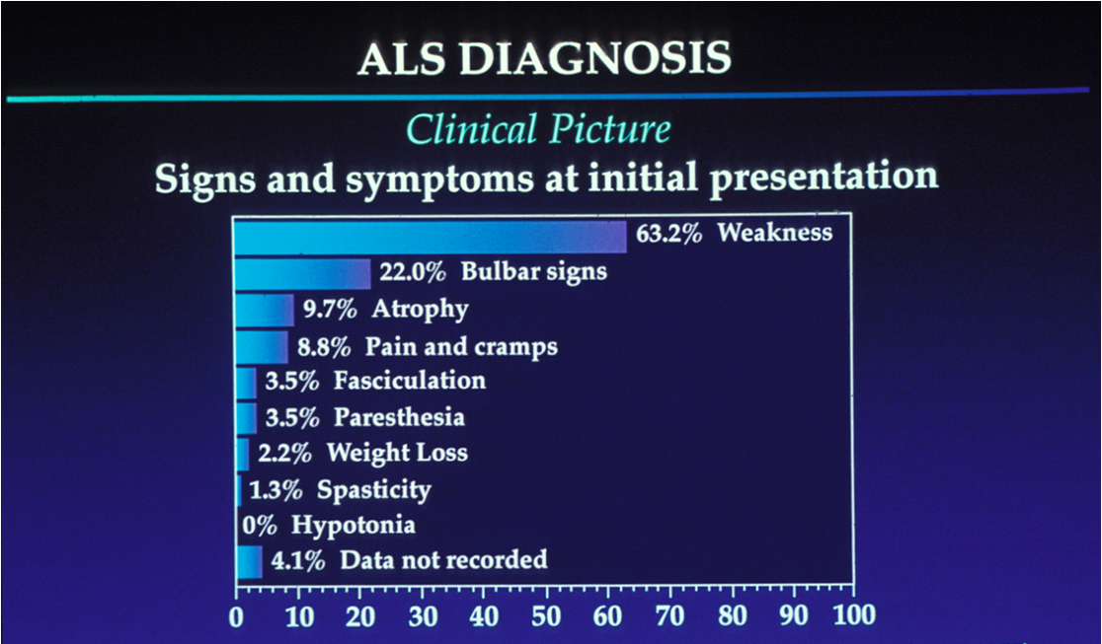

Slide 16
ALS PLUS syndrome
ALS is considered a degenerative disorder of the upper and lower motor neurons.
However, some patients have all of the clinical features of ALS along with features of other disorders such as
Frontotemporal dementia
Autonomic insufficiency
Parkinsonism, supranuclear gaze paresis and/or sensory loss.
Such patients are considered to have ALS plus syndrome

Slide 17
SPINOMUSCULAR ATROPHY
▸ LMN only; SMN gene (chromosome 5)
▸ SMA I (Werdnig-Hoffmann) — fatal infancy
▸ SMA II — childhood onset
▸ SMA III — late childhood; slow course
▸ Nusinersen / AAV gene therapy (SMA)

Slide 18
PATHOPHYSIOLOGY
Each individual has 2 SMN genes, SMN1 and SMN2.
More than 95% of patients with SMA have a homozygous disruption in the SMN1 gene on chromosome 5q
However, all patients with spinal muscular atrophy retain at least 1 copy of SMN2, which generates only 10% of the amount of full-length SMN protein versus SMN1.

Slide 19
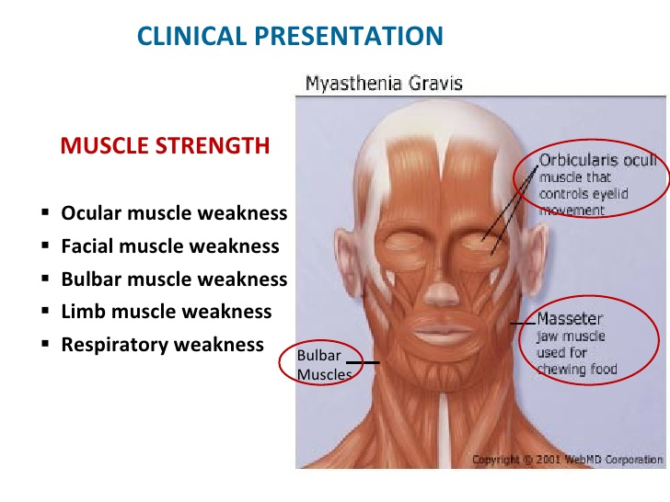
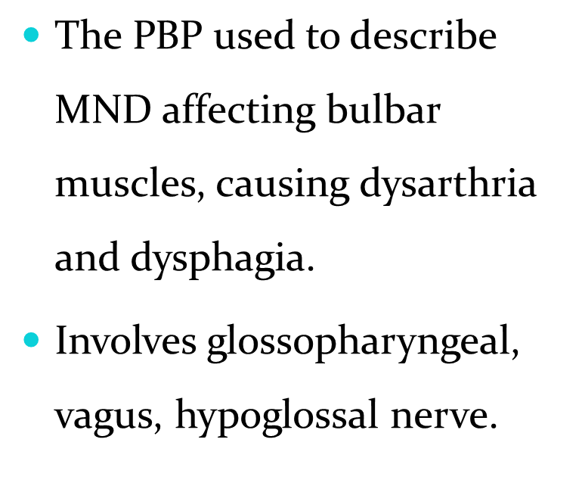
PROGRESSIVE BULBAR PALSY

Slide 20
MONOMELIC MUSCULAR ATROPHY
Rare benign LMND restricted to one limb, usually an arm or hand rather than a leg.
Also k/a Hirayama syndrome.
Affects men 10 times more then women.
Starts at 20 years .
Weakness involves the hand and forearm C7-T₁ innervated muscles.
Condition progress to 1-2 years and then seems to become arrested in most cases.

Slide 21
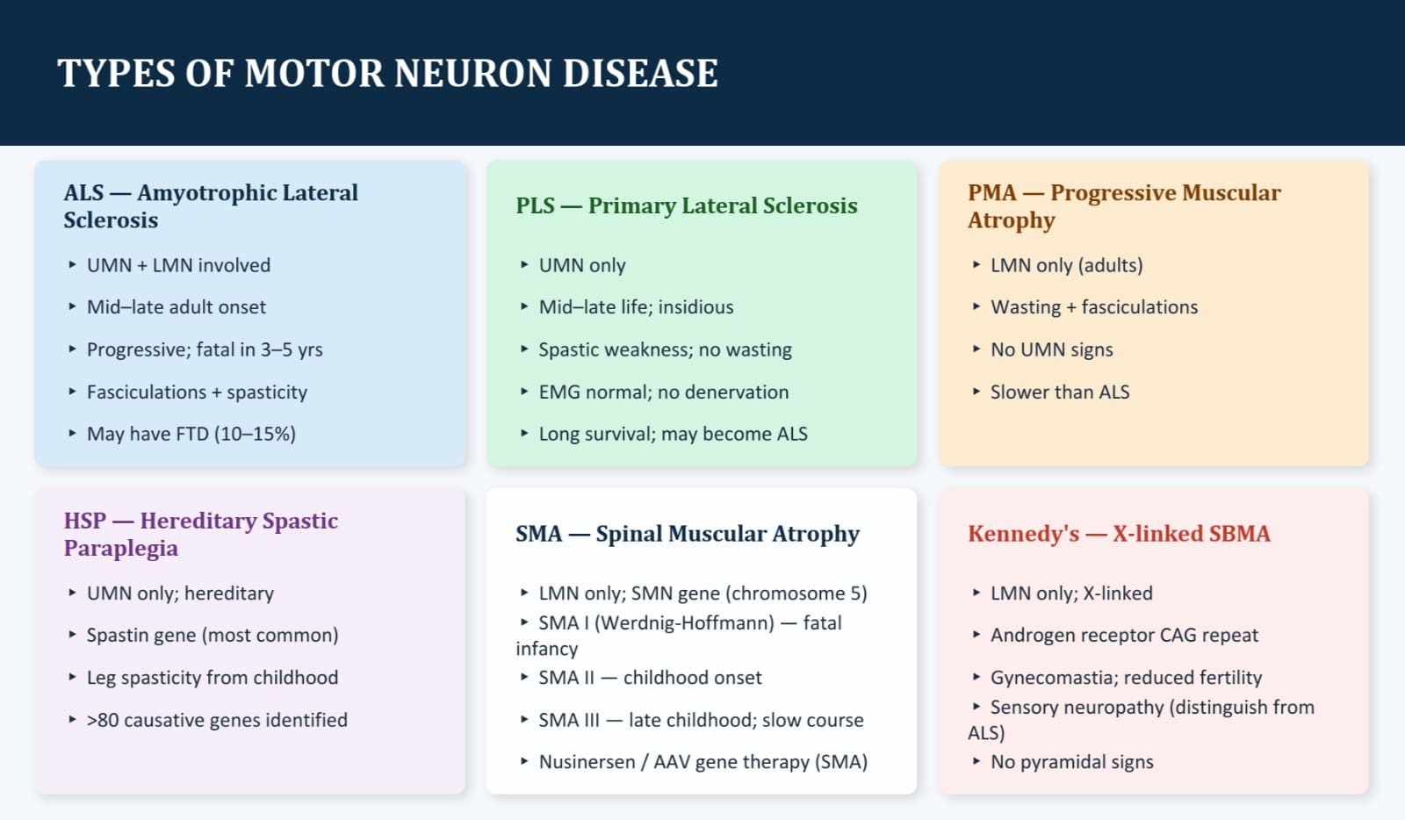

Slide 22
KEY TAKE AWAYS
MND = progressive death of UMN and/or LMN; ALS is the most common and fatal form
ALS: simultaneous UMN+LMN signs in multiple regions; diagnosis of exclusion
Genetics: C9orf72 (40–50%), SOD1 (20%), TDP43 & FUS (5% each) — key in FALS
Median survival 3–5 yrs; respiratory failure is the usual cause of death

Slide 23
THANK YOU

