Slide 1
A case of subclavian steal syndrome
Third medical unit
Prof.Dr.M.Natarajan M.D.,
Asst.prof-Dr.Syed bahavudeen hussaini M.D.,
Dr.P.S.Vallidevi M.D.,

Slide 2
Chief complaints
A 48 yr old female
Giddiness and vomiting-1 day
Unsteadiness of gait -1 day

Slide 3
h/o present illness
h/o acute onset giddiness,vomiting, unsteadiness of gait-1 day
h/o headache +
h/o pain in left upper limb – 1 week
-aggravated by exerting that limb
h/o parasthesia of left upper limb on and off for the past one week
No h/o weaknesss of any limbs
No h/o diplopia

Slide 4
No h/o deviaton of angle of mouth
No h/o any dysphagia, regurgitation of food
No h/o bowel and bladder disturbances
No h/o any tremors or incoordination of movements
No h/o any chest pain,palpitation,syncope
No h/o cough with expectoration,fever,seizures

Slide 5
Past history
Past history:
-no h/o T2DM,HT,seizure disorder, TB, CAD
Personal history:
-on mixed diet
-bowel and bladder habits normal
-no h/o any abortions

Slide 6
GENERAL EXAMINATION
Conscious
Oriented
afebrile
pallor +
No icterus/cyanosis/clubbing/pedal edema/ gen.lymphadenopathy/
Koilonychia +
Lt.upper limb cold when compared to rt.
Bluish discolouration of tips of fingers of lt.hand+

Slide 7
vitals
Pulse - 84/min
-feeble in left radial,brachial and axillary arteries
-normal volume in other accessible arteries
-regular in rhythm
BP - 140/80mm Hg in rt.upper limb
- 80/60mm Hg in lt.upper limb
-140/90mm Hg both lower limbs
SpO2 – 97% in rt.upper limb
-not recordable in lt.upper limb
RR -20/min

Slide 8
Cns examination
Higher mental function-normal
Cranial nerves -normal
Spino motor system -normal
Sensory system -normal

Slide 9
cerebellum
Finger nose test- impaired on left
Finger finger nose test- impaired on left
Heel knee test- normal
Tandem walking impaired
Rhomberg’s sign-positive
Spine and cranium-normal

Slide 10
Other systems
CVS:
S1 S2 +, no murmur
RS:
NVBS+, BAE +, No added sounds
ABDOMEN:
Soft, not tender, no organomegaly
While exerting the left upper limb for 2-3min she developed presyncope

Slide 11
investigations
Hb % | 8.8g%
TC | 11,700
DC | P64/L30/M6
ESR | 16mm in 1 hr
Platelet count | 3.14 l/mm3
PCV | 31
Cholesterol | 188mg%
TGL | 210mg%
HDL | 44mg%
LDL | 81mg%
VLDL | 42mg%
RBS FBS PPBS | 147 mg% 130 mg% 208 mg%
Bl. urea | 36 mg%
Sr. creatinine | 0.9g%
Na+ | 129 (mEq/l)
K+ | 4.3
Cl- | 98

Slide 12
VCTC- NON REACTIVE
VDRL- NON REACTIVE
CRP-POSITIVE
ANA-NEGATIVE
ECG,ECHO- NORMAL STUDY
XRAY NECK-NORMAL STUDY

Slide 13
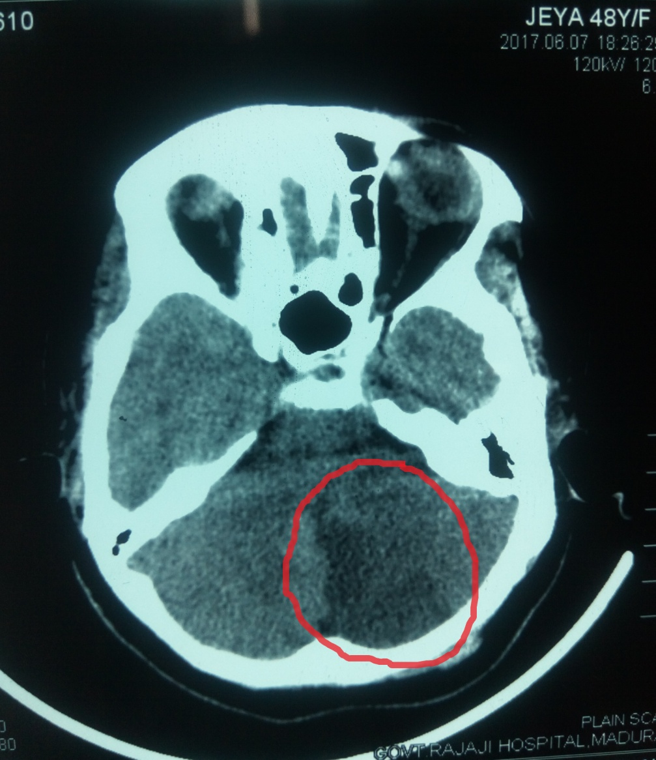
Ct brain

Slide 14
PROVISIONAL DIAGNOSIS
T2DM
POSTERIOR CIRCULATION STROKE
?SUBCLAVIAN STEAL SYNDROME

Slide 15
Neurologist opinion
Posterior circulation stroke
To r/o subclavian steal syndrome
Suggested:
Glycemic control
Inj.Heparin 5000u iv 6th hourly
Inj.Mannitol 100ml iv tds
T.ASA 75mg 1OD
T.ATORVASTATIN 10mg 2HS

Slide 16
Vascular surgeon opinion
CVA
LT. UPPER LIMB ISCHEMIA
SUGGESTED:
Continue the same treatment
Review with CT ANGIO Lt.upper limb

Slide 17
Lt.upper limb arterial doppler
Proximal lt.subclavian artery occlusion
Brachial show low velocity post
Ulnar stenotic parvus et tardus
Radial pattern

Slide 18
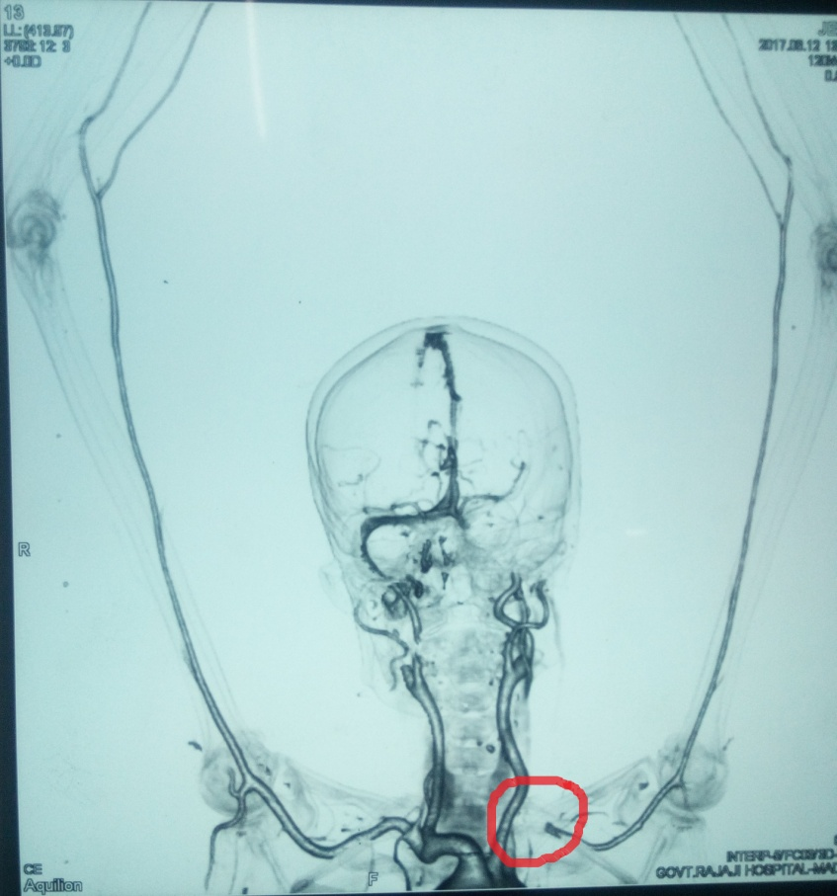
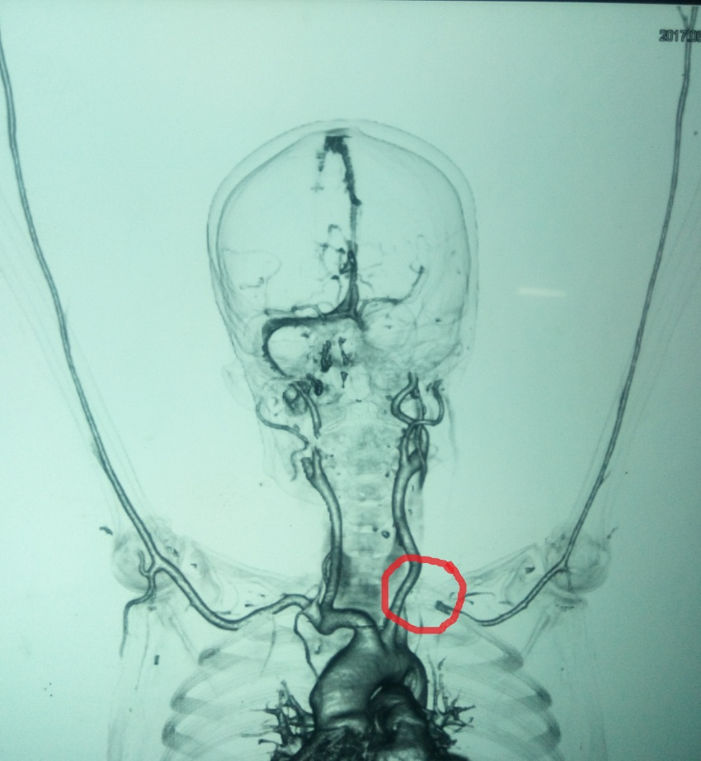
Ct angiogram

Slide 19
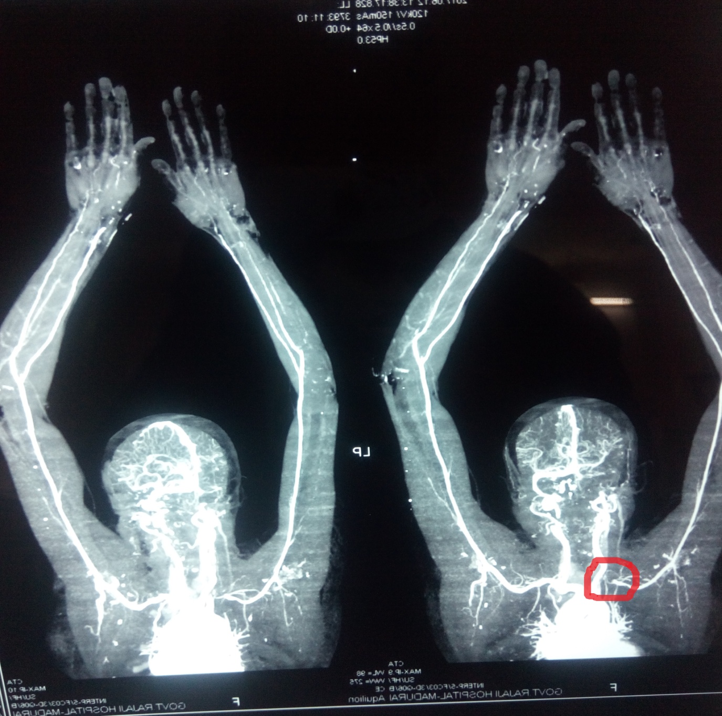

Slide 20
Ct angio report
e/o filling defect noted in Lt.subclavian artery from its origin for a length of 1.9cm
- P/O Thrombus
left axillary,brachial,radial and ulnar arteries appear narrowed with decreased caliber
Left dorsal palmar arch is not completely formed

Slide 21
Transcranial doppler(tcd)
Normal flow pattern detected in both vertebral arteries and basilar artery
Since exerting the left upper limb may lead to complications TCD was not done after exertion
CAROTID AND VERTEBRAL DOPPLER:
NORMAL STUDY

Slide 22
Vascular surgeon review
Medical management at present
To add T.Clopidogrel 75mg 1OD
Review after 2 weeks

Slide 23
Final diagnosis
T2DM
LEFT CEREBELLAR INFARCT
SUBCLAVIAN STEAL SYNDROME
-proximal subclavian artery thrombosis
-?atherosclerotic /?vasculitic etiology
IRON DEFICIENCY ANEMIA
Tretment:
-T.Aspirin 75mg 1OD
-T.Clopidogrel 75mg 1OD
-T.Atorvastatin 10mg 4HS
-T.Metformin 500mg BD
-T.FST 1BD

Slide 24
Aim of presentation
Rarity of subclavian steal syndrome to the extent of causing stroke
To examine all peripheral pulses in a case of CVA

Slide 25
Thank you

