Slide 1
CLINICO PATHOLOGICAL CONFERENCE
2nd UNIT
Chief: Dr. David Pradeep Kumar MD, MRCP
Assistant Professors: Dr Prabhu MD
Dr Naseema Banu MD
Dr Ram Kumar MD

Slide 2
36 years old male
Complaints: breathlessness and swelling of legs 1 month
HOPI:
breathlessness- 1 month
insidious onset
gradually worsening
no orthopnea / PND

Slide 3
Bilateral pedal edema - 1 month
insidious onset
gradually increasing
No c/o chest pain
palpitation / syncope
decreased urine output
abdominal distension / facial puffiness at present
No fever

Slide 4
PAST HISTORY:
2018 - pedal edema
relieved with diuretics - not evaluated
2019 - pedal edema and abdominal distension with diarrhoea
h/o breathlessness
Ascitic tapping done and symptoms relieved
USG Abdomen:
Mild b/l Pleural effusion, moderate ascites
On native treatment since then.

Slide 5
2023 - h/o breathlessness
X ray pleural effusion
B/l pleural tapping done and symptoms relieved
2024 Aug - breathlessness, fever and loose stools for 3 days
Left sided pricking type of chest pain 2 days
All blood investigations were normal.

Slide 6
Albumin - 1.6g/dl
Globulin - 1.8g/dl
Urine - albumin and sugar nil and no RBC
Pleural fluid analysis:
Colour - straw yellow
Appearance - clear
Sugar - 80mg/dl
Protein - 6.79 g/dl
ADA - 15.2 U/L
LDH - 215 U/L
Amylase - 31.8 U/L
Lipase - 197.3 U/L
Cytology - negative for malignancy
CT abdomen-normal

Slide 7
No h/o diabetes, hypertension, BA, TB, Epilepsy, Thyroid disorder, CAD, CKD, CVA in past.
Personal history:
No smoker
Occasional alcohol intake
Mixed diet - allergic to egg
Normal sleep pattern

Slide 8
VITAL SIGNS
PR - 90/min
BP - 120/70 mmHg
SPo2 - 99% on RA
General examination
Conscious
Poorly built, nourished

Slide 9
No pallor
icterus
clubbing
cyanosis
significant lymphadenopathy
B/l pitting edema both hands and feet
No external markers of TB and HIV

Slide 10
Systemic Examination
CVS - S1, S2
No murmur
RS - B/l AE decreased
No added sounds
Abdomen - Soft, non tender
No organomegaly
No shifting dullness, fluid thrill
CNS - Conscious, oriented
moves all 4 limbs, B/l plantar flexor
PERL
Fundus - Normal

Slide 11
Present investigations:
TC - 10200 cells/cu.mm
Hb - 12.9g/dl
MCV - 79.3 fl
Plt - 3.73 l
T. Protein - 4.0g/dl
Albumin - 1.3g/dl
Globulin - 2.7 g/dl
Urea - 17 mg
Creat - 0.9 mg
Na - 137meq
K - 4.4

Slide 12
LFT:
T.B - 0.2 mg/dl
D.B - 0.1 mg/dl
I.B - 0.1 mg/dl
OT/PT - 25/30 U/L
ALP - 69 U/L
PT-20sec
INR-1.8
Aptt-20 sec
Urine analysis
Alb - nil
Sugar - nil
Dep - 0 to 2 pus cells

Slide 13
Complete hemogram with PS:
TC - 7500 cells/cu.mm
RBC - 4.91 million/cu.mm
Hb - 12.4g/dl
PCV - 39.5 %
Plt - 2.69L
N - 76%
L - 14%
E - 4%
M - 6%

Slide 14
FLP
S. Cholesterol - 77mg%
TGL - 59mg%
S.HDL - 47 mg%
S.LDH - 324 U/L
24hr urine protein: 180mg/day
VCTC and V.M : negative
ANA by IF – negative
Pleural fluid and sputum CBNAAT- Negative
Chest X ray s/o bilateral moderate Pleural effusion
TSH-Euthyroid

Slide 16
USG abdomen and pelvis:
Liver - normal size and echoes
Spleen - Normal
RK-9 X 4.5 cm
LK-9.5 X 4.5 cm
CMD maintained
Minimal free fluid in abdomen
ECHO: NO RWMA
EF - 60%
minimal pericardial effusion

Slide 17
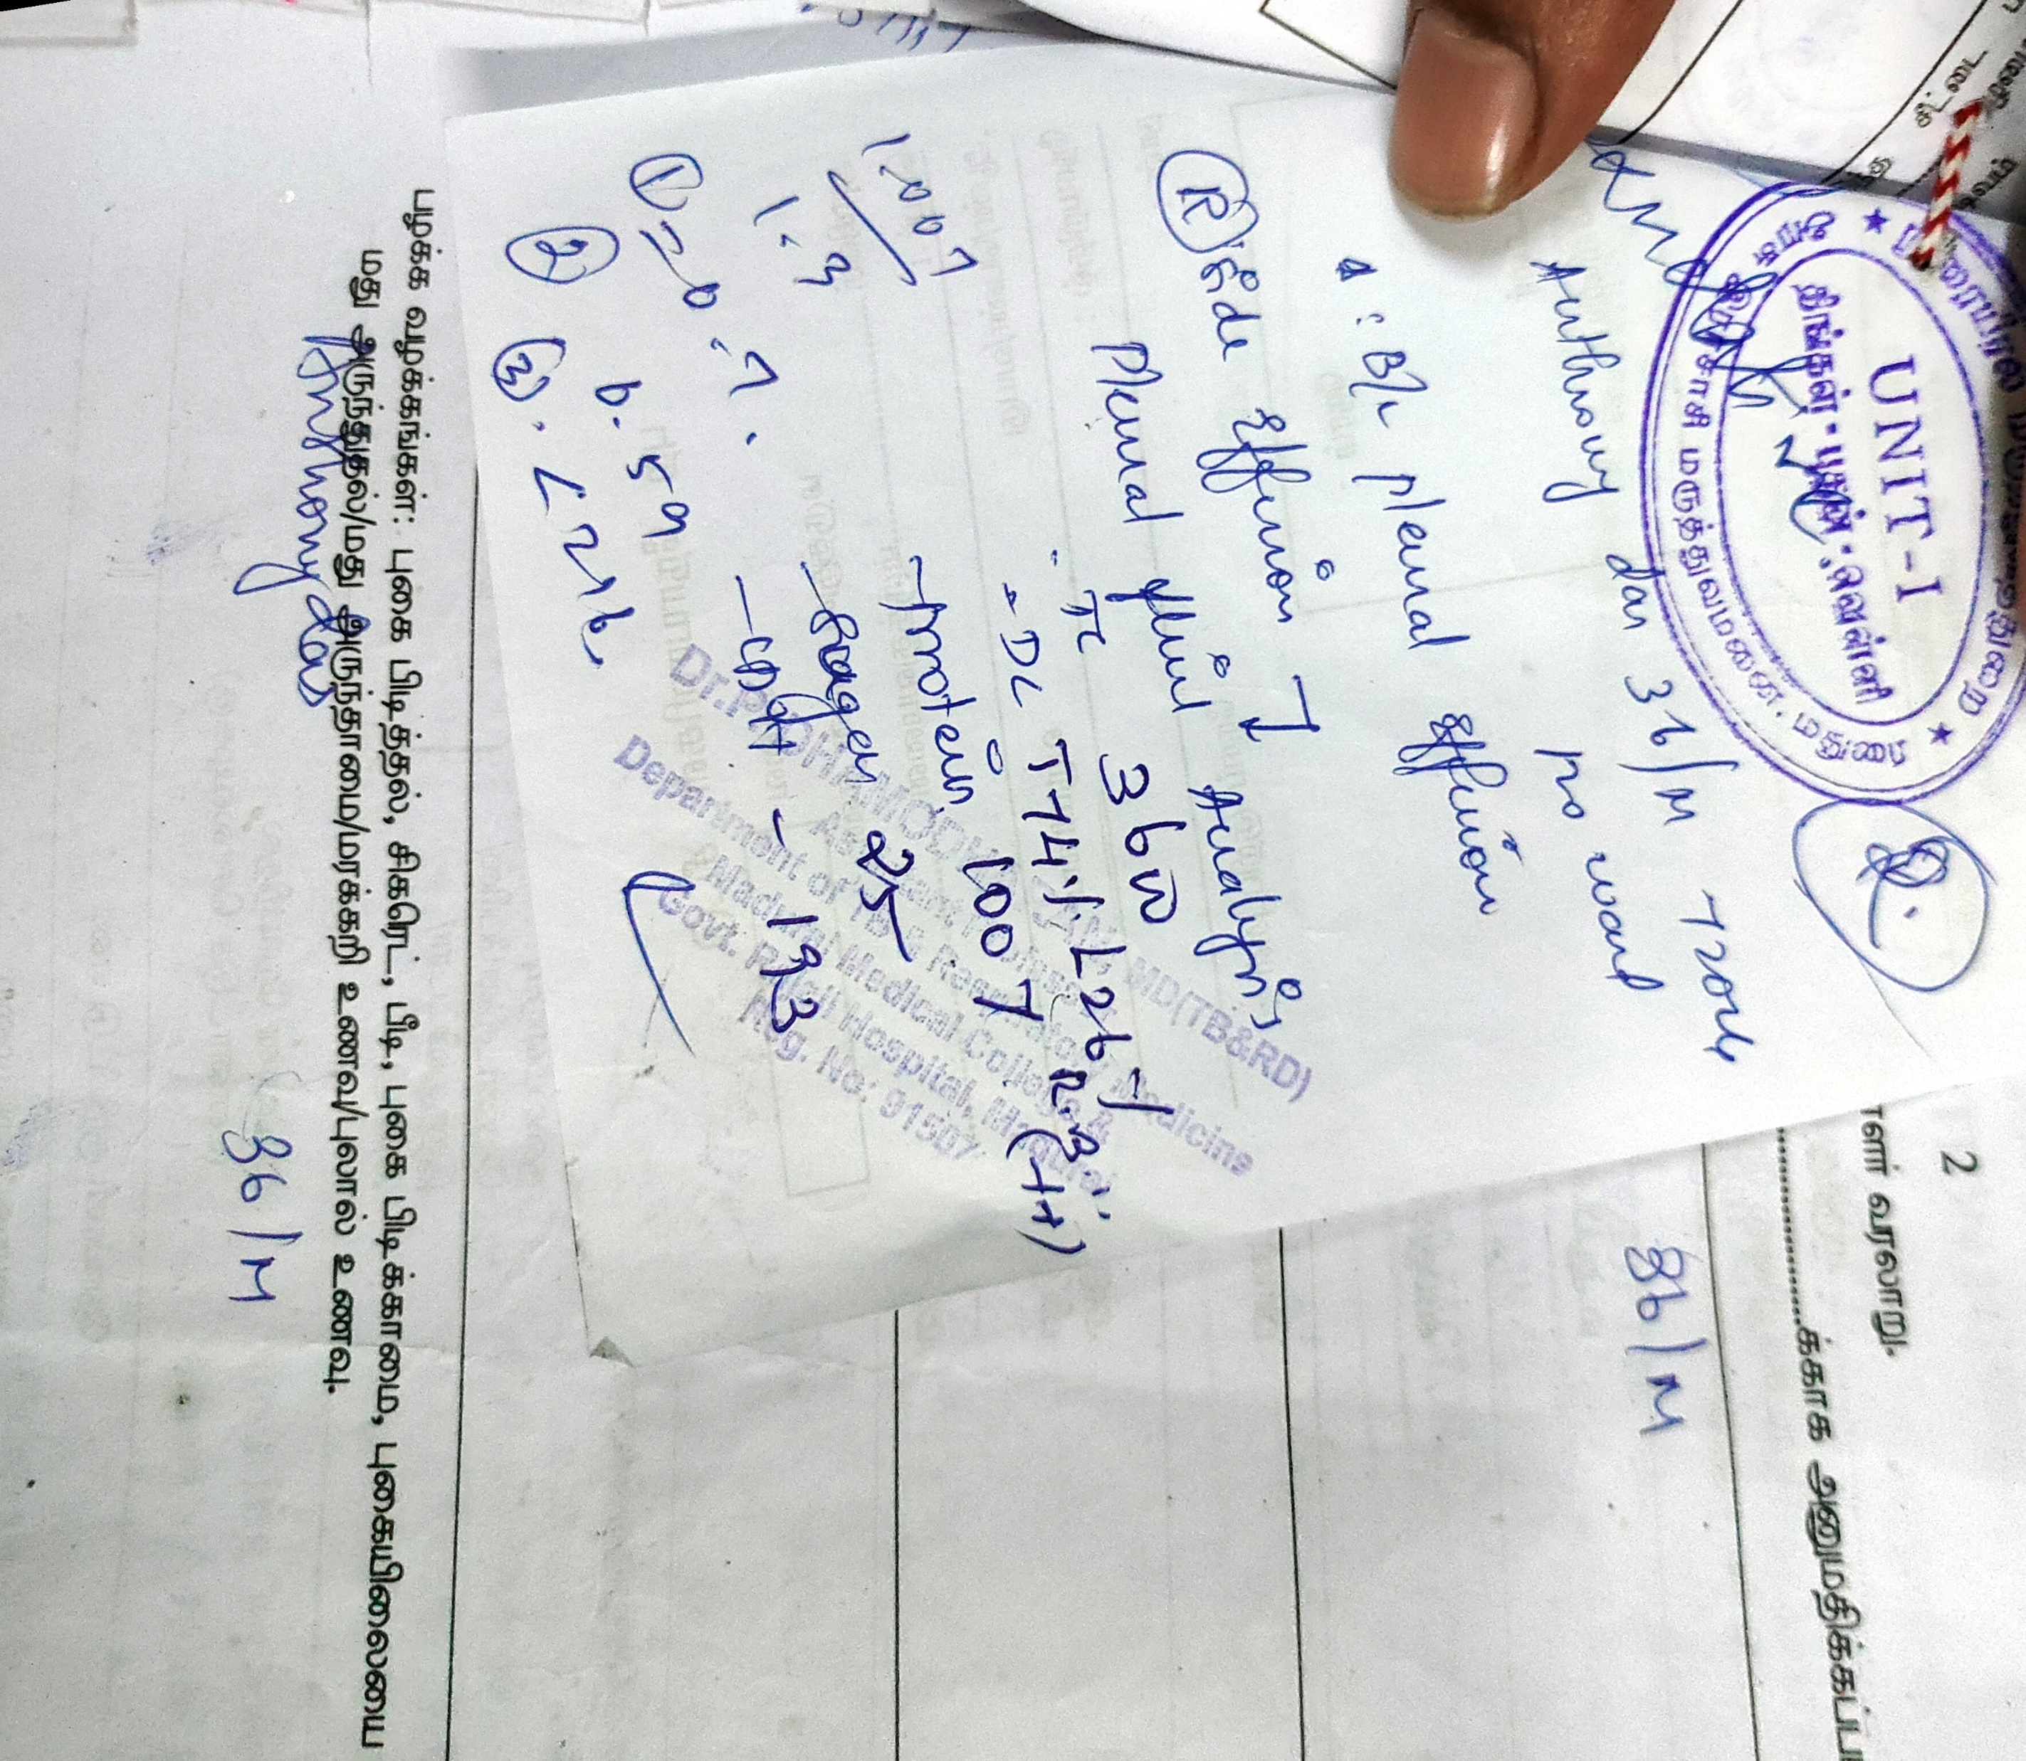

Slide 18
Pleural fluid gram stain- no organisms detected
Pleural fluid c/s – no growth

Slide 19
WHAT NEXT….?

