Slide 1
CLINICO PATHOLOGICAL CONFERENCE

Slide 2
35 year old male, auto driver by occupation
Cough with expectoration-1 week
scanty mucoid
no diurnal, postural variations
Breathlessness- 1 week
aggravated on exertion
MMRC grade 3
no orthopnea, PND
Loss of appetite – 1 week
Left sided chest pain-Non anginal
No h/o hemoptysis

Slide 3
No h/o of palpitation, syncope
No h/o fever
No h/o of leg swelling/abdominal distension
No h/o of decreased urine output

Slide 4
PAST HISTORY
No h/o of diabetes, hypertension, bronchial asthma, epilepsy, CVA, CKD, CAD, CLD, thyroid disorder.
H/o previous admissions for similar complaints in the past
2017- Diagnosed left tubercular pleural effusion in a medical college hospital, took ATT empirically for 6 months effusion subsided. Felt better.
2018-Again diagnosed as left tubercular pleural effusion took ATT for 6 months from the same medical college hospital.

Slide 5
2023 July-Pt referred to GRH for the same complaints. Empirically started on T.DEC.
Thoracoscopy and ICD insertion done on July 2023
-Multiple yellow plaques seen over the parietal pleura
Pleural fluid cytology
-plenty of eosinophils and lymphocytes in hemorrhagic background
DC : eosinophils 25 to 30/HPF
lymphocytes 3 to 4/HPF

Slide 6
Pleural fluid CBNAAT-MTB not detected.
Pleural biopsy - Chronic inflammation with granuloma.
Pleural fluid ADA-34
ANA-negative

Slide 7
BAL cytology-mature squamous epithelial cells, respiratory epithelial cells in mucoid background - no evidence of granulomas or malignancy.
PERSONAL HISTORY
-mixed diet
-chronic smoker
-chronic alcoholic
FAMILY HISTORY
Not history of TB / similar complaints

Slide 8
GENERAL EXAMINATION
Conscious, oriented,
Pallor-present
No icterus/clubbing/cyanosis/ lymphadenopathy/pedal edema
VITAL SIGNS
Pulse rate-110/min, regular, normal volume, no specific character, no delays
BP-110/70 mm hg
Spo2-94 percent in room air
RR-24/min
Afebrile

Slide 9
SYSTEMIC EXAMINATION
RESPIRATORY SYSTEM
INSPECTION:
-Trachea midline.
-Apical impulse not seen.
-Chest wall movements equal both sides.
-Scar in left infra axillary area.
-No sinuses/dilated veins.
-No drooping of shoulders.

Slide 10
PALPATION
-Trachea right side.
-Apical impulse left 5th ICS medial to mid clavicular line.
-Chest wall movements equal both sides.
-No tactile fremitus.
-Tenderness in left infrascapular area.
PERCUSSION
-Stony dull in left infrascapular area.

Slide 11
AUSCULTATION
Bilateral breath sounds decreased in mammary, infra axillary and infrascapular areas.
CVS-S1 S2 normal, no murmur.
P/A-soft, bowel sounds present
CNS-No focal neurological deficit.

Slide 12
INVESTIGATIONS
TC-17,500
Hb-12.7 g/dl
HCT-39%
Platelets-4.5lakhs
Sputum AFB, CBNAAT-negative
Pleural fluid CBNAAT-negative
Pleural fluid analysis
TC-26
DC: P-12, L-5/HPF
Sugar-125
Protein-7778

Slide 13
COMPLETE HEMOGRAM PERIPHERAL SMEAR
TC-28000 cells/cu.mm
Hb-12.3 gm/dl
Platelet-3.83 lakhs/cu.mm
RBC-Predominantly normocytic, normochromic cells
No hemoparasites seen.
WBC-Count is increased
N-30% L-10% E-56% M-4%
PLATELET-Adequate on smear.
Impression-eosinophilia
TSH-3.5U/l
S.Calcium-9.8 g/dl
Fundus examination-normal

Slide 14
S. Total protein-5.9
Albumin-3.1
Globulin-2.8
ESR-55mm/hr
CRP-positive.
RA factor-negative.
D-dimer -603
Viral markers-neg
VCTC-non reactive
Pleural fluid
Amylase-11u/l
Triglyceride-12
Cholesterol-117mg/dl

Slide 15
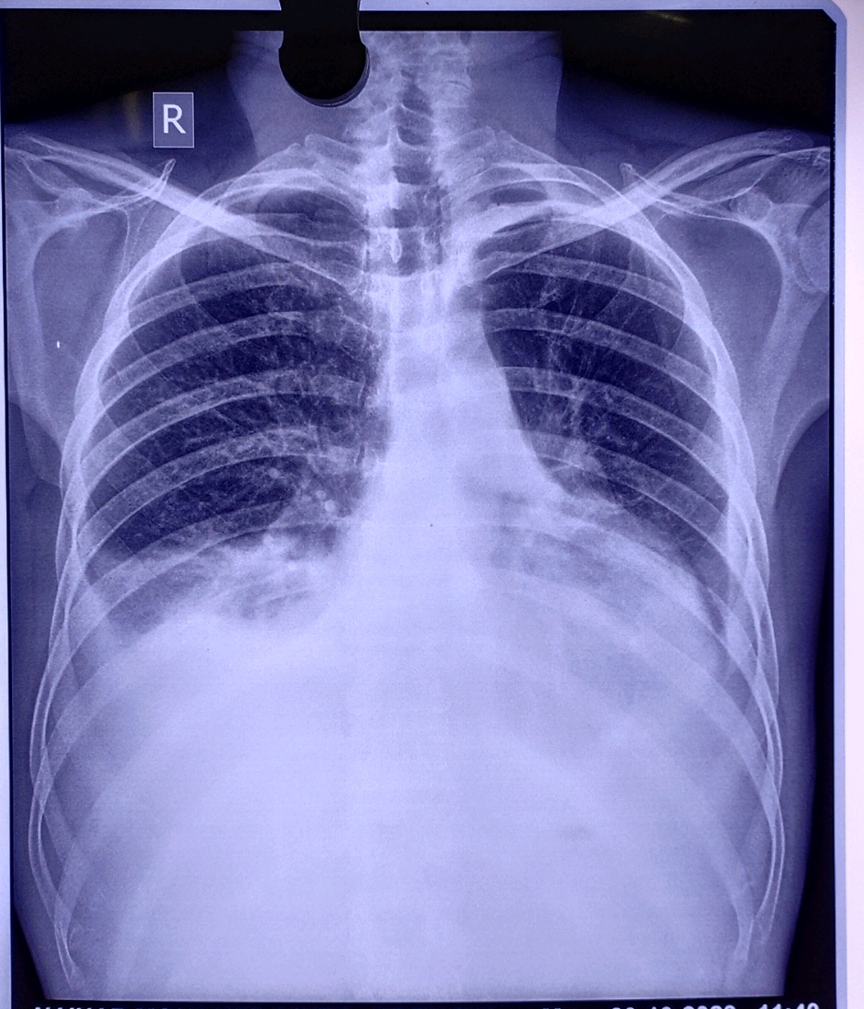

Slide 16
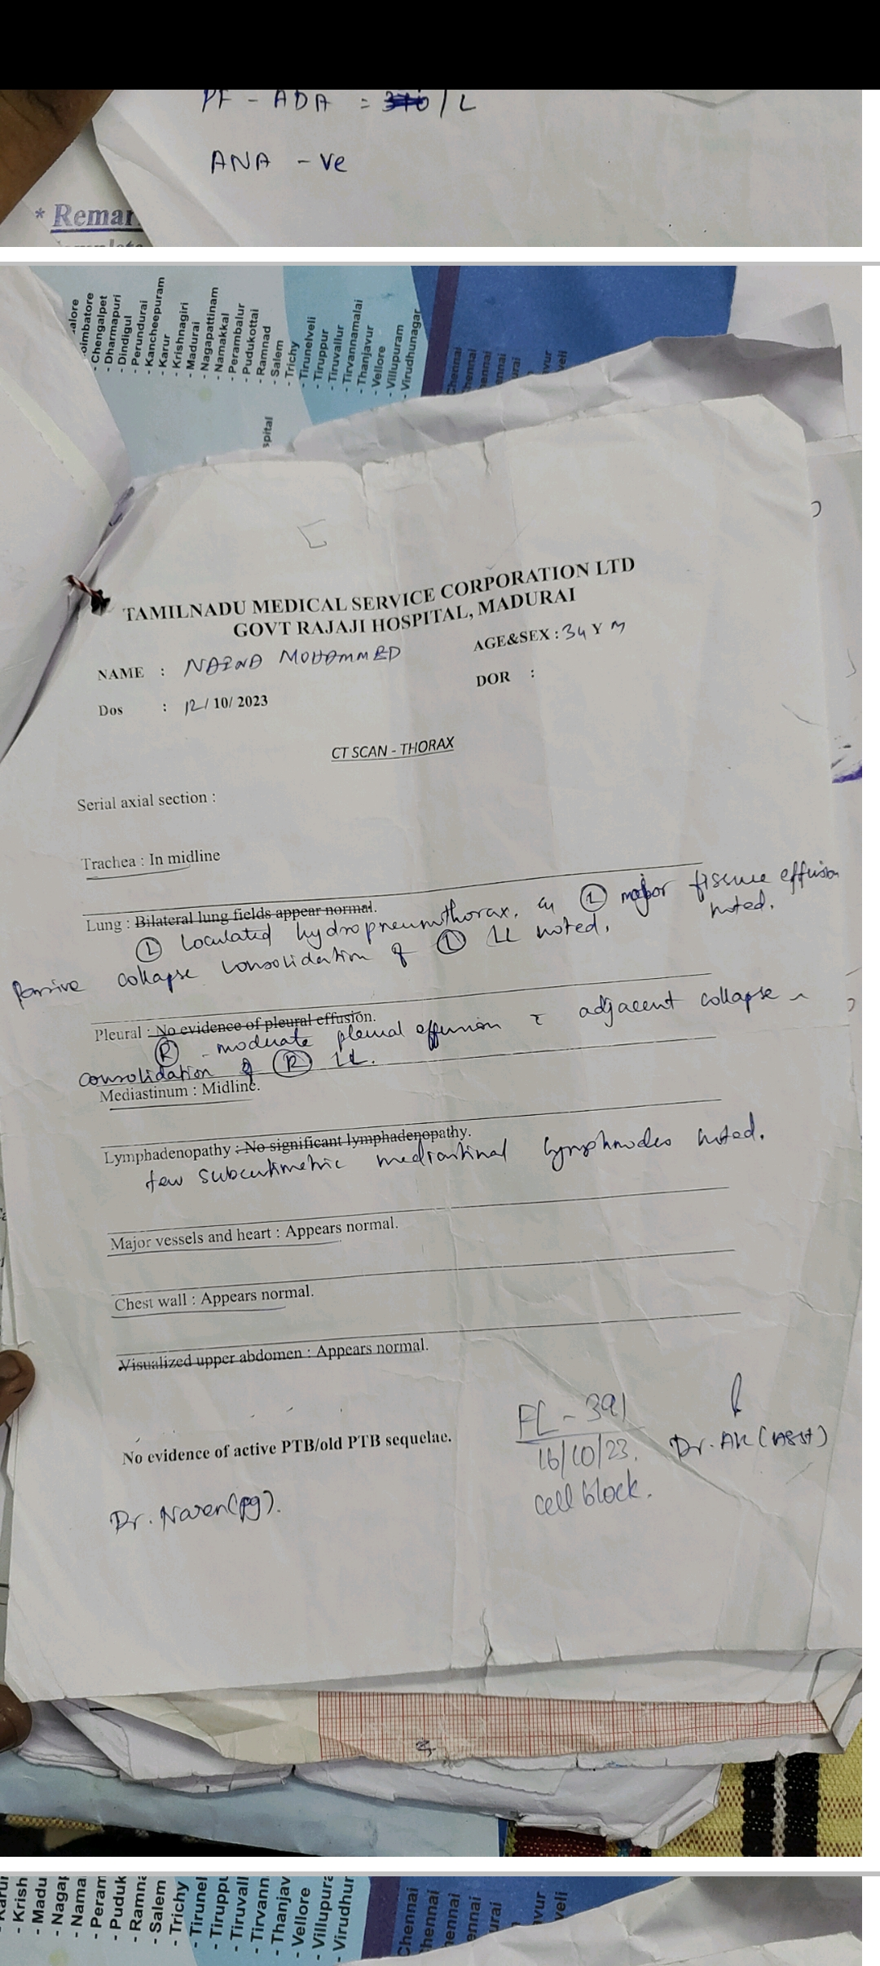

Slide 17
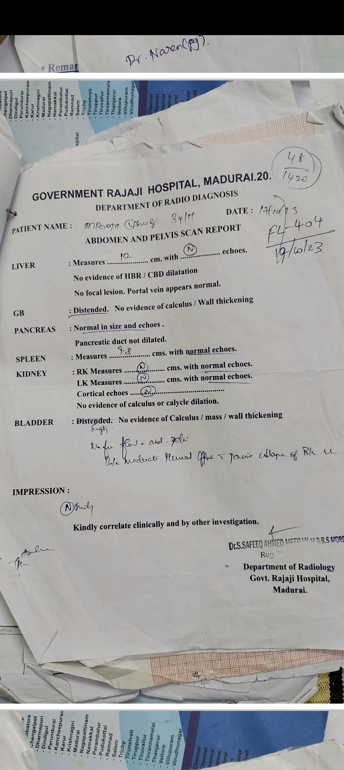

Slide 18
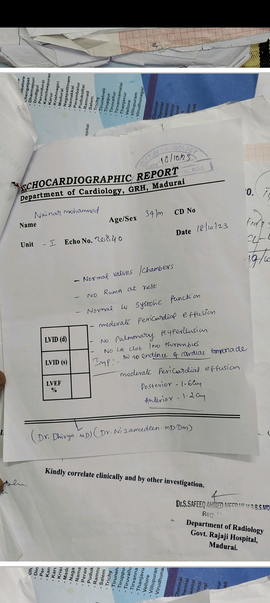

Slide 19
WHATS NEXT?

