Slide 1
Opportunistic Killer
By 2nd medical unit
Chief : Dr. G. BAGIALAKSHMI M.D
Assistant Professor : Dr. P. S. VALLIDEVI M. D
Dr. PON SENTHIL KUMAR M. D
Dr. M. ILAMARAN M. D

Slide 2
A 20 years old male Mr. Subash referred from Viruthunagar GH with
H/O Fever x 1 month
H/O Vomiting x 1 month
H/O Headache x 1 month
H/O Altered Sensorium x 1 week

Slide 3
HOPI :
Pt was apparenty normal 1 month back after which he developed
H/O Fever x 1 month - Low grade , Intermittent , Not associated with chills and rigor
H/O vomiting x 1 month – 4 episodes / day . Non projectile , immediately after taking food and contains food particles , not associated with blood
H/O Headache x 1 month - Diffuse , no aggravating and relieving Factor.
H/O Altered sensorium x 1 week, hypoactive, in a drowsy state

Slide 4
H/O Seizures – 2 episodes , involves all 4 limbs, associated with drooling of saliva, post ictal confusion
No H/O Blurring of vision , Double vision
No H/O chest pain/palpitations /cough
No H/O abdominal pain/diarrhoea
No H/O reduced urine output /bleeding manifestation
No H/O leg swelling

Slide 5
PAST HISTORY
N/K/C/O T1DM/PTB/SHTN/CKD/THYROID DISORDER

Slide 6
PERSONAL HISTORY
Mixed diet consumer
Alcoholic
Bowel and Bladder habits normal
No substance abuse
No active sexual contact history

Slide 7
GENERAL EXAMINATION:
O/E
Drowsy
Irritable
Partially obeys oral Commants
Afebile , Oral Candidiasis +
No pallor
No icterus
No cyanosis
No clubbing
No pedal edema
No Generalized Lymphadenopathy

Slide 8
VITALS :
BP – 100/70 mmHg
Pulse – 64 / min
Spo2 – 98 @ RA
RR – 20 /min
SYSTEMIC EXAMINATION ;
CVS – S1, S2 +
No murmur
RS - NVBS +
No Added Sounds
P/ A – Soft , Non tender , No Organomegaly

Slide 9
CNS :
Tone -
TONE | RIGHT | LEFT
UPPER LIMB | NORMAL | NORMAL
LOWER LIMB | NORMAL | NORMAL
POWER | RIGHT | LEFT
UPPER LIMB | 5/5 | 5/5
LOWER LIMB | 5/5 | 5/5
REFLEX | RIGHT | LEFT
UPPER LIMB | ++ | ++
LOWER LIMB | ++ | ++

Slide 10
BILATERAL PLANTAR – Flexor Flexor
No Sensory disturbance.
Neck stiffness +
Kernig sign – Positive
Brudzinski sign – Positive
FUNDUS EXAMINATION :
Normal fundus

Slide 11
INVESTIGATION ;
CBC
TC – 11200 cells / mm
RBC – 3.6 million
HB- 10.1 g/dl
DC – 80/ 15 / 5
PLATLET – 1.65 L
RFT : Rbs – 98 mg/dl
Urea - 45
Creatinine – 1.2

Slide 12
LFT :
T.B - 1.2
D/I.D – 0.8/ 0.6
OT/PT - 36/24
ALP - 40
Viral Markers – Negative
VCTC – REACTIVE
CD 4 Count – 24 cells .
CSF ANALYSIS :
Cells - TC – 85 cells
Lyphocytes - 80%
Polymorphs - 20%

Slide 13
PROTEIN – 122 mg/dl
SUGAR – 78 mg/dl
RBS – 122 mg/dl

Slide 14
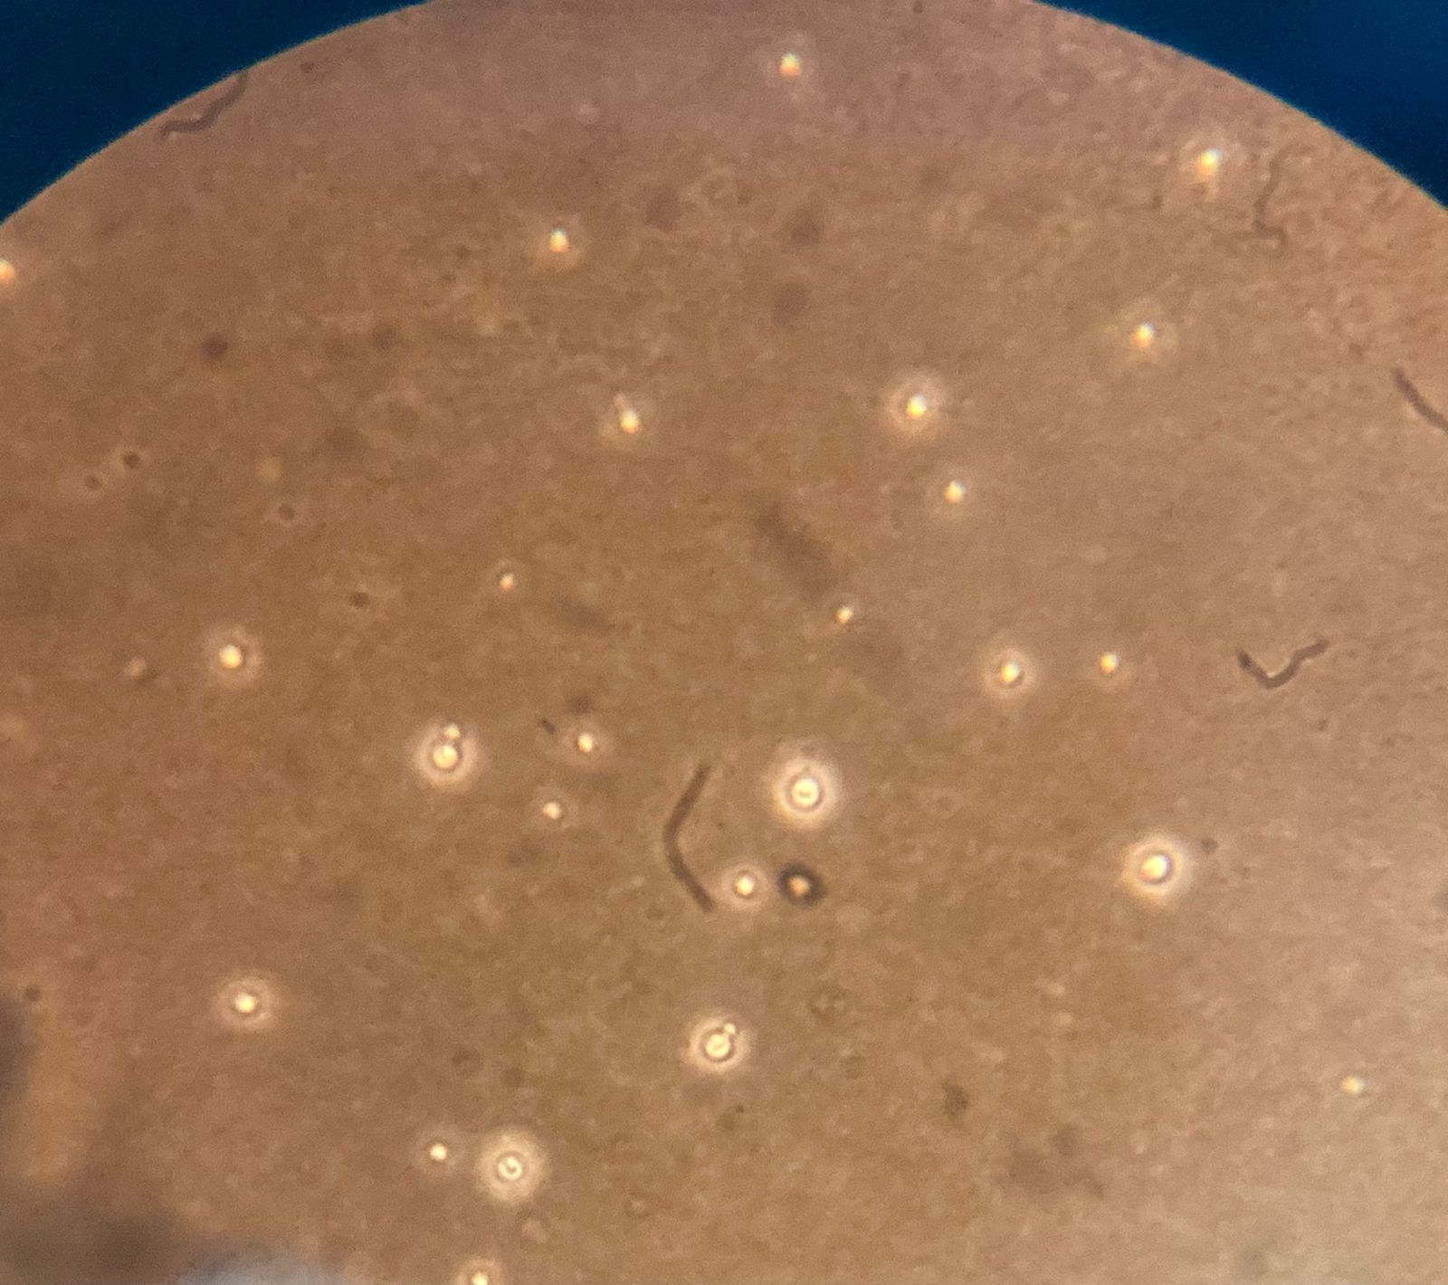
CSF INDIA INK STAIN:

Slide 15
MRI BRAIN
Hyperintensities in the Bilateral Capsuloganglionic region suggestive of Viral Enchephalitis .

Slide 16
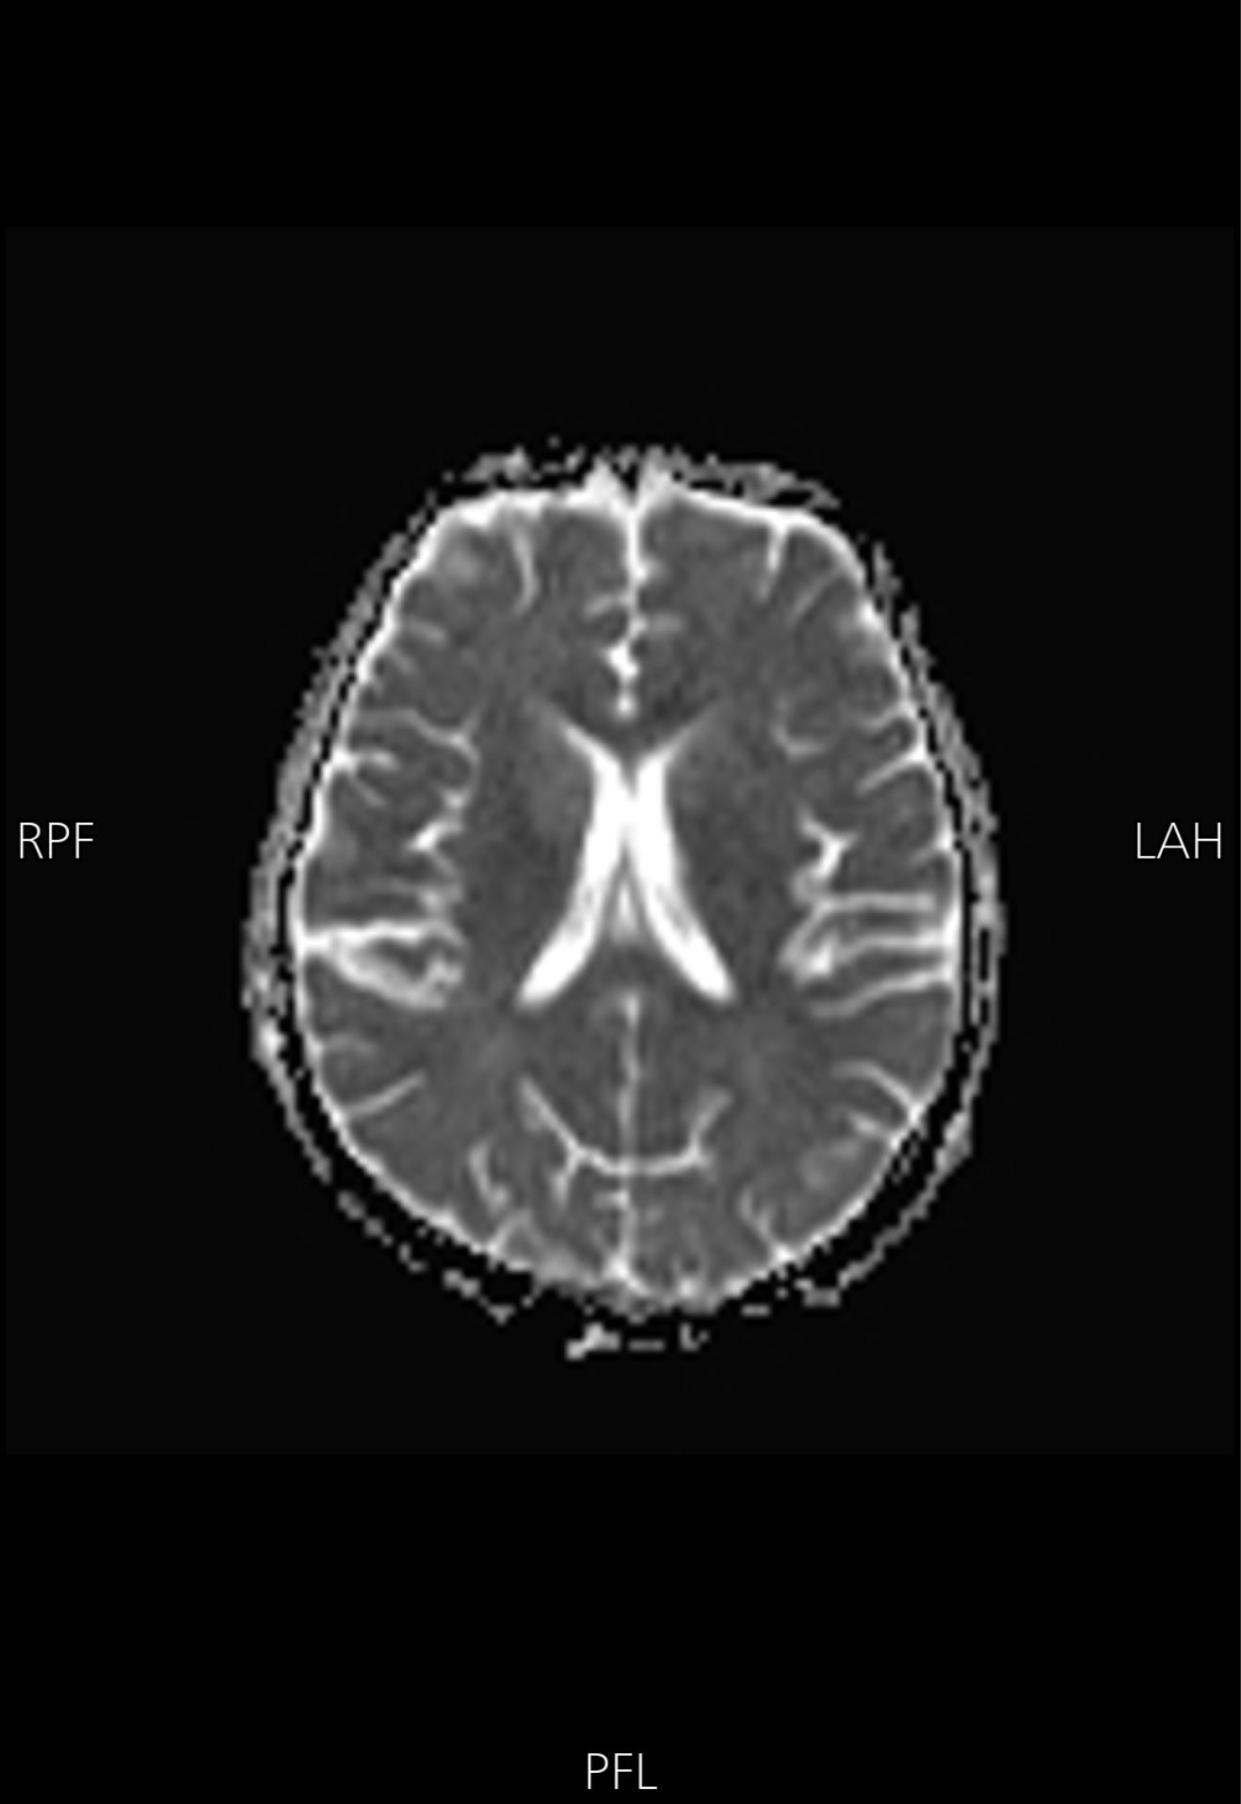

Slide 17
NEUROLOGY OPINION
IMP : PLHA associated cryptococcal meningitis
To start Inj. Amphotericin B - 1 mg / kg / day in 500 ml
5 % Dextrose IV .
Tab. Flucytosine 100 mg / kg / day into divided doses
To do csf analysis, c/s, ADA, KOH mount, fungal culture

Slide 18
ART MO OPINION
CD 4 – 24 cells
To start ATT
T. Septran 480mg 2-0-2

Slide 19
‘Case diagnosed as PLHA ASSOCIATED CRYPTOCOCCAL MENINGITIS.
TREATMENT GIVEN
Pre loading with 1L NS
Inj. Amphotericin B - 1 mg / kg / day in 500 ml
5 % Dextrose IV .
Inj. Pantoprazole 40 mg IV BD
Tab. Flucytosine 100 mg / kg / day into divided doses
Tab. Cotrimoxazole 480 mg 2 BD .

Slide 20
THANK YOU

