Slide 1
ECG FOR DISCUSSION
III MEDICAL UNIT
CHIEF: Dr. David Pradeep Kumar
ASSISTANT PROFESSORS: Dr. Naseema banu
dr. ram kumar
dr. nabil fayas

Slide 2
CASE SUMMARY
A 53 year old male presented with complaints of difficulty in breathing x 2 days
h/o fever x 2 days
No h/o cough with expectoration
No “ Rhinorrhea
no “ loose stools, abdominal pain, vomiting
No “ chest pain
No “ altered sensorium
No “ burning micturition
No “ headache
No “ seizures

Slide 3
Past HISTORY:
Patient Is known case of carcinoma oropharynx with cervical LYMPHNODE Metastasis
No H/O Any other medical or surgical illness
No “ Blood transfusion, drug allergy
Personal HISTORY:
Patient is a Chronic smoker, tobacco chewer and an alcoholic
Normal Bowel and bladder habits
Consumes Mixed diet
Vitals:
BP- 50/? Measured in right arm in supine position
PR- not recordable
SpO2- not recordable
HR- 136/min, irregularly irregular

Slide 4
On examination
pt drowsy
partly responds to oral commands
localizes pain
Pallor +
Tachypnic
Peripheries cold
no pedal edema, no cyanosis, no clubbing, no significant lymphadenopathy
CVS- S1 S2 +, No murmur
RS- B/L AE +, bilateral basal crepitations +
P/A- Soft

Slide 5
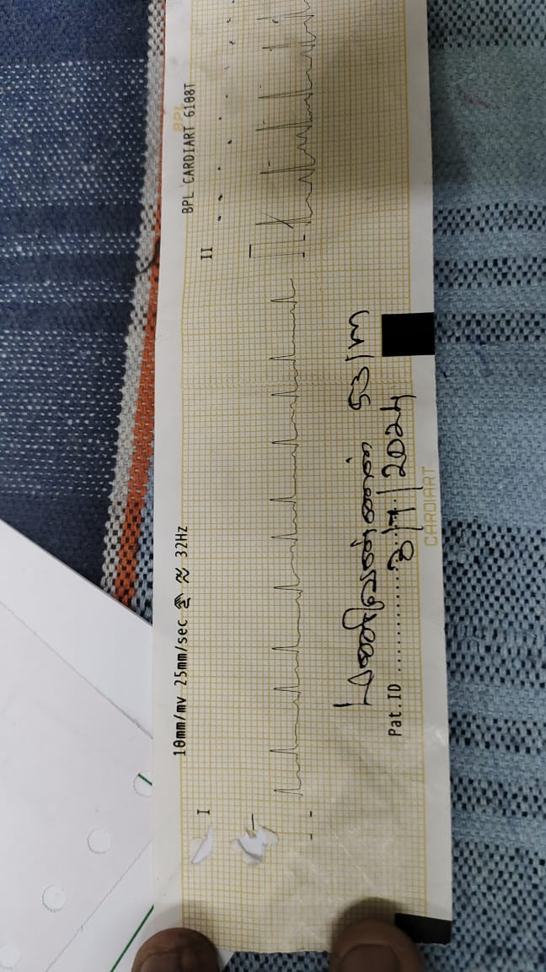
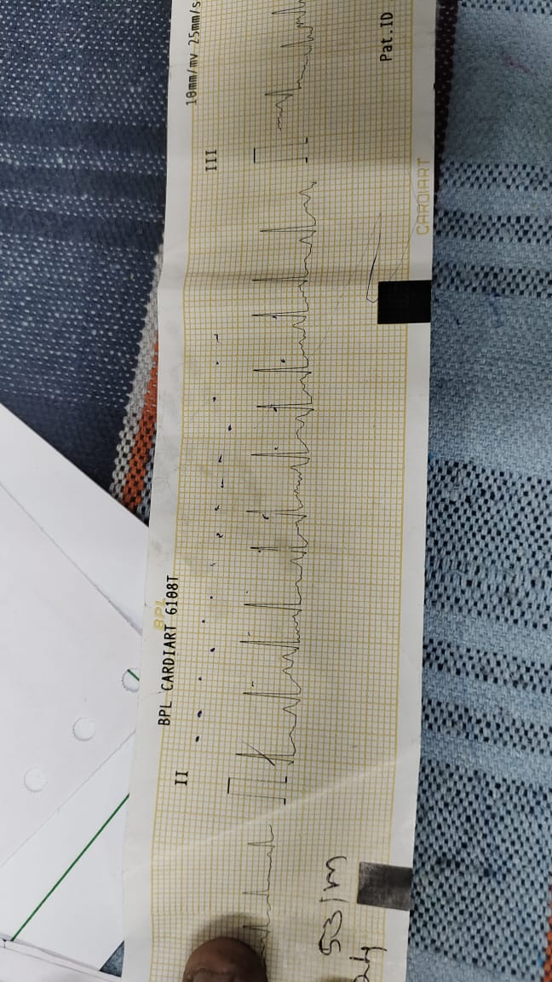
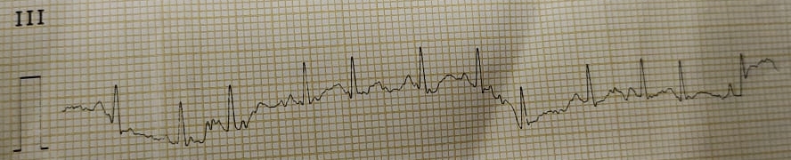
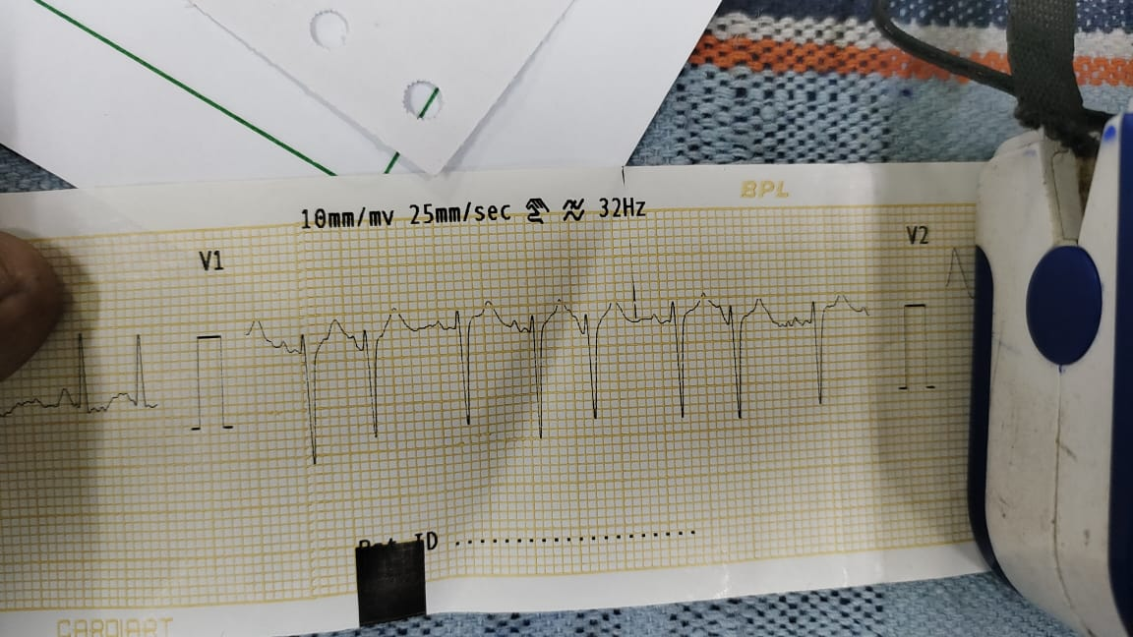
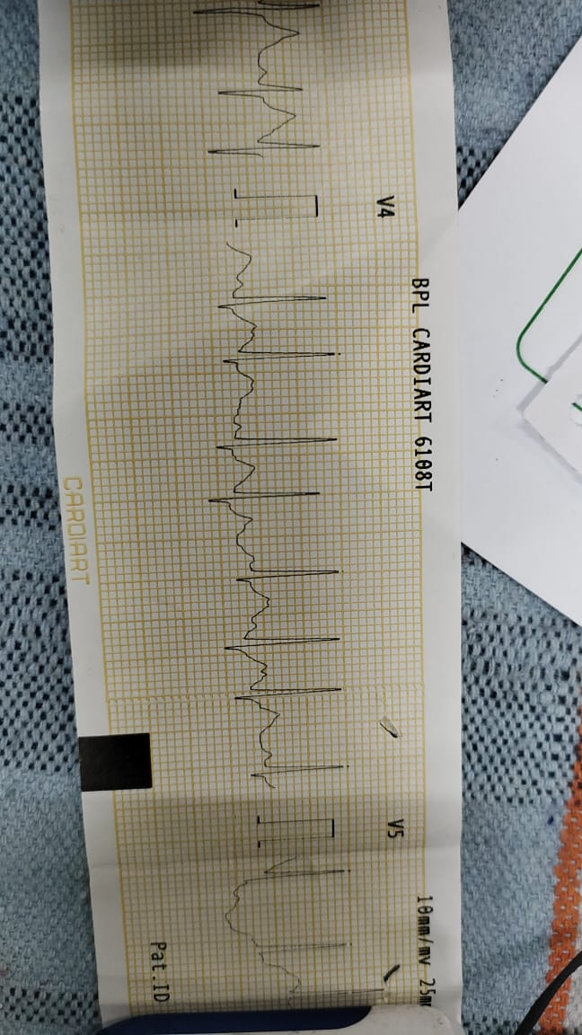
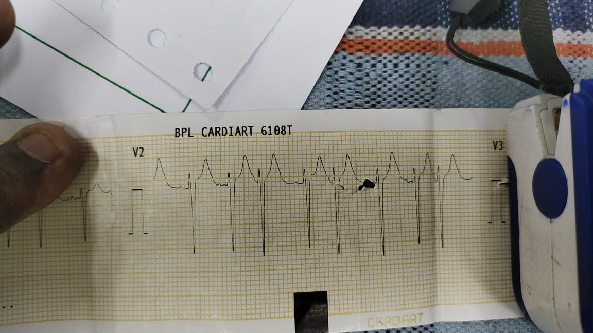
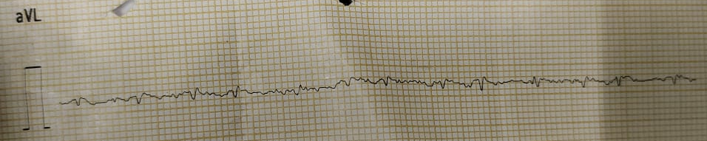
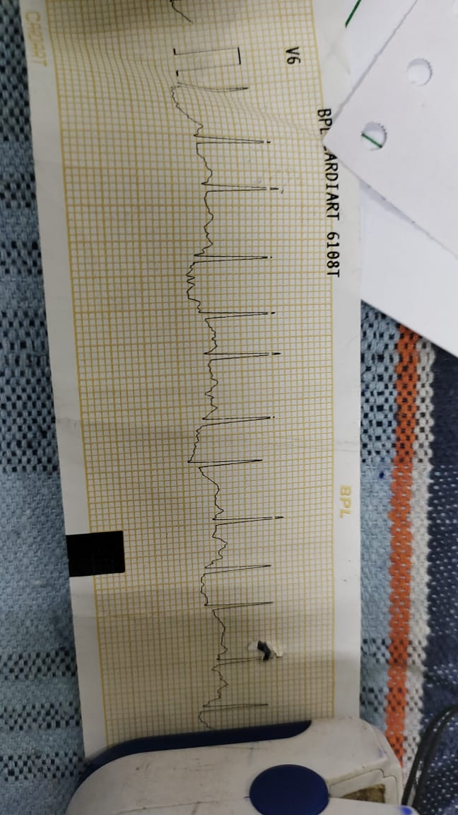
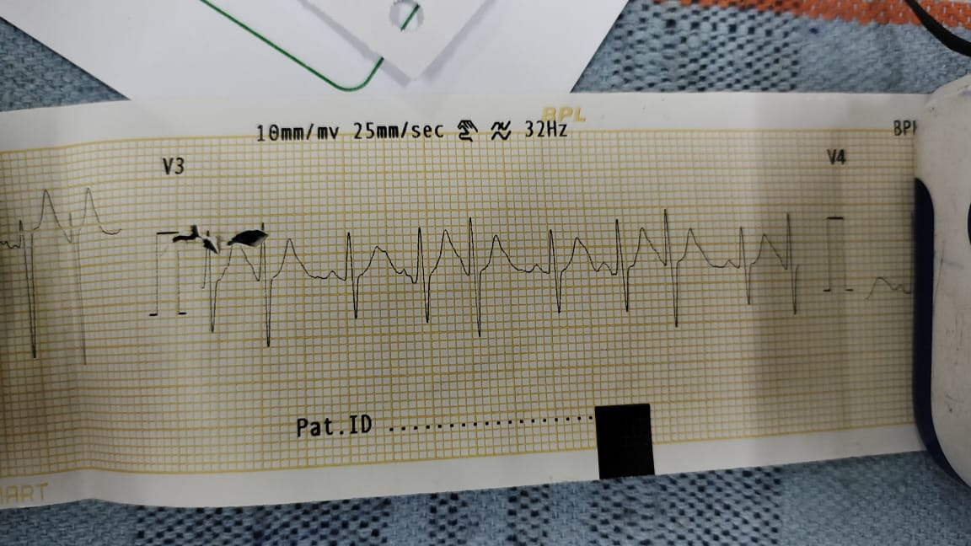
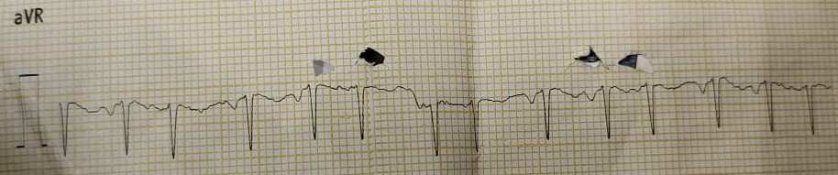
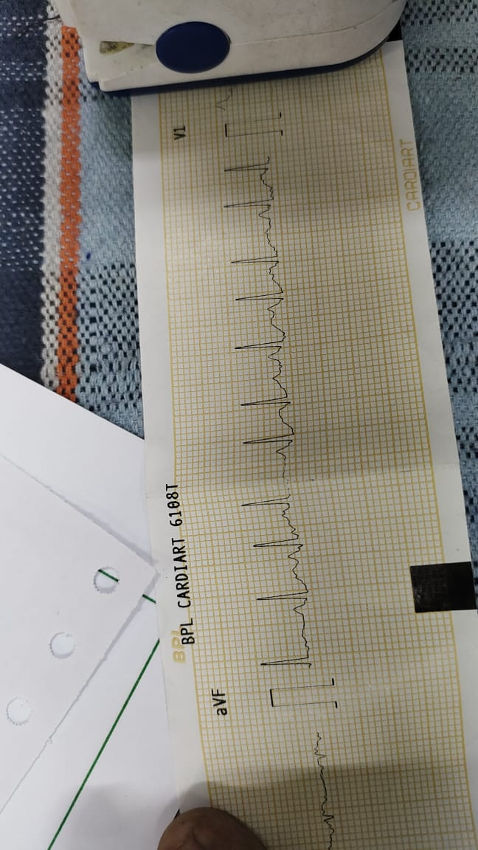
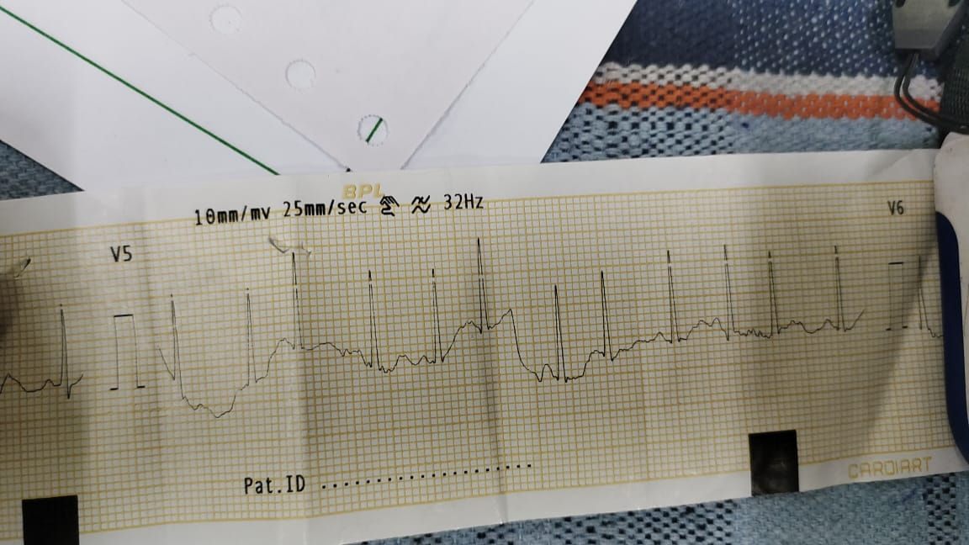

Slide 6
DISCUSSION

