Slide 1
A rare case of Cartap Poisoning
V MEDICAL UNIT
PROF: DR.J.SANGUMANI
ASST. PROF: DR.R.SUNDARAM
ASST. PROF: DR.K.S.RAGAVAN

Slide 2
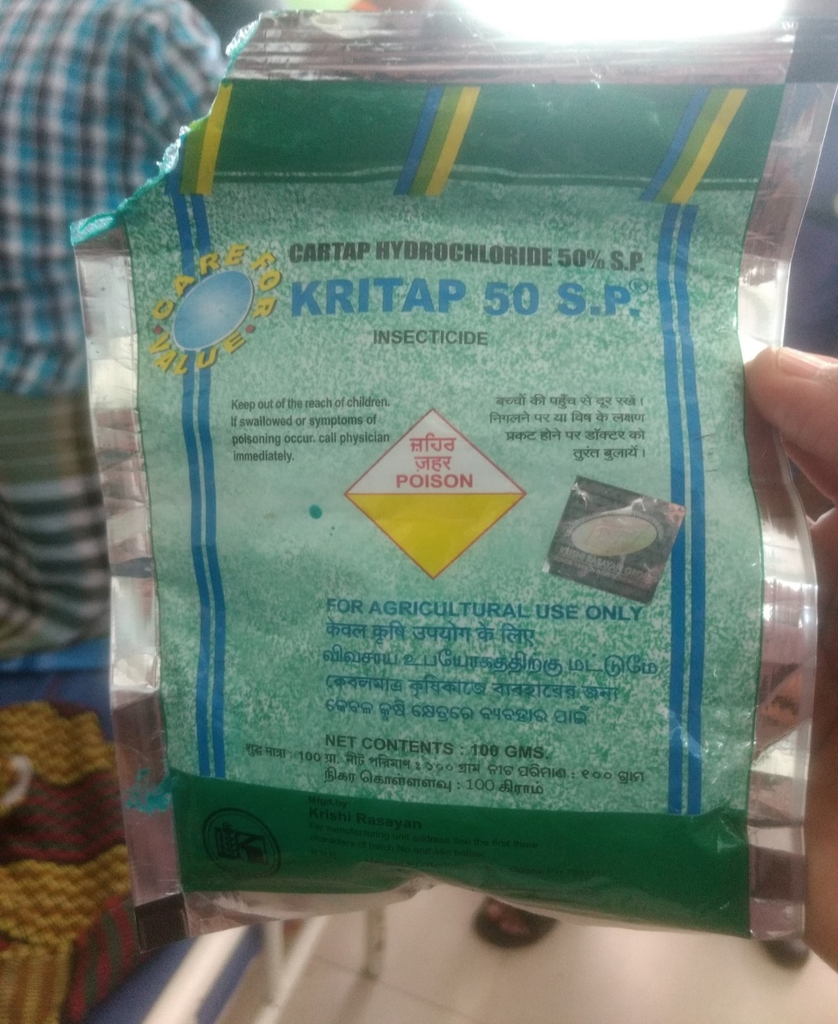
Complaints
25yrs old male
Alleged H/O Cartap poison ( 50% Cartap hydrochloride) ingestion on 3/3/17

Slide 3
Present history
H/O vomiting
No H/O increased salivation / lacrimation / increased sweating
No H/O involuntary micturition / loose stools
No H/O seizures
No H/O breathlessness

Slide 4
Past history
Not a K/C/O DM / HTN / BA / CVA / psychiatric illness.
No previous H/O deliberate self harm.

Slide 5
Personal history
Takes mixed diet
Smoker and alcoholic
Family history
Nil significant

Slide 6
On examination,
Pt was conscious, oriented
Not dyspneic / Not tachypneic
Afebrile
No pallor
No cyanosis / clubbing
Not icteric
No generalised lymphadenopathy
No pedal edema

Slide 7
Vitals
PR-96/min
BP-130/80mmHg
SpO2- 97% in room air
Temperature- Normal

Slide 8
Systemic examination
CVS-S1,S2 heard, No murmurs
RS- B/L air entry present, NVBS heard
No added sounds
Per abdomen- soft, non tender, BS Present, no organomegaly
CNS
Pt conscious, oriented
B/L pupils 4mm,RTL
Moves all 4limbs normally
No neck stiffness/Neck muscle weakness
No fasciculations

Slide 9
TONE | RIGHT | LEFT
UPPER LIMB | NORMAL | NORMAL
LOWER LIMB | NORMAL | NORMAL
POWER | RIGHT | LEFT
UPPER LIMB | 5/5 | 5/5
LOWER LIMB | 5/5 | 5/5
PLANTAR REFLEX | FLEXOR | FLEXOR
DTR | RIGHT | LEFT
BICEPS | BRISK | BRISK
TRICEPS | BRISK | BRISK
SUPINATOR | BRISK | BRISK
KNEE JERK | BRISK | BRISK
ANKLE JERK | BRISK | BRISK

Slide 10
Diagnosis
A case of Cartap Poisoning

Slide 11
Investigations
Hb- 15.2g%
TC- 8700cells/cumm
DC- 57/35/8
PLC-2.32L/cumm
PCV- 43%
ESR-12mm in 1hr
RBS-101mgs%
UREA-29mgs%
CREATININE-0.7mgs%
Sr.Pseudocholinesterase- 8000U/L
LFT-Normal
SODIUM-139mEq/L
POTASSIUM-4.2mEq/L
S.CALCIUM- 9.5mgs%

Slide 12
Treatment
NPO / RTA / Stomach wash
IV Fluids
Inj.Ranitidine 50mg iv bd
Inj.Thiamine 100mg IM od
Pt improved clinically and had been discharged on 7/3/17

Slide 13
Aim of presentation
A rare Poisoning and its different mechanism of action.

Slide 14
THANK YOU

