Slide 1
Delayed manifestation of snake bite
By 5th medicine unit
Chief Dr A SENTHAMARAI
Asst professor
Dr P sudha
Dr MJ senthil Kumar
Dr s sugadev
Presentor : Noorul Ameen

Slide 2
Chief complaints
A 60 year old male patient came to grh madurai er with the complaints of
Giddiness for 1 week

Slide 3
History of presenting illness
Patient was apparently normal one week before then he had
h/o giddiness for one week which is aggravated on changing the posture
h/o easy fatiguability which was started 4 years before and so he quits his job I. E mechanical shop worker
h/o vomiting 2 episodes per day for the last 5 days
No h/o headache /visual dusturbances
h/o altered mental status for 1 day

Slide 4
No h/o fever/myalgia/arthralgia
h/o weight gain
h/o cold intolerance
No h/o motor/sensory disturbance
h/o memory disturbance –recent memory on and off for past 2 years
No h/o abdominal pain/loose stools
No h/o loss of weight and loss of appetite
NO h/o libido/sexual disturbances

Slide 5
Past history
No h/o similar illness in the past
Not a known case of dm/htn/ckd/cad/epilepsy/thyroid disorders/copd
No h/o head trauma/surgery/irradiation
h/o snake bite in the left foot on 2007 for which he admitted with leg swelling,treated with surgical procedures –records not found

Slide 6
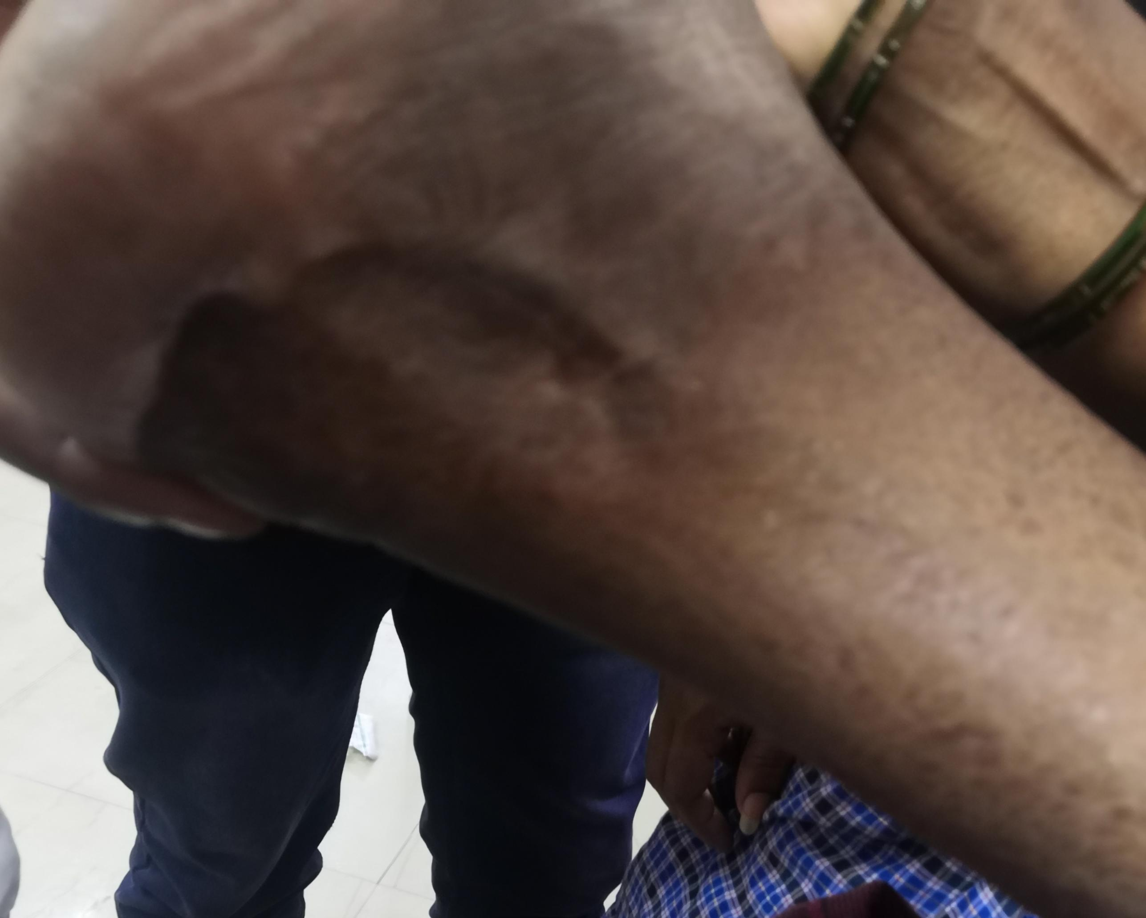

Slide 7
Personal history
Mixed diet
Normal bowel and bladder habits
Non smoker
Non alcoholic
Increased day time sleepiness

Slide 8
General examination
Pt was drowsy
Partially responds to oral commands
Afebrile
Pallor
Facial puffiness
No pedal edema
Scalp psoriasis

Slide 9
Hair loss in the frontal/temples
Sparse axillary hair
No hyperpigmentation
No striae/rashes
No lymphadenopathy
Bilateral gynaecomastia

Slide 10
IN the er department,cbg was recorded 40mgs ,hence treated with dextrose iv infusion
Pulse rate 50/mim regular rhythm normal volume
Blood pressure 100/60 mmhg measure in r upper limb supine posture
Saturation 96% in room air

Slide 11
Systemic examination
Cvs : s1 s2 heard,no murmur
Rs:bilateral air entry present, no added sounds
P/a:soft,bs+,no organomegaly
Cns :drowsy partially responds to oral commands
Moves all 4 limbs
Tone normal in all 4 limbs
Generalised muscle wasting
Deep tendon Reflexes +
No nystagmus
No involuntary movements
b/l pupil 3mm equally reacting to light

Slide 12
Basic investigation
Total count | 2200
Dc | 41/41/18
Hb | 8.1
Pcv | 24
Platelet | 1.77 l/mm3
Rbs | 73
Urea | 12
Creatinine | 1.0
Na+ | 121
K+ | 4.4
Total protein | 5.7
Albumin | 3.5
Globulin | 2.2

Slide 13
Vctc negative
Viral markers negative
Usg abdomen and pelvis : no ascites , liver /spleen n size and echoes, kidneys n size and cmd maintained
Ps:Manual wbc count 3900cells/mm3
Mild dimorphic anaemia{ microcytic + normocytic}
Thyroid profile
T4- 0.87 mcg/dl
T3- 0.34 mg/ml
Tsh – 2.77 miu/ml

Slide 14
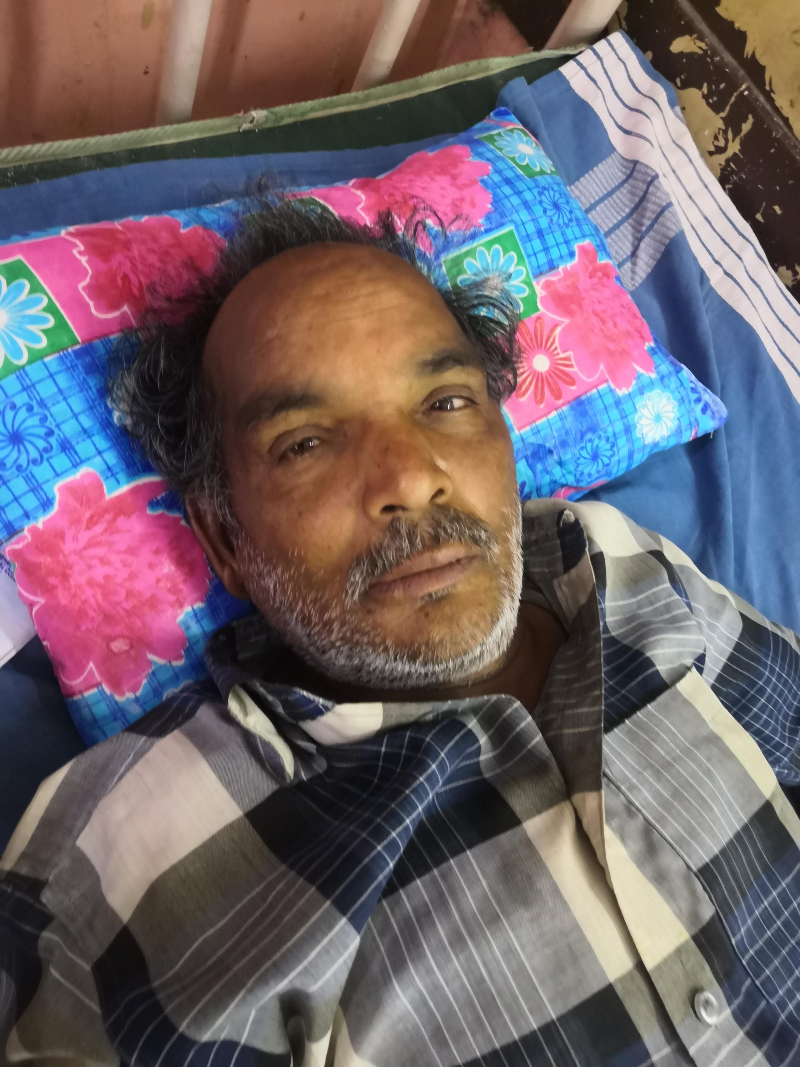
Provisional diagnosis
Giddiness for evaluation / central hypothyroidism/ anemia

Slide 15
Endocrinology opinion
Impression:
Central hypothyroidism ?central hypocortisolism
To r/o panhypopituitarism
Advice
Fasting serum cortisol
Repeat serm electrolytes
Mri brain
Add t.thyroxine 100 mcg 1 od on empty stomach

Slide 16
Investigations
Morning Serum cortisol- 3.38 mcg/dl
Repeat serum sodium – 114 meq/l
Lh- 1.73miu/ml
Fsh- 2.79 miu/ml
Testosterone- 34.01 ng/dl
Endocrinology review obtained
Panhypopituitarism - central hypocortisolism,hyoithyroiidism,hypogonadotropic hypogonadism
Inj.hydrocortisone 50 mg iv q8h
T.thyroxine 150 mcg od

Slide 17
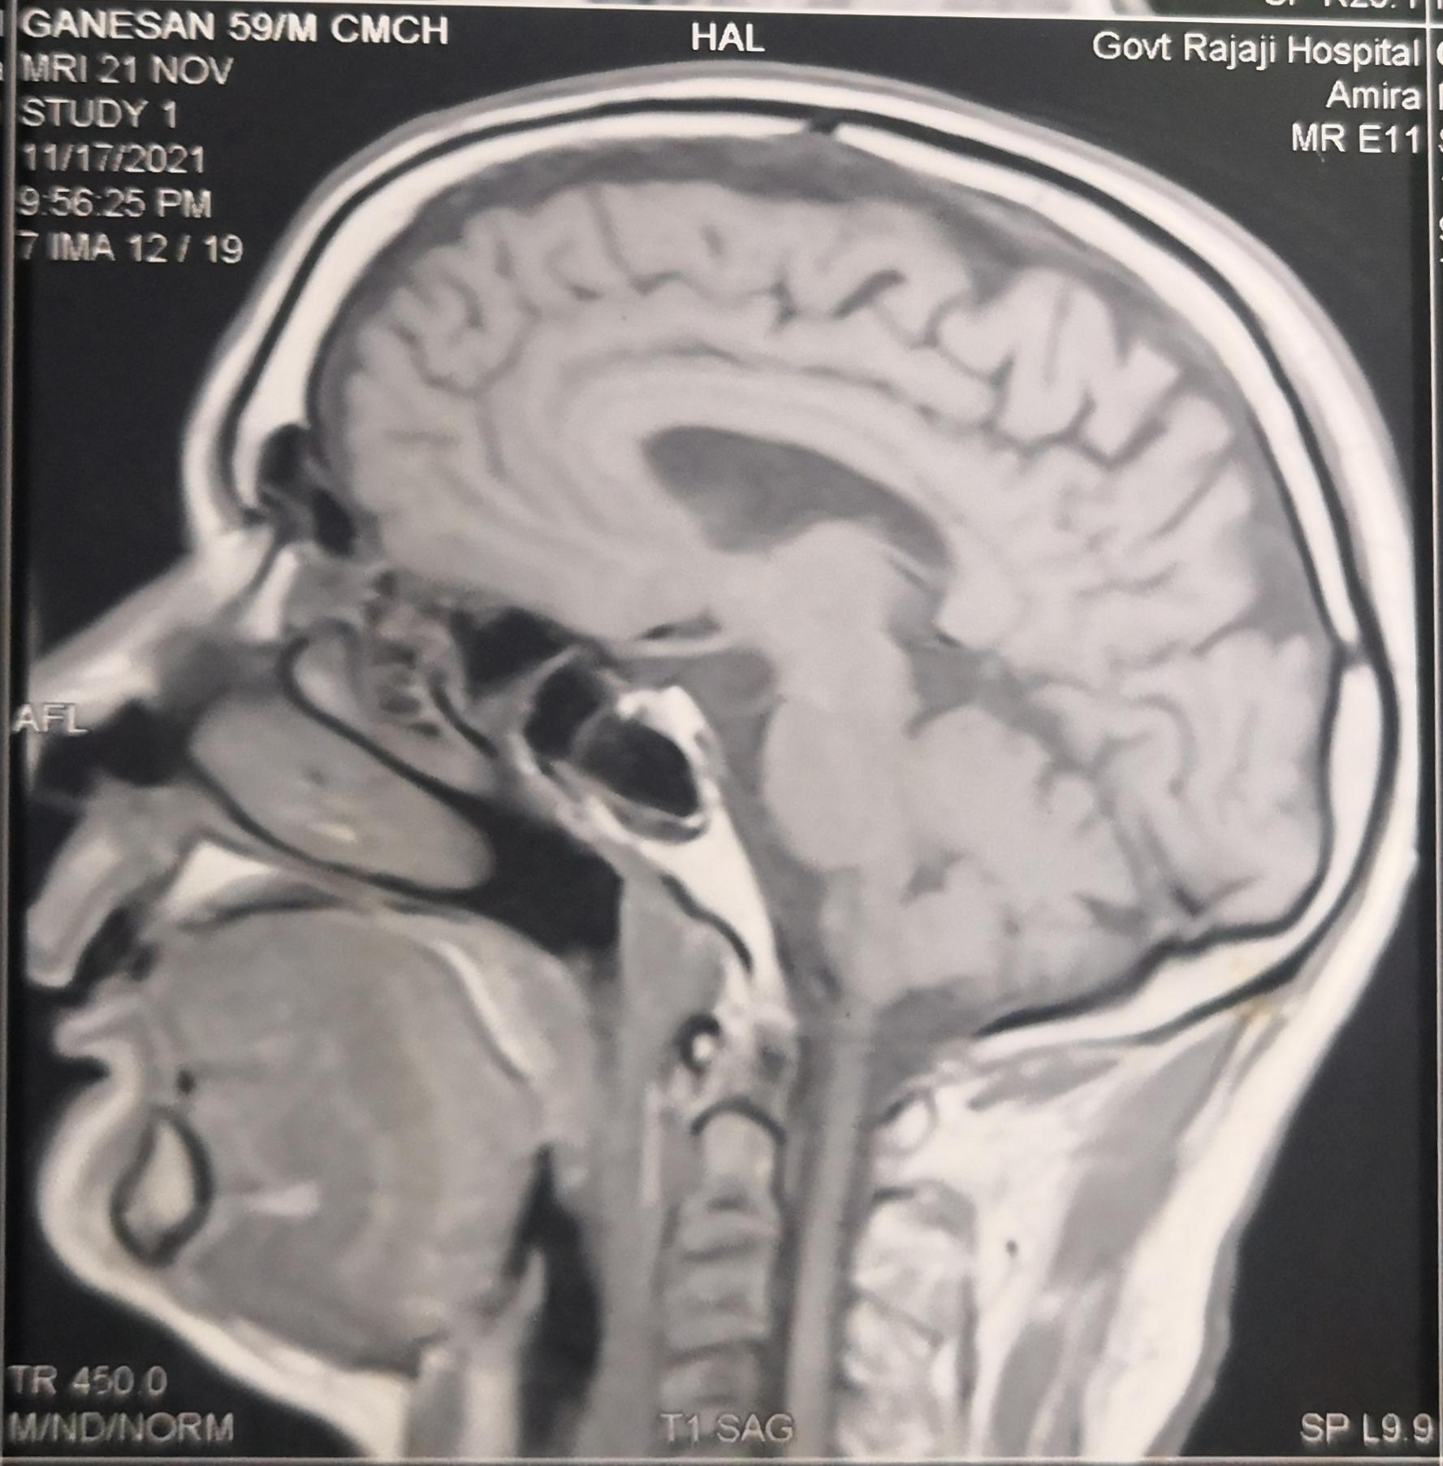
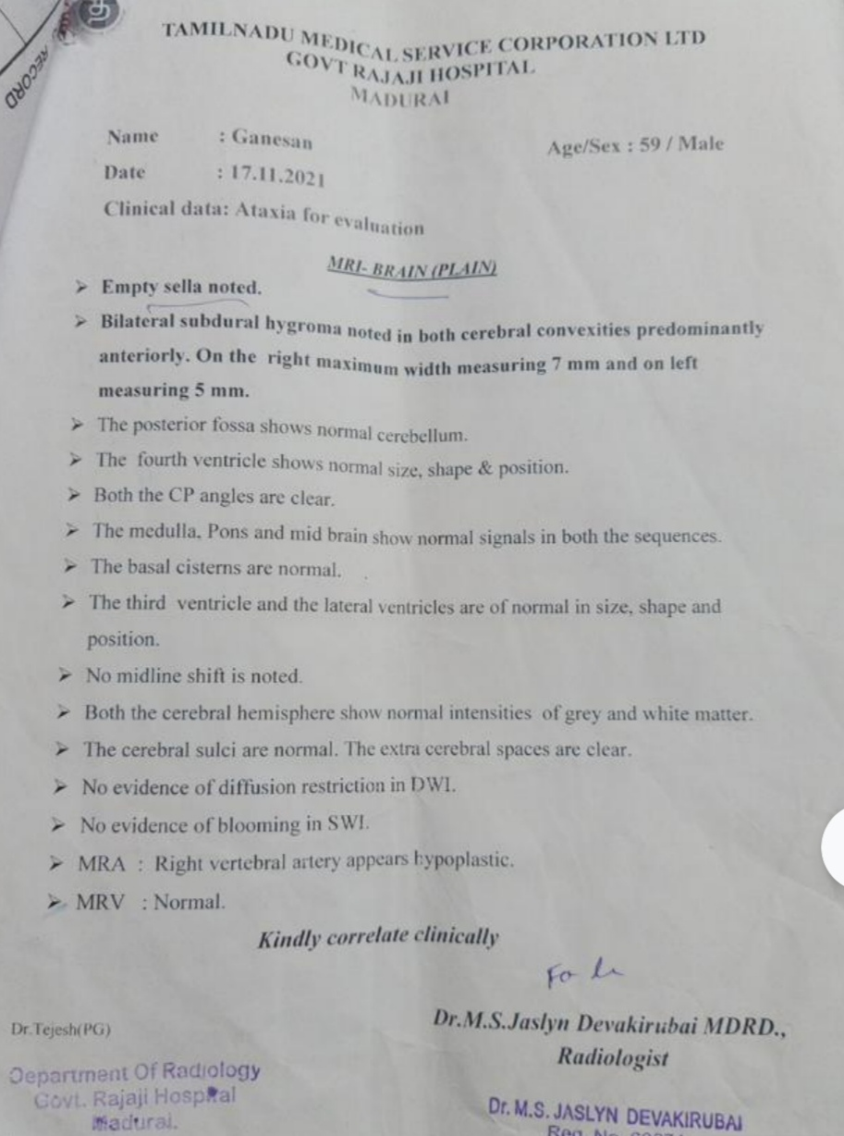
Mri brain

Slide 18
Final Diagnosis
Pan hypopituitarism /secondary empty sella/ Snake bite related

Slide 19
Aim of the presentation
Acute /chronic hypopituitarism can be the sequlae of snake bite mostly VIPER ENVENOMATION – high index of suspicion
Lab tests for hypopituitarism if unexplained hypotension, hyponatremia, hypoglycemia
Latency period can be as long as 4 upto 20 years

