Slide 1
A Hunt in THE cave
By VII th - MEDICAL UNIT
CHIEF & PROFESSOR :- Dr.S.Peer Mohamed M.D, ASST.PROF
Dr. Sheik Mohammed mydheen M.D,
Dr. M. Satheesh Kumar M.D,
Dr. C. Vignesh M.D,

Slide 2
Chief complaints
A 36 Years old female came with chief complaints of
- Headache X 2 weeks
- Painful left eye movements X 1 week
- Diplopia X 1week
- Outward deviation of left eye X 4 days
- Drooping of left eyelid X 4 Days

Slide 3
History of presenting illness :-
H/O Headache X 2 weeks
-Left frontal and around the left eye
-Sudden in onset
-Stabbing in nature
- Associated with nausea
-Non radiating
- no phonophobia/photophobia
-Releived on taking T.paracetamol
H/O painful left eye movement X 1 week
H/O Double vision X 1 week

Slide 4
History of presenting illness
H/O Outward deviation of left eye X 4 days
H/O Drooping of left upper eyelid X 4days
- initially partially covered eyeball, progressive
- Now eyelid completely covering left eye
NO H/O Fever
No H/O Vomiting
No H/O pain over the face
No H/O Diminished vision
No H/O Numbness over face

Slide 5
History of presenting illness
No h/o swaying to oneside
No h/o weakness of limbs
No h/o tremors /involuntary movement
No h/o swelling / congestion of eyes
No h/o altered mental status
No h/o involuntary movements
No h/o cough with expectoration
No h/o swelling in breast/ glands/ any other region
No h/o trauma
No h/o nasal or ear discharge /skin infection over face

Slide 6
Past history:-
No history of similar illness in the past.
No h/o recent neurosurgical /sinonasal procedures procedures
Not a known case of T2DM/SHTN/PTB/ thyroid disorders /Syphilis
Personal history :-
Mixed diet
Normal Bowel and bladder habits.
No h/o exposure to STD
Menstrual history:-
Regular cycle
3/28 days ,no menorrhagia/oligomenorrhea

Slide 7
Obstetric history :-
P3L3
Normal vaginal delivery
No history of abortion in the past
TREATMENT H/O :
-No h/o treatment with OC pills /immunosuppressive drugs

Slide 8
On examination
Pt conscious and oriented
Afebrile
Hydration – fair.
No pallor
Not Icterus
Not cyanosed
No clubbing
No pedal edema
No generalized lymphadenopathy
Vitals :-
BP – 110/70 mm of hg
PR – 72/MIN
SpO2 – 99% room air
BREAST Examination –normal
No glandular enlargement /goitre
No skin rashes

Slide 9
Cns examination :-
conscious
Oriented
Higher mental functions normal
MOTOR
power – 5/5 in all 4 limbs
Tone – normal in all 4 limbs
DTR - + in all 4 limbs
Bilateral plantar – flexor.
Muscles of mastication - normal
Sensory examination of face and limbs – normal
Cerebellum examination :
Finger nose test – normal
Finger Finger nose test – normal.
No dysdiadochokinesia.
No nystagmus.
No GAIT abnormality

Slide 10
Opthal examination
RIGHT EYE :
No ptosis
No protosis/ chemosis/conjunctival congestion
Conjuctival and corneal reflex +
No bruit over orbit
LEFT EYE :
Complete ptosis+,palpebral aperture closed
No proptosis/chemosis/conjunctival congestion
Conjunctival and corneal reflex +
No bruit over orbit

Slide 11
Ocular examination :-
EXTRA OCULAR MOVEMENT | Right eye | Left eye
Primary position | midline | Exotropia +
EYE LID ELEVATION | + | Complete ptosis +
ADDUCTION | + | restricted
ABDUCTION | + | +
ELEVATION | + | restricted
DEPRESSION | + | restricted
INTORSION | + | +
EXTORSION | + | impaired
Pupil | 3 mm | 5mm
Direct reflex Indirect reflex | + + | -- --
Oculomotor nerve involvement+
No RAPD - Optic nerve intact on bothside
Trochlear, abducent nerve not affected [abduction and intorsion normal]
Sensation over face normal –V1,V2 of trigeminal nerve unaffected
FUNDUS – normal on both eyes

Slide 12
Other cranial nerve examination
Visual acuity - 6/6 in both eyes,
No RAPD
Sensation over face normal
Nasolabial fold not obliterated,
No deviation of angle of mouth
Hearing – normal,
Rinne –AC>BC,weber –no lateralization
Gag reflex +
Palatal, pharyngeal reflex +
Sternocleidomastoid, trapezius – power normal.

Slide 13
Other system examination :-
CVS – S1,S2+ , NO MURMUR
RS – Normal vesicular breath sound+
No added sounds
P/A – Soft,
Bowel sound heard.
Ear ,nose,throat examination -normal

Slide 14
Provisional diagnosis :-
left eye painful opthalmoplegia
Isolated complete oculomotor nerve palsy with pupillary involvement

Slide 15
Routine Investigation :-
 | 15/1 | 19/1 | 23/1
WBC | 6400 | 6100 | 5500
Dc | 65/25/5 | 66/24/6 | 68/22/5
Hb | 9.6 | 9.9 | 10.1
Hct | 30.3 | 31 | 35
MCV | 77 | 79 | 82
PLT | 2.46L | 3.01L | 3.14L
Urea | 24 | 21 | 26
Creatinine | 0.7 | 0.8 | 0.7
Na+ | 136 | 134 | 135
K+ | 4.0 | 4.2 | 4.1

Slide 16
Investigation:-
 | 15/1/24
S.Corrected Ca2+ | 9.16
S. Phosphorous | 4
CRP | 35.8
ESR | 49
FBS | 96
PPBS | 136
Urine albumin | Nil
Urine sugar | Nil
Urine deposits | 0-2 pus cells
CHG WITH PS | Microcytic hypochromic anemia
LFT | 15/1
T. Bilirubin | 0.8
D.bilirubin | 0.3
I.bilirubin | 0.5
OT | 33
PT | 36
ALP | 59
Prothrombin time | 16.3
INR | 1.1
APTT | 27.4
T.protein | 8.0
T.albumin | 4.3
T.globulin | 3.7

Slide 17
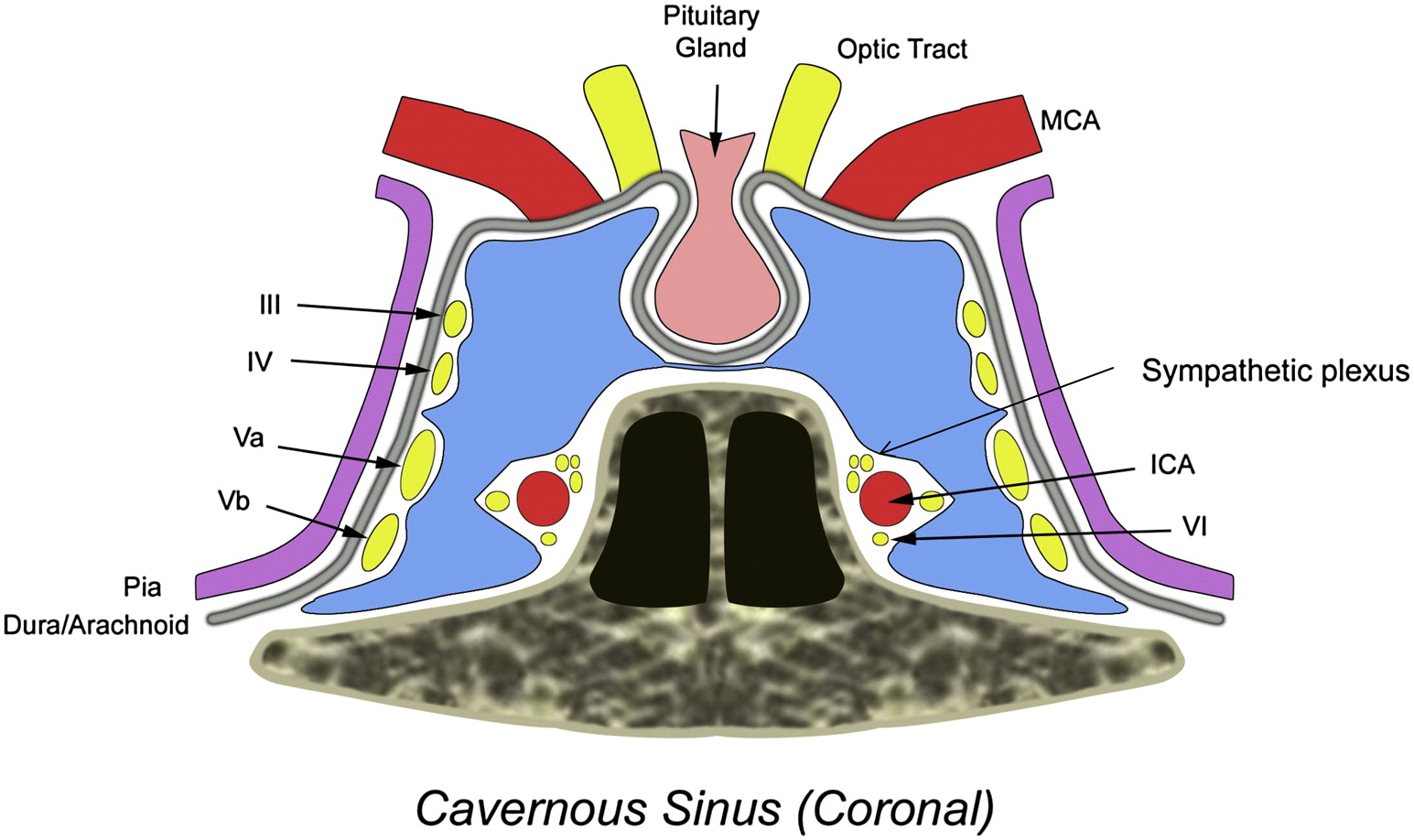

Slide 18
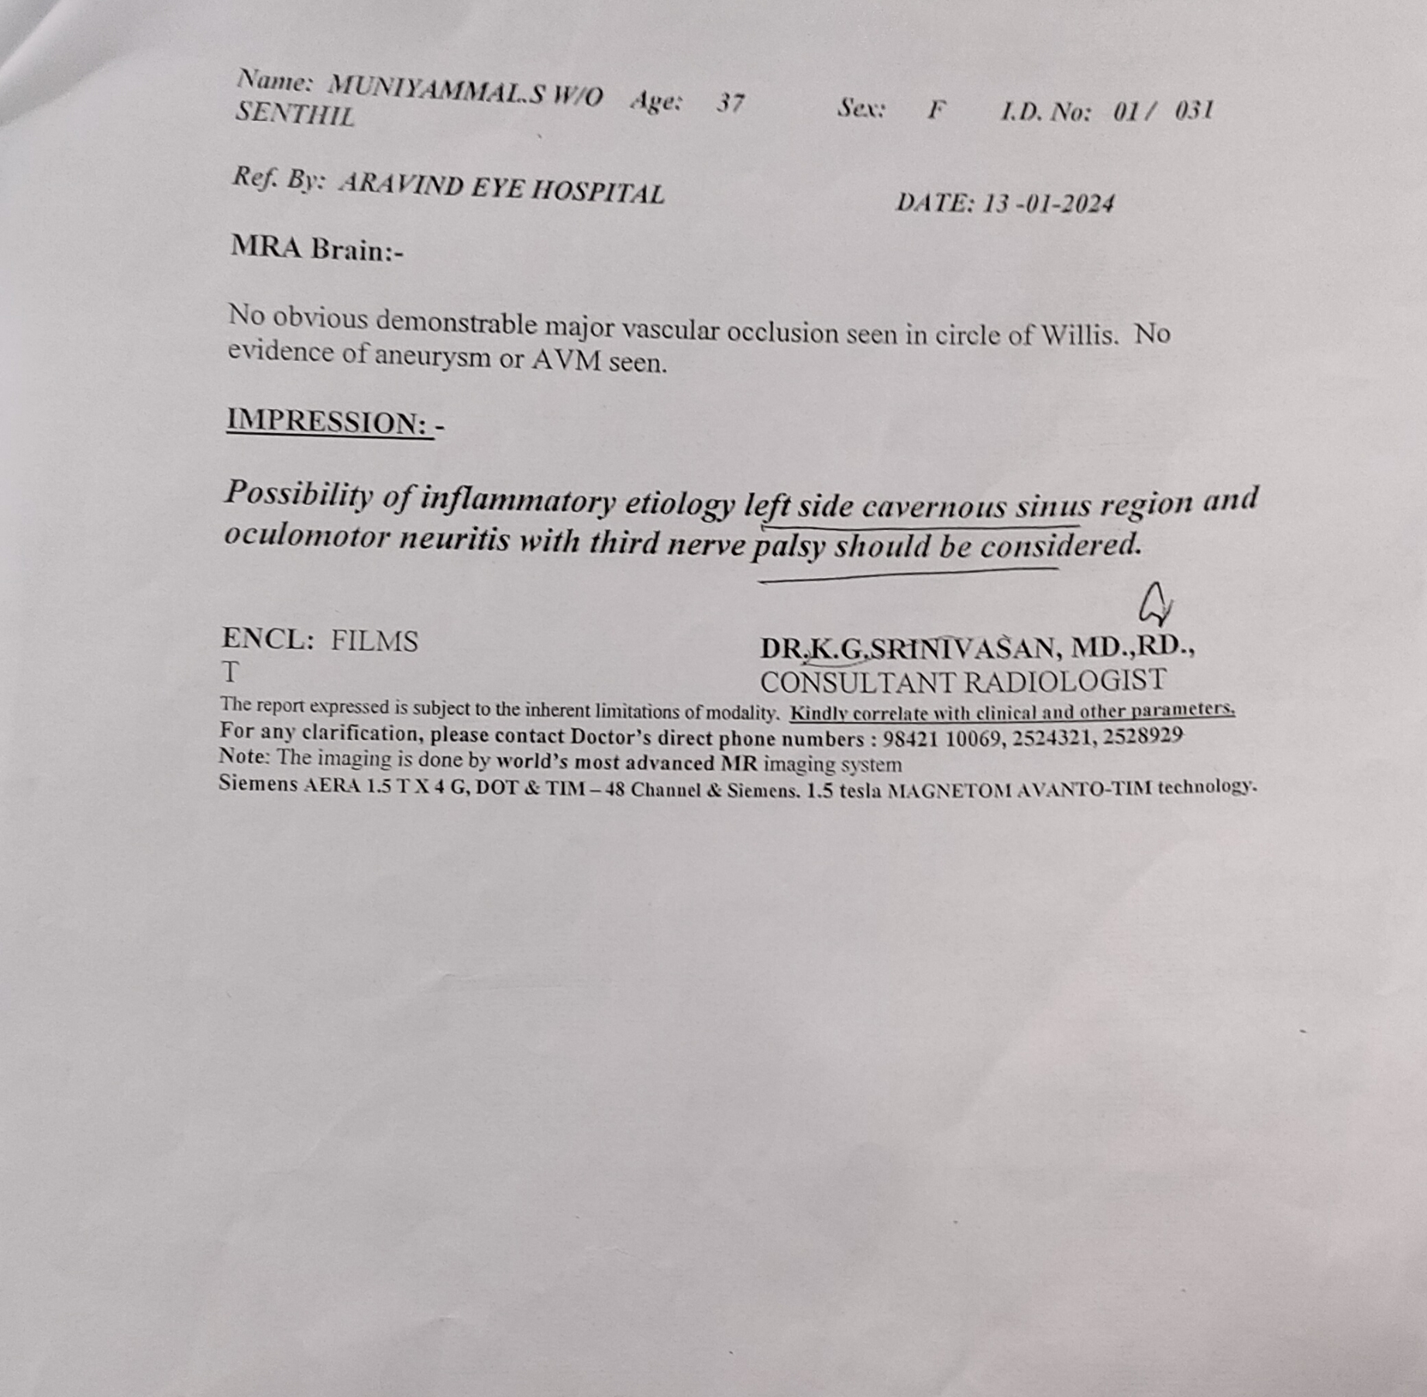
MRI BRAIN :-

Slide 19
Mri brain :
Soft tissue lesion involving left cavernous sinus region with thickened petroclinoid ligament measuring 1X 1 cm
Multiple T2 and flair bright signals involving both corona radiata and centrum semiovale - ?migraneous bright object/ ischemia related changes
Thickening of left oculomotor nerve +
MRA ,MRV – Normal.
Possibility of inflammatory etiology of left side cavernous sinus region and oculomotor neuritis with third nerve palsy should be considered.

Slide 20
Csf analysis :-
VCTC – Non reactive
Viral markers – negative
CT PNS - normal
CSF ANALYSIS | 15/1/24
Wbc - polymorphs | 2
Lymphocytes | 2
Protein | 35
Glucose | 98
LDH | Less than 20
CSF C/S | No growth.

Slide 21
Neurophysician opinion (14/1/24):-
Impression –
Left complete ptosis with left 3rd cranial nerve palsy with pupil involvement.
suggestive of cavernous sinus syndrome
Advice :-
ESR,CRP,ANA,CBC,RFT,LFT, S. ELECTROLYTES
INJ . methylprednisolone 1gm IV OD for 3 days
Continue IV antibiotics

Slide 22
Ophthalmologist opinion :-
Left eye Exotropia – 15°
Both eye Corneal and conjuctival reflex - normal
Both eye field of vision and colour vision – normal
Both eye fundus – normal
Right eye EOM - FULL
LEFT EYE EOM :-
Imp :- left occulomotor neuritis
-4
-3
-4
0
-4
-3

Slide 23
What next ?

