Slide 1
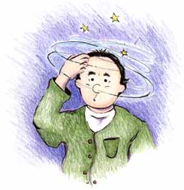
Dizziness and Vertigo

Slide 2
Dizziness
Vertigo: umbrella term. illusion of movement
Ataxia: inability to co-ordinate movements (walking or of extremities), “feel as if drunk”
Non-specific dizziness: lightheadedness, swimming sensation inside of head
Gait imbalance: feeling unsure when walking, okay if sitting or lying down

Slide 3
Evaluation of the Dizzy Patient
What type of dizziness is it?
How long does it last? Continuous or episodic
Spontaneous or positional
Duration of vertigo if episodic
Are there otologic symptoms?
Are there focal neurological symptoms?

Slide 4
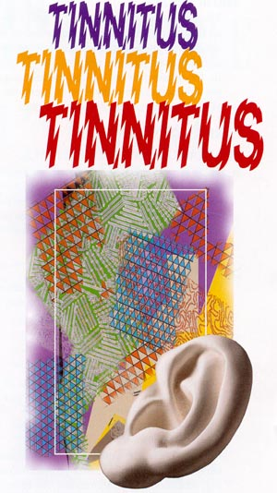
Otologic Symptoms in the Dizzy Patient
Hearing Loss: progressive, sudden SNHL,congenital, fluctuating
Tinnitus: continuous or episodic
Aural fullness
Ear pain, or chronic drainage
History of ear surgeries/infection

Slide 5
Focal Neurological Symptoms
Vertigo if secondary to cerebrovascular insufficiency is indicative of posterior circulatory problems
Visual loss
Loss of consciousness
Numbness especially if on one side
Weakness especially if on one side
Incoordination as if drunk, esp if in spells
Difficulty swallowing
Slurring of the speech

Slide 6
Evaluation of the Dizzy Patient
Family History:
Hearing Loss
Vertigo Spells
Headaches or visual auras
Gait ataxia or imbalance

Slide 7
Nystagmus: Features of Peripheral
Spontaneous nystagmus from imbalance of signals from the right and left vestibular periphery
The resulting nystagmus is a combined torsional, horizontal.
Alexander’s law: Increased frequency and amplitude of nystagmus with gaze in direction of fast component, reverse effect with gaze opposite to the fast component.
Inhibited by fixation

Slide 8
Features of Central Nystagmus
Prominent with and without fixation
Can be purely vertical (always central), horizontal, or torsional, of have some combination
The rule is if the nystagmus is vertical (upbeat or downbeat), it is central i.e. not coming from the inner ear
Cerebellar: spontaneous downbeat with vertical amplitude increasing with horizontal gaze deviation
or brought out when placed in supine position

Slide 9
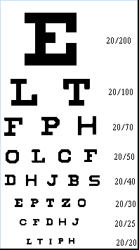
Bedside Tests of Vestibular Function: Dynamic Visual Acuity
Oscillopsia : perception of environment jumping up and down when walking.
Ask the patient: “Can you read the print on the cans while walking down the grocery store aisle?”
May be a sign of bilateral loss of VOR function
Horizontal passive rotation at 2 Hz. Normal is loss of 1 line of Snellen acuity card, bilateral vestibular loss will lose 5 lines.

Slide 10
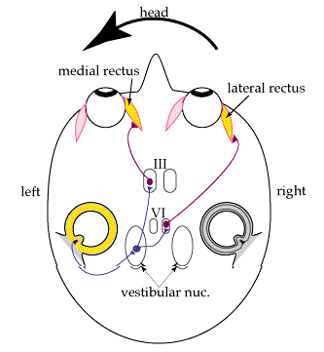
Bedside Tests of Horizontal VOR: Head Thrust Test
Rapid, high-acceleration head thrust with patient fixating on examiner’s nose
Corrective saccade (catch-up saccade) when head is rotated toward the affected vestibular periphery is positive
Positive in vestibular neuritis, gentamicin ototoxicity (bilateral), idiopathic and autoimmune vestibulopathy
May be normal to have slight VOR hypometria bilaterally in older patients

Slide 11
Bedside Vestibulospinal Examination

Slide 12
Ataxia Syndromes
Patient may present with unsteadiness, limb incoordination, dysarthria.
On examination, there may be dysmetria on FTN testing
On ENG testing, hypermetric saccades, abnormalities of OKN, or of smoooth pursuit.
MRI : atrophy of the cerebellar vermis and / or hemispheres

Slide 13
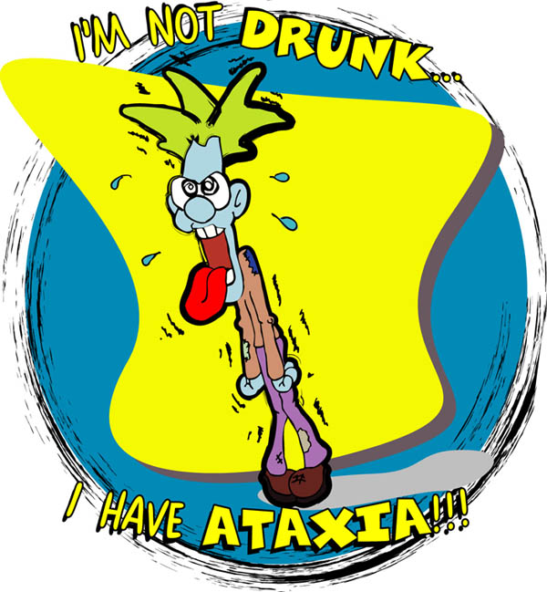
Spinocerebellar Ataxia
Familial SCA 6
Accounts for 5-15% of SCA autosomal dominant in U.S. (higher % in Japan)
Onset of symptoms usually 3rd to 6th decade
Usually complain of episodic vertigo and oscillopsia,
especially immediately after lying supine from the sitting position, or quick turn of the head
Chromosome 19p VGCC (CAG repeat)
highly expressed in the cerebellum
Down-beat nystagmus in supine position

Slide 14
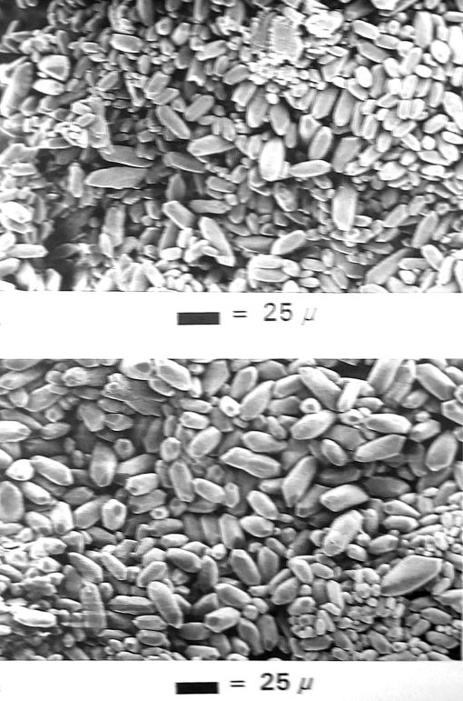
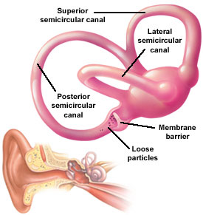
Benign Paroxysmal Positional Vertigo
Otolithic calcium carbonate crystals become loose, and fall into the posterior semicircular canal
Common with head trauma, older age, inner ear disease
One of the most common cause of vertigo seen in neurotology clinics, estimated at 20-30% of patients

Slide 15
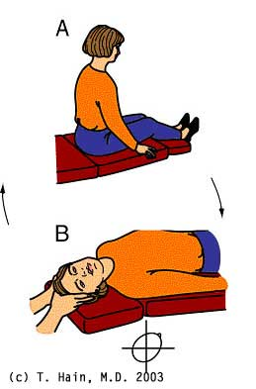
Benign Paroxysmal Positional Vertigo
Typical complaint: spells of vertigo when turning over in bed, “top shelf vertigo”
Examine the patient for nystagmus and vertigo in the Dix-Hallpike position : head-hanging R and L
Vertigo lasts shorter than 1 minute
Geotropic, torsional nystagmus
with upbeat component
Brought on only by positional changes
Latency of few seconds up to 45 sec
Fatigues with repeated testing

Slide 16
Modified Epley Maneuver

Slide 17
Epidemiology of BPPV
Lifetime prevalence of 3.2% in females and 1.6% in males
Of 100 unselected elderly patients, a prevalence of 9% was reported
Median duration of two weeks
Female preponderance likely reflects the association of migraine with BPPV
Association of BPPV with hypertension and hyperlipidemia
Vascular damage to the inner ear facilitates detachment of the otoconia
Von Brevern et al., 2006

Slide 18
Benign Paroxysmal Positional Vertigo
Can be presentation of acoustic / inner ear disease: screening audiogram is preferred
Etiology of BPPV in 240 patients (Baloh et al., 1987)
Idiopathic in 49%
Traumatic in 18%
Viral Labyrinthitis in 15%
VBI in 5%
Meniere’s in 2%
Surgery in 4%
Ototoxicity in 2%
Idiopathic young patients: 3x incidence of migraine vs. in those with BPPV with known cause (e.g. head trauma) Ishiyama et al., 2000

Slide 19
Positional and Spontaneous Vertigo: Multiple Sclerosis
Vertigo is the initial symptom of MS in 5%, and presents in 50% of MS patients at some time in the course.
25% of patients with MS have caloric paresis
80% have eye movement abnormalities
Oftentimes abnormalities on ABR and occasionally retrocochlear hearing loss from involvement at the root entry zone near pons

Slide 20
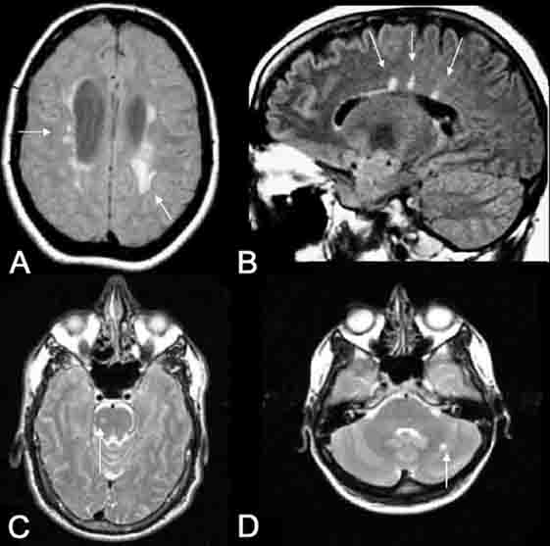
Positional and Spontaneous Vertigo: Multiple Sclerosis
Demyelinating disease of unknown etiology
Onset usually in 3rd and 4th decade of life
Common associated signs and symptoms: INO (internuclear ophthalmoplegia), optic neuritis, Llermitte’s sign, vibratory loss, spasticity, sensitivity to temperature
MRI with FLAIR: plaques

Slide 21
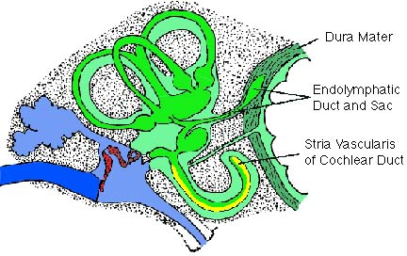
Meniere’s Disease
Symptoms: Fluctuating hearing loss, tinnitus, ear fullness, and vertigo. May have initially only hearing loss or only vertigo spells.
Possibly sudden falls (Tumarkin crisis)
Hearing loss, tinnitus, and aural fullness increase during the vertigo attack
Typically lasts 20 minutes or more in duration

Slide 22
Meniere’s Disease
On temporal bone histopathology, there is a distension of the entire endolymphatic system
Audiogram: often low-frequency sensorineural hearing loss that increases during attacks.
ENG: Vestibular paresis or directional preponderance to bithermal caloric stimulation

Slide 23
Meniere’s Disease: Tumarkin falls
In about 7-10% of Meniere’s disease, there are associated sudden falls “drop attacks”
No warning, sudden, violent fall without loss of consciousness
Subjective sensation of being pushed by an external force
Recently noted to be associated with migraine
(Ishiyama et al., 2003)
Surgical ablation is curative of these dangerous and frightening drop attacks

Slide 24
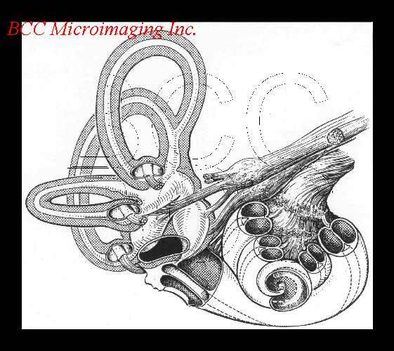
Meniere’s Disease Variant: Delayed Endolymphatic Hydrops
Delayed hydrops develops in an ear that has h/o profound SNHL years before (up to 70 years before)
Many years later: recurrent spells of vertigo of 20 minutes duration or longer
Often without accompanying otologic symptoms of aural fullness, increased tinnitus and hearing fluctuation
Can also have Tumarkin falls

Slide 25
Migraine-associated Vertigo
Vestibular Meniere’s, migraine-associated vestibulopathy, benign paroxysmal vertigo
25% of patients with migraine have vertigo spells
Duration of the vertigo varies:
31% few min-2 hr
49% > 24 hrs
7% seconds
25% of patients with migraine have caloric paresis
Isolated vertigo without headache are termed migraine equivalent

Slide 26
Migraine-associated Vertigo
Migraine is an inherited, likely metabolic syndrome with multiple causes, likely autosomal dominant with variable penetrance
Always ask about the family history
Ask about h/o motion sickness (50%)
Ask about h/o altitude sickness
Ask about sensitivity to visual stimuli (bright lights/ patterns, panoramic theater, computer work)

Slide 27
Migraine-associated Vertigo
Ask about h/o recurrent abdominal pains or cyclical vomiting as child, which is usually migraine equivalent
Ask women specifically regarding menses: some will call migraine headaches “PMS”
Migraine-associated vertigo often has a catamenial component, or worsened by OCP in women

Slide 28
International Headache Society Criteria for Migraine Headaches
At least 5 attacks fulfilling B-D
B. Headache lasting 4-72 hrs
C. At least 2 of: unilateral, pulsating, moderate or severe, aggravation by physical activity
D. At least one of N/V, photophobia and phonophobia
Other causes ruled out

Slide 29
Variants of Migraine
Migraine visual aura: Visual aura may occur isolated without headache: fortification spectra, scotoma, stars, patterns of colored lights lasting usually 15-20 minutes
Retinal migraine: retinal artery vasospasm which can cause monocular blindness: prophylaxis with verapamil
Benign paroxysmal vertigo of childhood: recurrent spells of vertigo in child is usually migraine, may or may not have H/A

Slide 30
Association between Migraine and Vestibulopathy
Tumarkin falls may be associated with migraine
Out of 55 patients with Tumarkin falls, 6 had >1yr h/o normal hearing
5 out of 6 had h/o migraine
Tumarkin falls are known to localize to the vestibular periphery since surgery is curative
Ishiyama et al., 2003

Slide 31
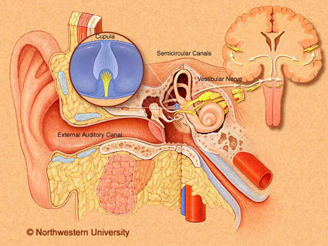
Vestibular Neuritis
Subacute onset of vertigo, often with nausea and vomiting
Vertigo lasts a few days, and crescendos in few hours, and decreases in severity with time
Suspicion for viral cause but evidence for ischemic causes
Temporal bone histopathology: Scarpa’s ganglion neuronal loss

Slide 32
Vertebrobasilar insufficiency
20% of all strokes are in the vertebrobasilar distribution
Usually from atherosclerotic disease, but 1/5 of infarcts may be cardioembolic
Common cause of episodic, spontaneus vertigo of abrupt onset in older patients
Grad and Baloh (1989): 62% had isolated vertigo without associated neurological deficits, and 19% had isolated vertigo as first TIA
Several minutes (3-4 min) duration is always suspicious for TIA

Slide 33
Vertebrobasilar insufficiency
Visual (diplopia/ illusions, field defects in 69%
Drop attacks in 33%
Imbalance/ incoordination in 21%
Extremity weakness in 21%
Confusion in 17%
Headache in 14%
Hearing loss in 14%
Loss of consciousness in 9.5%
Extremity numbness in 9.5%
Dysarthira in 9.5%
Tinnitus in 9.5%
Perioral numbness in 5%

Slide 35
Stroke syndrome with vertigo: Wallenberg syndrome
Dorsolateral medullary syndrome
PICA (posterior inferior cerebellar artery)
Vertebral atherosclerotic disease
(artery to artery emboli) prior to takeoff
Consider vertebral dissection
Look for h/o neck trauma or manipulation

Slide 36
Wallenberg symptoms
Right Dorsolateral medullary stroke
Nystagmus and vertigo (vestibular nuclei)
Difficulty swallowing, hoarse voice, absent gag on R (nucleus ambiguus)
Difficulty limb coordination on the right FTN, HTS (right cerebellum)
On walking, veers and falls to the right
Pain and temperature loss on right face and left leg, trunk, arm (spinothalamic)
Right Horner’s: ptosis, miosis, anhydrosis (reticulospinal fibers in lateral medulla)

Slide 37
Stroke syndrome with vertigo: Anterior inferior cerebellar artery
Vertigo
Tinnitus, hearing loss secondary to infarct of cochlea/nerve or cochlear nucleus
Ataxia
Facial paralysis and numbness
Ispilateral Horner’s

Slide 38
Stroke syndrome with vertigo: Labyrinthine infarction
Occlusion of the internal auditory artery
Sudden, profound hearing loss
Acute onset of spontaneous vertigo lasting days
Consider the diagnosis in older patients with h/o TIA, stroke, or atherosclerotic vascular disease

Slide 39
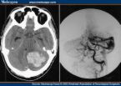
Cerebellar Hemorrhage
Etiology is hypertensive vascular disease in 2/3 of patients
Acute onset of vertigo, nausea, and vomiting and severe headache, inability to stand
Spontaneous or gaze evoked nystagmus, dysmetria, truncal ataxia
Often requires prompt evaluation and surgical decompression to prevent progression to coma or even death from herniation

Slide 40
Duration of vertigo
Duration
BPPV Seconds, always < 1 min
VBI Few minutes,
± focal neurological signs
Migraine Varies sec, minutes, hours or days
Meniere’s 20 minutes to hours
Vest.neuritis Days
Stroke Days

Slide 41
Treatment of vertigo
Treatment reserved for short term control of vertigo.
Longer duration of treatment can cause psychomotor retardation and sedation
Vestibular suppresents like
1.Flunarizin 5 -10 mg daily
2.vasodilator like betahistine 24-48 mg/day
3.Tranquilizer like diazepam 2.5 mg 1-3 times daily.
4.Antidepressents like Amitriptyline 10 mg 1 HS to 1 TDS
5.Antihistamine. Like Dimenhydrinate ,Meclizine, Promethazine,cinnarizine. And diuretic in case of endolymphatic hydrops.

