Slide 1
A CASE OF ANAEMIA WITH SPENOMEGALY
CHIEF PROF: Dr.DAVID PRADEEP KUMAR M.D,MRCP
ASST PROF: Dr.RAM KUMAR M.D
ASST PROF: Dr.NASEEMA BANU M.D
ASST PROF: Dr.NABIL FAYAZ M.D
PRESENTOR: Dr.HAMITH MUJAMMIL KHAN PG

Slide 2
A 33 years old male came here, with history of
Easy Fatigability
Abdominal distention
for 2 years

Slide 3
TREATMENT HISTORY:
Patient was previously treated for multiple joint pain and fatigue, in Theni GH as a case of Anaemia with splenomegaly and gouty arthritis
2 months later, went to Private hospital, and evaluated
1) Usg Abd showed Gross splenomegaly with Portal vein, IVC, Hepatic vein doppler showing normal flow
2) OGDscopy – Normal study

Slide 4
3) Echo – Normal study
4)Bone marrow aspiration study:
Hypocellular marrow
and planned for splenectomy
Patient went to alternate medicine and discontinued treatment as his condition doesnot improve

Slide 5
GENERAL EXAMINATION
VITALS
Conscious, oriented
Pallor+
No icterus, cyanosis, clubbing
No generalized lymphadenopathy
No pedal edema
BP-100/60 mmHg
PR- 96/ min
SpO2- 98% in RA

Slide 6
SYSTEMIC EXAMINATION
ABDOMEN:
Spleen crosses umblicus, 11cm from Left Costal margin
BS+
Other system examination – Normal
Fundus examination- Normal

Slide 7
INVESTIGATIONS
TC | 4500
Hb | 7.6
PCV | 24.5
PLT | 1,80,000
MCV | 84.8
MCH | 26.3
Ur | 20
Cr | 1.0
RBS | 135
Na | 135
K | 3.5
Ca | 8.6
P | 4.7
Uric Acid | 9.1

Slide 8
TOT. BILIRUBIN | 1.2
DIR. BILIRUBIN | 0.9
IND. BILIRUBIN | 0.3
SGOT | 18
SGPT | 15
ALP | 84
PT | 16.1
INR | 1.2
APTT | 35.9
HBsAg | NEGATIVE
HCV | NEGATIVE
HIV | NON-REACTIVE
CHEST X-RAY | Normal Study

Slide 9
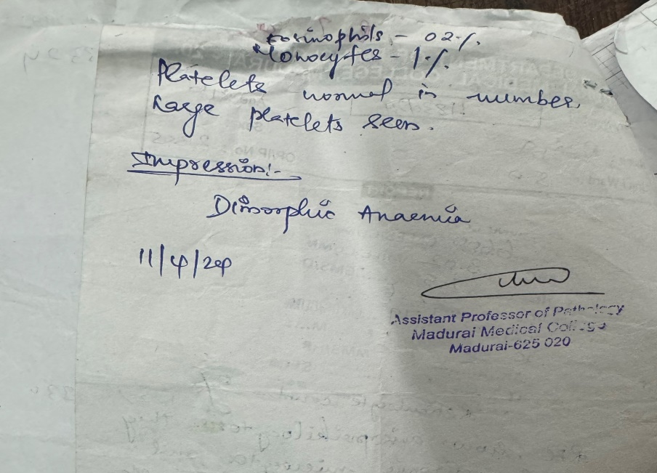
PERIPERAL SMEAR

Slide 10
USG ABD AND PELVIS

