Slide 1
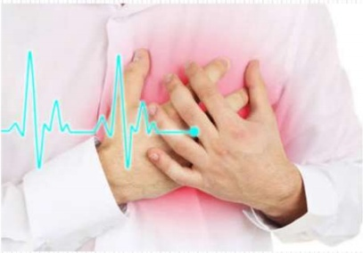
ACUTE MYOCARDIAL INFARCTION
Prof.Dr.G.Bagialakshmi M.D
Associate Professor
Department of General Medicine
GRH Madurai

Slide 2
DEFINITION
EPIDEMOLGY AND CLASSIFICATION
RISK FACTORS
PATHOGENESIS
SYMPTOMS AND SIGNS
DIAGNOSIS
MANAGEMENT
COMPLICATIONS
PROGNOSIS

Slide 3
Criteria for Acute Myocardial Infarction
The term acute MI should be used when there is evidence of myocardial necrosis in a clinical setting consistent with acute myocardial ischemia
• Detection of a rise and/or fall in cardiac biomarker values (preferably cTn), with at least one value above the 99th percentile of the URL and with at least one of the following:
• Symptoms of ischemia
• New or presumed new significant ST-segment T wave (ST-T) changes or new LBBB
• Development of pathologic Q waves on the ECG
• Imaging evidence of new loss of viable myocardium or new regional wall motion abnormality
• Identification of an intracoronary thrombus by angiography or autopsy

Slide 6
Cardiac Risk Factors
• Diabetes
• Smoking
• Hypertension
• High cholesterol
• Hyperlipidemia
• Sedentary lifestyle
• High-fat diet
• Stress
• “Metabolic syndrome”
• Family history of CHD (including history of MI, sudden
cardiac death, and first-degree relatives who underwent
coronary revascularization)
• Age
• Male sex
• Obesity

Slide 7
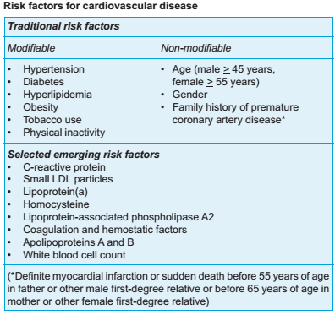

Slide 8
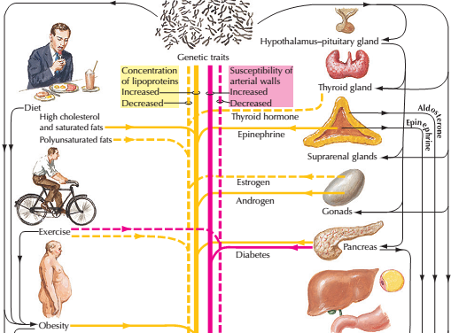

Slide 9
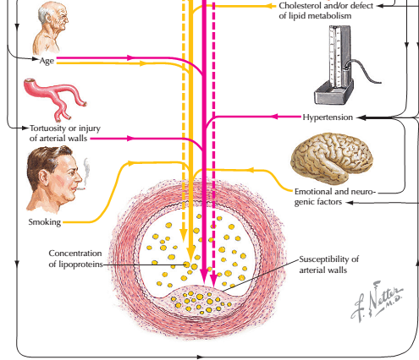

Slide 10
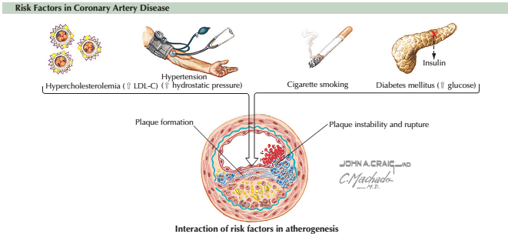

Slide 11
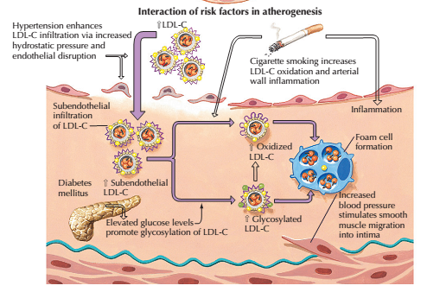

Slide 12
PATHOGENESIS

Slide 13
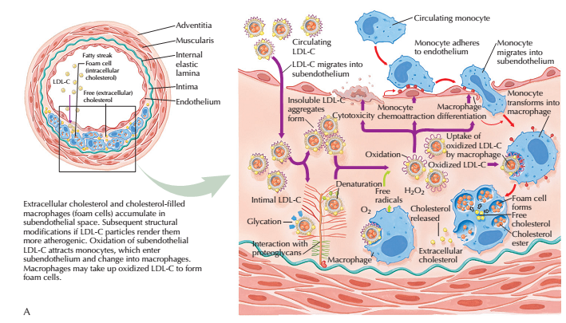

Slide 14
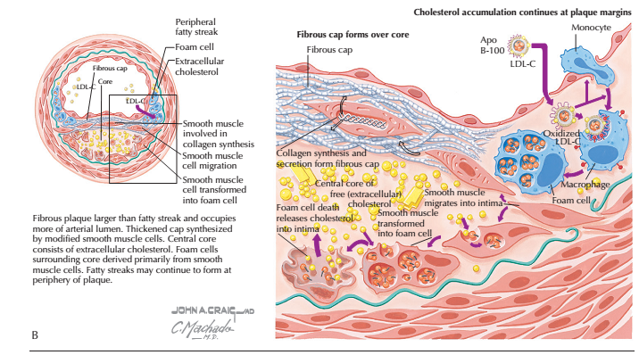

Slide 15
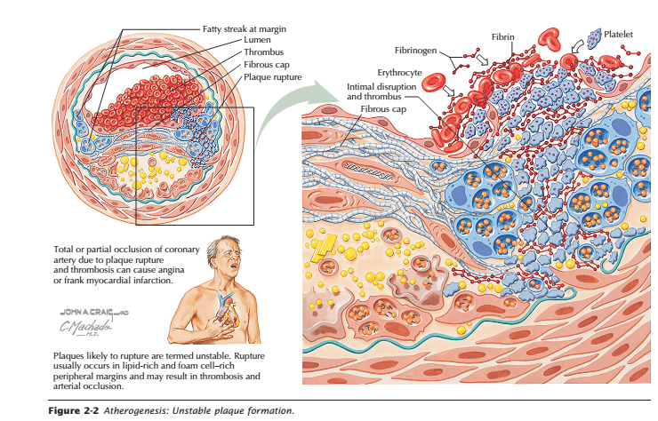

Slide 16
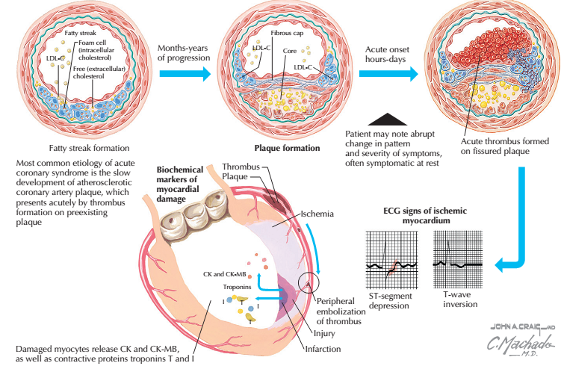

Slide 17
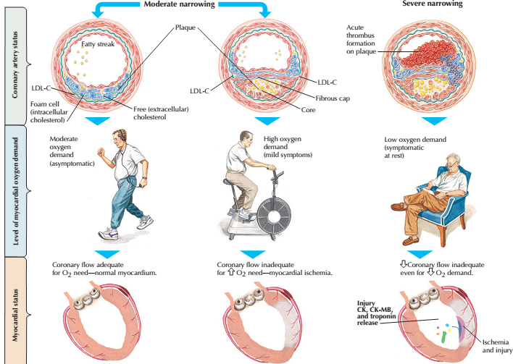

Slide 18
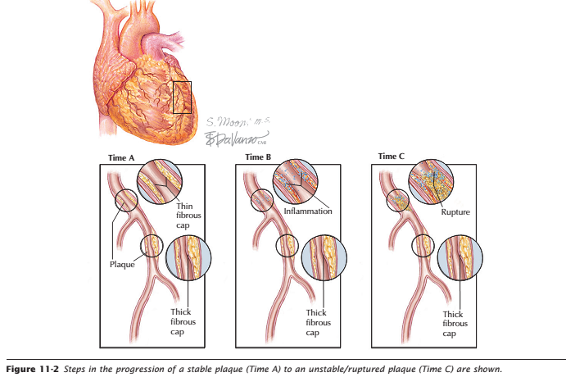

Slide 20
‘Vulnerable’ plaques are characterised by a lipid-rich core, a thin fibrocellular cap and an increase in inflammatory cells that release specific enzymes to degrade matrix proteins.
Stable plaques are typified by a small lipid pool, a thick fibrous cap, calcification and plentiful collagenous cross-struts.
Fissuring or rupture tends to occur at sites of maximal mechanical stress, particularly the margins of an eccentric plaque, and may be triggered by a surge in BP, such as during exercise or emotional stress.

Slide 22
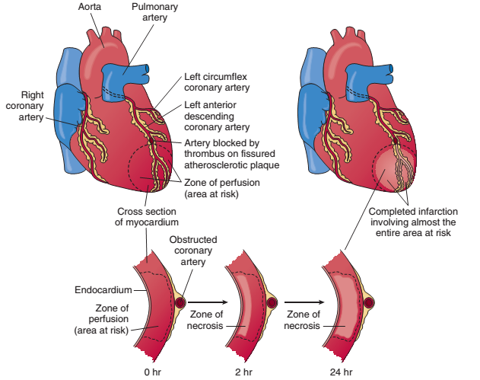

Slide 23
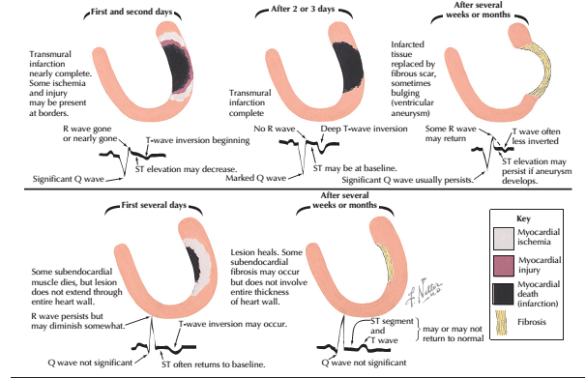

Slide 24
Acute coronary syndrome (ACS)
Umbrella term for the clinical signs and symptoms of myocardial ischemia:
Unstable angina
Non–ST-segment elevation myocardial infarction
ST-segment elevation myocardial infarction.

Slide 25
SYMPTOMS /SIGNS

Slide 26
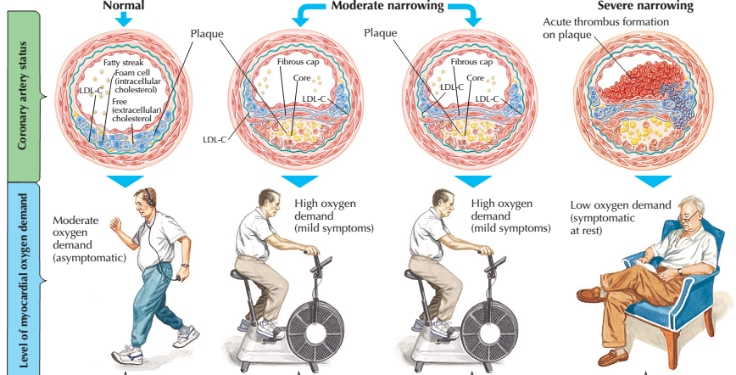

Slide 27
Ischemic-Type Chest PainPressure sensation, fullness or squeezing retro-sternally
Radiation of chest pain into thejaw/teeth, shoulder, arm, and/or back
Associated dyspnea or shortness ofbreath
Associated epigastric discomfort with or without nausea and vomiting

Slide 28
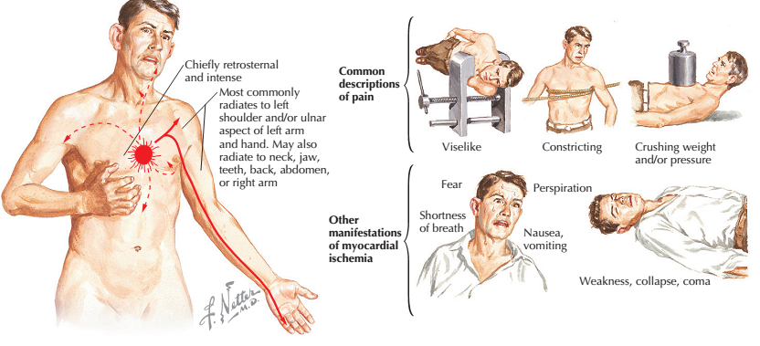

Slide 29
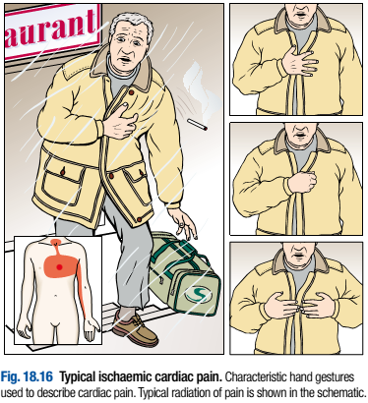
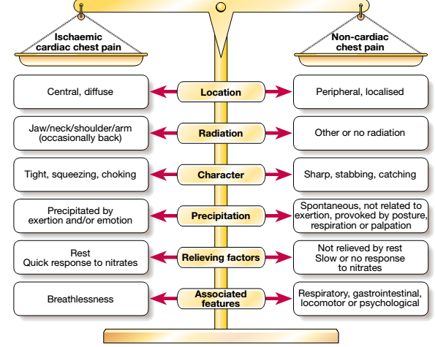

Slide 31
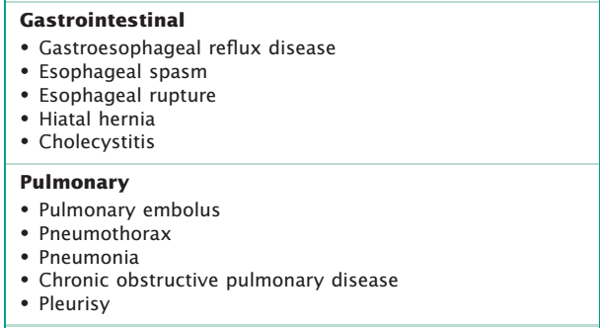

Slide 33
Other Symptoms
Diaphoresis or sweating
Syncope or near-syncope
Impairment of cognitive function without
other cause

Slide 34
INVESTIGATIONS

Slide 35
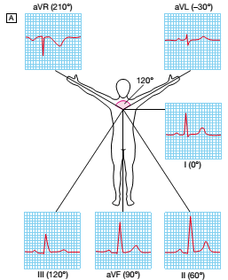
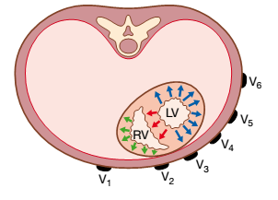
ECG
■ ST-segment elevation (with compatible history)
specificity=91%, sensitivity=46%
■ The higher the elevation and the more the leads
involved, the larger the infarct and the greater the
mortality

Slide 36
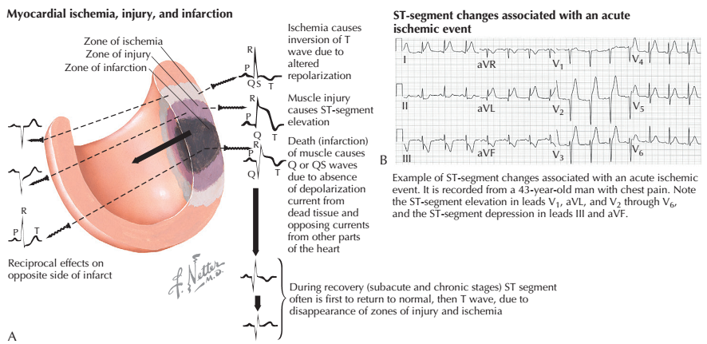

Slide 37
Other causes of ST-segment elevation
■ Pericarditis
■ Old MI (aneurysm)
■ Normal variant (early repolarization)

Slide 38
The ECG in ST Elevation MI

Slide 39
The Hyper-acute Phase
Less than 12 hours
“ST segment elevation is the hallmark ECG abnormality of acute myocardial infarction” (Quinn, 1996)
The ECG changes are evidence that the ischaemic myocardium cannot completely depolarize or repolarize as normal
Usually occurs within a few hours of infarction
May vary in severity from 1mm to ‘tombstone’ elevation

Slide 40
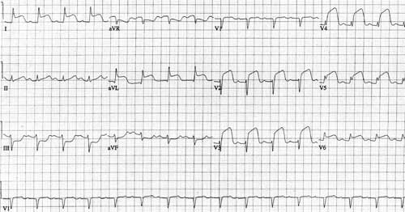

Slide 41
The Fully Evolved Phase
24 - 48 hours from the onset of a myocardial infarction
ST segment elevation is less (coming back to baseline).
T waves are inverting.
Pathological Q waves are developing (>2mm)

Slide 42
The Chronic Stabilised Phase
Isoelectric ST segments
T waves upright.
Pathological Q waves.
May take months or weeks.

Slide 44
Reciprocal Changes
Changes occurring on the opposite side of the myocardium that is infarcting

Slide 45
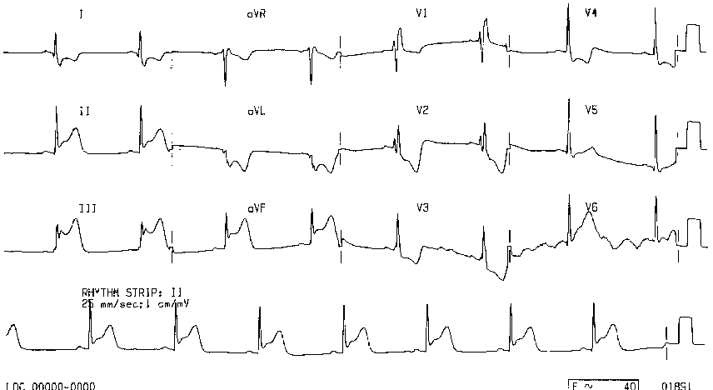
Reciprocal Changes ie S-T depression in some leads in MI

Slide 46
Non ST Elevation MI
Commonly ST depression and deep T wave inversion
History of chest pain typical of MI
Other autonomic nervous symptoms present
Biochemistry results required to diagnose MI
Q-waves may or may not form on the ECG

Slide 47
Changes in NSTEMI

Slide 48
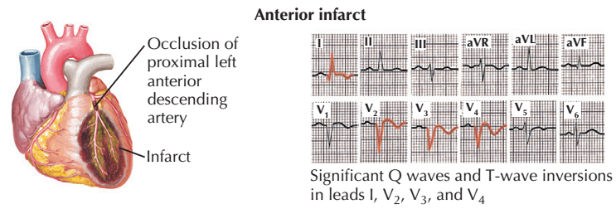

Slide 49
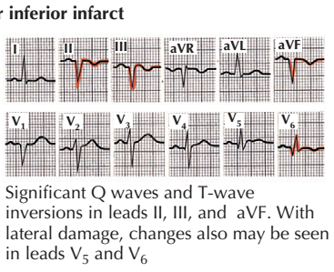
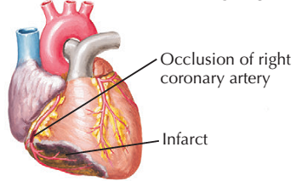

Slide 50
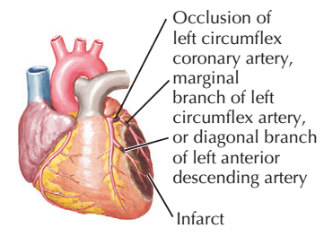
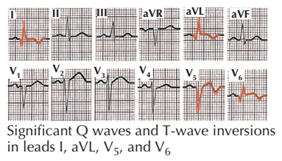
ANTEROLATERAL INFARCT

Slide 51
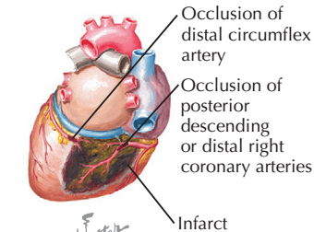
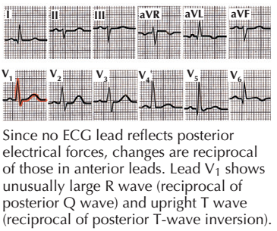
TRUE POSTERIOR WALL INFARCT

Slide 53
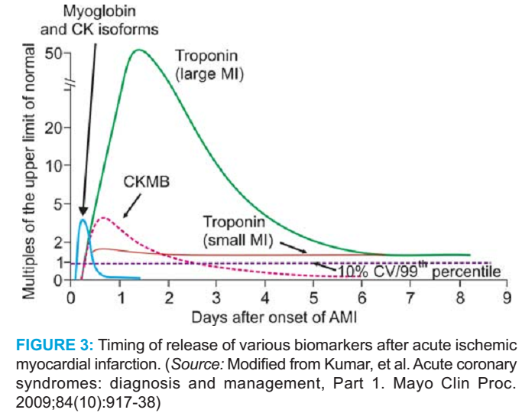

Slide 54
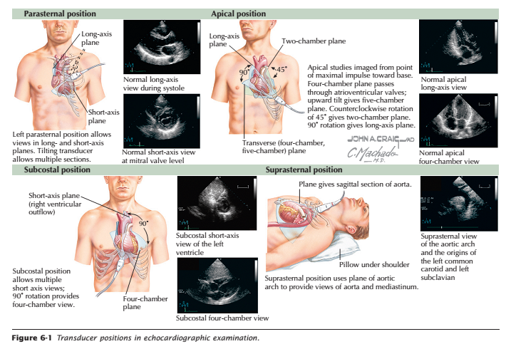

Slide 55
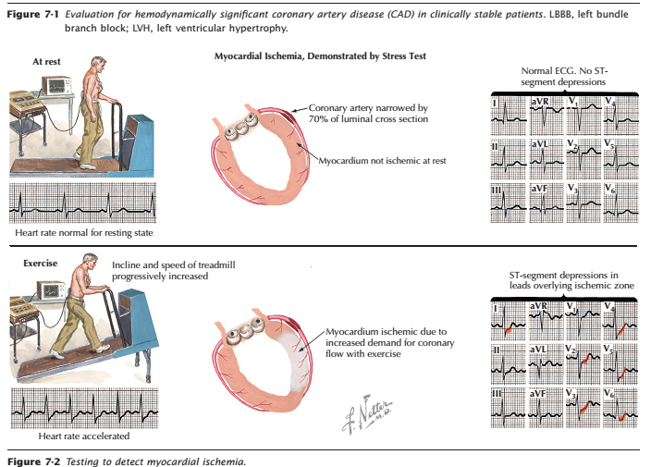

Slide 56
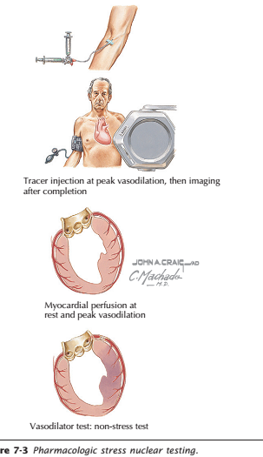
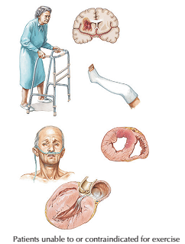

Slide 57
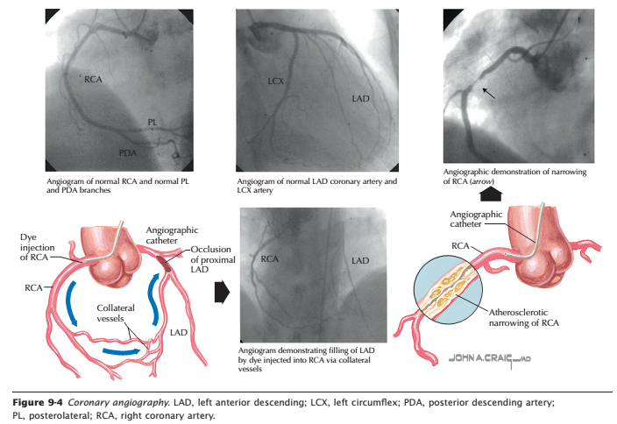

Slide 58
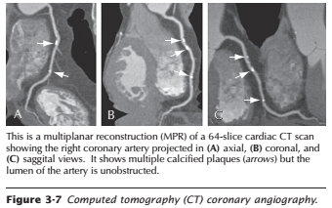
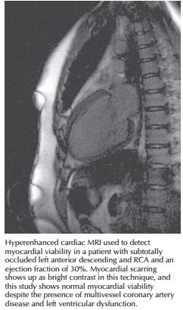

Slide 59
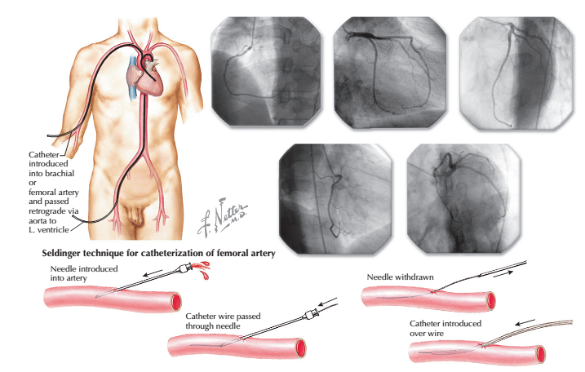

Slide 60
TREATMENT

Slide 61
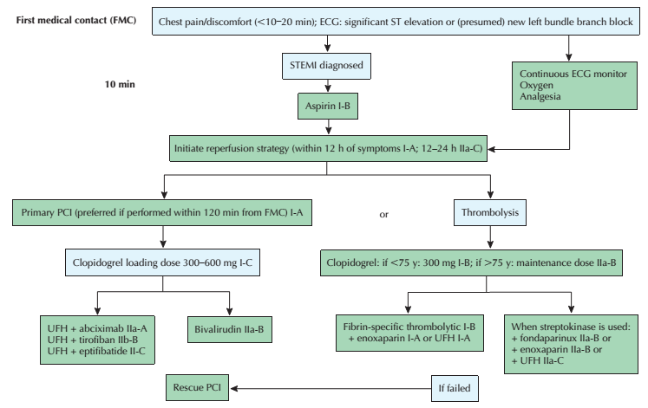

Slide 64
Primary PCI in STEMI
■ Ischemic symptoms <12 h
■ Contraindications to fibrinolytic therapy
irrespective of time delay
■ Cardiogenic shock or acute severe HF
■ Evidence of ongoing ischemia 12 to 24 h

Slide 65
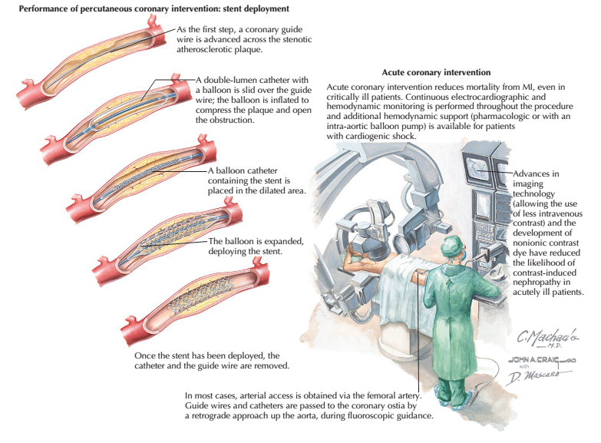

Slide 66
