Slide 1
THE HUMOURLESS IMMUNITY
CHIEF PROFESSOR:
DR. B. PALANI KUMAR M.D.,
ASSISTANT PROFESSOR:
Dr. M. ILAMARAN M.D.,
DR. S. PONSENTHIL KUMAR M.D.,

Slide 2
CASE HISTORY
8/4/26:
14 yr old male pt, a k/c/o X linked agammaglobulinemia came to GRH for routine IVIG injection
PAST HISTORY:
Child was apparently normal till 11 yrs of age and for last 5 yrs h/o recurrent sinopulmonary infections and ear discharge.
On 10/9/24, Sputum neg (radiologically diagnosed ) PTB f/b admission for 4 days (10 days later) for recurrent relapsing pneumonia.
FAMILY HISTORY:
h/o elder sibling (male) death 7 yrs back- records not available

Slide 3
2024
CBC:
HB | 9.1
WBC | 1910
PLT | 278000
DC | 21.1/45/0.3/ 33.2
HCT | 29.8
MCV | 70.5
MCH | 21.6
MCHC | 30.6
ESR | 47
qCRP | 145
ANC | 400 (1500-6000)
ALC | 860 (3000-7000)
AEC | 10 (40-440)
AMC | 630 (12-1100)
ABC | 10 (0-100)

Slide 4
FBS | 72
Total cholesterol | 155
TGA | 120
HDL | 47
LDL | 84
VLDL | 24
LDL/HDL | 1.79
Chol/HDL | 3.30
urea | 14
creatinine | 0.9
Sr. sodium | 140
Sr. potassium | 4.2
Sr. chloride | 102
Sr. bicarbonate | 22.6
Sr.ionized calcium | 1.1
Sr.pH | 7.41
Sr.PCO2 | 35.3

Slide 5
IMMUNOGLOBULINS
On 7/11/24 blood investigation showed decreased IgG, IgM, IgA levels- suspected primary immunodeficiency (outside hospital)
Lab findings:
↓ IgG, IgA, IgM
Normal IgE
Suggests primary immunodeficiency
Total IgE | 15 (28-140)
IgM | 3.88 (40-230)
IgG | 58 (700-1600)

Slide 6
13/11/2024:
Hematology opinion was obtained and suspected ?CVID ?Brutons agammaglobulinemia and adviced to do
lymphocyte subset analysis
genetic analysis (WES).

Slide 7
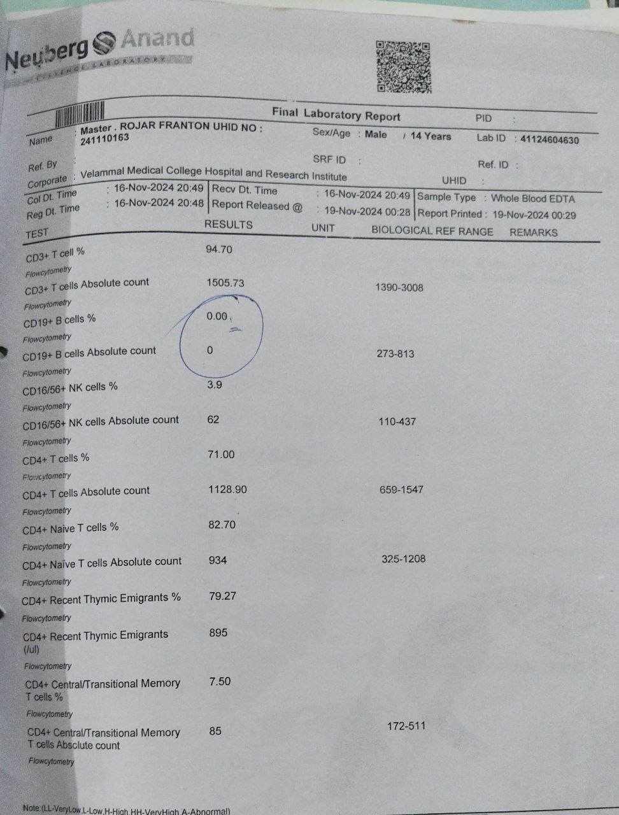
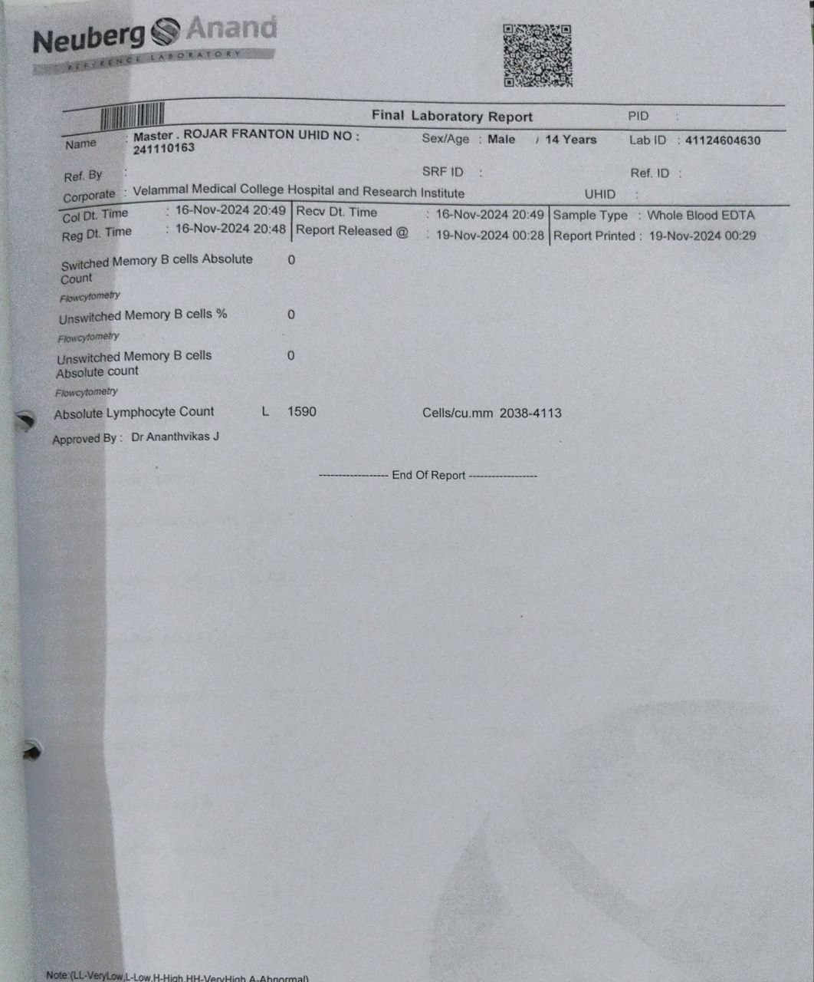
LYMPHOCYTE ANALYSIS

Slide 8
Parameter | Result | Reference Range | Interpretation
CD3+ T cells (%) | 94.7 | — | Normal
CD3+ T cells (Absolute) | 1505 | 1390–3008 | Normal
CD19+ B cells (%) | 0.0 | — | ❗ Absent
CD19+ B cells (Absolute) | 0 | 273–813 | ❗ Severely low
CD16/56+ NK cells (%) | 3.9 | — | Borderline low
CD16/56+ NK cells (Absolute) | 62 | 110–437 | ❗ Low
CD4+ T cells (%) | 71 | — | Normal
CD4+ T cells (Absolute) | 1128 | 659–1547 | Normal
CD4+ Naive T cells (%) | 82.7 | — | Normal
CD4+ Naive T cells (Absolute) | 934 | 325–1208 | Normal
CD4+ Recent Thymic Emigrants (%) | 79.27 | — | Normal
CD4+ Recent Thymic Emigrants (Abs) | 895 | — | Normal
CD4+ Central Memory T cells (%) | 7.5 | — | ↓
CD4+ Central Memory T cells (Abs) | 85 | 172–511 | ❗ Low

Slide 9
Parameter | Result | Reference Range | Interpretation
Switched Memory B cells (Absolute) | 0 | — | ❗ Absent
Unswitched Memory B cells (%) | 0 | — | ❗ Absent
Unswitched Memory B cells (Absolute) | 0 | — | ❗ Absent
Absolute Lymphocyte Count | 1590 | 2038–4113 | ❗ Low

Slide 10
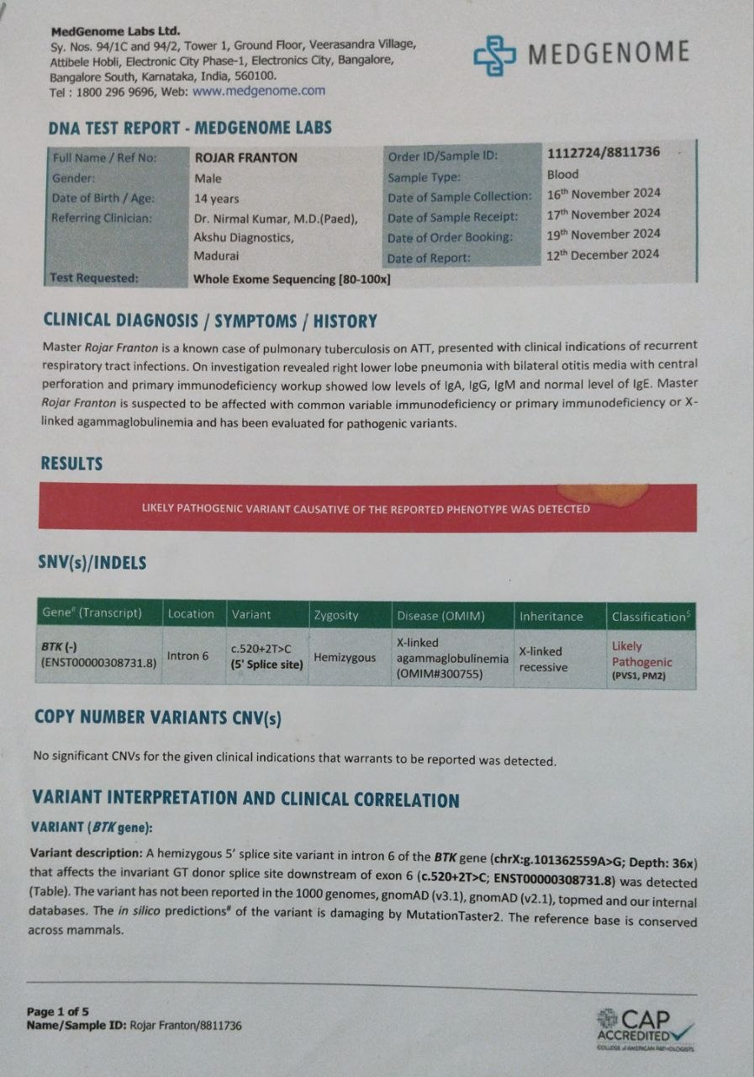
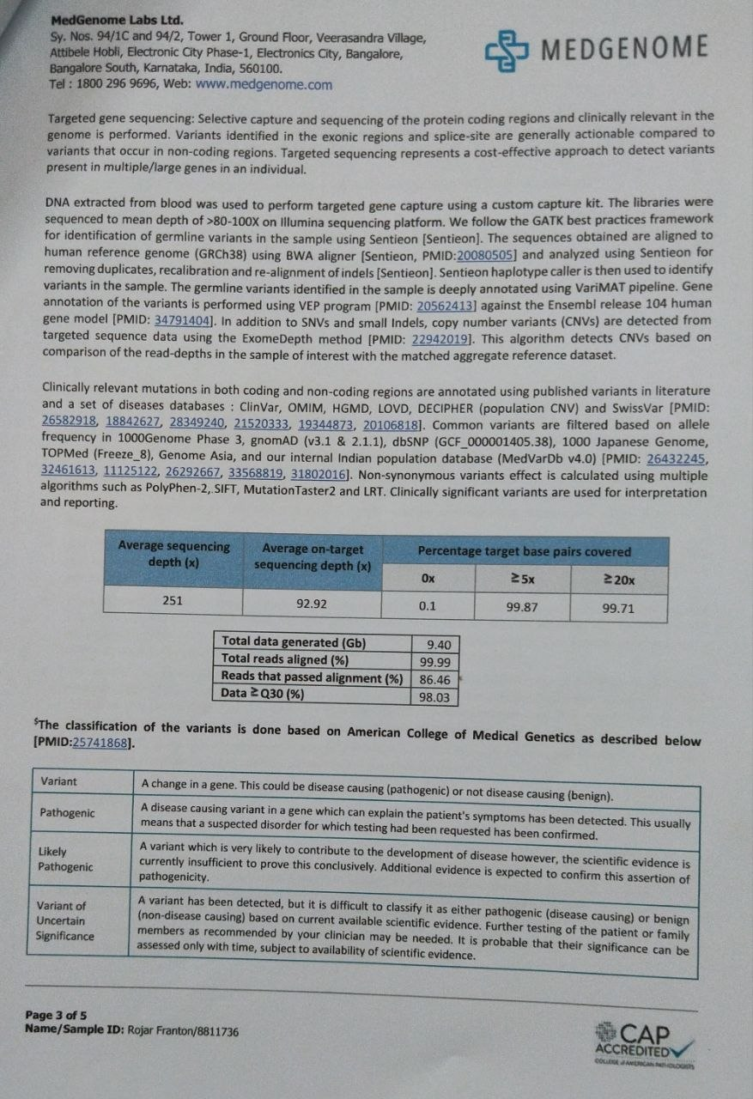
GENETIC ANALYSIS
Whole Exome Sequencing (WES)

Slide 11
Whole Exome Sequencing (WES)
Result
“Likely pathogenic variant detected”
Gene Identified:
  BTK gene
Mutation:
  c.520+2T>C (splice site mutation, intron 6)
  Hemizygous (only one X chromosome in males)

Slide 12
Pt was planed for Bone marrow transplantation/ monthly IVIG infusion.
IVIG infusion was first done on 20/11/2024 (15g) over 12 hrs.
Pt was treated with IV antibiotics, ATT, IVIG infusion, nebulization and other supportive measures. General condition was improved and hence discharged with advice of continuing T.cotrimoxazole and T.azithromycin.
Pt is now on monthly IVIG therapy.

Slide 13
DISCUSSION

Slide 14
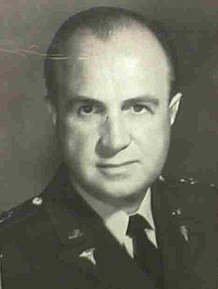
X LINKED AGAMMAGLOBULINEMIA
It was the first primary immunodeficiency ever described
by OGDEN BRUTON in 1952.

Slide 15
INTRODUCTION
‘X linked agammaglobulinemia is one of the most common pediatric primary immunodeficiencies that prevent affected individuals from making antibodies and requires lifelong immunoglobulin replacement therapy for survival.’

Slide 16
GENETICS
Mutation in: BTK gene (Bruton Tyrosine Kinase)
  Missense mutations (most common)
Location: X chromosome (Xq21.3–Xq22)
Inheritance: X-linked recessive
Affects: Almost exclusively males

Slide 17
Role of BTK
(Normal Physiology)
Part of B-cell receptor (BCR) signaling pathway
Required for:
  Survival of pre-B cells
  Differentiation → mature B cells
Acts at pre-B cell stage in bone marrow

Slide 18
PATHOGENESIS
Defect leads to:
  Arrest at pre-B cell stage
  Failure of B-cell maturation
Result:
  Absent mature B cells
  Severely reduced immunoglobulins

Slide 19
IMMUNOLOGICAL PROFILE
Peripheral B cells (CD19/CD20): <1% (absent)
Immunoglobulins:
  IgG ↓↓↓
  IgM ↓↓↓
  IgA ↓↓↓
T-cell immunity: Normal

Slide 20
ONSET
Symptoms begin after 6 months
Reason: Decline of maternal IgG

Slide 21
MICROBIOLOGY
Predisposed organisms:
  Encapsulated bacteria:
  Streptococcus pneumoniae
  Haemophilus influenzae
  Staphylococcus aureus
Others:
  Enteroviruses
  Giardia lamblia

Slide 22
CLINICAL FEATURES
Recurrent:
  Pneumonia
  Sinusitis
  Otitis media
Chronic diarrhea
Failure to thrive (some cases)
EXAMINATION:
Absent tonsils and lymph nodes (important exam clue)

Slide 23
RED FLAG SIGNS
Recurrent severe infections
Poor response to antibiotics
Male child
No lymphoid tissue

Slide 24
DIAGNOSIS
Step 1:
Serum immunoglobulins: All markedly decreased
Step 2:
Flow cytometry: Absent CD19+ B cells
Step 3:
Genetic testing: BTK mutation (confirmatory)

Slide 25
D/D:
Type | Condition | Key Clue
Primary | X-linked agammaglobulinemia | Male infant, absent B cells
 | Severe Combined Immunodeficiency | Severe infections early
 | Common Variable Immunodeficiency | Adolescent/adult onset
 | Wiskott–Aldrich syndrome | Eczema + thrombocytopenia
Secondary | Nephrotic syndrome | Protein loss in urine
 | Protein-losing enteropathy | GI protein loss
 | Chronic lymphocytic leukemia / Multiple myeloma | Malignancy
 | Drugs (rituximab, steroids) | Drug history
 | HIV infection | Late-stage HIV
Transient | Transient hypogammaglobulinemia of infancy | Self-resolving infancy

Slide 26
TREATMENT
Mainstay:
  IVIG replacement therapy
    Dose:
    400–600 mg/kg every 3–4 weeks
Additional:
  Aggressive antibiotics
  Avoid live vaccines
    Contraindicated:
      OPV
      MMR
      BCG
    Reason: Risk of vaccine-associated infection

Slide 27
COMPLICATIONS
Bronchiectasis
Chronic lung disease
Enteroviral meningoencephalitis

Slide 28
PROGNOSIS
Good with: Regular IVIG
Poor if:
  Delayed diagnosis
  Irreversible lung damage

Slide 29
CORRELATION TO CASE
Classical XLA presentation!
Male child | ✔️
Recurrent pneumonia | ✔️
Encapsulated organism (S. pneumoniae) | ✔️
Low Ig | ✔️
BTK mutation | ✔️

Slide 30
Look beyond infections… Look for the missing B cells!!
THANK YOU

