Slide 1
An Interesting case of tetralogy OF fallot
V MEDICAL UNIT
CHIEF
DR J. SANGUMANI MD, D.Diab
ASSISTANTs
DR R. SUNDARAM MD
DR K.S. RAGHAVAN MD,d.diab

Slide 2
15 years old male Mr. Ranjith Kumar studying in 6th standard admitted with complaints of
Breathlessness - 15 days
Fever – 7 days

Slide 3
History of present illness
Dyspnoea
present at rest
aggravated on exertion
relieved by squatting
not associated with chest pain / palpitation

Slide 4
H/O orthopnoea +
H/O Cyanotic spells +
H/O Squatting +
H/O Recurrent respiratory tract infections +
H/O leg swelling +
H/O epistaxis +
H/O numbness in hands and legs +
No H/O headache/blurring of vision
No H/O LOC/convulsion
No H/O weakness of limbs

Slide 5
Past HISTORY
Known case of congenital cyanotic heart disease – tetralogy of fallot diagnosed at 2 months of age
No previous h/o surgery
No previous h/o TB/ Br.asthma/Epilepsy/DM/SHT/thyroid disorder
H/O frequent hospital admissions(necrotizing pneumonia)
H/O seizure at the age of 3 months

Slide 6
Developmental HISTORY
Full term normal vaginal delivery in a hospital
Antenatal history - booked and immunized
H/O feeding difficulties + in the first few weeks
Started smiling at 4 months of age
Monosyllable at 9 months of age
Walking by 20 months of age
Growth retardation +
Suggestive of developmental delay +

Slide 7
Family history

Slide 8
General examination
Conscious, oriented
Afebrile
Tachypnoeic
Central cyanosis +
Polycythemic
B/L pan digital carpopedal clubbing +
B/L pitting pedal edema +
No lymphadenopathy/icterus

Slide 9
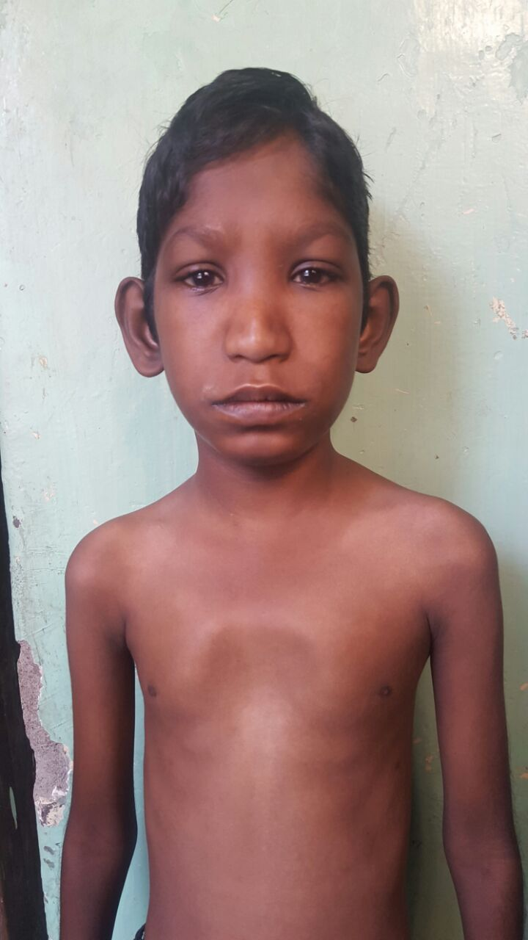
Low set ears +
Hypertelorism +
Depressed nasal
bridge +
Pectus excavatum +

Slide 10
B/L pan digital carpopedal clubbing +

Slide 12
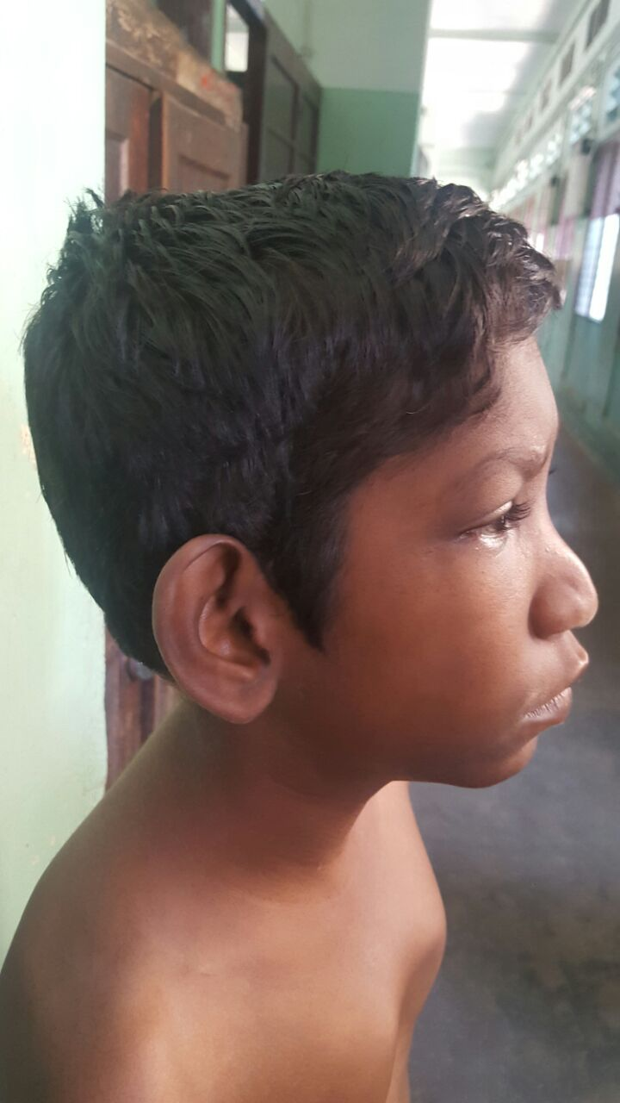
Dolichocephaly

Slide 13
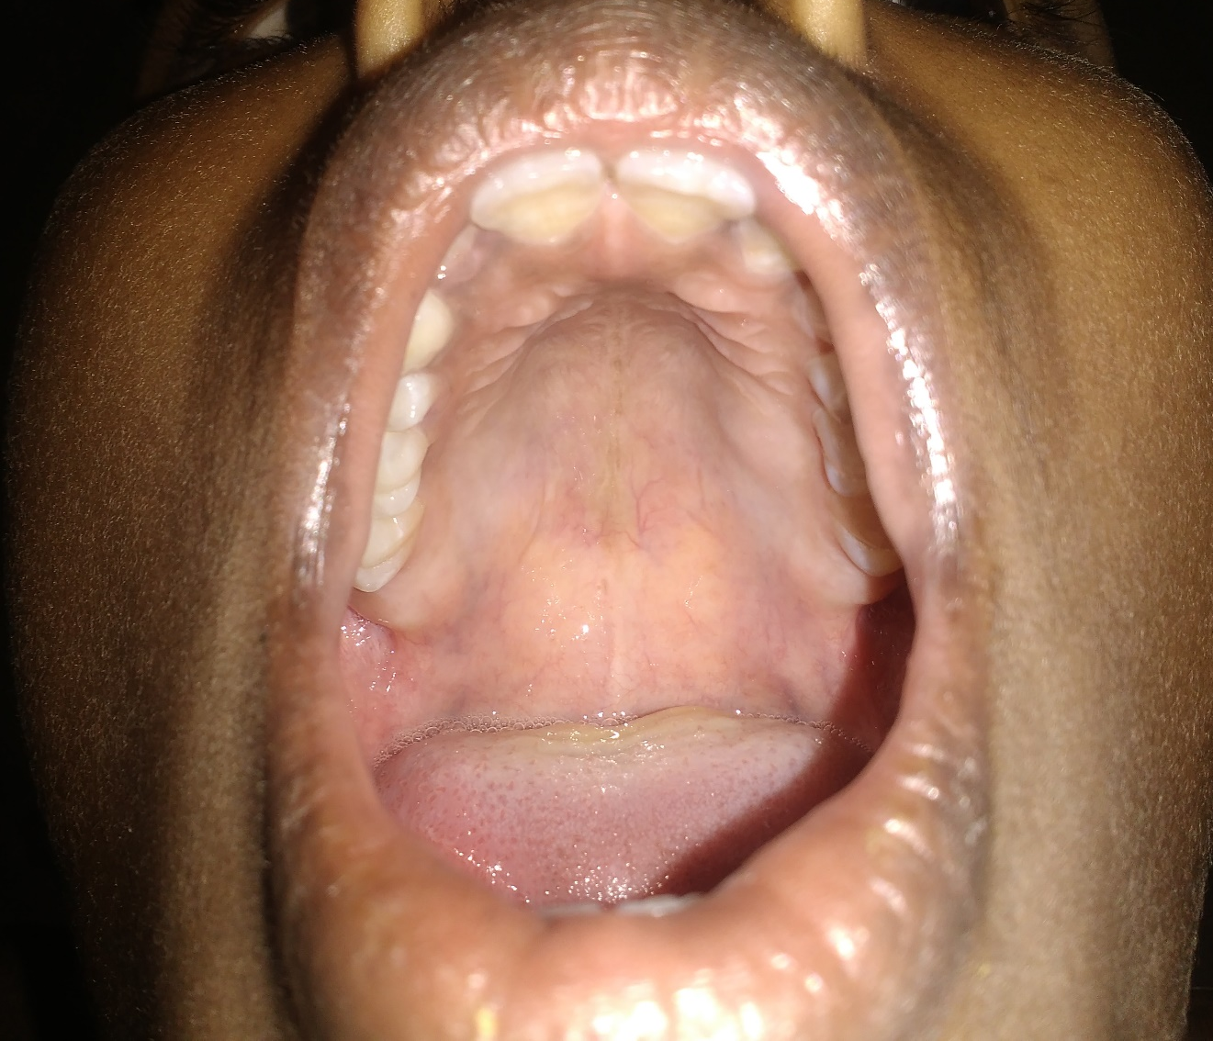
High arched palate

Slide 14
Anthropometry
Height - 127cm
Weight -19 kg
Upper segment – 57 cm
Lower segment- 70 cm
Head circumference – 47 cm
Arm span -125 cm

Slide 15
vitals
Pulse – 112/min, regular, large volume pulse, normal character, no arterial wall thickening, no radio-radial and radio-femoral delay, felt equally in all peripheral accessible vessels.
BP(mm of Hg)- Upper Limb Right- 90/60 Left- 90/60
Lower Limb Right- 100/70 Left- 100/70
SPO2 – 90% in room air
Respiratory rate – 28/min,

Slide 16
Systemic examination
CVS
INSPECTION
Precordial bulge +
Pectus excavatum +
Trachea in midline
Apical impulse in left 6th intercostal space ½ inch lateral to mid-clavicular line, hyper dynamic in character
Epigastric / Rt. & Lt. Parasternal/ Supraclavicular / Suprasternal pulsations +
JVP elevated
No scar/sinus
No spinal deformity

Slide 17
palpation
Parasternal heave
Systolic thrill present in mitral area
No palpable heart sounds

Slide 18
auscultation
AORTIC AREA
S2 single
ESM GRADE 3/6 +
MITRAL AREA
PSM GRADE 4/6 +
S1 S2 soft
TRICUSPID AREA
PSM+ 3/6
S1 S2 soft
PULMONARY AREA
ESM GRADE 3/6
S2 single
CONTINUOUS MURMUR + left INTERSCAPULAR and INFRASCAPULAR AREAS

Slide 19
RESPIRATORY SYSTEM
B/L AIR ENTRY EQUAL
CREPTS IN LEFT INTERSCAPULAR N INFRASCAPULAR AREA
ABDOMEN
SOFT
TENDERNESS IN RIGHT HYPOCHONDRIUM
NO ORGANOMEGALY
CNS
NO FOCAL NEUROLOGICAL DEFICIT

Slide 20
INVESTIGATIONS
Hb – 16.6 gm %
TC -11300 cells / cu.mm
Polymorphs -58%
Lymphocytes – 42%
Platelets -1.43 lakhs
ESR- 4 mm / 1hr
Hematocrit-46%

Slide 21
RBS 112 mg/dl
Urea 28 mg/dl
Creatinine 0.98 mg/dl
URINE
ALB NIL
SUG NIL
DEPOSITS
0-2 PUS CELLS
Na 134 mEq/L K 4.1 mEq/L Cl 101 mEq/L

Slide 22
Bilirubin
total-0.9 mgldl
Indirect-0.6
Direct-0.3
Total protein-6.0
S. albumin-3.5
S. globulin-2.5
SGOT-222 IU/L
SGPT-104 IU/L
ALP- 85 IU/L
S. Calcium-6.3 mg/dl

Slide 23
Ionized calcium – 4.1mg/dl
(normal-4.6-5.4) mg/dl
Intact PTH – 21pg/ml
Normal 23-66 pg/ml
(CLIA method)
S. phosphorus – 4.5 mg/dl

Slide 24
Usg abdomen
LIVER- 11.4cm with normal echoes
IVC & Hepatic veins prominent
Both kidneys normal in size
Impression :
congestive liver, minimal free fluid

Slide 26
ECG
Rate 120/ min
Sinus rhythm
Right axis deviation
P- pulmonale
R- ventricular hypertrophy

Slide 27
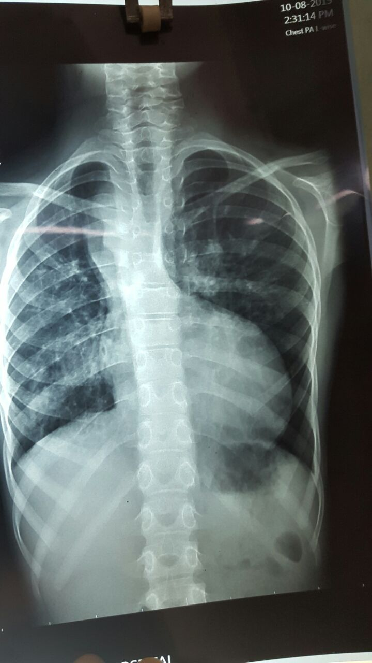
CHEST XRAY
RIGHT SIDE AORTIC ARCH
BOOT SHAPED HEART

Slide 28
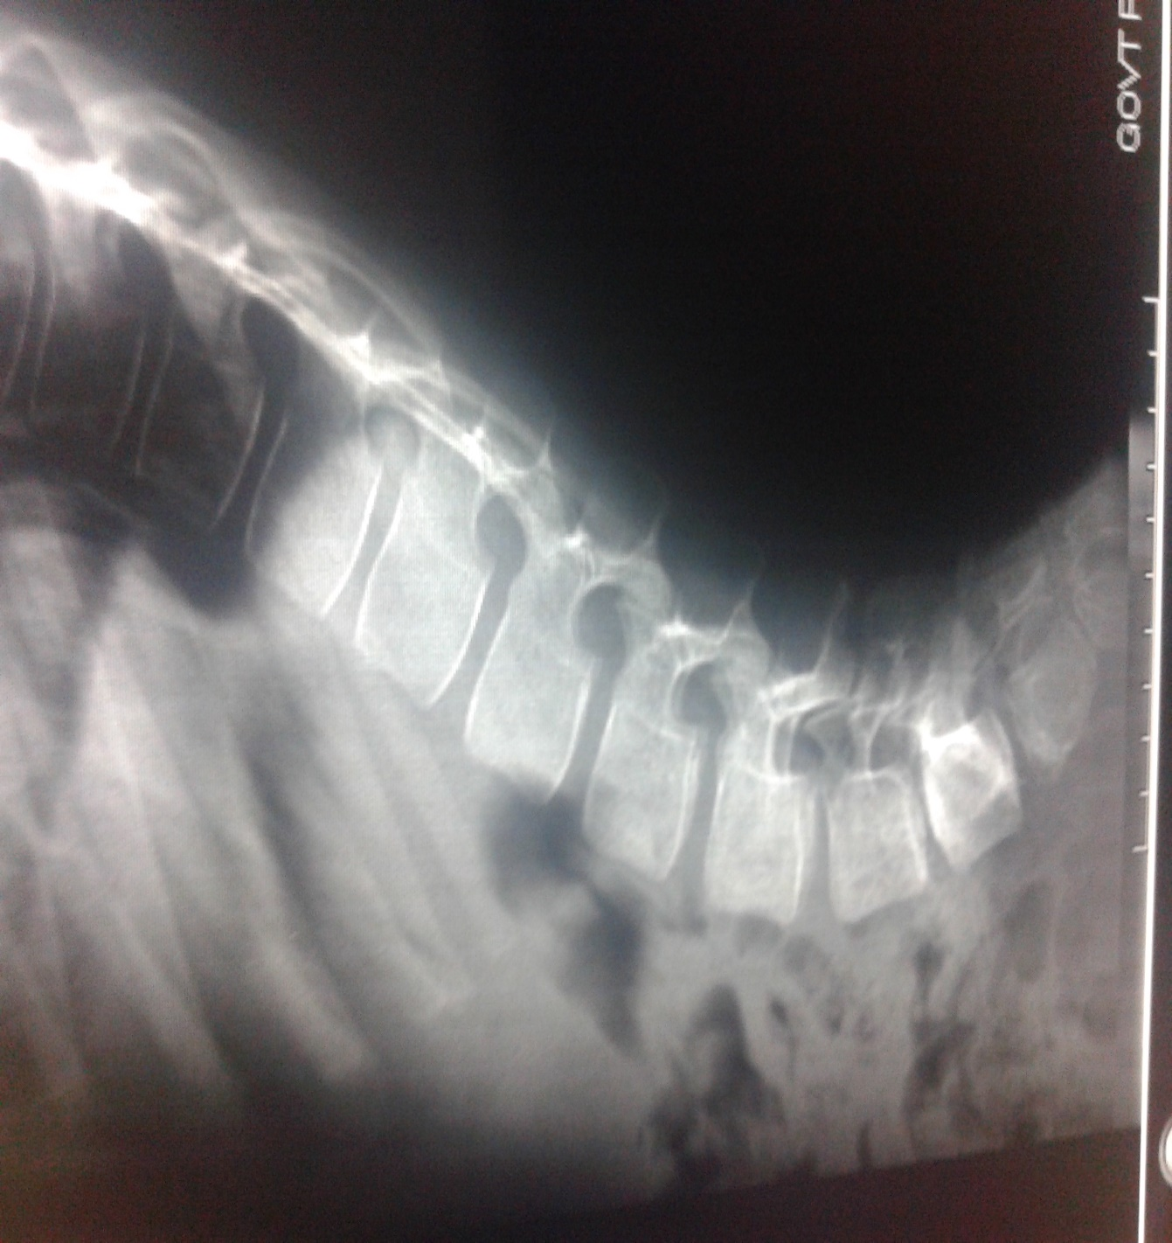
X RAY SKELETAL SURVEY
HEMI VERTEBRAE L4
L4

Slide 29
Cardiologist opinion
Conotruncal facies
ECHO
- Large sub aortic VSD with bi-directional shunt
- 50% overriding of aorta
- Right ventricular outflow tract obstruction appears to end blindly
Pulmonary atresia +
- Right sided aortic arch
- Aorto - pulmonary collaterals
- Patent foramen ovale +
RA RV dilated, Tricuspid regurgitation
- No PDA , No coarctation of aorta

Slide 36
Ct angiogram
MAPCA from left suclavian artery
MAPCA from descending aorta

Slide 37
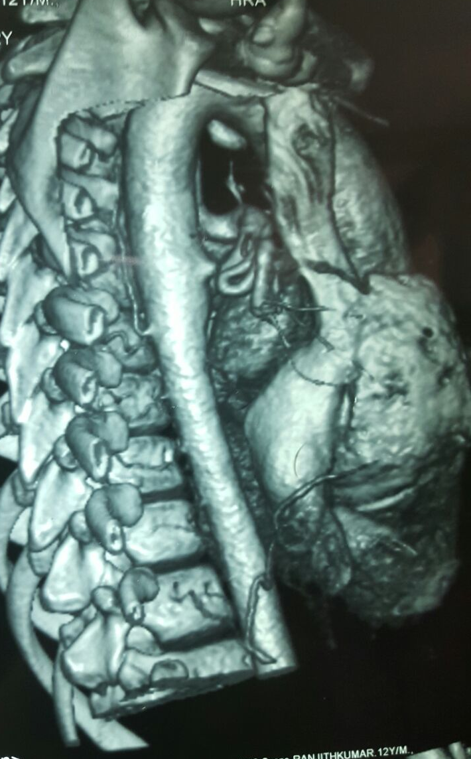
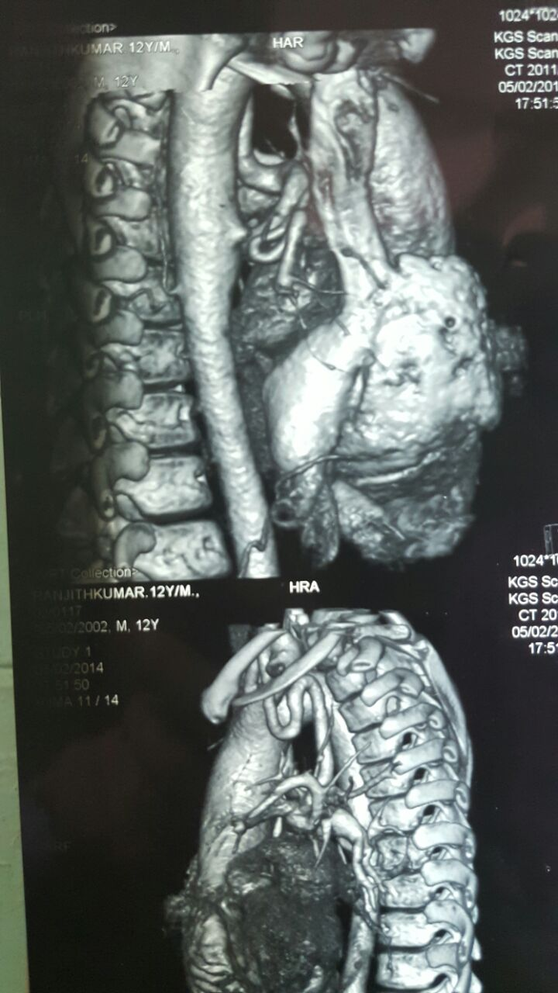

Slide 38
DOUBLE AORTIC ARCH
Ascending aorta- 3.6 cm Descending aorta- 1.9 cm
Normal situs solitus and levocardia
Grossly dilated RA RV with PULMONARY ATRESIA
Large VSD
MAPCA a) size 0.8 cm as a branch from L-subclavian
b) 1.1 cm from descending aorta
All pulmonary veins draining into L-atrium
R- dominant normal epicardial coronaries

Slide 39
ENDOCRINOLOGY OPINION
? CATCH 22 syndrome
sr. Ionized Calcium
Intact PTH

Slide 40
CARDIOTHORACIC SURGERY OPINION
- A case of pulmonary atresia with VSD Unifocalisation of collaterals followed by complete intra cardiac repair.

Slide 41
treatment
Nasal O2
Tablet propranolol 10 mg TDS
Tablet furosemide 20 mg 1-1-0
Inj. Ceftriaxone 500 mg IV BD
BCT 1 tab OD

Slide 42
DIAGNOSIS
Fallot’s Pentalogy with Pulmonary Atresia with Right sided Double Aortic Arch with features of Di-George Syndrome

Slide 43
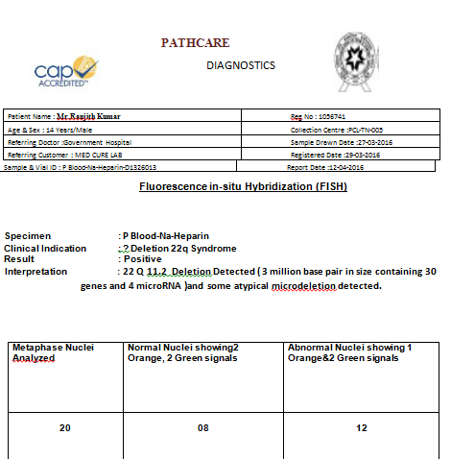

Slide 46
AIM OF DISCUSSION
To highlight uncommon variant in a common congenital cyanotic heart disease
Rarity of patient’s survival till teenage with such variant
Life expectancy without surgery < 50% at 1 yr, 4% at 10 yrs.

Slide 47
HIGHLIGHTS
Pulmonary Atresia with VSD
Also known as pseudotruncus arteriosus
Incidence 7 cases per 100000 population
Classified in to three types – DEPENDS UPON SOURCE OF PULMONARY CIRCULATION
TYPE A- presence of pulmonary arteries with PDA supplying blood
TYPE B- presence of both native pulmonary arteries and MAPCAs
TYPE C – only MAPCAs

Slide 48
Digeorge syndrome
Developmental defect of 3&4 pharyngeal arches
Cardiac abnormality(interrupted aortic arch,tetralogy of fallot)
Abnormal facies
Thymic hypoplasia/aplasia
Hypoparathyroidism/hypocalcemia
Cleft palate

Slide 49
Congenital heart disease(40%)-conotruncal anomalies
Cyanosis
Charecteristic facial features(90%)
Learning difficulties(90%)
Palatal abnormalities(50%)
Hypocalcemia (50%)
Significant feeding problem
Seizure(with or without hypocalcemia)
Immunodefeciency
Skeletal abnormalities
Psychiatric disorders
Renal anomalies

Slide 50
THANK YOU…

