Slide 1
Novel biomarkers
CHIEF : PROF. Dr. SYED BAHAVUDEEN HUSSAINI M.D,
ASST.PROF : Dr. VINOTH KANNAN M.D,
Dr . PRIYA M.D,
PRESENTOR : Dr . RISHIKESH 1st year PG 5th UNIT

Slide 2
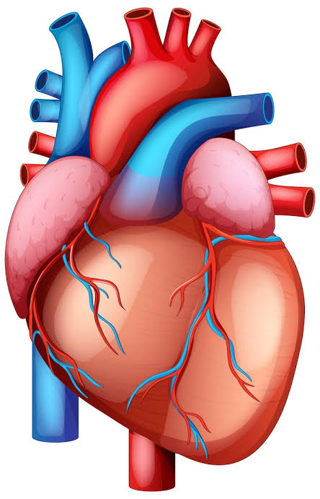
Lp PLA 2 (Lipoprotein PhosphoLipase A2 )
Independent predictor of: Myocardial infarction , Ischemic stroke , Sudden cardiac death.
Secreted by macrophage and circulates mainly bound to small dense LDL
Hydrolyzes oxidized phospholipids on LDL and Produces
Lysophosphatidylcholine (Lyso-PC) → endothelial dysfunction,
monocyte adhesion
Oxidized fatty acids → pro-inflammatory, pro-apoptotic

Slide 3
Leads to endothelial dysfunction, Foam cell formation , Necrotic core development , Plaque instability and rupture.
Higher levels ( >235ng/ml )= vulnerable plaque ( high rupture risk )
Inhibition (Darapladib): ↓ activity, but no outcome benefit
LDL is the cholesterol cargo (fuel) , Lp PLA2 is the spark that ignites Inflammation
Cost ~ ₹1000 ( thyrocare lab )

Slide 4
ST2 (Suppression of Tumorigenicity-2)
Its a strong predictor of heart failure progression and mortality.
A member of the interleukin-1 receptor family.
Exists in 2 forms: sST2 (soluble form) – circulates in blood, measurable. ST2L (membrane-bound form) – expressed on cardiomyocytes & Immune cells.
ST2 is the receptor for IL 33 which has cardioprotective effect ( anti hypertrophic and anti fibrotic ) . When sST2 is elevated it binds to IL 33 in circulation , blocking its cardioprotective effect and leads to cardiac remodelling , fibrosis and worsening of heart failure.
Notes:
Its a dynamic biomarker as it has rapid response to therapy

Slide 5
Independent prognostic marker , high levels >35ng/ml has worse outcomes .
Less influenced by confounders like obesity , age , renal function , atrial fibrillation ( unlike NT pro BNP )
FDA approved test PRESAGE ST 2 ( $50 per test )
ST2 is not useful in diagnosing acute heart failure ( levels dont rise acutely with hemodynamic stress and congestion like nt pro bnp ) but more valuable for prognosis once heart failure is diagnosed.
How overloaded is heart right now ? NT pro BNP
How much damage and remodelling is happening to heart long term ? sST2

Slide 6
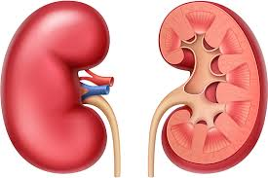
NGAL (Neutrophil Gelatinase–Associated Lipocalin)
Often called as Troponins of kidney.
Small glycoprotein (25 kDa).
Stored in neutrophils, also released by renal tubular epithelial cells after injury.
Earliest biomarker of AKI – rises within 2–4 hours of tubular injury (much earlier than creatinine).
Normal serum NGAL <150ng/ml
It is useful in sepsis related AKI , Post cardiac surgery AKI , Contrast induced nephropathy and ckd progression.
Notes:
NGAL is often called the troponins of kidney

Slide 7
Detects injury before creatinine rises (which is a late marker).
Sensitivity NGAL - High for early AKI
Creatinine - Low in early AKI (creatinine may remain
normal despite injury)
Specificity NGAL - Can be elevated in inflammation, infection,
cancer
Creatinine - More specific for GFR, but affected by
muscle mass, diet, hydration

Slide 8
KIM-1 (Kidney Injury Molecule-1)
A transmembrane glycoprotein (type 1 membrane protein) expressed at very low levels in healthy kidneys but highly upregulated in proximal tubular epithelial cells after ischemic or toxic injury.
After tubular injury, KIM-1 is shed into the urine and blood, making it a measurable non-invasive biomarker.
Early detection of AKI (acute kidney injury) → rises before serum creatinine.
Useful in drug-induced nephrotoxicity monitoring (esp. In clinical trials).
Correlates with severity of tubular damage and predicts progression to CKD.

Slide 9
Helps differentiate ischemic vs pre-renal AKI (since it reflects tubular damage).
Advantages over Creatinine: Detects injury hours to days earlier than creatinine , More specific for proximal tubular damage, whereas creatinine only reflects GFR decline.
Limitations: Still not widely available as a routine test (mainly research / pharma trials) , Elevated in chronic tubular damage too, not just acute cases. , Costs higher than creatinine.
Normal range: Healthy subjects: very low / undetectable in urine. Pathological: rises significantly (>2–5 ng/mL depending on assay).

Slide 10
Cystatin C
A low molecular weight (13 kDa) cysteine protease inhibitor, produced at a constant rate by all nucleated cells. Normal range 0.6 to 1.3 mg/L
Clearance: Freely filtered by the glomerulus and completely reabsorbed & catabolized by proximal tubules (not secreted).
Reflects GFR more accurately than serum creatinine. , Less affected by muscle mass, age, sex, or diet compared to creatinine. , Detects mild or early reductions in GFR (better for early CKD).

Slide 11
Serum cystatin c rises earlier than creatinine after GFR decline and it is useful in perioperative AKI
It is also a prognostic marker in cardiovascular disease
Advantages over Creatinine - Independent of muscle mass, age, sex, diet. , Earlier rise in AKI. , Better performance in elderly, children, and malnourished patients.
Limitations - Levels may be affected by: Inflammation , Thyroid dysfunction (↑ in hyperthyroidism, ↓ in hypothyroidism) , High-dose corticosteroid therapy , Costlier and less widely available than creatinine. Costs around ~ ₹800

Slide 12

pTau217/β-Aβ Ratio
Highly specific marker for early Alzheimers disease.
pTau217 = marker of tau tangle pathology.Aβ42 (β-amyloid) = marker of amyloid plaque pathology.The ratio (pTau217/Aβ42) combines both → higher values indicate more tau with less amyloid, characteristic of Alzheimer’s disease (AD).
Plasma ratio shows >90% agreement with amyloid PET and CSF biomarkers. Superior to pTau217 alone, especially in early/mild cognitive impairment. Accurately distinguishes AD dementia from non-AD dementias.

Slide 13
Range – Negative ≤0.0074 → AD pathology unlikely. Positive ≥0.0132 → AD pathology likely.
FDA-cleared blood test (Lumipulse G).
Against Amyloid PET (Gold Standard) : High accuracy (~97% specificity; ~92% sensitivity)
Costs around $100 , which is much cheaper when compared against Amyloid PET .

Slide 14
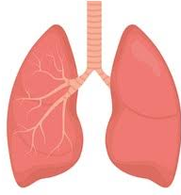
PERIOSTIN
It is an extracellular matrix protein and biomarker of fibrosis and airway remodeling, especially in asthma and idiopathic pulmonary fibrosis.
Encoded by the POSTN gene , Plays a role in cell adhesion, tissue remodelling, and fibrosis.
Upregulated in chronic inflammation and fibrotic diseases , Induced by IL-4 and IL-13, linking it to type 2 (Th2) inflammation.
Asthma & COPD : Marker of type 2 airway inflammation , Higher serum periostin levels → severe, eosinophilic asthma phenotype , Helps predict response to biologics (e.g., anti–IL-13, anti–IL-4Rα).

Slide 15
Interstitial Lung Disease & Pulmonary Fibrosis , Elevated in idiopathic pulmonary fibrosis (IPF) , Correlates with disease progression and poor outcomes.
It can help in distinguishing IPF from other ILD ( interstitial lung ) , 85% specificity and 75% sensitivity
Therapeutic monitoring: Could guide response to antifibrotic therapy (e.g., nintedanib, pirfenidone).
Range 35 to 70 ng/ml
Costs ~ $ 10

Slide 16
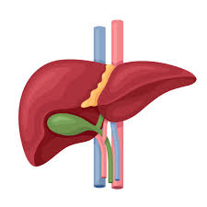
Cytokeratin 18 (CK18 / M30)
Biomarker for apoptosis and necrosis of hepatocytes.
CK18 is an intermediate filament protein expressed in hepatocytes and epithelial cells.
During apoptosis, CK18 is cleaved by caspases, producing fragments detectable as M30 antigen in serum. Released fragments reflect hepatocyte cell death rather than just general liver injury.
Non-Alcoholic Fatty Liver Disease (NAFLD) / NASH - Differentiates simple steatosis vs steatohepatitis. Correlates with fibrosis progression and inflammation.

Slide 17
Hepatocellular Carcinoma (HCC) - CK18 levels may rise in tumor necrosis or apoptosis. Can be used to monitor therapy response in HCC.
Drug-Induced Liver Injury (DILI) - CK18 fragments can serve as early markers of hepatocyte apoptosis before ALT rises.
Specific for apoptosis: Unlike ALT/AST, which reflect general hepatocyte injury. Prognostic value: Higher CK18 correlates with worse disease severity.
Normal range – 150 to 250 U/L
Costs ₹800

Slide 18
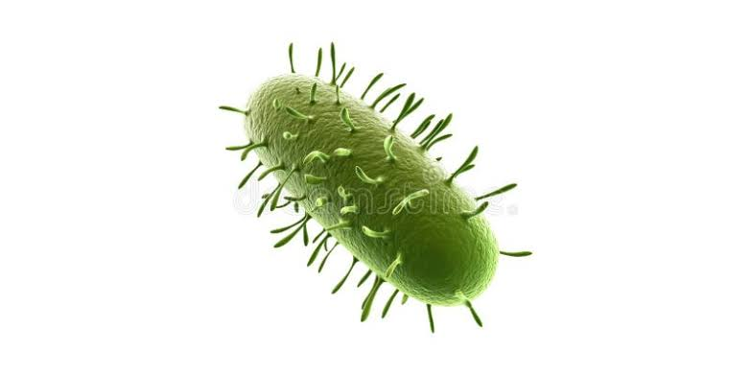
PENTRAXIN 3
Biomarker for sepsis .
Family of conserved pattern-recognition proteins of the innate immune system.
Named for their pentameric structure (“pentraxin”).
Bind to pathogens, apoptotic cells, and damaged tissue → activate complement system and recruit phagocytes
CRP is a short pentraxin made in the liver reflecting systemic inflammation, whereas Pentraxin-3 is a long pentraxin produced locally at inflammatory sites (by macrophages, dendritic and endothelial cells), providing an earlier (within minutes) and more specific marker of vascular and tissue inflammation.

Slide 19
PTX3 correlates with severity and prognosis in sepsis better than CRP or procalcitonin in some studies
Normal levels <2ng/ml
ELISA based test costs ₹30000 for 96 well kit (~₹300)

Slide 20
PRESEPSIN
Presepsin is the soluble subtype of CD14 (sCD14-ST), a co-receptor for lipopolysaccharide (LPS) recognition in bacterial infections. Released into circulation when monocytes/macrophages are activated by bacterial pathogens. Serves as a marker of innate immune response, reflecting real-time infection severity.
PATHFEST FDA approved presepsin assay , reference range - Healthy individuals: 100–300 pg/mL , Mild infection / SIRS: 300–500 pg/mL , Sepsis: 500–1000 pg/mL , Severe sepsis / septic shock: >1000 pg/mL
Presepsin rises earliest ( within minutes ) in sepsis among CRP and Procalcitonin ( 4 hours )

Slide 21
Presepsin has shortest half life (4hours) when compared with CRP and PCT ( 20 hours ) , therefore presepsin decreases with effective therapy and allows real time monitoring .
Presepsin is highly specific for bacterial sepsis and has highest prognostic correlation > Procalcitonin
Cost ~ ₹2000

Slide 22
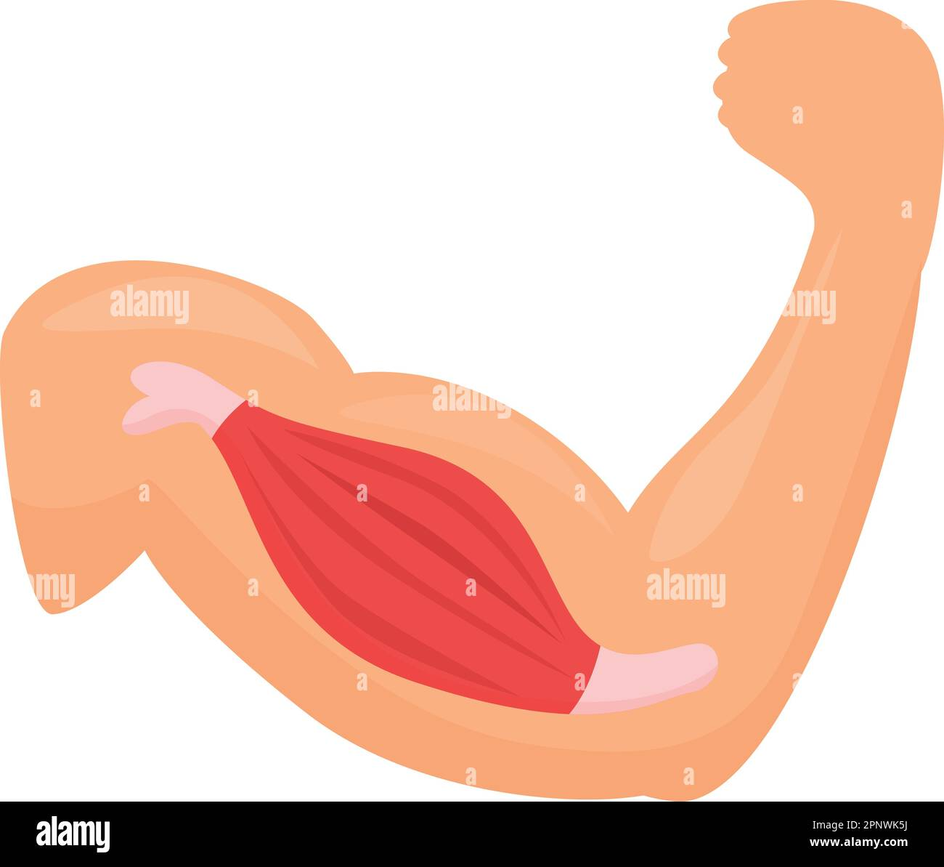
IRISIN
Biomarker of metabolic health.
Irisin is a myokine, a hormone secreted by skeletal muscles during physical activity. It is produced by cleavage of FNDC5 (fibronectin type III domain-containing protein) and released into the bloodstream.
Functions - Fat Browning: Converts white adipose tissue into brown-like adipose tissue , increasing thermogenesis and energy expenditure. Improves insulin sensitivity, reduces inflammation, and helps regulate glucose and lipid metabolism. Stimulates osteoblast activity (bone formation) and may enhance neuroprotection via increased BDNF expression.
Circulating irisin is often lower in obesity and insulin resistance . It may serve as a marker of exercise response and metabolic health. May protect against atherosclerosis and support endothelial function.

Slide 23
Irisin has strong therapeutic potential for metabolic, cardiovascular, skeletal, and neurological disorders, but translation into clinical therapy requires further research and human trials.
Normal range : 3 to 5 ng/ml (sedentary adults)
Low irisin: Associated with obesity, insulin resistance, and metabolic syndrome.
High irisin: May reflect exercise adaptation or compensatory response in early metabolic stress.

Slide 24
Thank you

