Slide 1
UNCOMMON PRESENTATION OF COMMON MALIGNANCY
V MEDICAL UNIT
PROFFESSOR & CHIEF :DR.A.SENTHAMARAI
ASSISTANT PROFESSORS:DR.P.SUDHA
DR.MJ.SENTHILKUMAR
DR.SUGADEV
PRESENTOR DR.PRIYADHARSHAN

Slide 2
A 73 Years Male came to our hospital with c/o
Breathlessness for 1 week
He was apparently normal before 1 week then had
c/o breathlessness Gradual in onset,progressive in nature
Grade II MMRC
h/o trepopnea +
h/o left sided chest pain.
Chest pain aggravated by Respiratory movements
not associated with palpitation,sweating,Radiation of pain

Slide 3
h/o cough non-productive
No h/o hemoptysis.
No h/o fever.
No h/o abdominal pain.
No h/o hoarseness of voice.
No h/o abdominal distention, swelling of legs.
No h/o loss of weight,loss of appetite.
No h/o Evening raise of temperature,night sweats

Slide 4
PAST HISTORY
Not a known diabetic.
Not a known Hypertensive.
No h/o Pulmonary TB ,Asthma,COPD,Epilepsy.
No h/o CAD.

Slide 5
Personal history
Consumes mixed diet,
Bowel and Bladder habits normal.
Sleep and Appetite normal.
Not an alcholic
Not a smoker.

Slide 6
ON EXAMINATION
Patient Conscious
Oriented
Afebrile
Not Tachypneic
Pallor +
No cyanosis
No clubbing
No lymphadenopathy.
No pedal edema.
BP-110/80 mmhg
PR-110/min
SPO2-93% @Room air
RR-22/min

Slide 7
CVS-S1,S2 +, No murmur
Abdomen- soft,bowel sounds heard ,no organomegaly.
CNS-Conscious, oriented, B/L pupil 3mm ERTL.

Slide 8
RESPIRATORY SYSTEM
INSPECTION
Upper Respiratory Tract-normal
Fullness of intercostal spaces on left side of chest
Diminished movements of left side of chest
PERCUSSION
Stony dullness on the left side of chest
PALPATION
Diminished movement on left side of chest
Trachea shifted to right side
Diminished vocal fremitus on left side
AUSCULTATION
Diminished vesicular breath sound on left side

Slide 9
CHEST X RAY PA VIEW

Slide 10
Ct chest

Slide 11
Ct chest report
Left Massive Pleural Effusion.
No lymphadenopathy
No evidence of active PTB.
No evidence of Old PTB Changes.

Slide 12
Working diagnosis
LEFT MASSIVE PLEURAL EFFUSION

Slide 13
INVESTIGATIONS
UREA | 16mg/dl
CREATININE | 0.8
TOTAL BILIRUBIN | 1.2
DIRECT | 0.4
INDIRECT | 0.8
SGOT | 17
SGPT | 20
Total count | 5400
P/L/E | 79/13/8
Hb | 8.6
PCV | 27%
Platelet | 1.78 lakhs

Slide 14
PLEURAL FLUID ANALYSIS
PROTEIN | 3.5g
GLUCOSE | 29mg
CELL COUNT | 1600
ADA | 19.5 U/L
SERUM PROTEIN
TOTAL PROTEIN | 6g/dl
ALBUMIN | 4g/dl
GLOBULIN | 2g/dl

Slide 15
TOTAL COUNT | 5400 | 6300 | 6600
P/L/E | 79/13/8 | 84/8/8 | 86/5/9
Hb | 8.6 | 8.7 | 8
PCV | 27% | 28% | 25%
PLATELET | 1.78 LAKHS | 2.49 | 1.88
MCV | 128
MCH | 41
MCHC | 32
RDW | 81
 | 1.8

Slide 16
COMPLETE HEMOGRAM WITH PERIPHERAL SMEAR
TC-5800/cu.mm
HB-8.7 g/dl
RBC-2.11 million
PCV-25%
PLT-2.24 lakhs
ESR-113 mm/hr
DIMORPHIC ANEMIA
FOLIC ACID | 4.O4ng/ml
VITAMIN B12 | 65 pg/ml

Slide 17
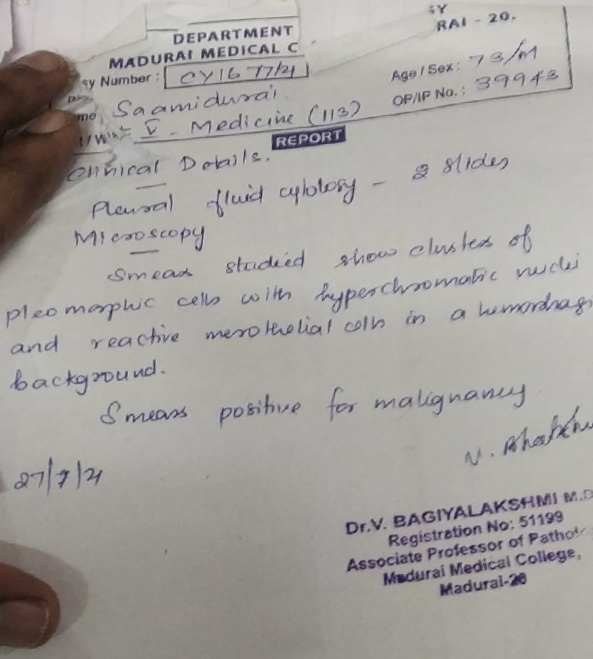
SPUTUM PLEURAL FLUID
SPUTUM AFB-Negative
SPUTUM GENE EXPERT-MTB Not detected
SPUTUM Gram stain- No oganism.
SPUTUM Culture and sensitivity-NO GROWTH
PLEURAL FLUID Culture and sensitivity –NO GROWTH
PLEURAL FLUID CYTOLOGY-POSITIVE FOR MALIGNANT CELLS

Slide 18
treatment
ICD Insertion done and Repositioning done multiple times as suggested by cardiothoracic surgeon
Vitamin B12 and Folic acid Supplementation were given.

Slide 19
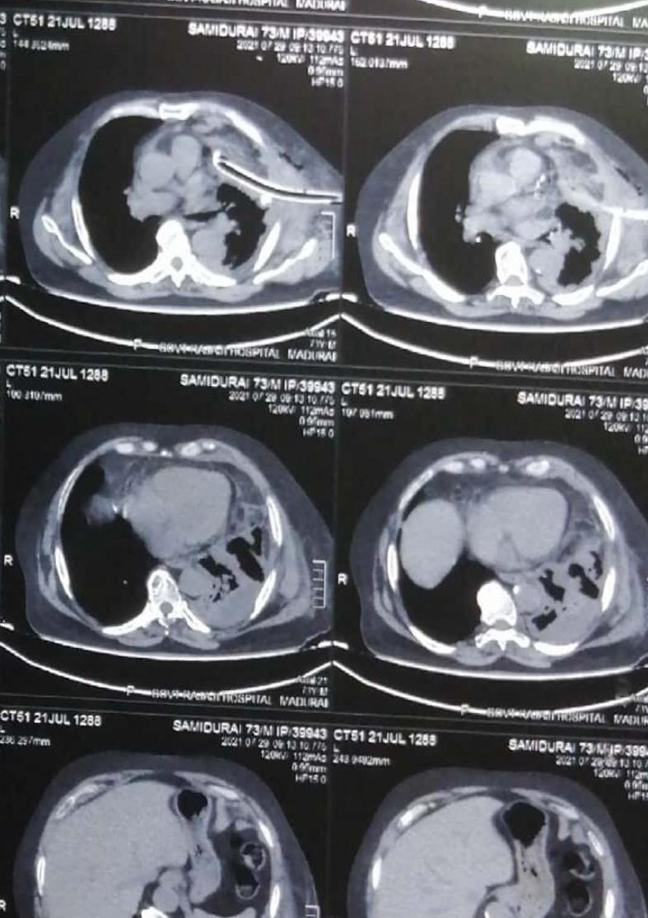
CECT CHEST

Slide 20
Cect chest report
Subpleural fibrotic strands seen.
Multiloculated Thick Collection in pleural cavity.
No significant Lymphadenopathy.
No active PTB

Slide 21
CECT Abdomen and Pelvis –normal
NO Palpable mass in the testis
NO lymphadenopathy

Slide 22
MALIGNANT PLEURAL EFFUSION
?? UNKNOWN PRIMARY
MEGALO
BLASTIC ANEMIA

Slide 23
What next??

