Slide 1
A case of OSMOTIC DEMYELINATION SYNDROME from IMCU 2
Prestented by: SRIKANTAN.N.S
2nd yr post graduate,
6th medical unit

Slide 2
Presenting complaints
A 68 year old female, a known case of type 2 diabetes mellitus, systemic hypertension, was brought by her attenders with chief complains of altered sensorium for the past 2 weeks

Slide 3
HISTORY OF PRESENTING ILLNESS
Patient was apparently normal 2 weeks back after which
She had 4 episodes of vomiting, loose stools for 2 days followed by giddiness and altered sensorium
Initially she was taken to a private hospital nearby and managed with iv fluids. During her treatment course in the hospital she had 1 episode of involuntary movement involving all 4 limbs (tonic) and face with loss of consciousness, tongue biting, frothing and treated with iv medication regained consciousness within 10-20 mins.
She was referred to another hospital and treated for dyselectrolytemia diagnosed to have fungal sinusitis and referred to GRH, Madurai for further management.

Slide 4
H/O low backache
H/O constipation
H/O difficulty in micturition
No H/O difficulty in rolling over bed
No H/O difficulty in lifting head from lying position
No H/O difficulty in feeling clothes.
No H/O difficulty in appreciating hot /cold sensation
No H/O difficulty in appreciating mosquito bite

Slide 5
No H/O difficulty in appreciating smell
No H/O blurring of vision
No H/O difficulty in appreciating colour
No H/O double vision or squint or dropping of eyelids
No H/O difficulty in chewing or loss of sensation over face
No H/O deviation of angle of mouth
No H/O loss of taste

Slide 6
No H/O hard of hearing/tinnitus/vertigo
No H/O nasal twang of voice
No H/O difficulty in swallowing
No H/O regurgitation of food particles
No H/O difficulty in turning head side to side
No H/O difficulty in mixing food inside mouth/slurred speech

Slide 7
Able to feel bladder fullness
No H/O muscle twitching
No H/O involuntary movements
No H/O swaying

Slide 8
No H/O head ache/ neck pain
No H/O fever
No H/O recent trauma
No H/O Chest pain, palpitation, syncope
No H/O loss of weight or loss of appetite
No H/O dog bite

Slide 9
Past history
Known case of T2DM for 2 years and SHTN for the past 6 months on medication.
H/O low backache for 1 month diagnosed to have lumbar disc disease-conservative management
H/O pain during defaecation diagnosed to have anal fissure and advised high fibre diet, diltiazem gel, laxatives
Recently diagnosed to have subclinical hypothyroidism and started on Thyroxine tablet 12.5 micrograms OD
No H/O BA, PTB, epilepsy, CVA, CKD, CAD in the past.

Slide 10
Personal history
Family history
Consumes mixed diet
No adverse social habits
Normal sleep pattern
No H/O similar illness in family

Slide 11
Vitals
PR –90/min Regular rhythm, normal volume , no special character , felt in all peripheral vessels, no R-R or R-F delay, condition of vessel wall - normal
BP- 140/80 mm/hg in right arm in supine position
RR – 14/min , thoracoabdominal type of respiration

Slide 12
General examination
Well built, moderately nourished
No pallor, no icterus, no cyanosis, no clubbing
No pedal edema, no generalised lymphadenopathy
Lip swelling+
No external markers of Tuberculosis/ HIV/ Syphilis
No Neurocutaneous markers
No external markers of atherosclerosis
Fundus examination- Normal

Slide 13
Higher mental functions
Drowsy, arousable
Partly obeying oral commands
Right handed person
Intelligence – normal
Slow and strained speech

Slide 14
Cranial nerve examination
I - able to perceive olfactory stimulus in both sides equally
II -
 | Right Eye | Left Eye
Visual acuity | 6/6 | 6/6
Field of vision | Normal | Normal
Colour vision | Normal | Normal

Slide 15
III,IV,VI – Extra ocular movements – full in both eyes
No squint or ptosis
Direct and indirect light reflex – normal on both eyes
Accomodation reflex normal on both eyes
V – Touch, pain, temperature sensation equal on both sides of the face
Able to clench the teeth equally on both sides
Corneal and conjunctival reflex normal on both sides
Jaw jerk - absent

Slide 16
VII - Wrinkling of forehead + on both sides Able to close both eyes tightly against resistance Nasolabial fold appears equal on both sides No deviation of angle of mouth
Taste sensation in anterior 2/3 of tongue – normal
Lacrimation was present
VIII - Rinnes test AC > BC in both sides
Webers test- no lateralisation
ABC – normal

Slide 17
IX, X – Uvula in midline, no deviation
Gag and palatal reflex normal
XI – Able to turn head side to side against resistance
Able to flex the head forward against resistance
Shrugging of shoulder normal on both sides
XII – Tongue – normal in size , no wasting/ fasciculation
No deviation of tongue
Power – normal

Slide 18
Motor system
Bulk | Right | Left
Arm | 25 cm | 25 cm
Forearm | 20 cm | 20 cm
Thigh | 46 cm | 46 cm
Leg | 25 cm | 25 cm
Tone | Right | Left
Upper limb | Increased | Increased
Lower limb | Increased | Increased

Slide 19
Power |  |  | Right | Left
Upper limb | Shoulder | Flexion | 3/5 | 3/5
 |  | Extension | 3/5 | 3/5
 |  | Abduction | 3/5 | 3/5
 |  | Adduction | 3/5 | 3/5
 |  | Internal rotation | 3/5 | 3/5
 |  | External rotation | 3/5 | 3/5
 | Elbow | Flexion | 3/5 | 3/5
 |  | Extension | 3/5 | 3/5
 | Wrist | Flexion | 3/5 | 3/5
 |  | Extension | 3/5 | 3/5
 | Handgrip |  | 50% | 50%

Slide 20
Power |  |  | Right | Left
Lower limb | Hip | Flexion | 3/5 | 3/5
 |  | Extension | 3/5 | 3/5
 |  | Abduction | 3/5 | 3/5
 |  | Adduction | 3/5 | 3/5
 | Knee | Flexion | 3/5 | 3/5
 |  | Extension | 3/5 | 3/5
 | Ankle | Dorsiflexion | 3/5 | 3/5
 |  | Plantar flexion | 3/5 | 3/5
 | Great toe | Dorsiflexion | 3/5 | 3/5

Slide 21
Reflexes
SUPERFICIAL REFLEXES | RIGHT | LEFT
Abdominal reflex | Present | Present
Plantar | Equivocal | Equivocal
DEEP TENDON REFLEX | RIGHT | LEFT
Biceps | ++ | ++
Triceps | ++ | ++
Supinator | ++ | ++
Knee | ++ | ++
Ankle | ++ | ++
Patellar Clonus-absent
Ankle clonus-absent
Beevor sign-negative

Slide 22
SENSORY SYSTEM | RIGHT | LEFT
Touch | Normal | Normal
Pain | Normal | Normal
Temperature | Normal | Normal
Vibration | Normal | Normal
COORDINATION | RIGHT | LEFT
Finger- nose-finger test | Could not be done | Could not be done
Finger-finger test | Could not be done | Normal
Heel – knee test | Could not be done | Could not be done
No Dysdiadokokinesia No Nystagmus
Spinal Vibration- normal
Cortical sensation – normal

Slide 23
Gait could not be assessed
No neck stiffness
No Spinal tenderness
No nerve thickening
Other system examination:
CVS- S1 S2 normal
No murmur
RS – Bilateral NVBS Heard , no added sounds
PA – soft non tender , no organomegaly

Slide 24
Investigations
 | 19/1/25 | 20/1/25 | 21/1/25 | 24/1/25 | 27/1/25
Total WBC count | 7300 | 8200 | 8000 | 11,900 | 8,400
Hb | 9.8 g/dl | 11.6 | 11.3 | 11.9 | 11.0
Platelets | 2.95 lakhs/ uL | 2.88 |  | 3.92 | 4.97
ESR | 22 mm/hr
Plasma glucose | 114mg/dl | FBS -156 | PPBS 226
Urea | 10 | 10 | 10
Creatinine | 0.3 | 0.4 | 0.4
TSH 5.78. LFT - normal Free T3 - 2.16 pg/mL. Urine albumin - nil T4 - 1.25 ng/dL. Urine sugar - nil sr.proteins - 4.78mg/dL albumin - 3.5 mg/dL

Slide 25
 | 19/1 | 20/1 | 21/1 | 22/1 | 24/1 | 27/1
Hba1c | 6.5%
Serum sodium | 126 | 131 | 131 | 133 | 129 | 133(1st value at GRH)
Sr.potassium | 2.5 | 2.9 | 3.8 | 3.1 | 3.7 | 3.3(1st value at GRH)
Calcium | 6.7 | 7.9 | 9.2 |  | 9.9
Phosphorus | 1.4 |  |  |  | 3.0
Magnesium | 1.1 | 1.4 |  |  | 1.6
Chloride | 108 | 105
Serum osmlarity 279 mOsm/kg
Urine osmlarity 396 mOs /L. Urine sodium - 70 mEq/L Urine potassium - 13mEq/L Uric acid - 1.2 mg/dL

Slide 26
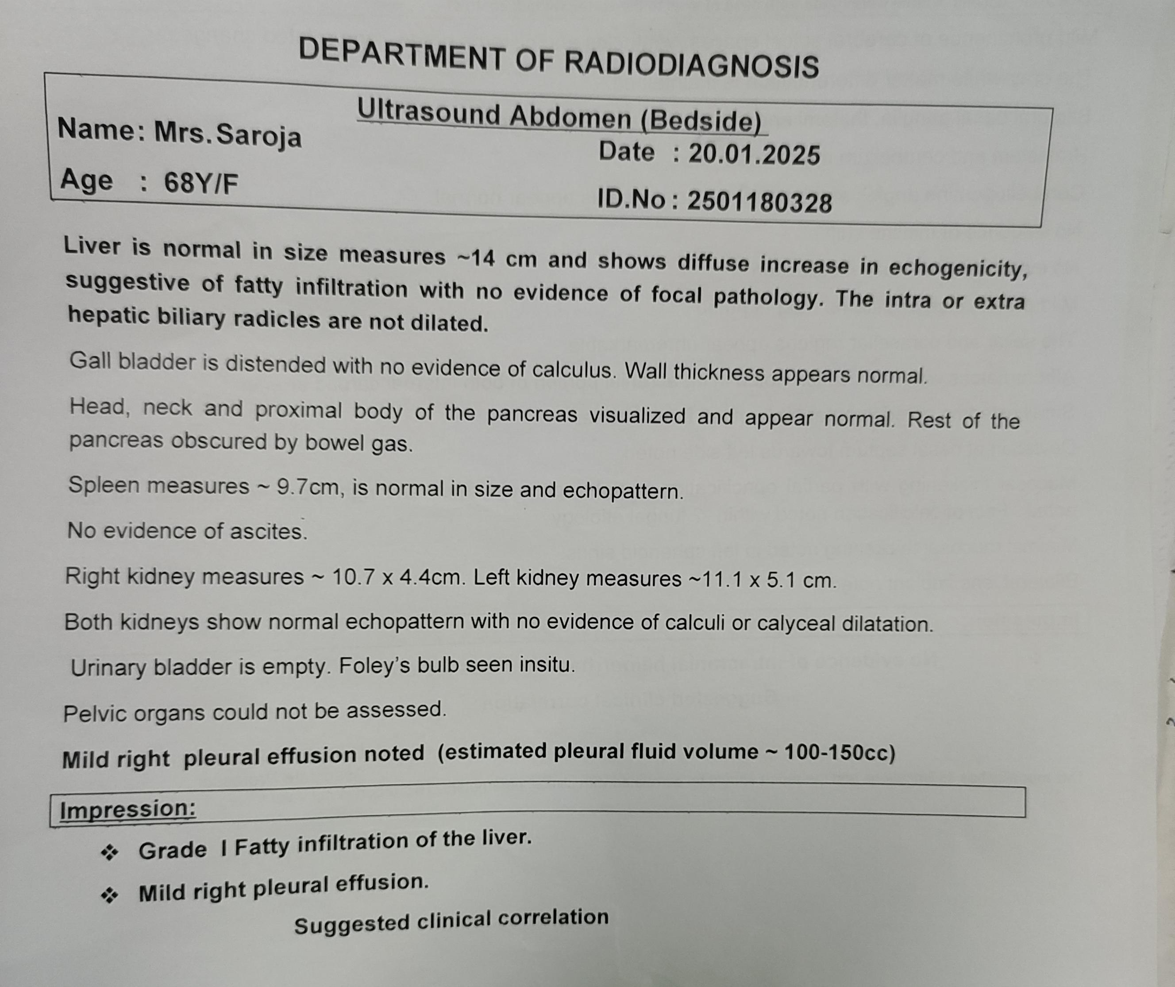

Slide 27
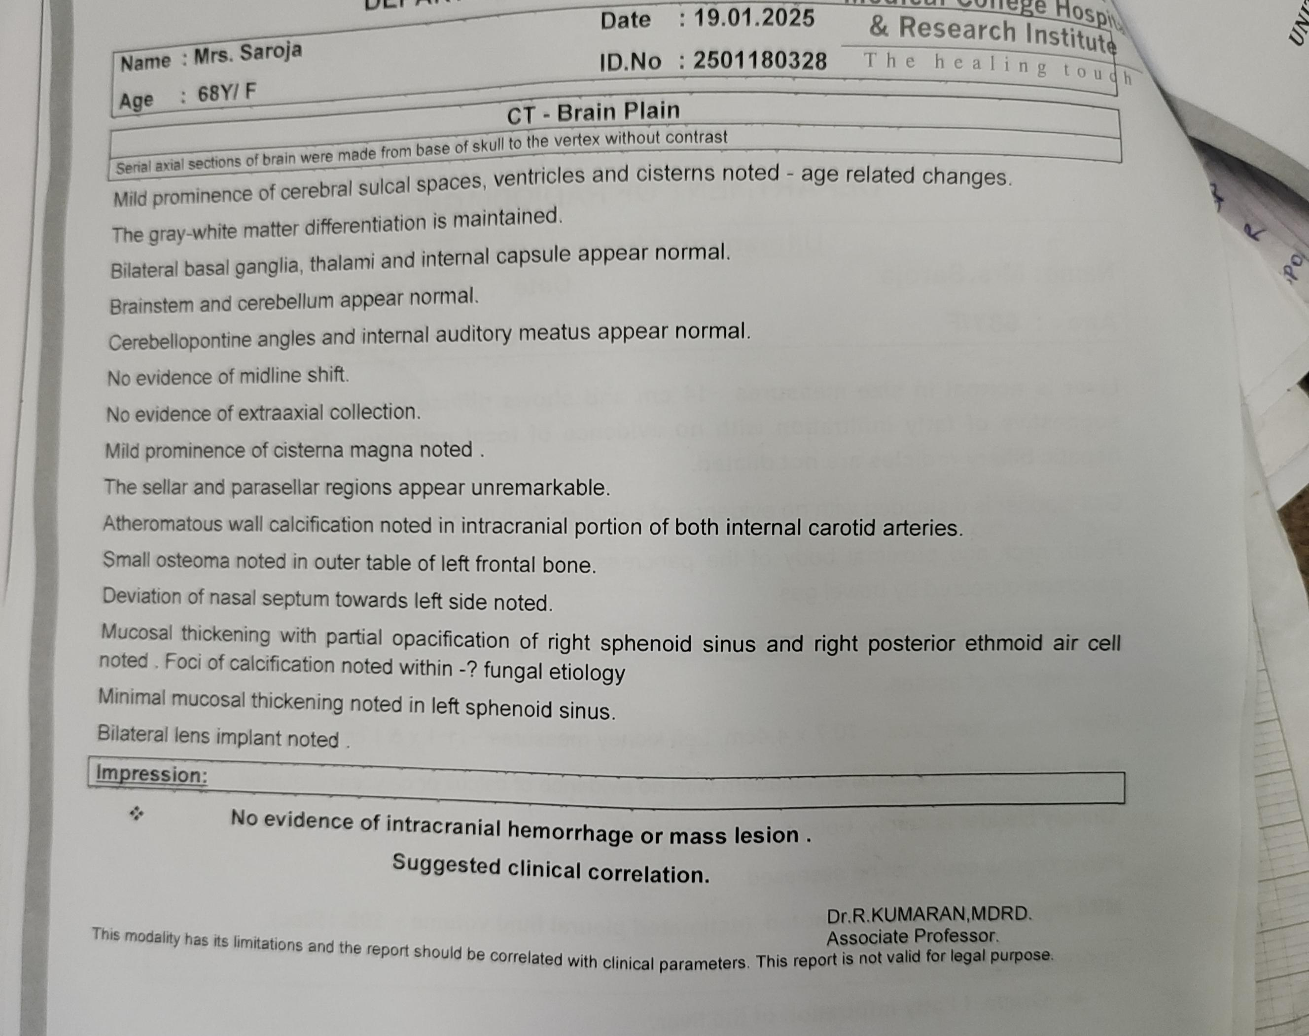

Slide 28
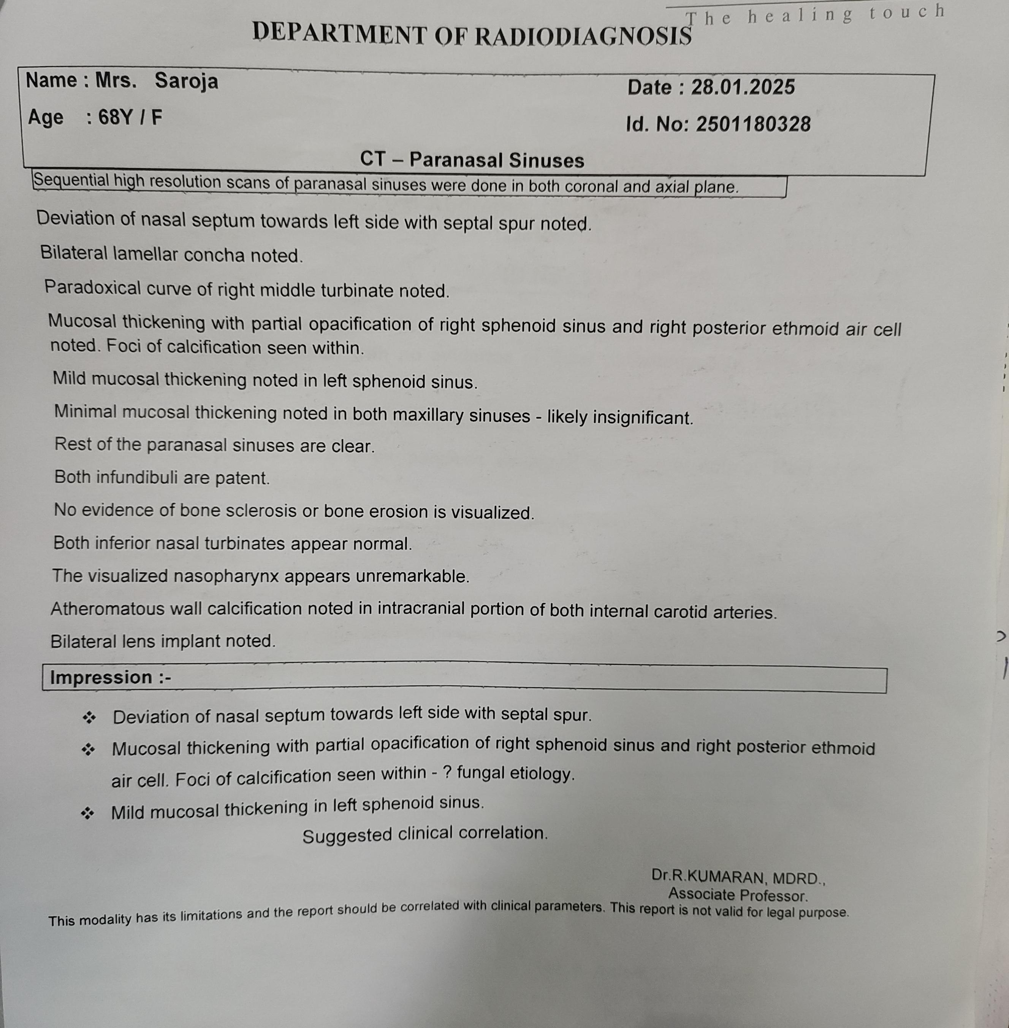

Slide 29
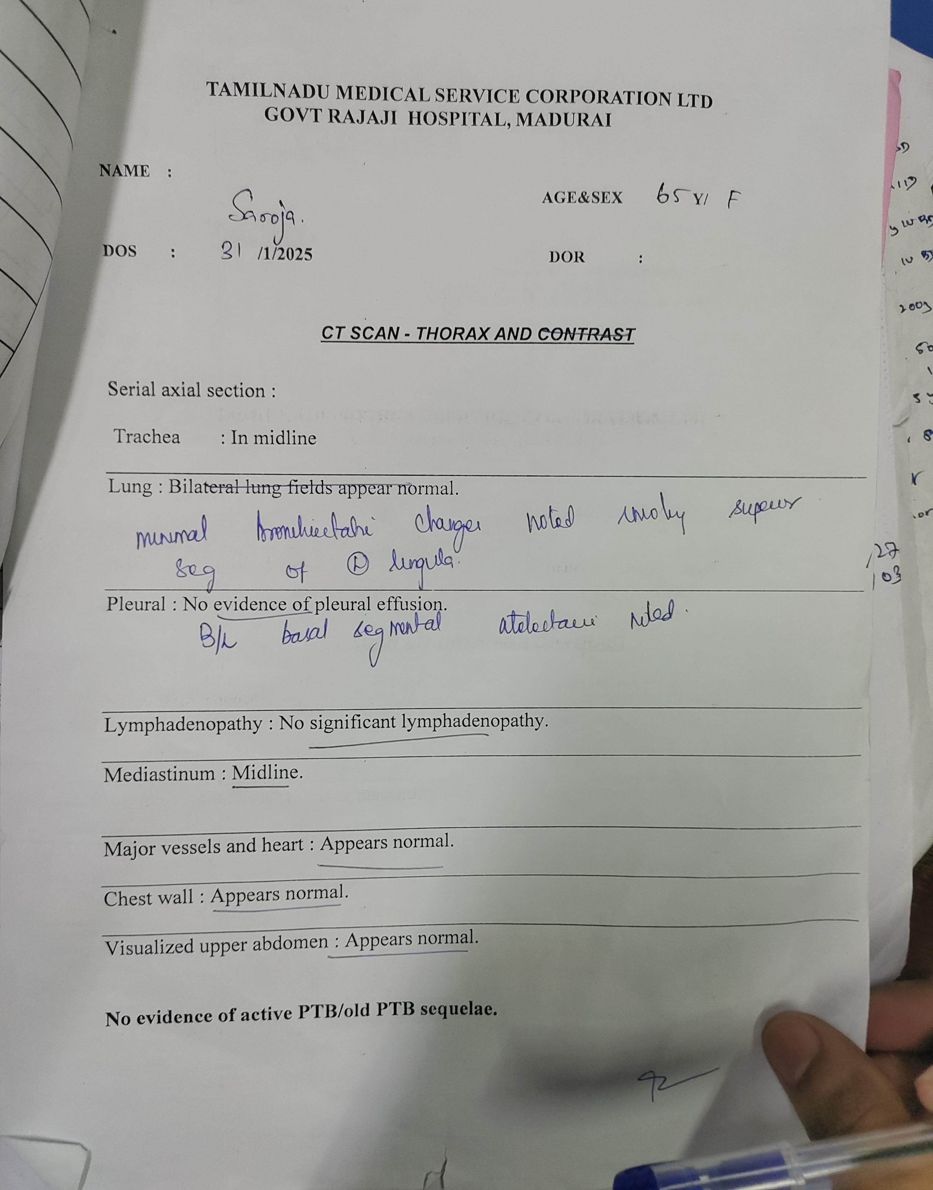

Slide 30
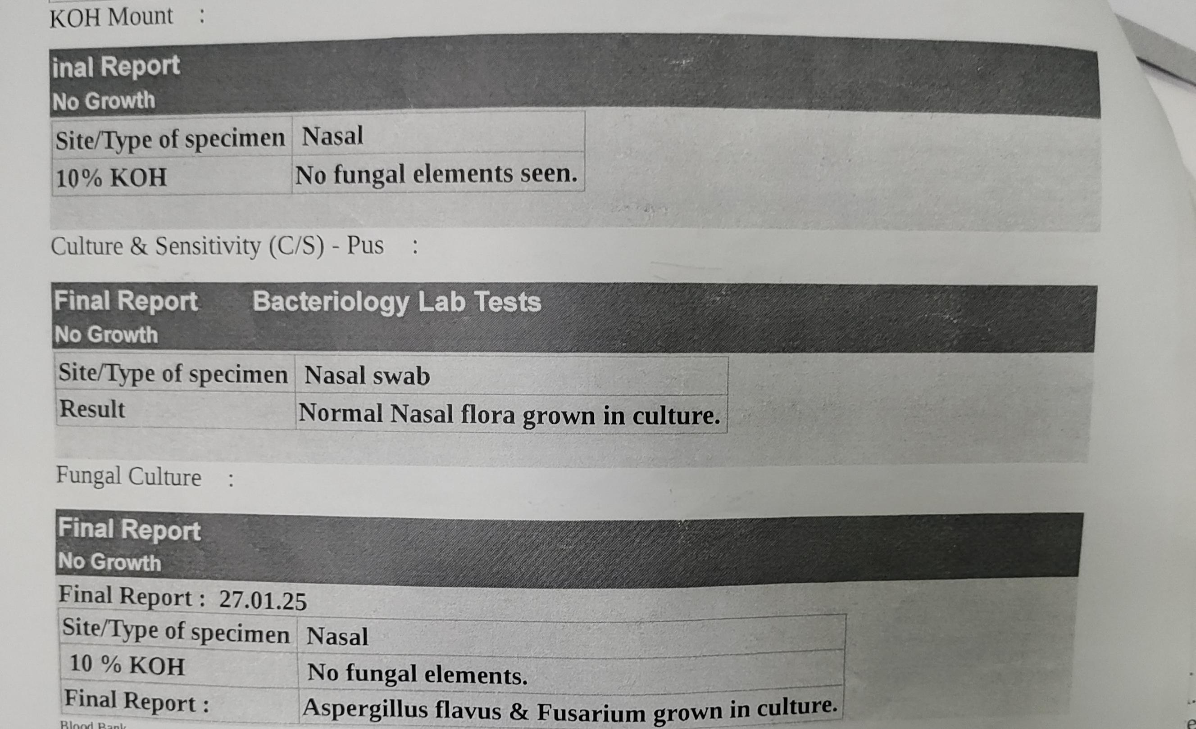

Slide 31
Ophthal opinion: both eyes normal fundus at present
Ent Opinion: suggested DNE and DNE revealed left inferior turbinate hypertrophy, midline septum, right middle meatus secretions. To do CT PNS and review.
Ent review: to continue tablet voriconazole, glycemic control, assessment to plan for FESS

Slide 32
Neuro medicine opinion (31/1/25)
Imp: T2DM /SHTN /fungal sinusitis/ acute encephalopathy ( metabolic/septic)
Suggested - to continue iv antibiotics ,
Inj.Levitracetam 500mg IV TDS
Serial electrolytes monitoring & correction
Glycemic control
To do – MRI Brain with MRA , MRV
CSF study

Slide 33
CSF ANALYSIS
Total count – 3 cells
Differential count – polymorphs – 0, lymphocytes – 3
Sugar – 84 CBG - 137 mg/dL
Protein – 43 mg/dL
LDH – 25 U/L

Slide 34
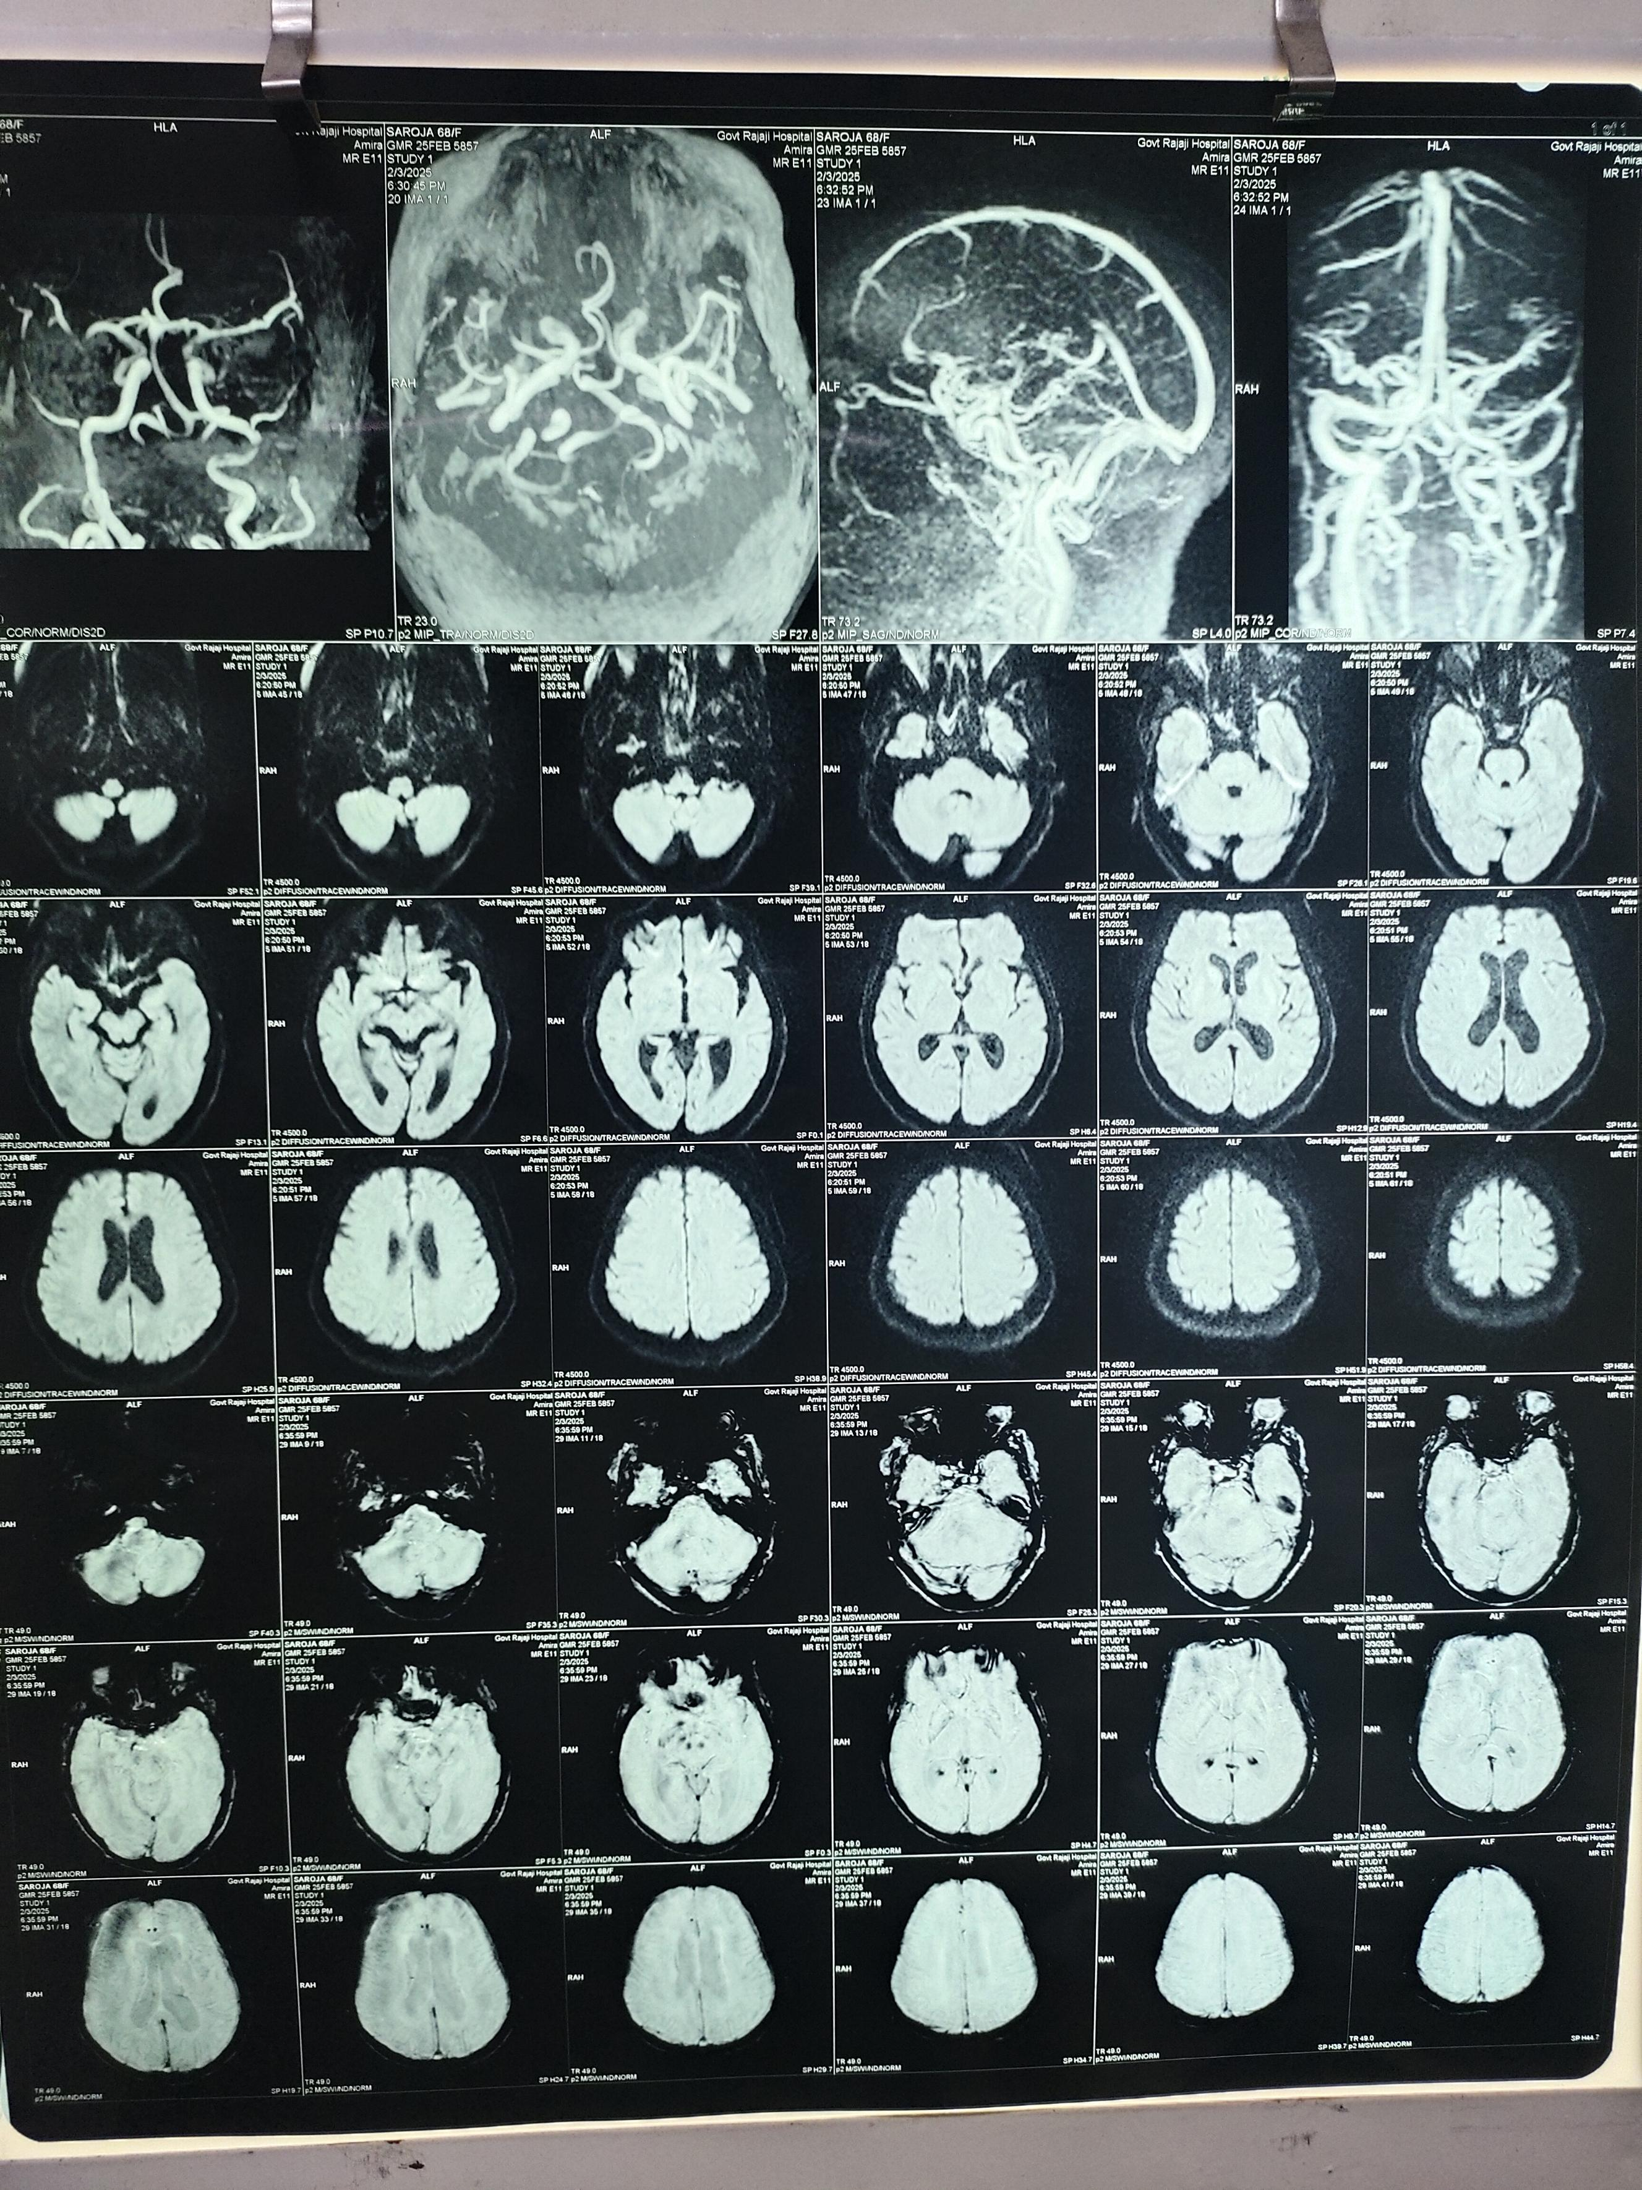
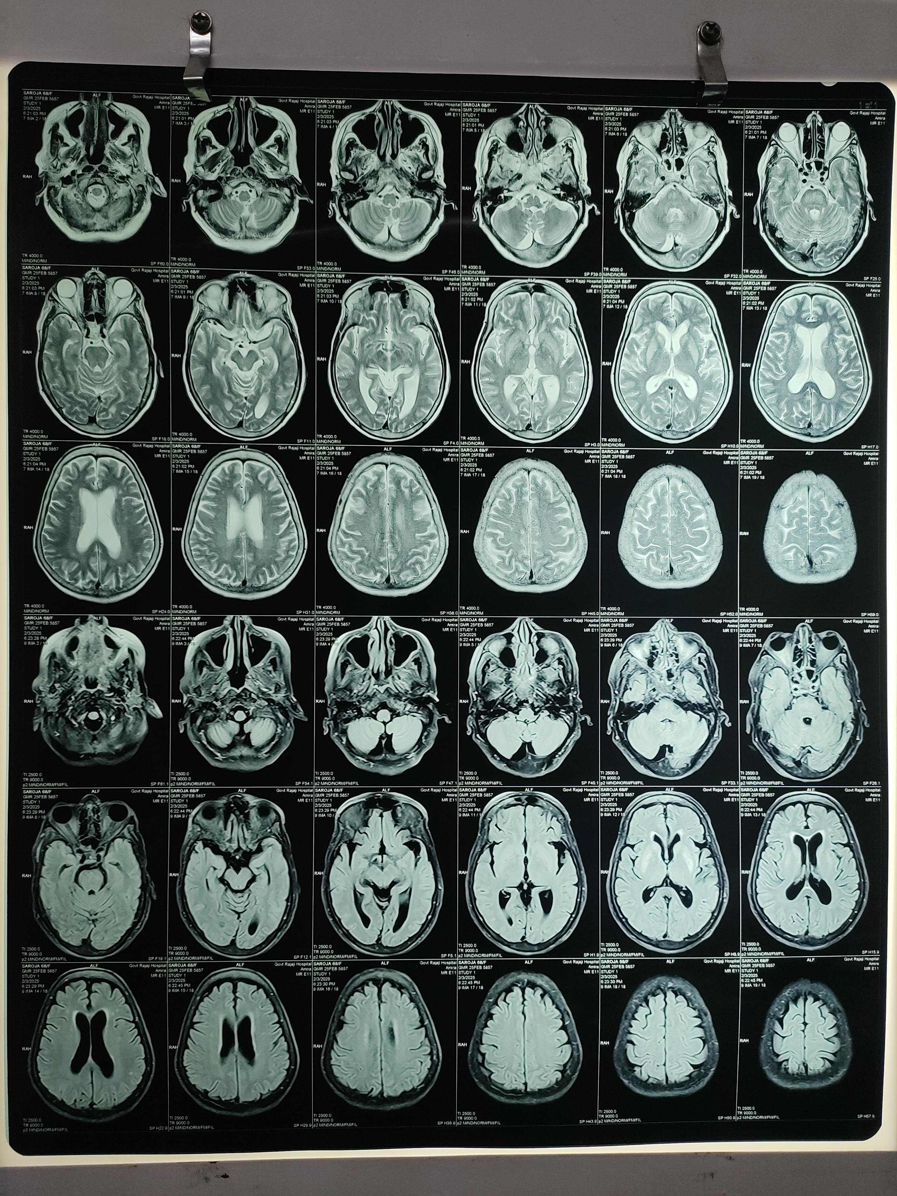

Slide 35
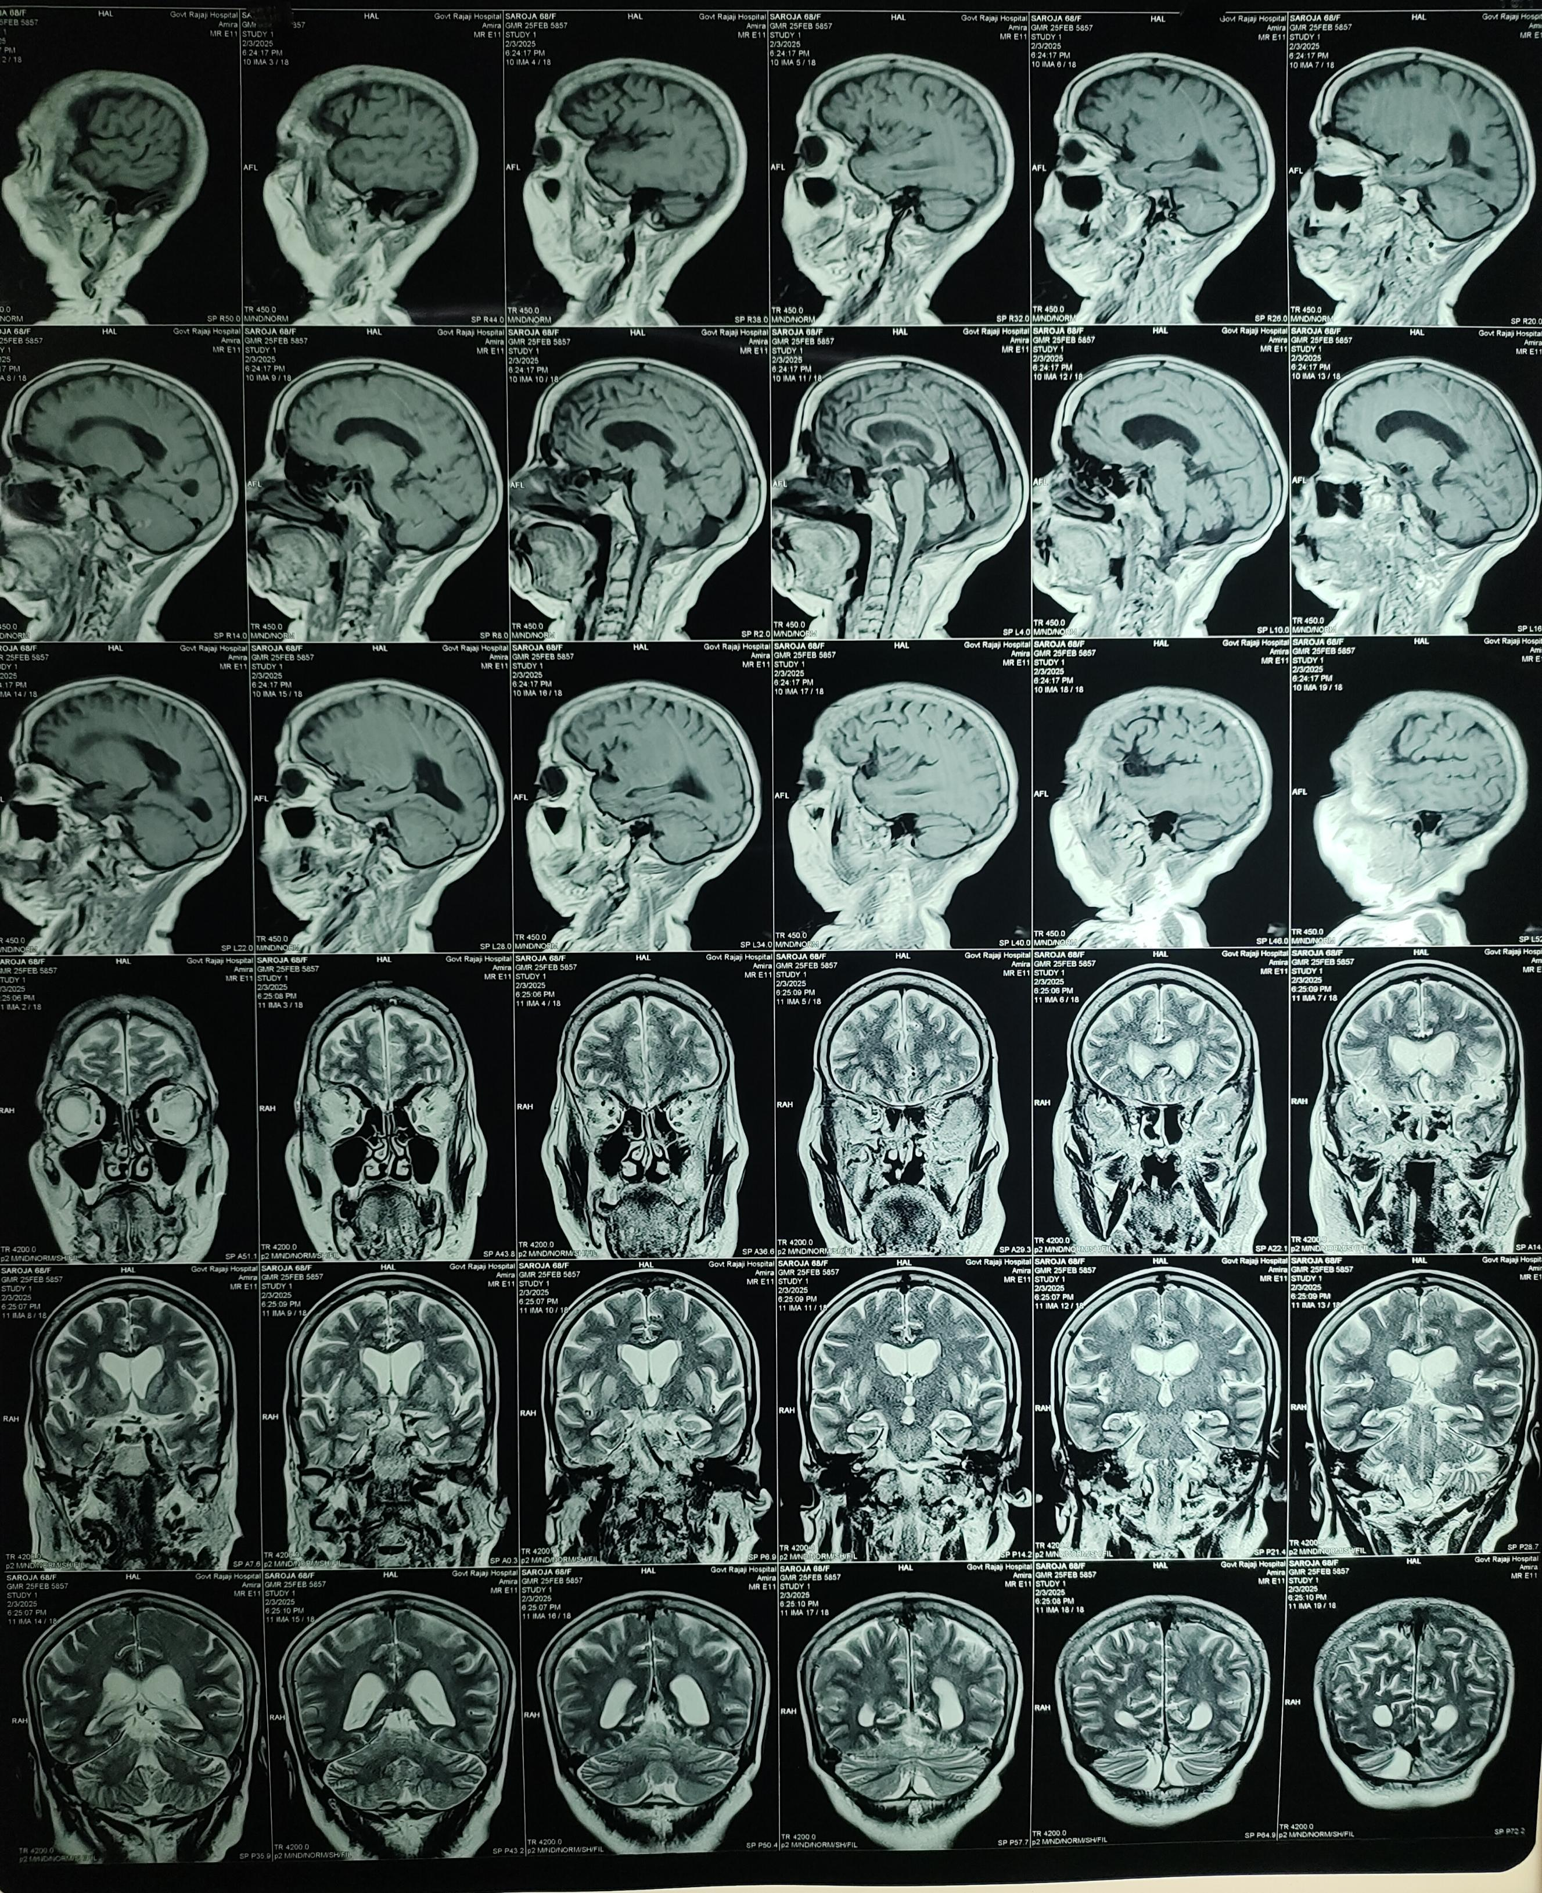
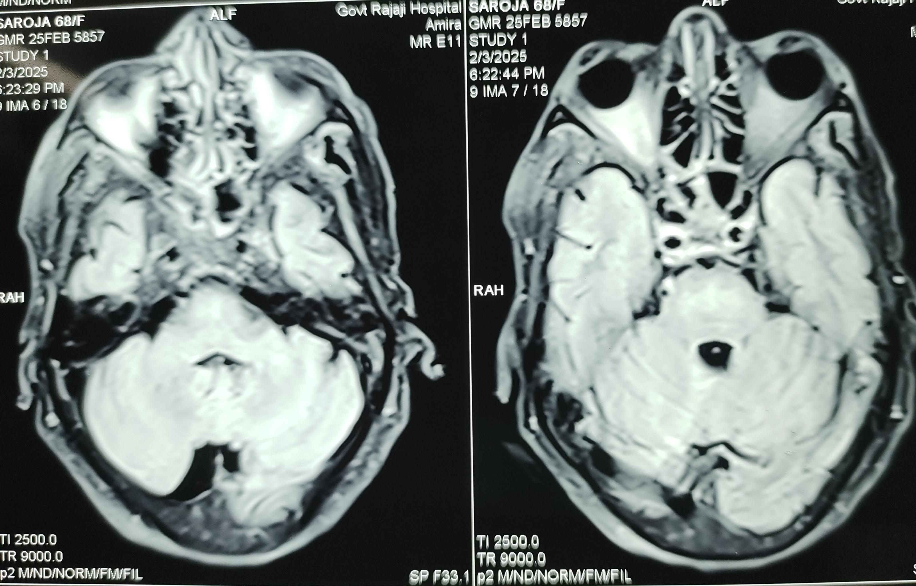

Slide 36
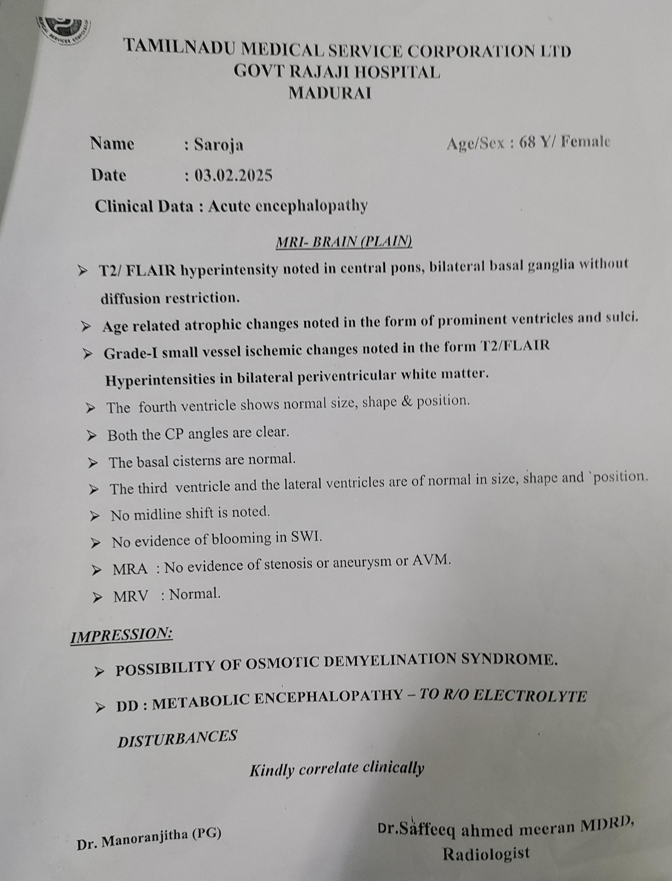
MRI REPORT

Slide 37
Neurology review:
Imp: T2DM/SHTN/FUNGAL SINUSITIS/METABOLIC ENCEPHALOPATHY/ OSMOTIC DEMYELINATION SYNDROME
Sugg: To continue iv antibiotics,
Continue T.Levitiracetam 500mg 1-1-1
To add Inj. Thiamine 300 mg in 100 ml NS iv OD
Vitals monitoring
To do: Ent , Ophthal opinion, Sr TSH & CORTISOL
Repeated TSH – 2.28 uIU /ml

Slide 38
Final diagnosis:
Type 2 Diabetes mellitus/ Systemic hypertension/ Fungal sinusitis/ Metabolic encephalopathy/ Osmotic Demyelination Syndrome

Slide 39
Treatment given
Inj Ceftriaxone 1g IV BD
Inj.Levitiracetam 500 mg iv TDS
Inj.Ranitidine 50 mg iv. BD
Inj. Thiamine 300 mg iv OD
T. Voriconazole 200mg 1-0-1
T.Amlodipine 5mg 1 OD
T.Bisacodyl 5 mg 1 hs
Inj Insulin regular 4-4-4 sc ½ hr b/f

Slide 40
THANK YOU

