Slide 1
THE UNQUIET BODY: A Rare Neurological Case”
By IST MEDICAL UNIT
HOD/CHIEF PROFESSOR : DR.K.SENTHIL M.D
ASSOCIATET PROFESSOR : DR.MURALIDHARAN M.D
ASSISTANT PROFESSOR : DR.MANIKANDAN M.D., D.A
DR.SUDHA M.D
DR.SARAVANAMADHAV M.D

Slide 2
CHIEF COMPLAINTS
A 26 year old female patient was brought to GRH with chief complaints of tremor for past 6 months.

Slide 3
HISTORY OF PRESENTING ILLNESS
THE PATIENT WAS APPARENTLY NORMAL BEFORE 6MONTHS AFTER THAT THE PATIENT DEVELOPED
H/O tremor for past 6months in his both hand . Which is gradual in onset, progressive nature, no aggravating or reliving factor, no diurnal variation
H/o gait disturbance for past 6months .
No H/o memory loss/ abnormal behaviour
No H/O Headache/ vomiting
No H/O seizure
No H/O paucity of movement/Deviation of angle of mouth
No H/O Difficulty in swallowing
No H/O Speech disturbance
No H/O fever

Slide 4
No H/O Bowel-Bladder disturbance
No H/O Sensory disturbance
No H/O Cough with expectoration
No H/O Breathlessness
No H/O Chest Pain/Palpitation
No H/O LOW/ heat intolerance
No H/O decreased urine output/ leg swelling
No H/O Abdominal Pain/ jaundice/ malena
No H/O chronic drug intake

Slide 5
PAST HISTORY
Not a k/c/o DIABETES/SHTN/Bronchial Asthma/Epilepsy/CAD/Thyroid Disorder.

Slide 6
PERSONAL HISTORY
Mixed diet
Bowel and bladder habits - normal
Sleep pattern - normal
Menarche at 13 years- 4/30 days cycle . Lmp 26/09/2025

Slide 7
FAMILY HISTORY
No significant family history

Slide 8
GENERAL EXAMINATION
Pt concious oriented
obeys oral commands
Afebrile
No pallor
No Clubbing
No Icterus
No cyanosis
No pedal edema
No generalized lymphadenopathy
No External markers for HIV/Tuberculosis
No External Neurocutaneous markers

Slide 9
SYSTEMIC EXAMINATION
CVS - S1 S2 +, No murmur
RS - BAE + , No added sounds
P/A - soft BS+ , No organomegaly

Slide 10
SYSTEMIC EXAMINATION
CNS – concious, oriented
obeys oral commands
Pupils 3mm equally reacting to light
CEREBELLAR SIGNS
Gait abnormality present
Finger nose test +ve
Finger finger test +ve
Dysdiadochokinesia +ve
DYSTONIC GAIT +
 | RIGHT | LEFT
Power | 5/5 | 5/5
 | 5/5 | 5/5
Tone | Normal | Normal
 | Normal | Normal
DTR | + | +
 | + | +
PLANTAR | FLEXOR | FLEXOR

Slide 11
VITALS
BP - 120/70 mmHg
PR - 84/min
SPO2 - 98% in room air
CBG - 92 mg/dl

Slide 12
INVESTIGATIONS
Date/ Investigations | 30.09.25
Hb | 13.1g/dl
TC | 8300/ul
PLT | 2.2 L/ul
RBS | 97 mg/dl
U/Cr | 17/0.9 mg/dl
TB/DB/IB | 0.6/0.5/0.1 mg/dl
OT/PT/ALP | 31/17/77 U/L

Slide 13
INVESTIGATIONS
Date/Investigations
LDH | 391 U/L
S.PROTEIN | 6.2/4.0/2.2 g/dl
PT/INR/APTT | 16.2/1.34/34
ICT | NEGATIVE
qCRP | 0.5mg/dl

Slide 14
INVESTIGATIONS
URINE ALBUMIN- Nil
URINE SUGAR- Nil
URINE DEPOSITS- 1-2 pus cells
VCTC - NON REACTIVE
VIRAL MARKERS- NEGATIVE

Slide 15
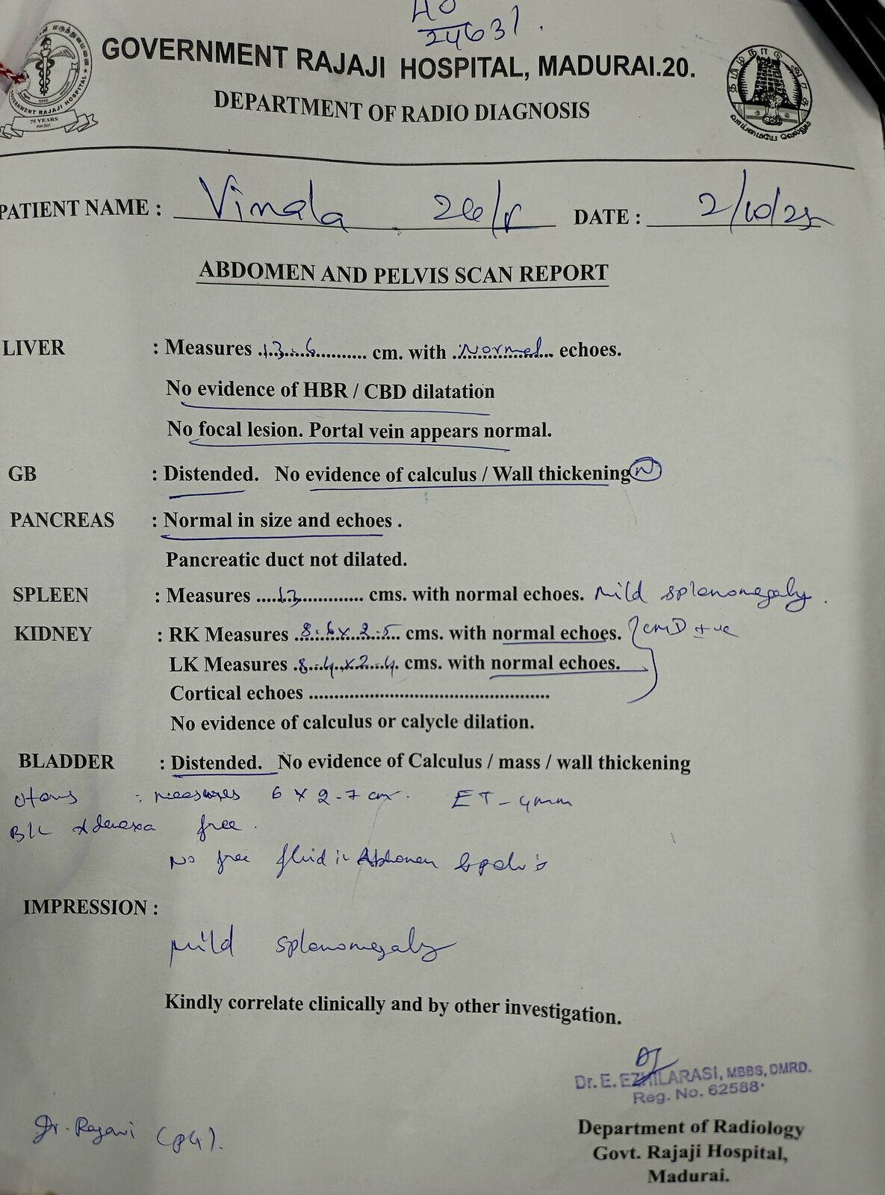
USG ABDOMEN
AND
PELVIS

Slide 16
ECHO
No RWMA
EF - 60%
MILD MR
No evidence of vegetations

Slide 17
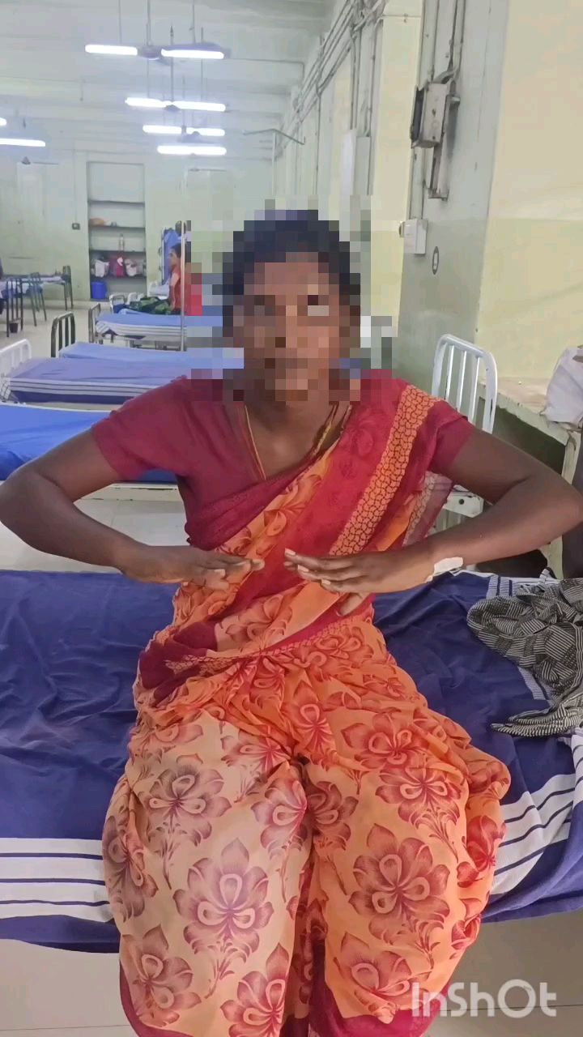

Slide 18
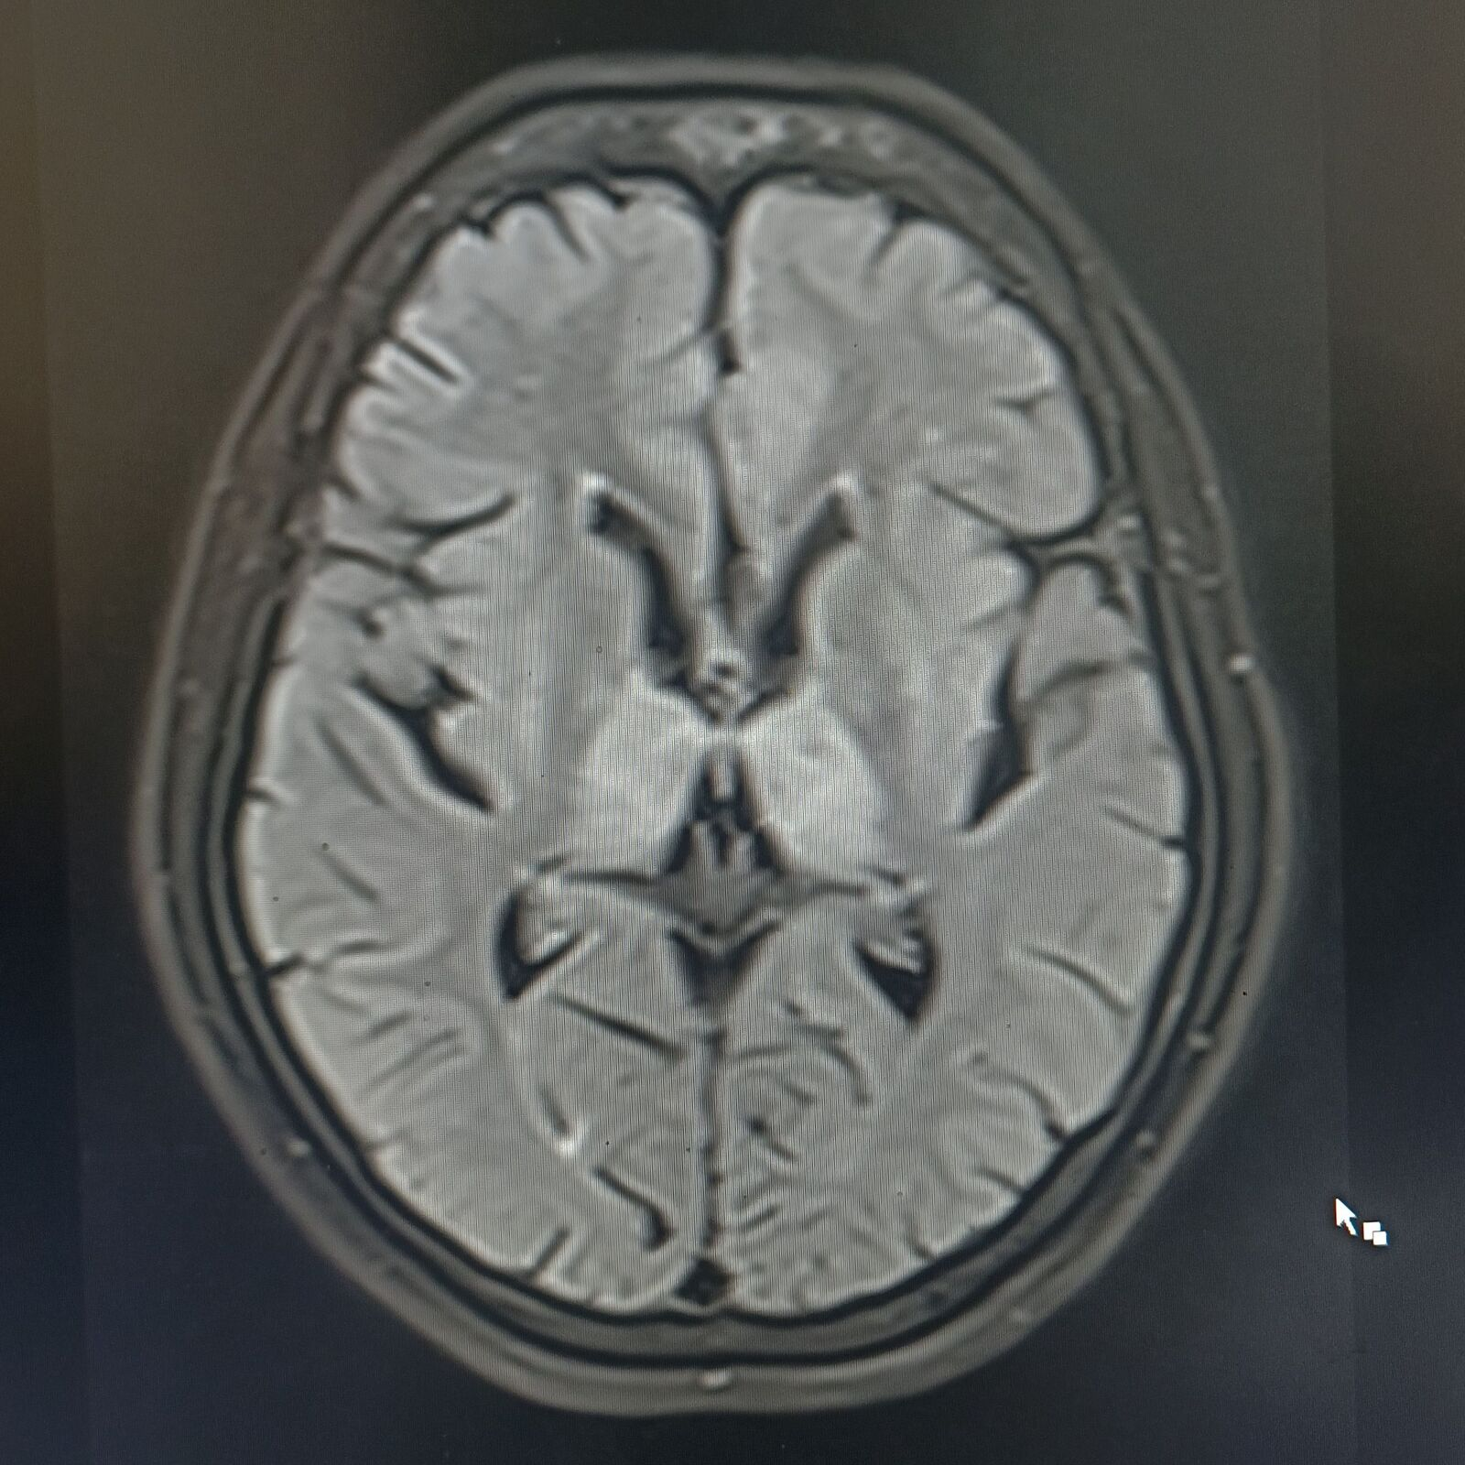
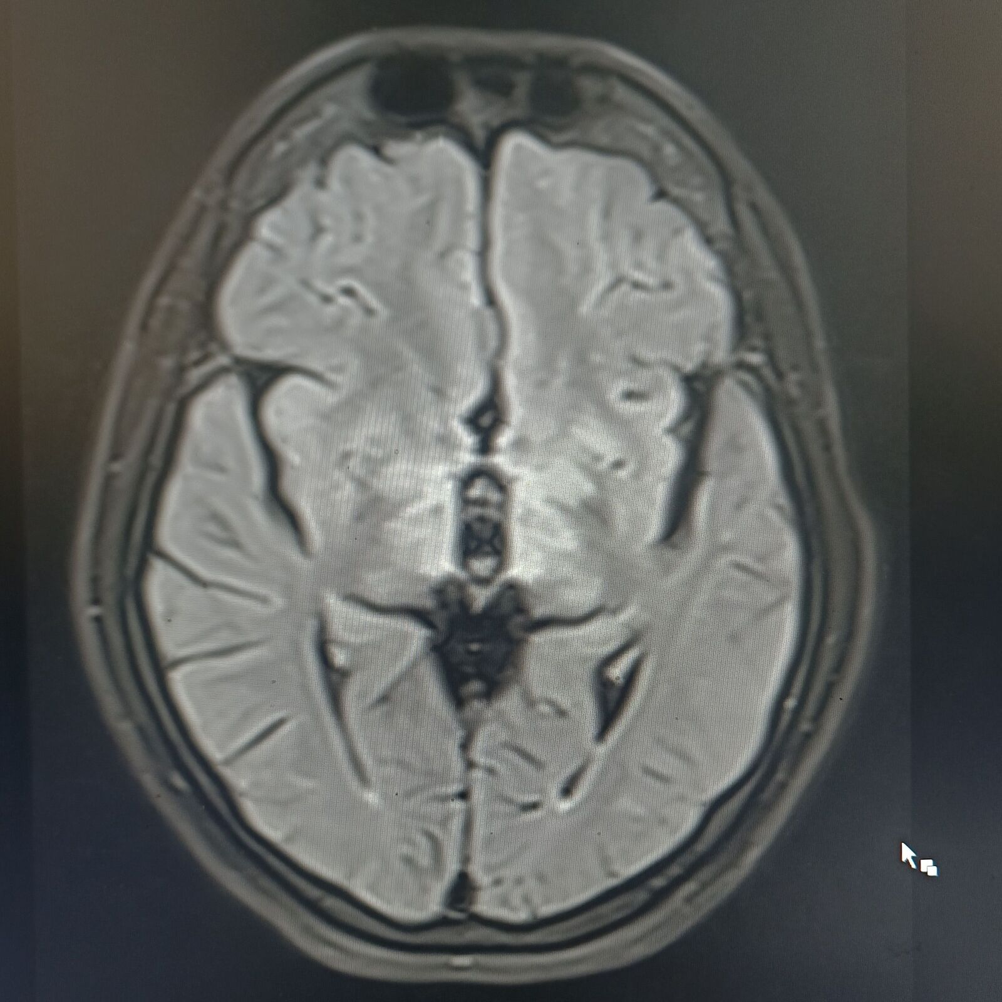

Slide 19
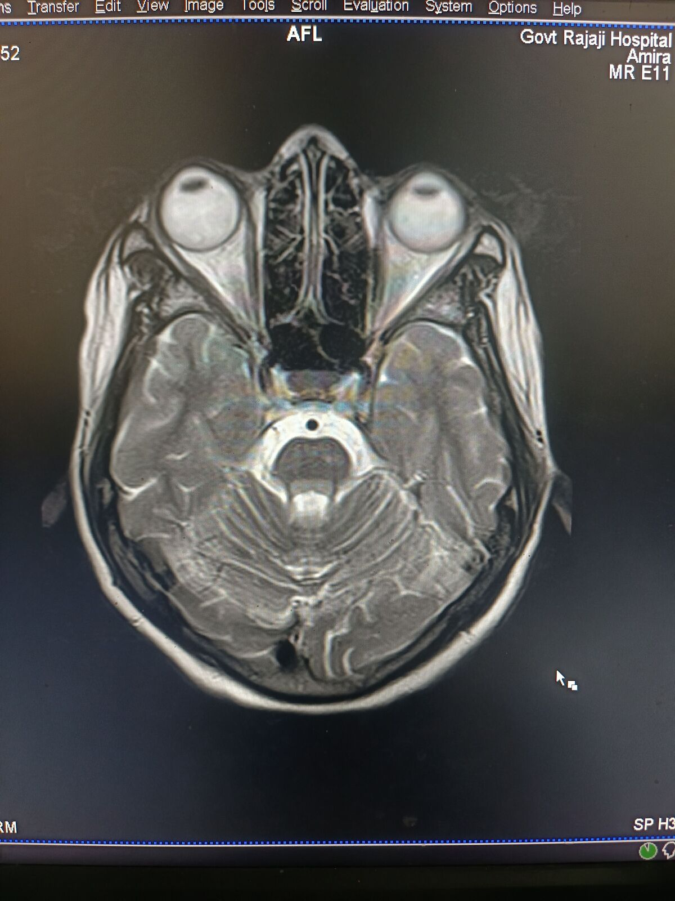
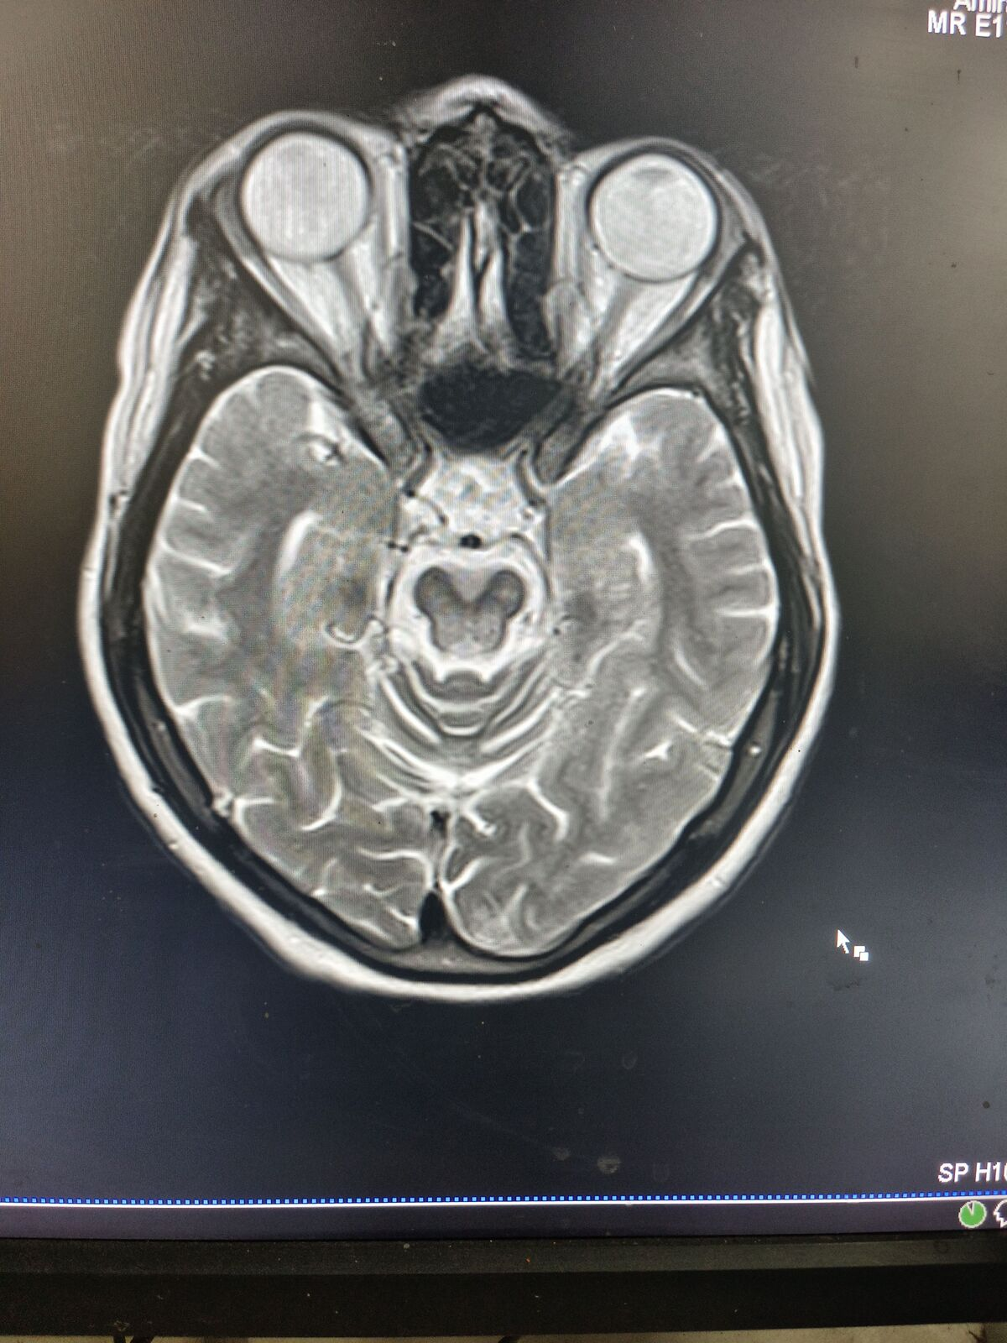

Slide 20
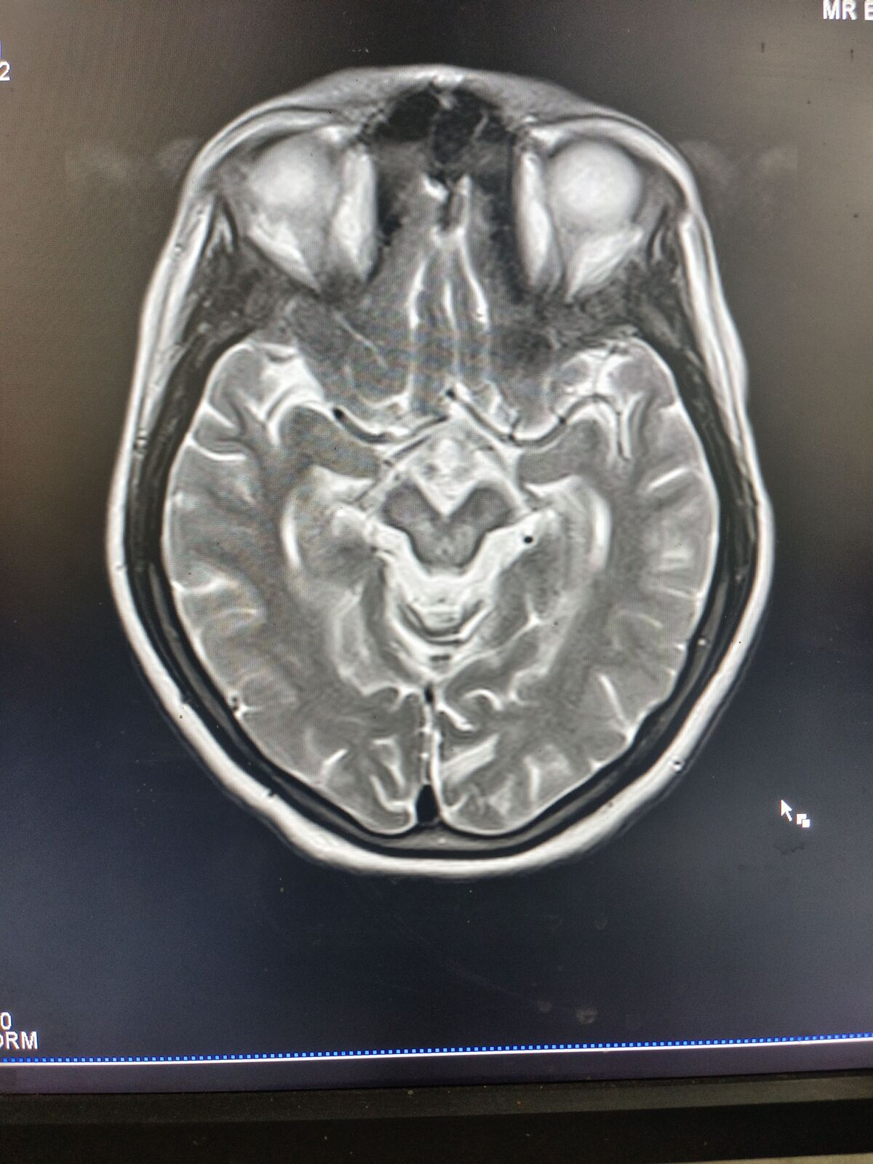

Slide 21
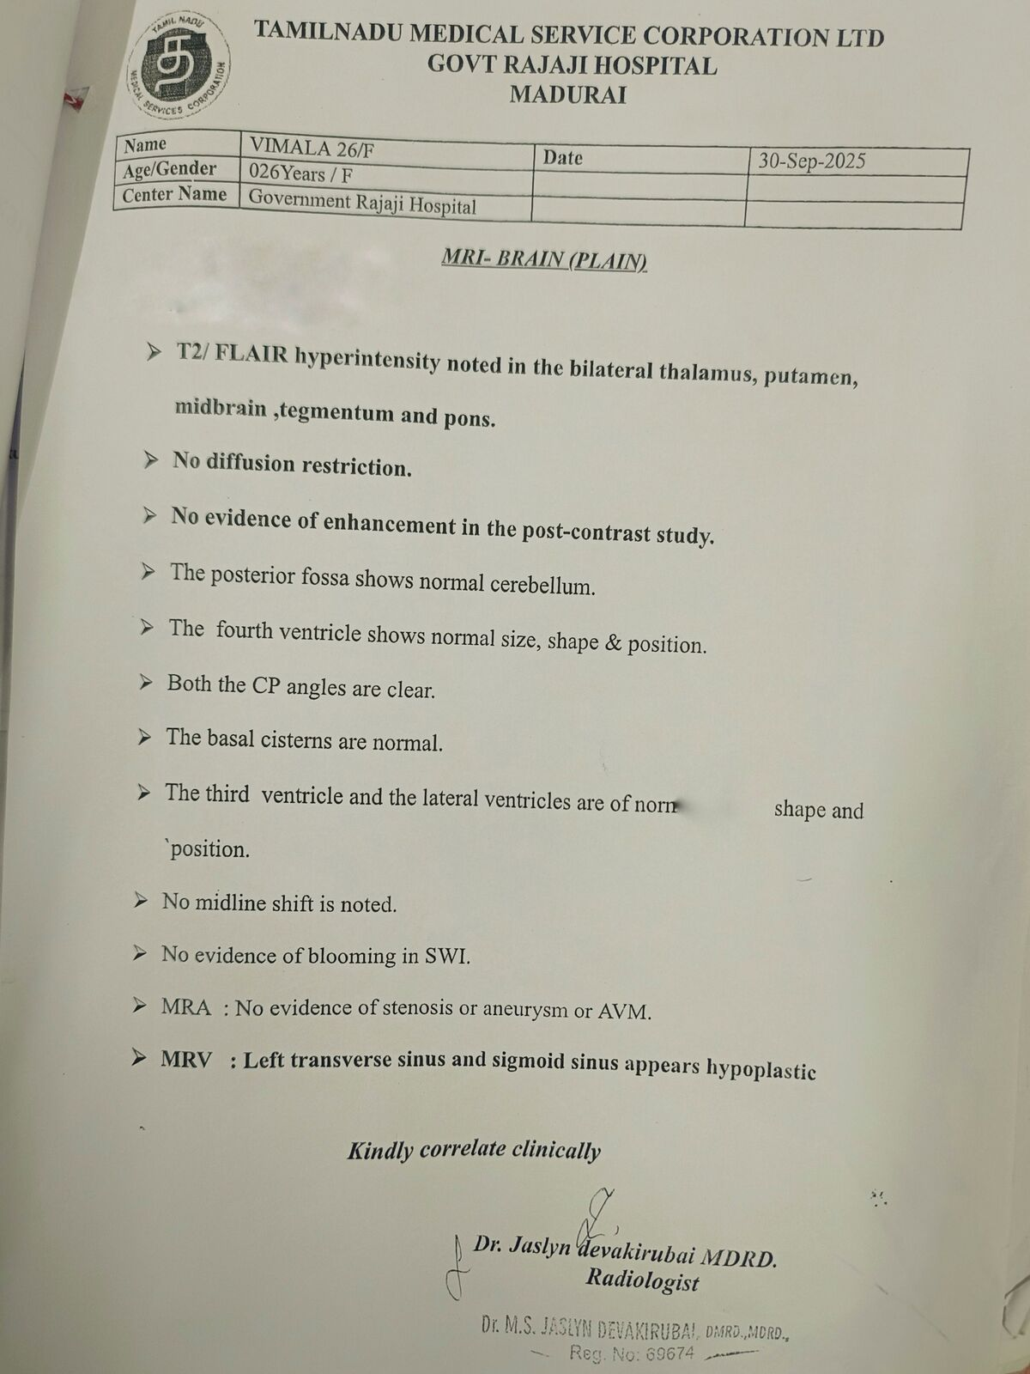

Slide 22
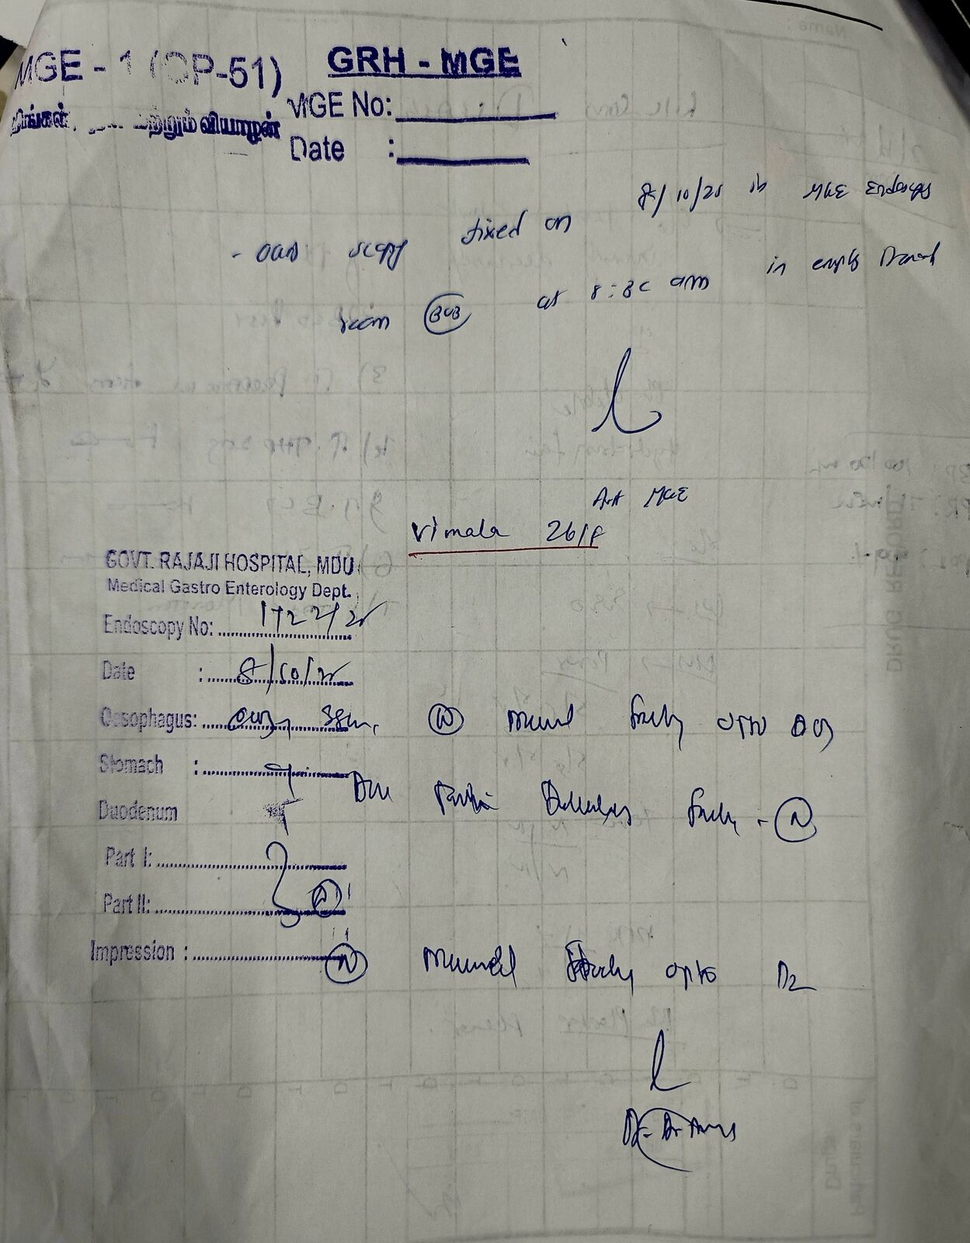
MEDICAL GASTROENTEROLOGY OPENION
OGD - NORMAL STUDY
plan - Fibroscan

Slide 23
Let's discuss

