Slide 1
OSMOTIC DEMYELINATION SYNDROME
ON BEHALF OF IMCU
CHIEF - PROFESSOR . DR.M.NATARAJAN.M.D.
ASST – DR.C.VIGNESH.M.D.
PRESENTOR – DR.K.KEERTHI.

Slide 2
A 48 years old male, Senthil kumar presented with vomiting for a week, immediately after a meal
* 3-4 episodes a day
* Vomitus had food particles and not blood stained
* not associated with headache
* associated with loss of appetite

Slide 3
He then had experienced slurring of speech
H/O altered sensorium
H/O easy fatiguability
H/O gait disturbance

Slide 4
Negative history
No h/o headache
No h/o fever
No h/o seizures
No h/o urinary/ faecal inconvenience
No h/o loose stools
No h/o cough
No h/o chest pain
No h/o abdomen pain

Slide 5
Past history
Hypertensive for 5 years
Old CVA 4 years ago, Recovered
Hypertensive Retinopathy – Laser Photocoagulation done
CT brain report ( 08/ 04/2017 ) left capsuloganglionic ischemic infarct

Slide 6
Drug history
Patient on,
T. Telmisartan 40 mg 1 - 0 – 1
T.Hydrochlorthiazide 12.5 mg 1 -0 - 1
T. Clinidipine 10 mg 0 - 0 – 1
T. Atorvastatin 10 mg 0 - 0 – 2
T. Clopidogrel 75mg 0 – 1 – 0
T. Zolfresh 10 mg 0 – 0 - 1

Slide 7
Personal history
Occasional alcoholic
Reformed smoker
Patient compliant with drug intake
Mixed diet consumer

Slide 8
Patient taken to Velammal hospital, where MRI taken on 23.09.2021 which showed small vessel ischemic changes. He was diagnosed hyponatremia based on serum Na+ Value of 100 meq/l

Slide 9
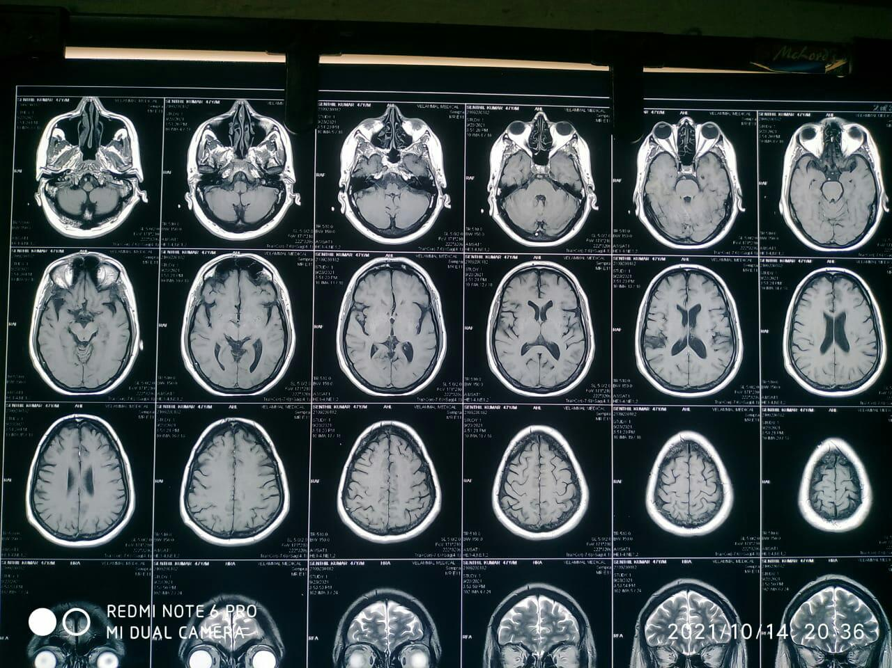

Slide 10
On next day his Na+ level was increased to 117meq/l
After 2 days his Na+ level was 127 meq/l
He was corrected with 3% NaCl
His sensorium deteriorated further and they took MRI brain again on 01/ 10/ 2021.

Slide 11
MRI brain – extensive demyelination in pons, cerebellum,midbrain,thalamus and cortex suggestive of osmotic demyelination syndrome
ECG - Generalised slowing of background activity , suggestive of diffuse Cerebral dysfunction

Slide 12
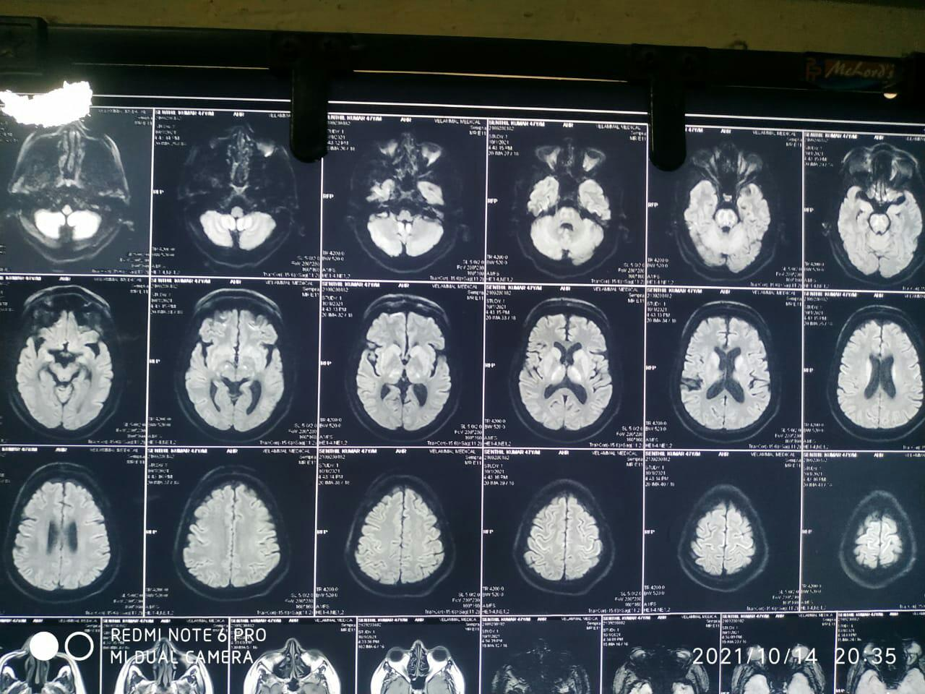

Slide 13
In view of poor GCS patient was intubated and later tracheostomy was done.
Total days of stay – 15 days
Patient got A.M.A and came to GRH, Madurai for further Management.

Slide 14
Vitals
Blood pressure – 140/80 mmhg
Pulse - 90/ mins
SpO2 - 98% on TT

Slide 15
General EXAMINATION
Unconscious
Not responding to pain
No P*/ I*/ C*/ C*/ L*/ E*

Slide 16
SYSTEMIC EXAMINATION
CVS – S1S2 +
NO murmur
RS – BAE +
NVBS +
On MV – TT
P/A soft
BS +
CNS – Unconscious,
Not responding to pain
No spontaneous eye opening
bilateral pupils 3mm reacting to light

Slide 17
Tone | RIGHT | LEFT
UL | N | N
LL | N | N
DTR
UL | + | +
LL | + | +
Planter | No response | No response

Slide 18
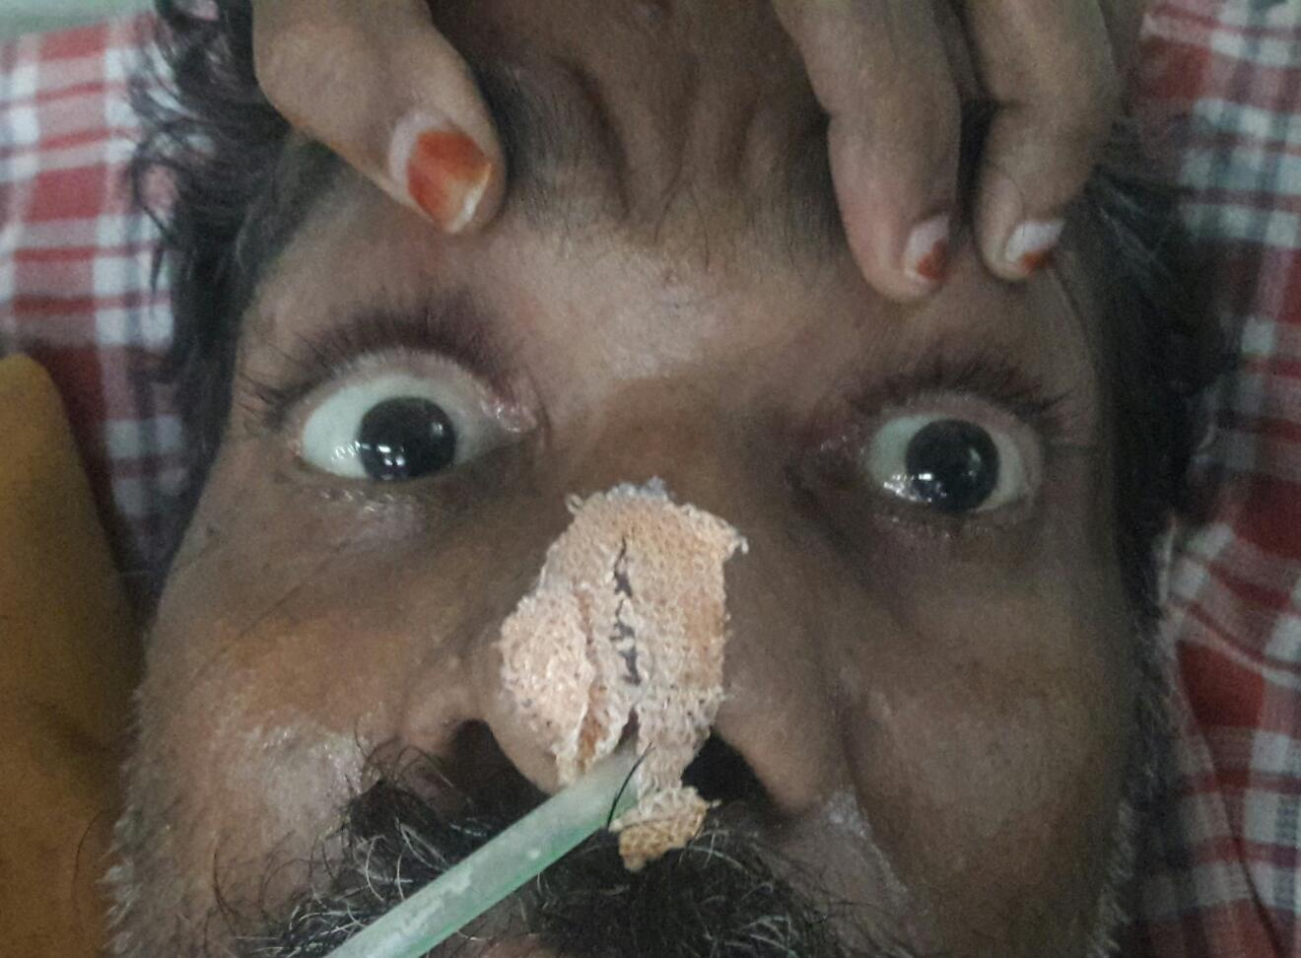

Slide 19
INVESTIGATIONS
CBC | RESULTS
TC | 12000
DC | 93/5/2
Hb | 9.0
PCV | 29
PLC | 2.50

Slide 20
LFT | RESULTS
Bilirubin ( T ) | 1.6
Direct | 0.8
URINE ROUTINE | RESULTS
ALB SUGAR | Nil Nil
ACETONE DEPOSITS | Negative 2- 3 pus cells
Indirect | 0.8
SGOT | 81
SGPT ALP | 126 302
RENAL FUNCTION | RESULTS
UREA | 25
CREATININE | 0.6

Slide 21
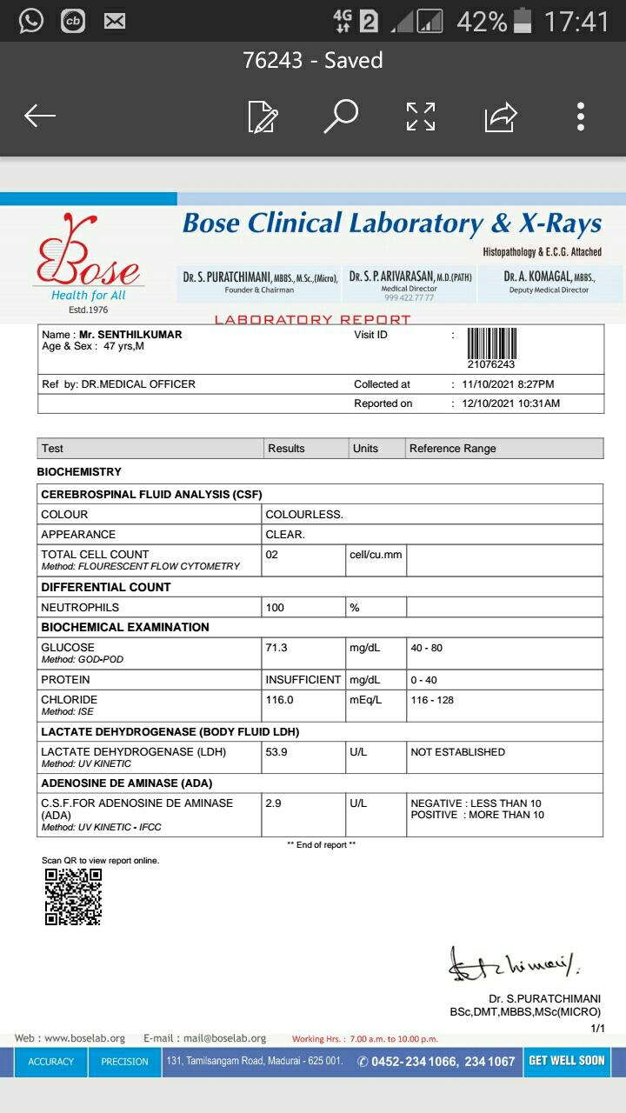

Slide 22
Serum electrolytes | 25.9.21 | 26.9.21 | 26.9.21 | 27.9.21 | 30.9.21 | 9.10.21
Sodium | 100 | 117 | 127 | 132 | 135 | 135
Potassium | 2 | 2.7 | 2.7 | 4.3 | 3.8 | 3.8

Slide 23
THYROID PROFILE
TSH 0.333 microIU/ml
free T4 1.44 ng/dl
free T3 1.89 pg/ml

