Slide 1
DIAGNOSIS OF HIV
BY 1ST MEDICAL UNIT
CHIEF : | Prof.Dr.M.NATARAJAN MD
ASST PROF : | Dr.PALANI KUMARAN MD D.Diab Dr.VASANTHA KALYANI MD DCP Dr.SURESH KUMAR MD
PRESENTOR : | Dr.M.KRUTHIKA

Slide 2
EARLY DIAGNOSIS
Early diagnosis is important because
Initiation of ART causes significant improvement in the quality of life.
For preventive care - Vaccination, Antibiotic prophylaxis to reduce opportunistic infections.
Reducing HIV transmission by reducing viral load.
Notes:
Injury of India Health Care worker

Slide 3
FIEBIG STAGING

Slide 4
FIEBIG STAGING
FIEBIG STAGING
Classification system with 6 stages of early HIV infection that were based on the timing and results of HIV diagnostic tests.
Fiebig I:
Acute infection stage.
HIV RNA detectable, HIV antibodies and p24 antigen not yet developed.
Occurs within the first few days to 2 weeks post-exposure.
Notes:
Injury of India Health Care worker

Slide 5
FIEBIG STAGING
Fiebig II:
HIV RNA detectable, and p24 antigen can be found in the blood. HIV Antibodies are not detectable.
Occurs within a few weeks after exposure.
Fiebig III:
HIV RNA and p24 antigen detectable, HIV-specific antibodies begin to appear.
Early phase of seroconversion.
Antibodies are not yet present in high enough amounts to be detected by standard HIV tests.
Notes:
Injury of India Health Care worker

Slide 6
FIEBIG STAGING
Fiebig IV:
HIV RNA, p24 antigen, and HIV antibodies are all detectable.
Patient starts to test positive for HIV in a standard HIV test.
Fiebig V:
HIV antibodies are detectable in significant amounts.
p24 antigen levels drop.
Patient typically diagnosed with acute HIV infection based on standard HIV tests.
Notes:
Injury of India Health Care worker

Slide 7
FIEBIG STAGING
Fiebig VI:
Characterized by a fully established immune response.
p24 antigen is no longer detectable.
HIV RNA and Antibodies are at detectable levels, and HIV infection is considered confirmed.
Notes:
Injury of India Health Care worker

Slide 8
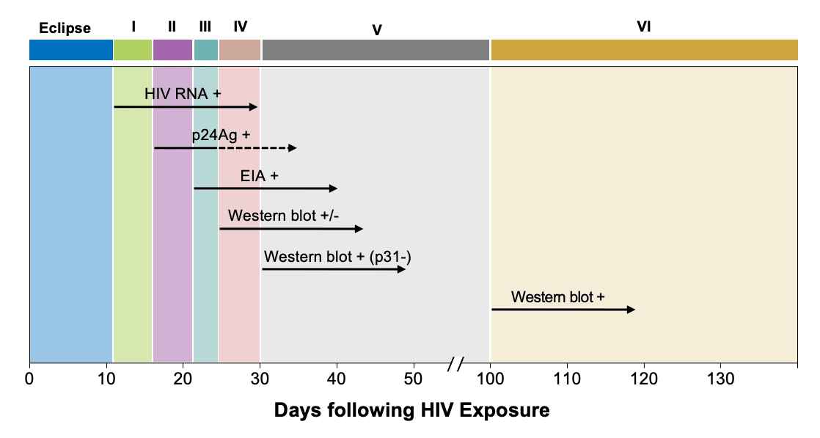
FIEBIG STAGING
Notes:
Injury of India Health Care worker

Slide 9
STAGES OF HIV

Slide 10
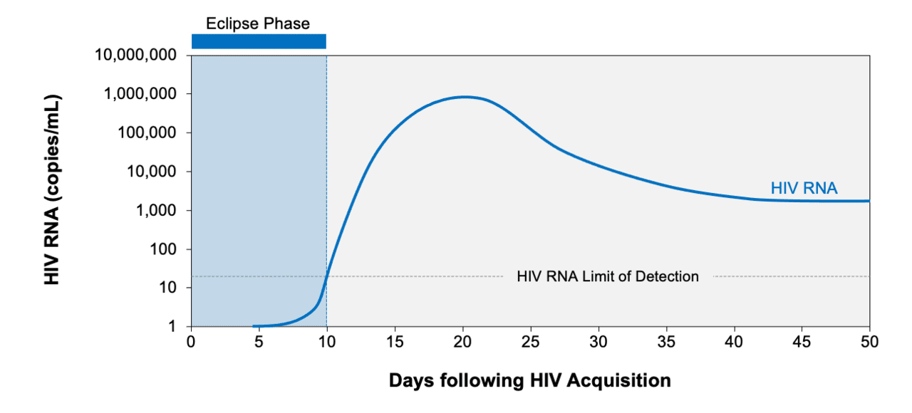
STAGES OF HIV
Eclipse Phase: The short interval following HIV acquisition in which no diagnostic test is capable of detecting HIV. This interval is typically 8 to 10 days in duration.
Notes:
Injury of India Health Care worker

Slide 11
STAGES OF HIV
Seroconversion Window Period:
The interval between HIV acquisition and the first detection of anti-HIV antibodies.
The duration of the window period depends on the sensitivity of the antibody assay used, with IgM/IgG-sensitive HIV antibody tests detecting HIV sooner than IgG-sensitive HIV antibody tests.
Notes:
Injury of India Health Care worker

Slide 12
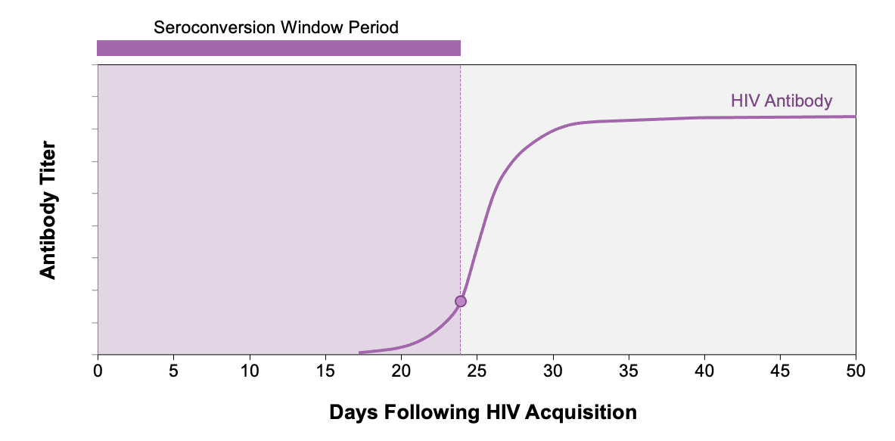
STAGES OF HIV
Notes:
Injury of India Health Care worker

Slide 13
STAGES OF HIV
Acute HIV Infection:
Defined as the phase of HIV disease that occurs soon after HIV acquisition and is characterized by detectable HIV RNA or HIV p24 antigen in the absence of anti-HIV antibodies. The term acute HIV was previously used interchangeably with the term primary HIV, but acute HIV is now the preferred term.
Notes:
Injury of India Health Care worker

Slide 14
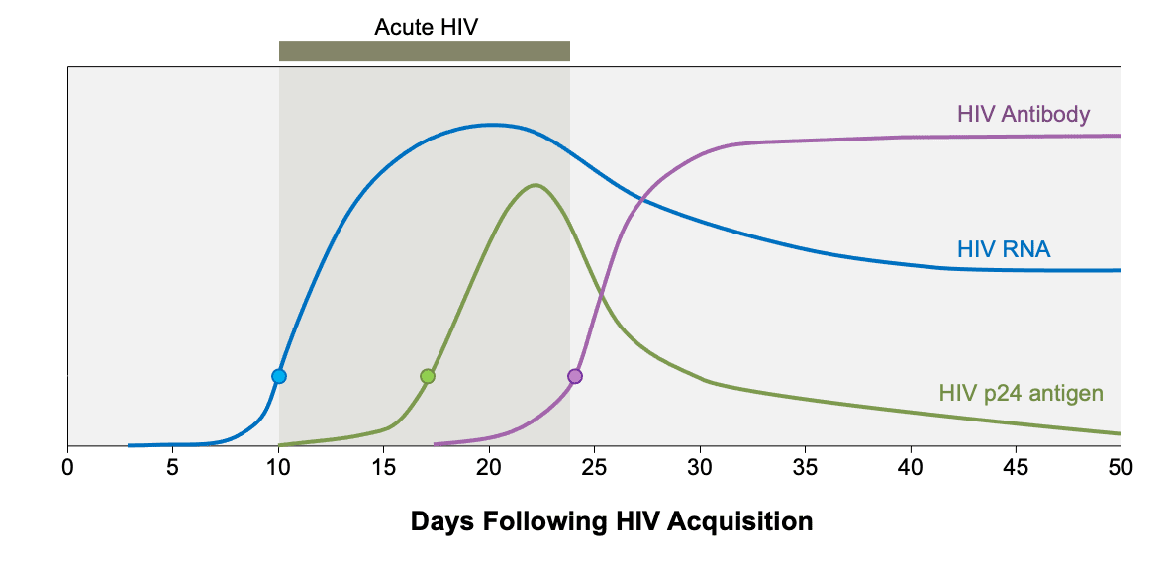
STAGES OF HIV
Notes:
Injury of India Health Care worker

Slide 15
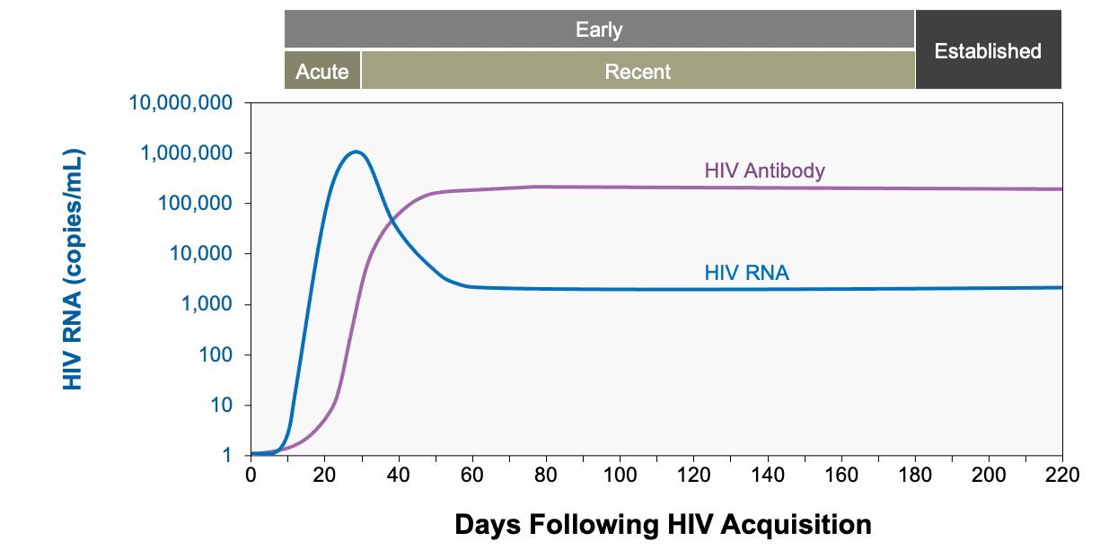
STAGES OF HIV
Early HIV Infection: Early infection is generally used to describe both acute and recent HIV time periods, which extend out to 6 months after HIV acquisition.
Notes:
Injury of India Health Care worker

Slide 16
SCREENING

Slide 17
INITIAL SCREENING
Type of test | Target of detection | Approximate time to positivity following infection (days) | Additional information
HIV Antigen/ Antibody tests | IgM and IgG antibody to HIV-1 and HIV-2 p24 antigen | Laboratory-based test: 18 to 45 Point of care: 18 to 90 | Improved sensitivity compared with antibody-only tests. Laboratory and point of care-based tests are available. Most laboratory tests are immunoassays. Point of care tests use lateral flow technology and are not as sensitive. Does not differentiate between HIV-1 and HIV-2.
HIV antibody only (ELISA) | IgM and IgG antibody to HIV-1 | 23 to 90 | Laboratory and rapid tests available. An FDA-approved self-test also available. Laboratory-based tests usually able to detect virus sooner. Positive results require confirmation with the laboratory-based antigen/antibody assay.
Notes:
Injury of India Health Care worker

Slide 18
ELISA TEST
All ELISAs consist of either HIV antigens or antibodies (depending upon the principle), attached to a solid phase (matrix or support), and incorporated with a conjugate and substrate detection system.
On the basis of the principle of the test, ELISA can be divided into:
Indirect
Competitive
Sandwich
Capture
Notes:
Injury of India Health Care worker

Slide 19
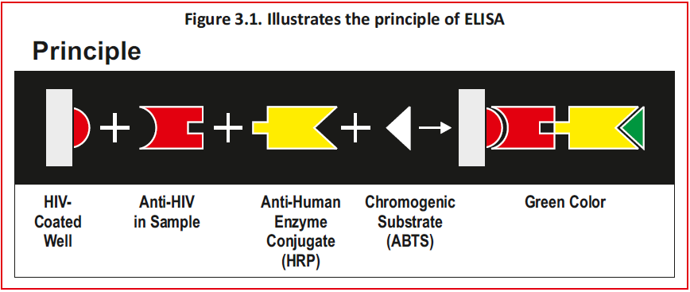
ELISA TEST
Notes:
Injury of India Health Care worker

Slide 20
ELISA TEST
INDIRECT | COMPETITIVE
SANDWICH | CAPTURE
Notes:
Injury of India Health Care worker

Slide 21
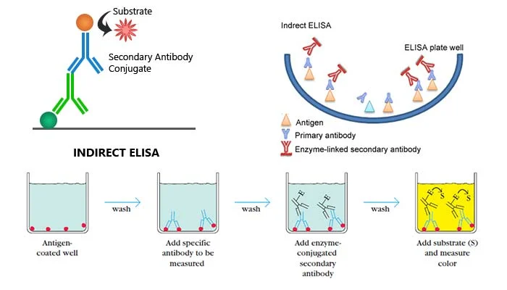
INDIRECT ELISA
Notes:
Injury of India Health Care worker

Slide 22
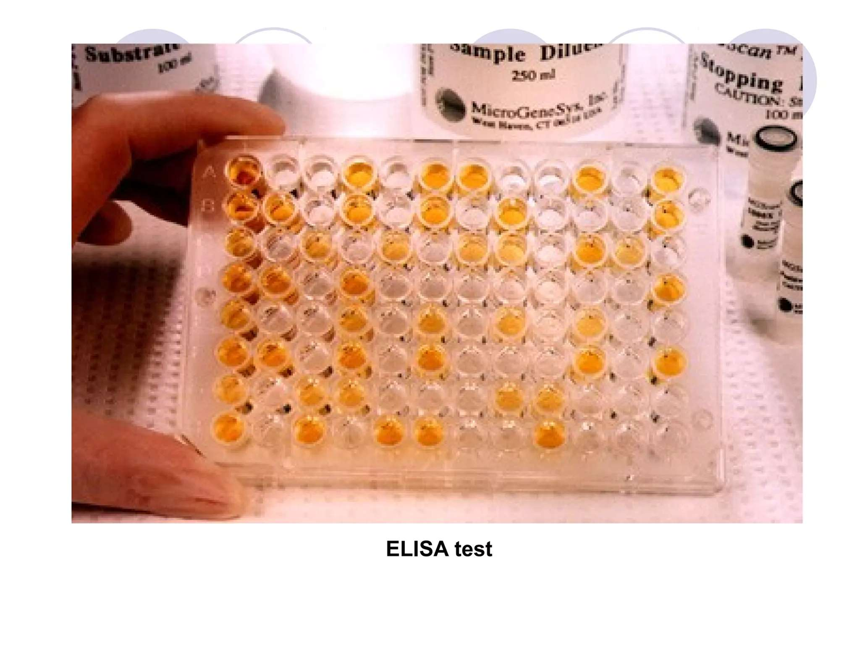
ELISA TEST
Notes:
Injury of India Health Care worker

Slide 23
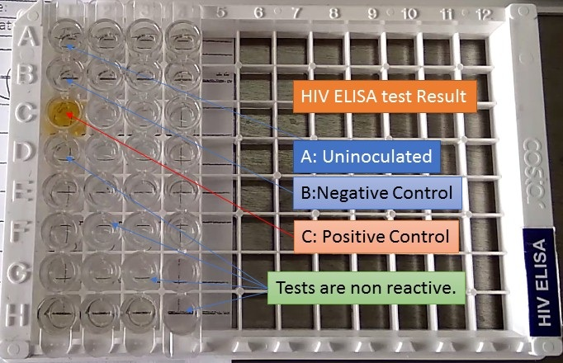
ELISA TEST
Notes:
Injury of India Health Care worker

Slide 24
RAPID TEST
Rapid tests are visual point of care tests that do not require any special equipment.
Immunoconcentration / Dot Blot immunoassay (vertical flow)
This is a type of solid phase immunoassay.
HIV antigens are immobilized on a porous membrane.
Specimen & reagent pass through the membrane & are absorbed into the underlying absorbent pad.
HIV antibodies if present, bind to the immobilized antigens.
The conjugate binds to the Fc portion of the HIV antibodies and produces a distinct coloured dot against a white background.
Notes:
Injury of India Health Care worker

Slide 25
RAPID TEST
Immunochromatography Tests
The strips/cards incorporate both the antigen and signal reagent into the nitrocellulose strip.
The specimen (usually followed by a buffer) is applied to the absorbent pad on the kit.
The specimen migrates through the strip and combines with the signal reagent.
A positive reaction results in a visual line on the membrane where the HIV antigen has been incorporated.
Notes:
Injury of India Health Care worker

Slide 26
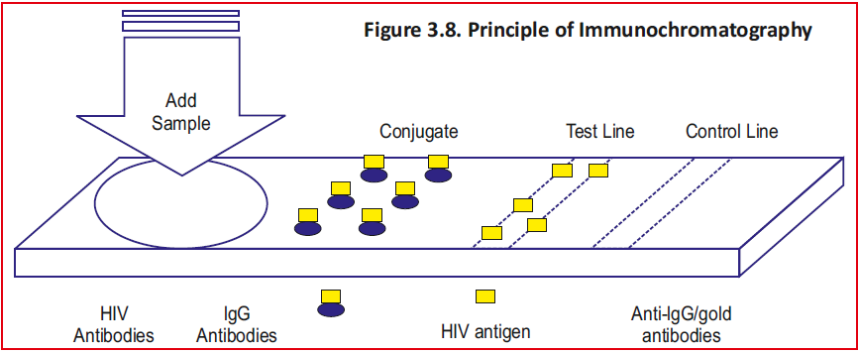
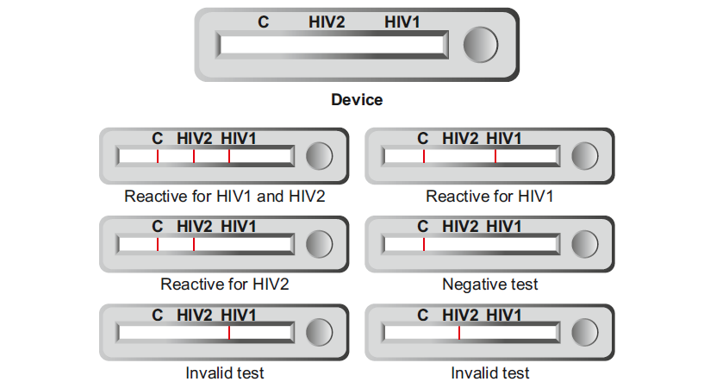
RAPID TEST
Notes:
Injury of India Health Care worker

Slide 27
RAPID TEST
Agglutination assays.
Used for antibody detection, where the antigen is coated on a carrier particle and the antigen antibody reaction is observed in clumps.
Assays incorporate a variety of antigen-coated carriers, e.g., red cells, latex particles, gelatine particles and micro beads.
During the agglutination reaction, an HIV antibody combines with the HIV antigen on the carrier particles. Since all antibodies are multivalent, a sort of lattice network is formed
Notes:
Injury of India Health Care worker

Slide 28
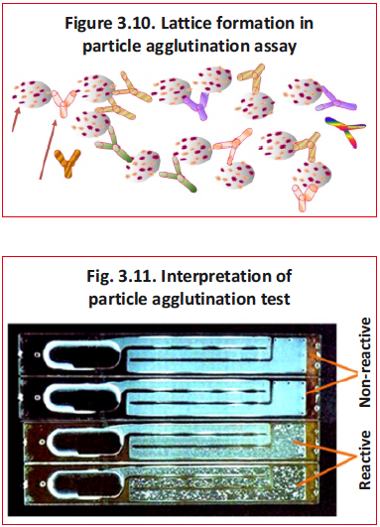
RAPID TEST
Notes:
Injury of India Health Care worker

Slide 29
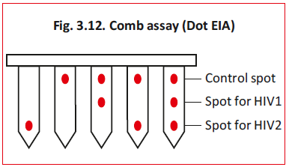
RAPID TEST
D. Immunocomb Assay
Rapid assay intended to differentiate between HIV-1 and HIV-2 antibodies.
A comb like device with projections. Each tooth represents the solid phase and has three spots for adsorption of a specific antigen/antibody.
HIV-1 and HIV-2 antigens are immobilized as circular spots at two sites.
The third spot acts as an antibody control containing goat anti-human IgG.
Notes:
Injury of India Health Care worker

Slide 30
CONFIRMATORY TESTS
Type of test | Target of detection | Approximate time to positivity following infection (days) | Additional information
HIV-1/HIV-2 differentiation assay | Antibodies to HIV-1 and/or HIV-2 antigens | 23 to 90 | This is a rapid laboratory-based test used to confirm a positive antigen/antibody combination assay. It can distinguish between HIV-1 and HIV-2 infection.
Western blot | IgG antibody | Indeterminate result: 35 to 50 Positive result: 45 to 60 | Test results often take several days to weeks to return. Detects IgG antibody to HIV-1 proteins. Does not reliably detect HIV-2 or subtype O HIV-1 virus. No longer offered by most labs.
Notes:
Injury of India Health Care worker

Slide 31
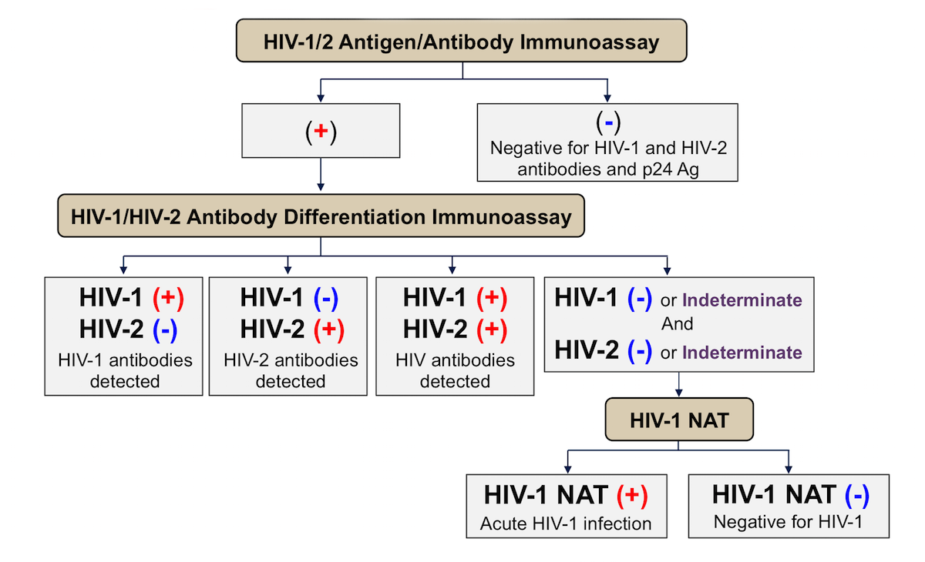
CONFIRMATORY TEST
Notes:
Injury of India Health Care worker

Slide 32
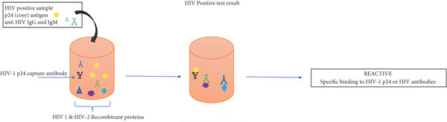
DIAGNOSIS
Notes:
Injury of India Health Care worker

Slide 33
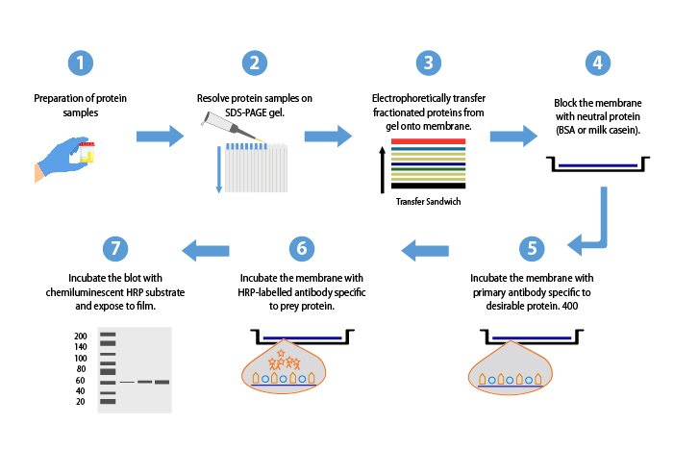
WESTERN BLOT
Notes:
Injury of India Health Care worker

Slide 34
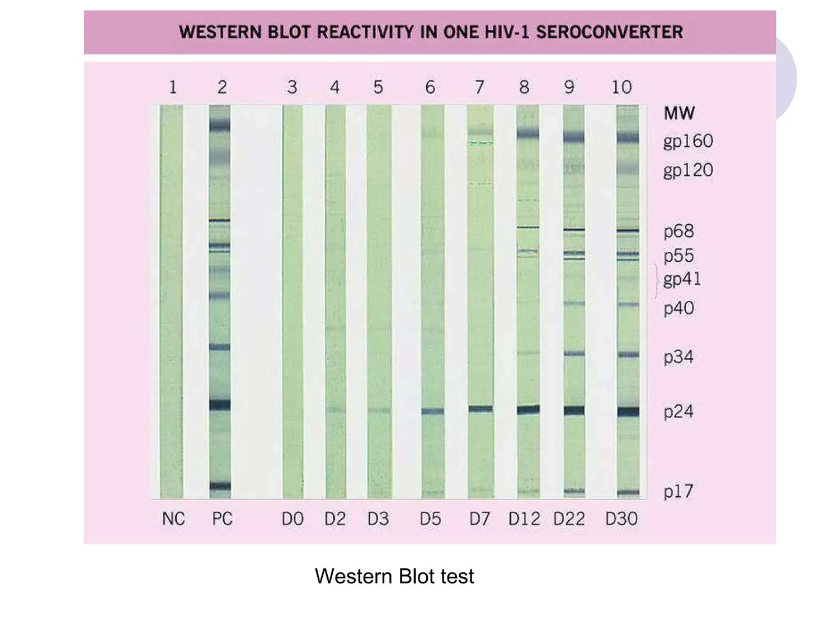
WESTERN BLOT
Notes:
Injury of India Health Care worker

Slide 35
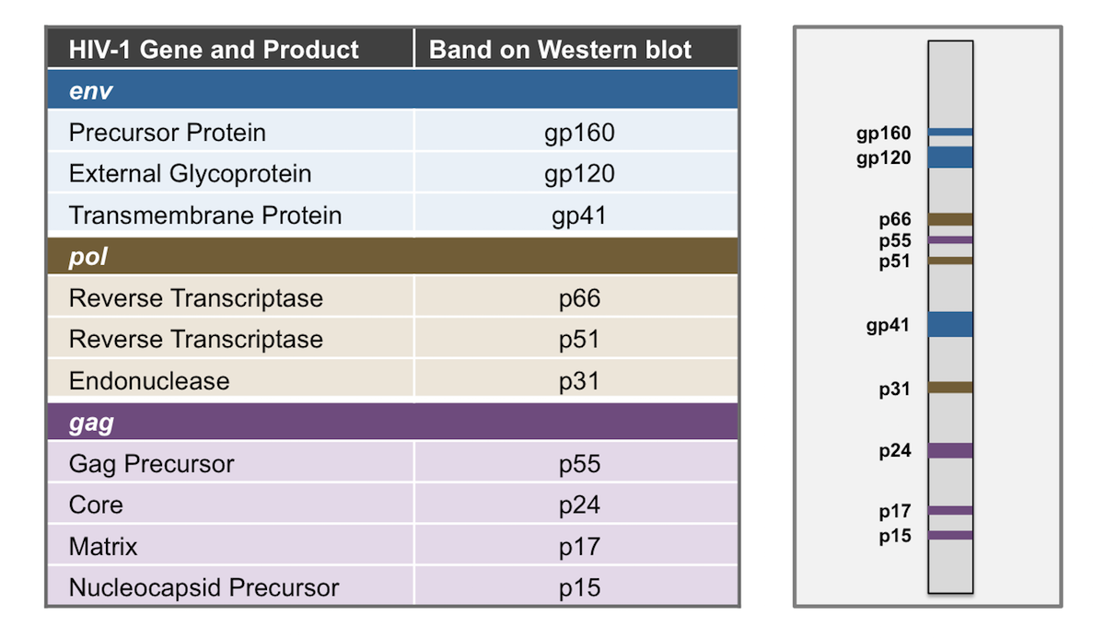
WESTERN BLOT
Notes:
Injury of India Health Care worker

Slide 36
WESTERN BLOT
Various HIV specific recombinant or synthetic antigens are adsorbed onto nitrocellulose paper antibody when present, attaches to the antigen on the strip and the antigen antibody complex is then detected using enzyme conjugate and substrate.
Similar to an ELISA test, except that the product is insoluble.
The test procedure should be carried out as per the kit insert.
WB tests detect the presence of antibodies against specific HIV proteins, which are seen as bands on the test strip.
Notes:
Injury of India Health Care worker

Slide 37
NUCLEIC ACID TESTS
Type of test | Target of detection | Approximate time to positivity following infection (days) | Additional information
Qualitative tests | HIV RNA Transcription Mediated Amplification Assay (TMA) | 10 to 33 | Typically reserved for evaluation of possible acute HIV infection or as part of HIV screening for blood donors or individuals being evaluated for or taking HIV PrEP (especially injectable PrEP).
 | HIV DNA Polymerase Chain Reaction (PCR) | 10 to 33 | Not intended for initial screening or routine testing of adults. Reserved for evaluation of indeterminate test results, particularly in setting of risk factors for HIV.
Notes:
Injury of India Health Care worker

Slide 38
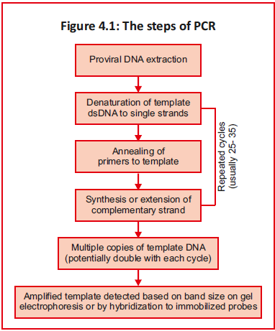
NUCLEIC ACID TESTS
Notes:
Injury of India Health Care worker

Slide 39
NUCLEIC ACID TESTS
Type of test | Target of detection | Approximate time to positivity following infection (days) | Additional information
Quantitative tests | HIV RNA | 10 to 33 | Used to quantify HIV-1 RNA or HIV-2 RNA from plasma samples. Primarily used for monitoring response to treatment in persons with HIV-1. Quantitative tests are more readily available than qualitative tests. In addition, they are generally preferred if concern for acute HIV infection since they give an HIV RNA level that serves as pre-treatment baseline.
Notes:
Injury of India Health Care worker

Slide 40
NUCLEIC ACID TESTS
Quantitative HIV-1 RNA Assays
The methods of amplification of HIV-1 RNA include:
Target amplification by
Reverse transcriptase PCR (RT-PCR)
Real time PCR (qPCR)
Nucleic acid sequence-based amplification (NASBA)
Signal amplification by branched-chain DNA technique (bDNA)
Notes:
Injury of India Health Care worker

Slide 41
FALSE RESULTS

Slide 42
FALSE RESULTS
Result of patient-related factors
Lack or low level of HIV antibodies,
Cross-reactive antibodies due to a concurrent condition,
Test has low sensitivity, failure to detect certain subtypes of HIV, laboratory error during testing.
Notes:
Injury of India Health Care worker

Slide 43
FALSE NEGATIVE RESULTS
False-negative results:
Most false-negative results are due to being in the "window period" after HIV acquisition.
Likely in Antibody-only enzyme-linked immunosorbent assays (ELISA) tests.
Combination antigen/antibody assays has reduced false-negative result by the addition of the p24 antigen test.
Also in very advanced HIV disease due to waning of the antibody response.
Seroreversion can also occur when Antiretroviral therapy (ART) is initiated very early during acute infection.
Notes:
Injury of India Health Care worker

Slide 44
FALSE POSITIVE RESULTS
False-positive results
A positive antigen/antibody test followed by a negative confirmatory test is an indeterminate result and should be evaluated with an HIV RNA assay.
Due to
Cross-reacting alloantibodies from pregnancy.
Autoantibodies (associated with collagen-vascular diseases, autoimmune diseases, malignancy, certain classes of chemotherapy)
Receipt of an experimental HIV-1 vaccine
Influenza vaccination
Recent SARS-CoV-2 infection
Often a false-positive screening result occurs, and no specific trigger or cause can be identified.
Notes:
Injury of India Health Care worker

Slide 45
NACO STRATEGY

Slide 46
NACO STRATEGY
National AIDS Control Organisation Testing Strategies
The various strategies, so designated, involve the use of categories of tests in various permutations and combinations.
ELISA/ Rapid tests (E/R) used in strategy I, II, & III
Confirmatory tests with high specificity, like WBs and line immunoassays, are used in problem cases.
NACO recommends the use of ELISA kits with a sensitivity of ≥99.5 percent and the specificity of ≥98 percent and rapid kits with a sensitivity of ≥99.5 percent and the specificity of ≥98 percent.
Notes:
Injury of India Health Care worker

Slide 47
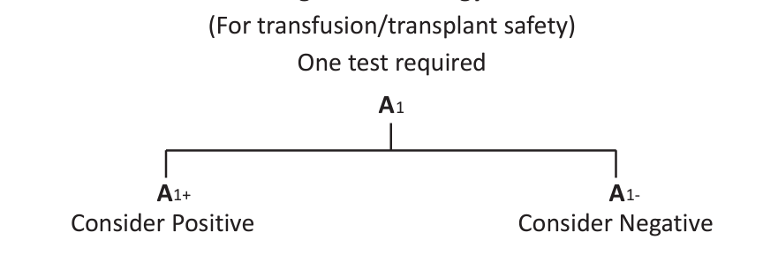
NACO STRATEGY
Strategy I (for blood transfusion/transplant safety)
The specimen is subjected to one test for HIV reactivity.
The test used in strategy 1 must have high sensitivity.
If non reactive, HIV negative. If reactive, HIV positive.
Used for donation safety. The unit of blood that tests reactive is discarded.
Donor is to be notified of his result. Proceed to Strategy II, III.
Notes:
Injury of India Health Care worker

Slide 48
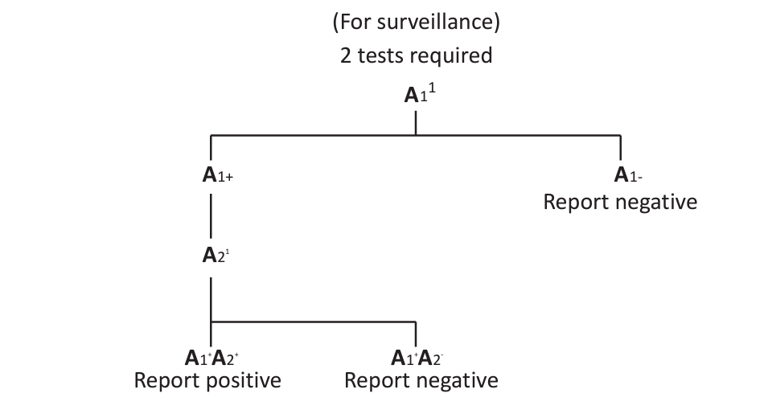
NACO STRATEGY
Strategy 2 A (used in sentinel surveillance)
If Reactive under Strategy I, subjected to a second ELISA or rapid test.
Utilizes system different from the first. i.e., the principle of the test and/or the antigen used is different.
Positive only if the second ELISA/rapid test also gives a reactive. If non reactive, negative for sentinel surveillance purposes.
Notes:
Injury of India Health Care worker

Slide 49
NACO STRATEGY
Strategy 2 B (used for diagnosis in symptomatic patients)
For Clinically symptomatic suspected AIDS cases.
Tested with a highly sensitive screening test.
Negative if the test gives a non-reactive result.
If Reactive the specimen is tested with another test kit utilising a different System.
If Reactive, then Positive for HIV.
If Non reactive subjected to a third tiebreaker test.
If the third test is reactive, reported as indeterminate and follow up testing is undertaken after 2 to 4 weeks.
If the third tiebreaker test is non-reactive, reported as negative.
Notes:
Injury of India Health Care worker

Slide 50
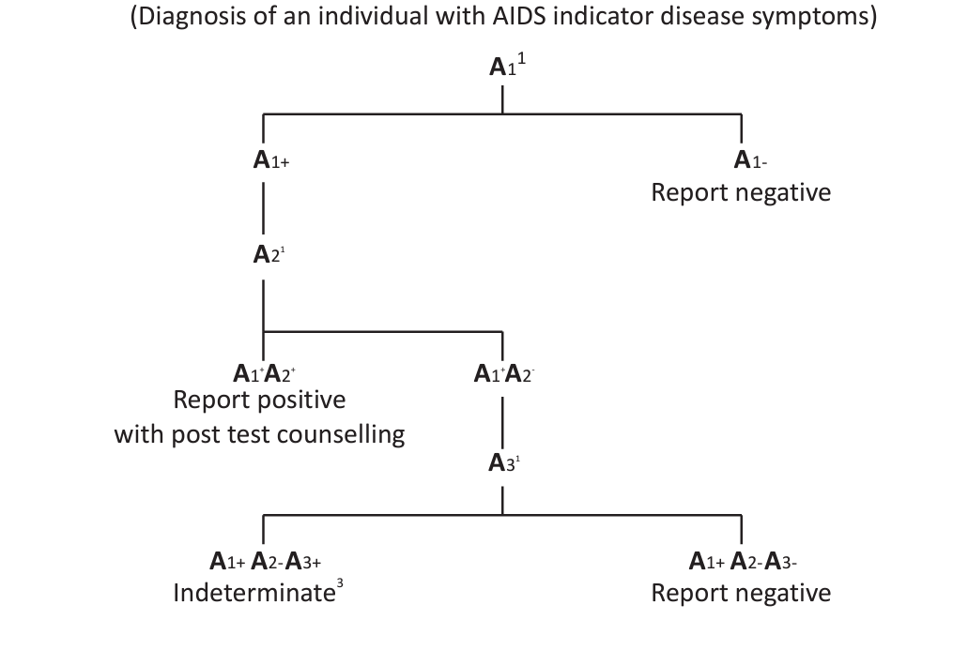
NACO STRATEGY
Notes:
Injury of India Health Care worker

Slide 51
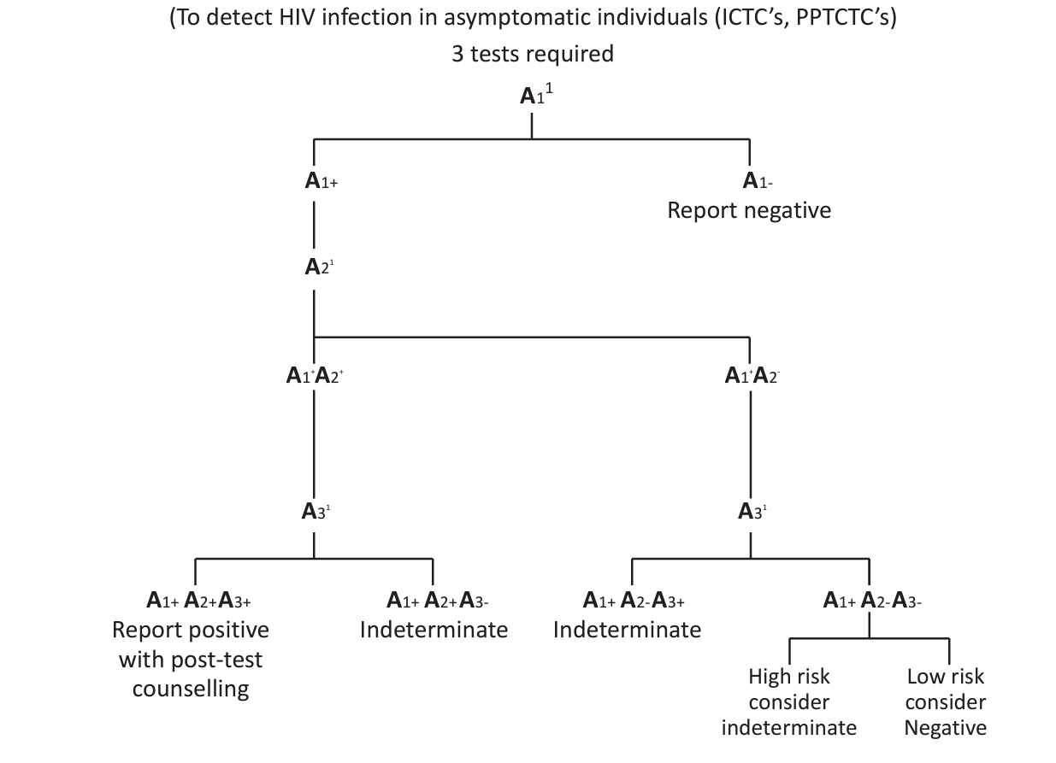
NACO STRATEGY
Strategy 3 (used for diagnosis in asymptomatic patients)
Notes:
Injury of India Health Care worker

Slide 52
NACO STRATEGY
Test platform - Elisa | Dot Blot | Comb EIA
Confirm Antibody Detection - Anti HIV Antibiotics
A1 - Combo Immunoassay
A2 - ICT| Elisa
A3 - Dot Blot
Assay A1 should be of high sensitivity and A2 and A3 should be of high specificity.
A2 & A3 should differentiate between HIV 1 & 2 infection.
Testing should be repeated on a second specimen taken after 14 - 28 days.
Notes:
Injury of India Health Care worker

Slide 53
THANK YOU

