Slide 1
by dr.gouri G 3 rd medical unit unit chief – PROF. dr.peer Mohamed MD assistant PROFESSORS – dr.C.Vignesh MD - dr .M.Satheesh kumar MD - dr.vp priya MD
POTASSIUM DISORDERS

Slide 2
POTASSIUM HOMEOSTASIS
Normal plasma K+ conc – 3.5 – 5 meq/l
98% -intracellular
Principal or P cells of connecting segment and cortical collecting duct – major role in K+ secretion .
Alpha intercalated cells of outer medullary cortical duct-reabsorption
Two major K+ channels – ROMK and flow sensitive big K+ or maxi K+ channels

Slide 3
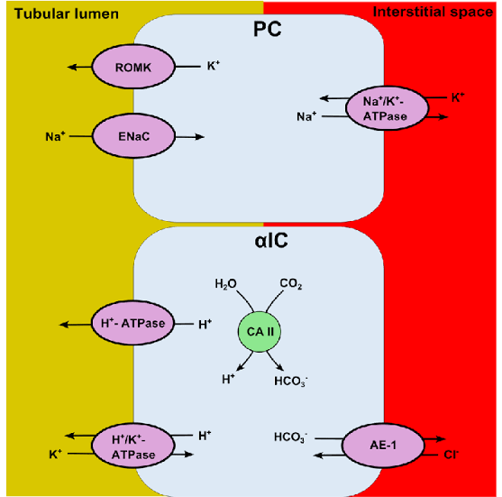

Slide 4
HYPOKALEMIA
Plasma K+ concentration of <3.5 meq/l

Slide 5
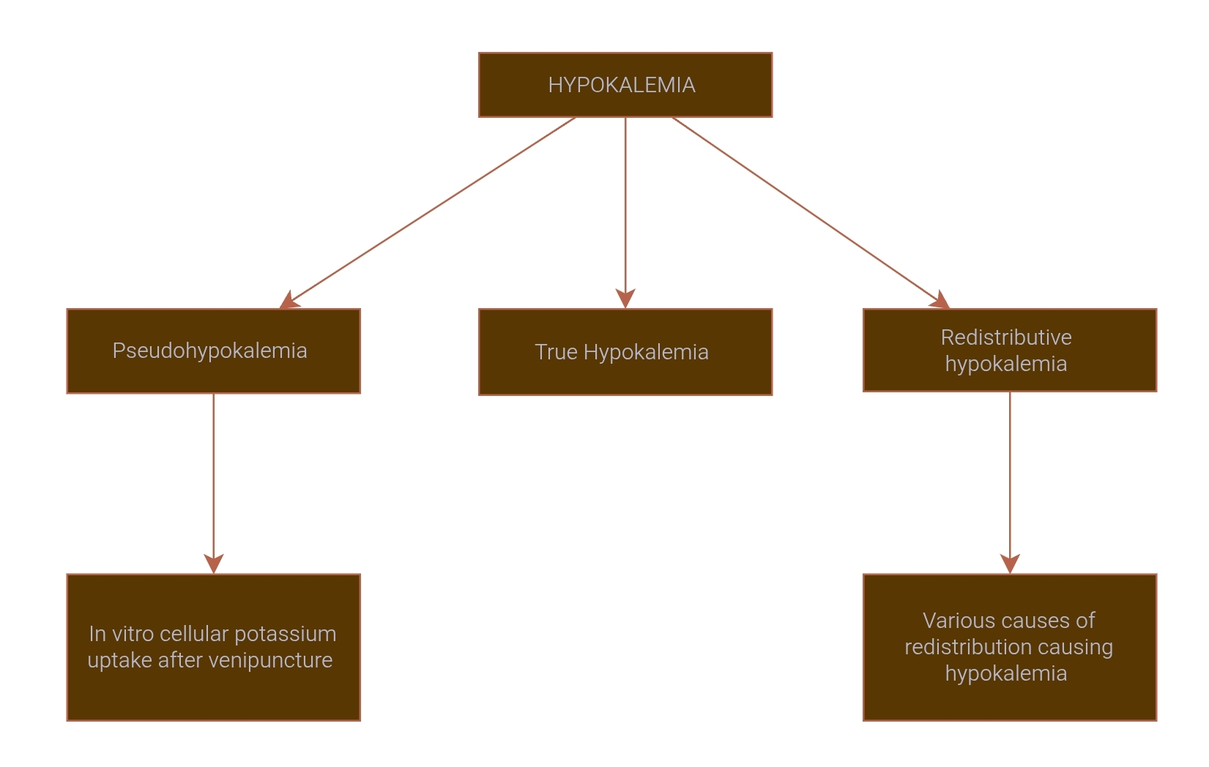
causes

Slide 6
Redistributive hypokalemia
Metabolic alkalosis
Insulin - increase the activity of Na+/K+ ATPase pump.
Increased beta2 adrenergic activity
- leads to activation of CAMP dependent signalling pathways
-Seen in SABA , LABA , Acute MI , Head injury and Alcohol withdrawal.

Slide 7
Hyperthyroidism - by direct and indirect activation of Na+/K+ ATP ase -Hypokalemia , Hypomagnesemia and Hypophosphatemia
Anabolic states
Hypothermia
Familial hypokalemic periodic paralysis
Barium toxicity

Slide 8
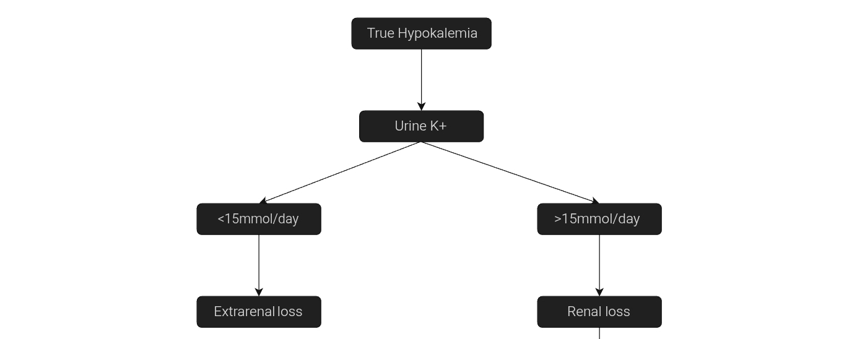
1.GI K+ loss
2. Profuse sweating

Slide 9
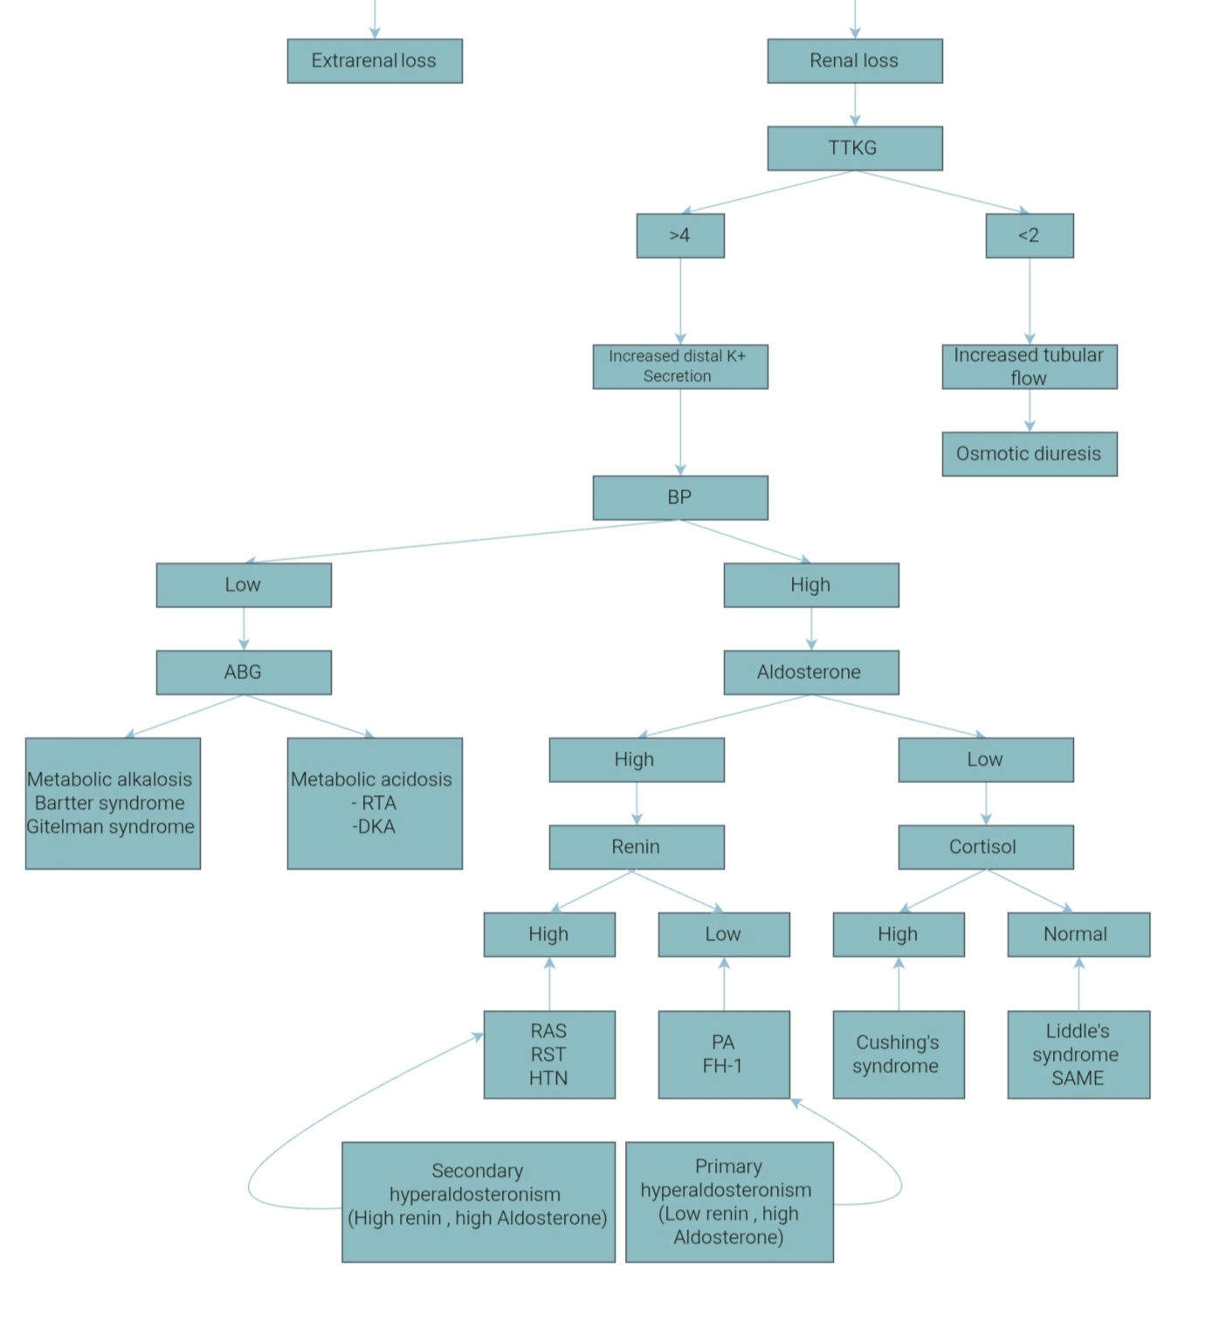

Slide 10
Renal loss
TTKG - Estimates potassium gradient between urine and the blood in distal nephron - > 4 - inappropriate renal K+ loss
- < 2 - osmotic diuresis - uncontrolled diabetes,mannitol,uremia,
Radiological contrast agents.

Slide 11
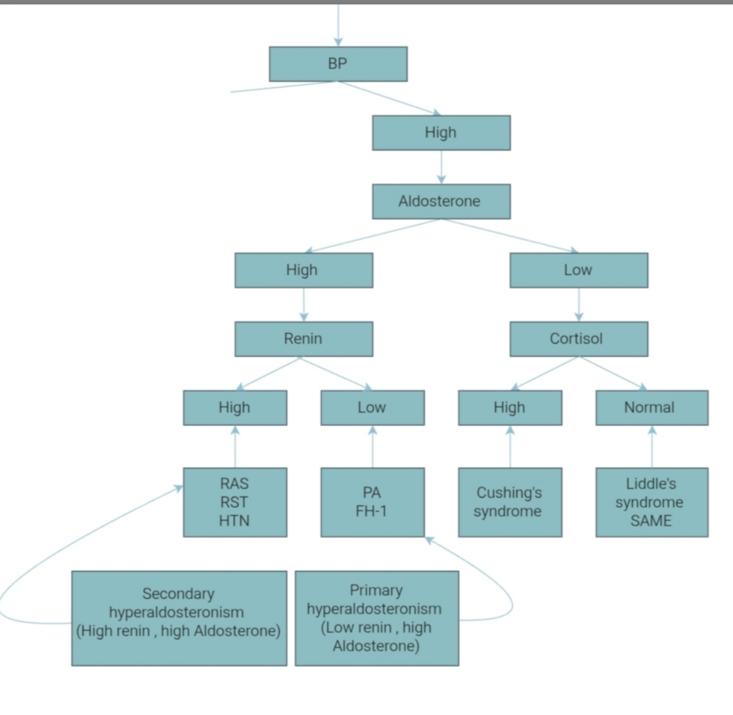

Slide 12
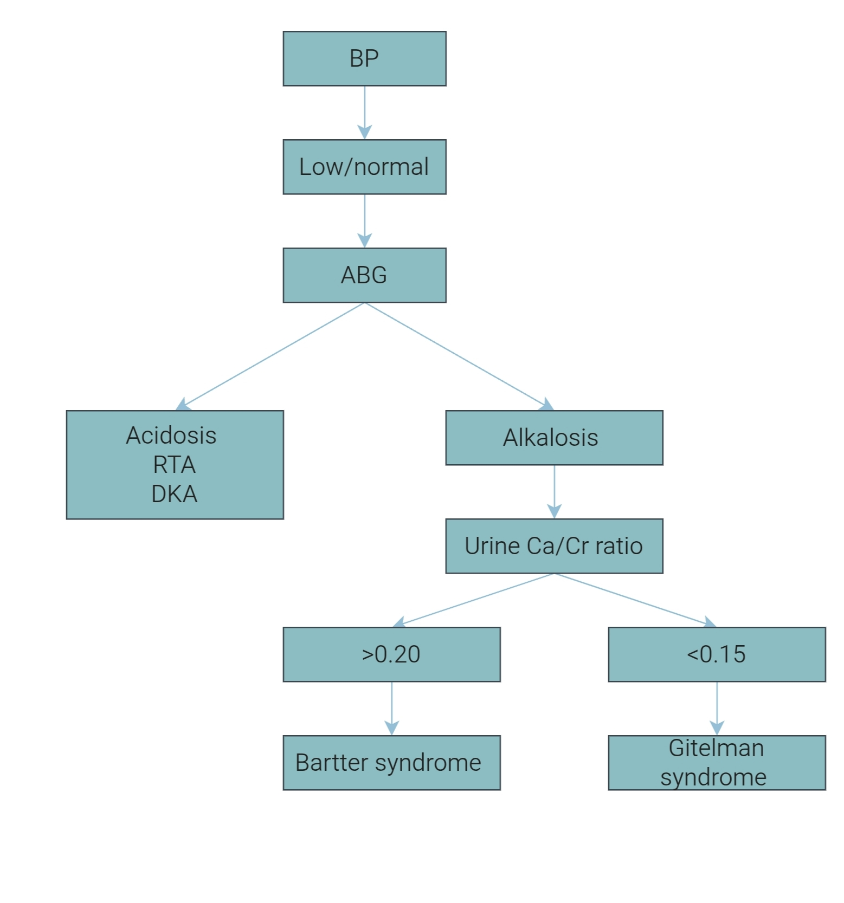

Slide 13
DRUGS
1. Diuretics like thiazide 2. High dose of penicillin related antibiotics( nafacillin , dicloxacillin , ticarcillin) 3. Renal tubular toxins – aminoglycosides, amphotericin, foscarnet, cisplatin, ifosfamide > causing mg2+ and k+ wasting

Slide 14
Clinical features
Cardiac arrythmia
1. Premature atrial complex
2. Premature ventricular beat
3. Sinus bradycardia
4. Paroxysmal atrial tachycardia
5. AV block
6. Atrial fibrillation
7. Ventricular tachycardia or fibrillation
Predisposes to digoxin toxicity.

Slide 15
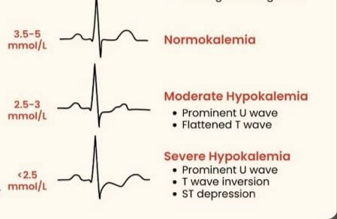
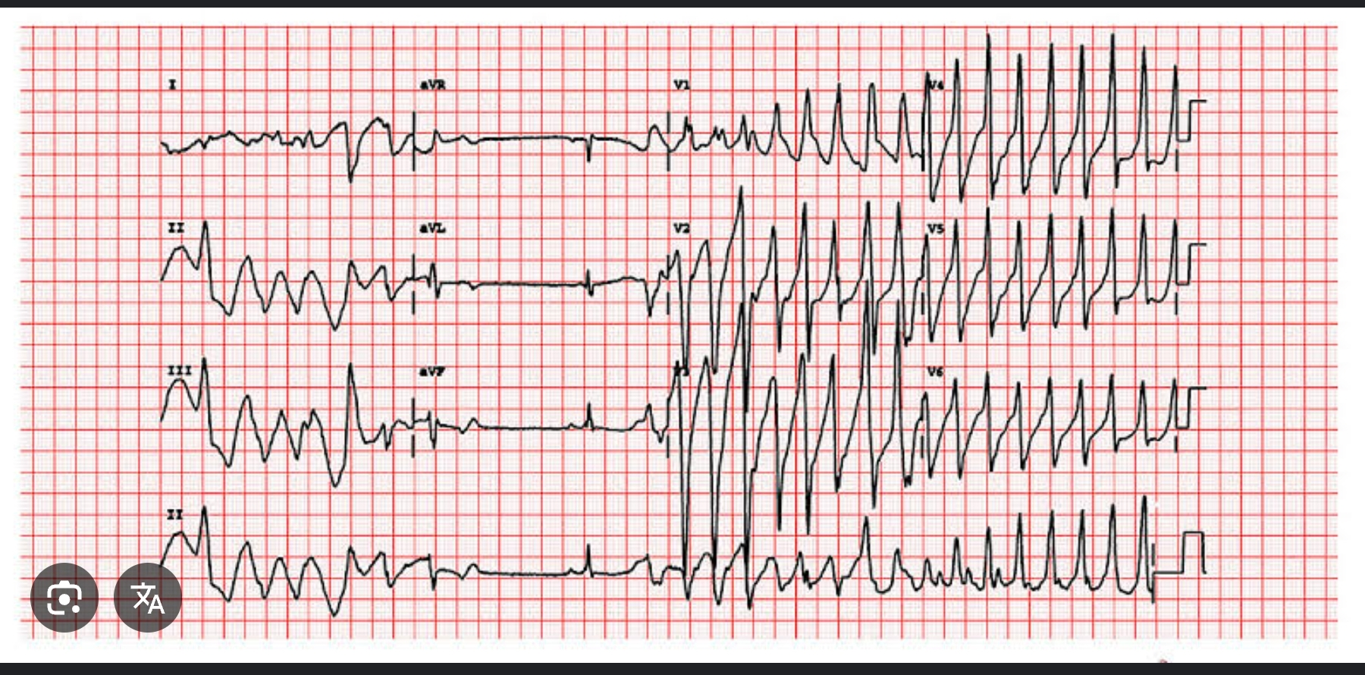
Prolonged QT - TDP

Slide 16
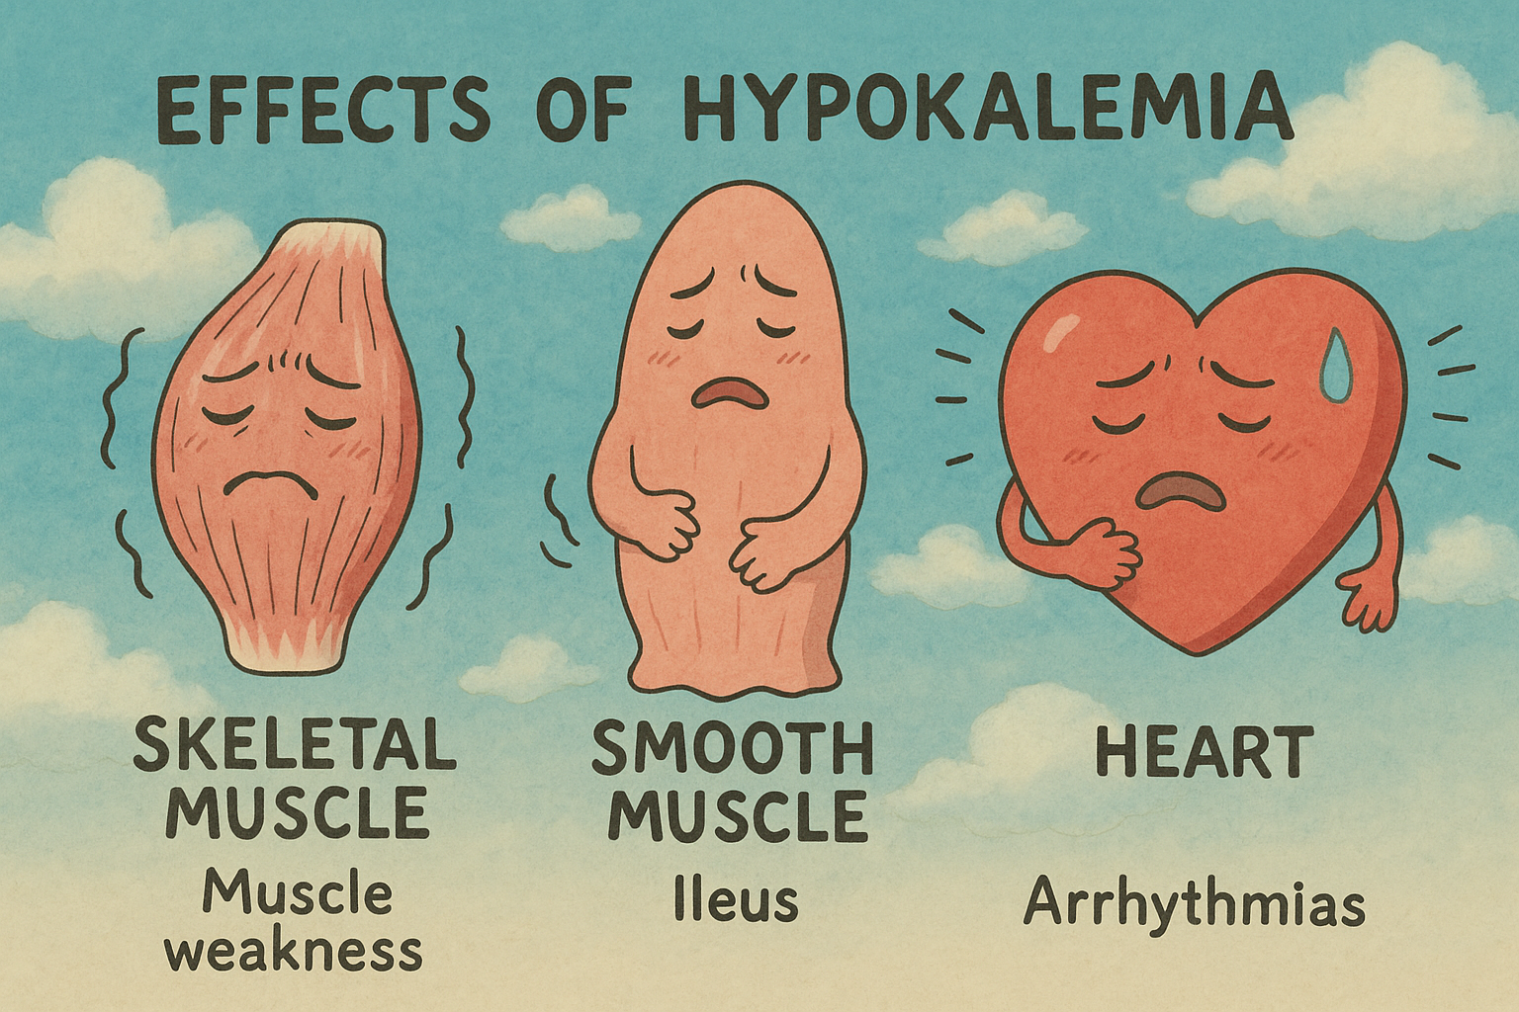
Skeletal muscle & Smooth muscles
Effects are due to hyperpolarisation of membranes
Acute severe hypokalemia with s.potassium <2.5 - rhabdomyolysis.
Smooth muscle - colonic pseudoobstruction or ogilvie’s syndrome.
Skeletal muscle - weakness associated with depressed DTR

Slide 17
Renal system - polyuria , phosphaturia and bicarbonate retention causing alkalosis.
Chronic hypokalemia causes structural changes in kidney ( impaired concentrating ability, increased ammonia pdn , injury to PCT , interstitial nephritis, renal cyst , ESRD ).
Also implicated in hypertension, heart failure and stroke.
Glucose intolerance

Slide 18
Management
Prevention of hypokalemia warranted in
1. Hepatic failure
2. Previous history of MI or IHD
3. Diabetes mellitus
4. Patients on TPN or IV fluids ( 40-50meq/day)
Normal daily intake : 60meq/day
Oral salts are safer as they have minimum risk of hyperkalemia

Slide 19
Potassium level of 3-3.5 meq/L:
Treatment is indicated only in high risk patients:
1. Risk of arrythmia
2. Hepatic failure
3. DM
4. Digitalis therapy
5. IHD / Congestive heart failure
Potassium level of <3.0 meq/L:
IV potassium replenishment is indicated.
When cardiac rhythm returns to normal or respiratory muscle strength is restored, IV KCl tapered and switched to oral.

Slide 20
Oral potassium salts
Oral potassium replacement with KCl is the mainstay of treatment.
Mild to moderate Hypokalemia (3.0-3.5meq/L) : average dose is 20meq 3-4 times a day.
Treat the underlying cause.
Potassium chloride solution contains 20meq in 15ml solution.
Potassium chloride tab contains 8meq per tab.
If acidosis - potassium bicarbonate or citrate is a better alternative.
Associated Hypophosphatemia - potassium phosphate.
Oral potassium preparations are associated frequently with GI irritation, to avoid this solution should be properly diluted and administered after food.

Slide 21
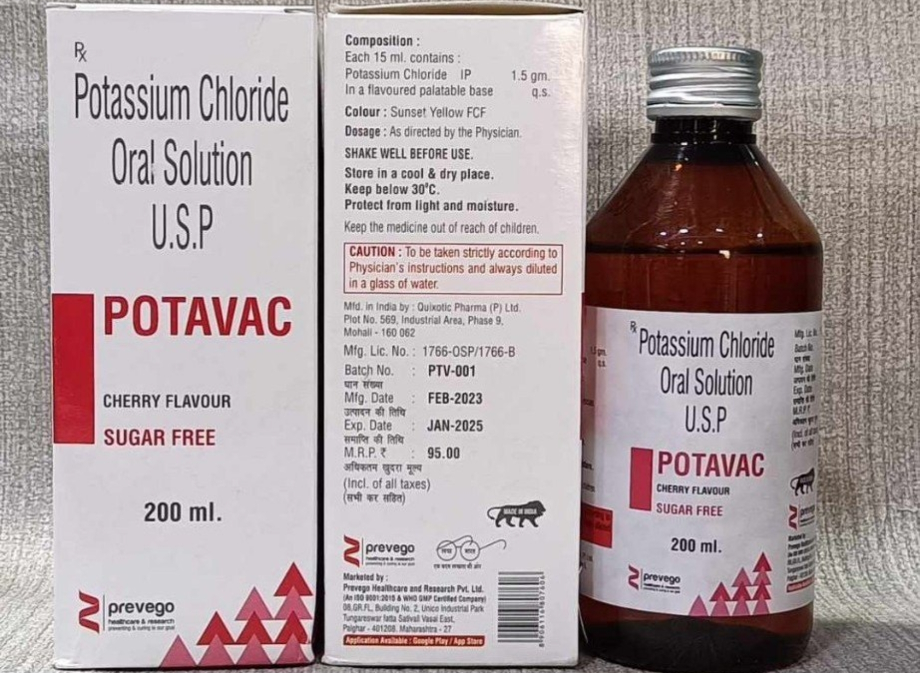
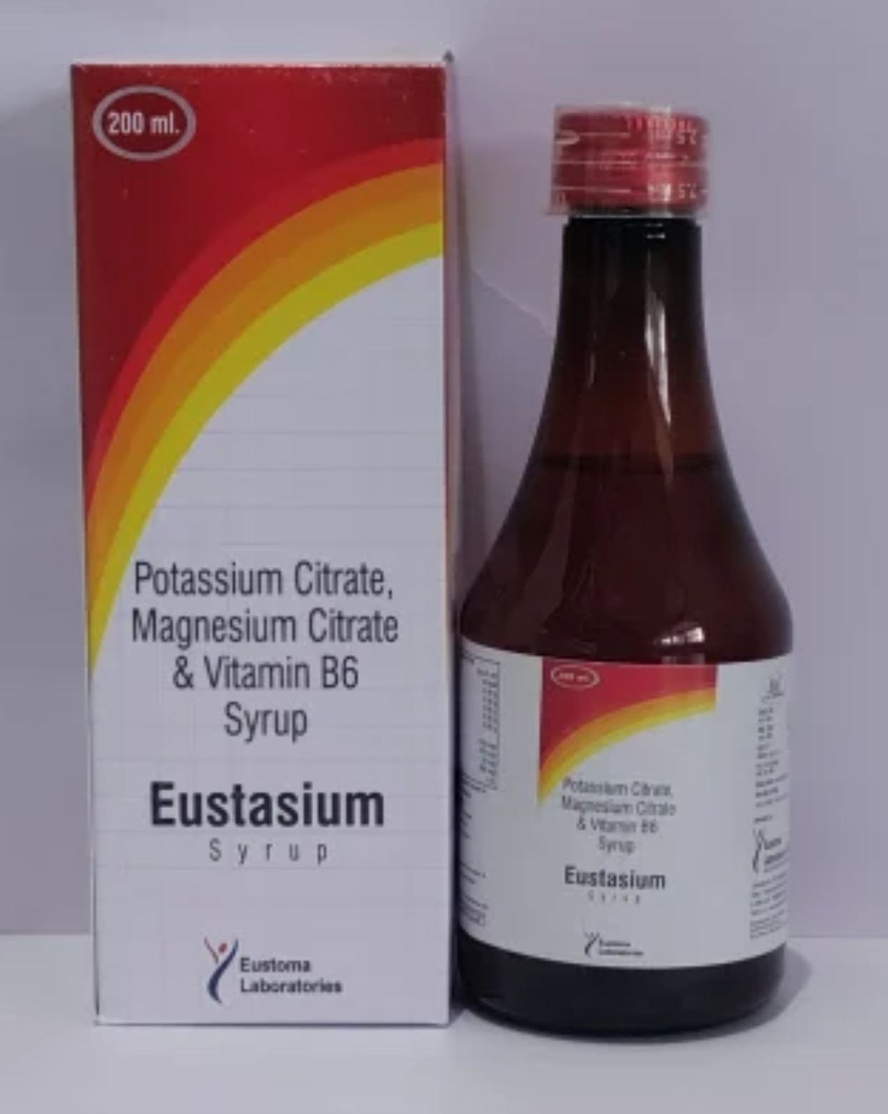
15ml contains 1.5gm KCl (19.95mEq)
Used in hypokalemia a/w acidosis
Esophageal and small bowel erosions or strictures are uncommon but serious side effects associated with oral potassium preparations

Slide 22
IV Potassium chloride
Indicated in patients having severe hypokalemia (<3.0meq/L) or those who are unable to take oral medication.
IV KCl 40mEq in 200 ml NS over 2 hrs , administered only in saline or RL not in dextrose
Maximum rate of infusion should not exceed 20-40 meq/L in peripheral vein and 100meq/L in central vein.
>40mEq/L can cause thrombophlebitis.
Rate of infusion maximum should be 20 meq/hr
Maximum daily dose – 240 – 400 meq/day
Always monitor IV therapy with continuous ECG and serial serum potassium levels.
1 amp KCl contains 15%w/v or 20 mEq KCl

Slide 23
Case scenario
Suresh , a software engineer presented to ED with sudden onset muscle weakness in both legs progressing to involve the arms over past 2 hours. Episode began early in the morning after eating a large carbohydrate rich meal. Also complaints of palpitations, heat intolerance and increased sweating.
Physical examination:
BP-132/78mmHg
HR-124/min - irregularly irregular
RR-18/min
Temp-37.3
CNS - Power -⅕(LL) , ⅖ (UL)
Reflexes - decreased , Sensory system - normal

Slide 24
Lab - Serum potassium - 2.3
Serum phosphate - 2.0
Urine potassium - 15
Serum TSH - <0.01mIU/litre
Free T4 - elevated
RBS - normal
ECG - Sinus tachycardia with U wave and flattened T wave

Slide 25
Diagnosis and management
Diagnosis: Thyrotoxic periodic paralysis due to underlying grave’s disease
Management: Careful IV potassium replacement
Non selective beta blockers
Anti thyroid drugs
Dietary counselling - avoid high carbohydrate meal , alcohol and
Intense excercise until thyroid is controlled.

Slide 26
Case scenario
2. Aswathy 22yr old presents to the clinic with muscle weakness, fatigue, and cramps for the past several months especially after exercise or prolonged standing.. She also reports feeling lightheaded and faint, especially after standing up.
No history of vomiting, diarrhea, or recent infections. No significant changes in diet or medication. Family history is negative for similar symptoms

Slide 27
Physical Examination:
BP: 110/70 mmHg ( normal)
HR: 80 bpm (regular)
Weight: 50 kg (slightly underweight)
General appearance: No signs of dehydration
Neurological exam: Mild muscle weakness in the lower limbs
Muscle tenderness: Noted in calves, no visible edema or swelling
No goiter

Slide 28
Laboratory Results:
Serum potassium: 2.5 mmol/L ,
Serum magnesium: 1.0 mg/dL ,
Serum sodium: 135 mmol/L
Urinary potassium: 25mEq/day
Bicarbonate: 28 mmol/L , pH- 7.45
Serum calcium and RFT: Normal
TTKG - 7
ECG:U waves in v4-v6, prolonged QT interval

Slide 29
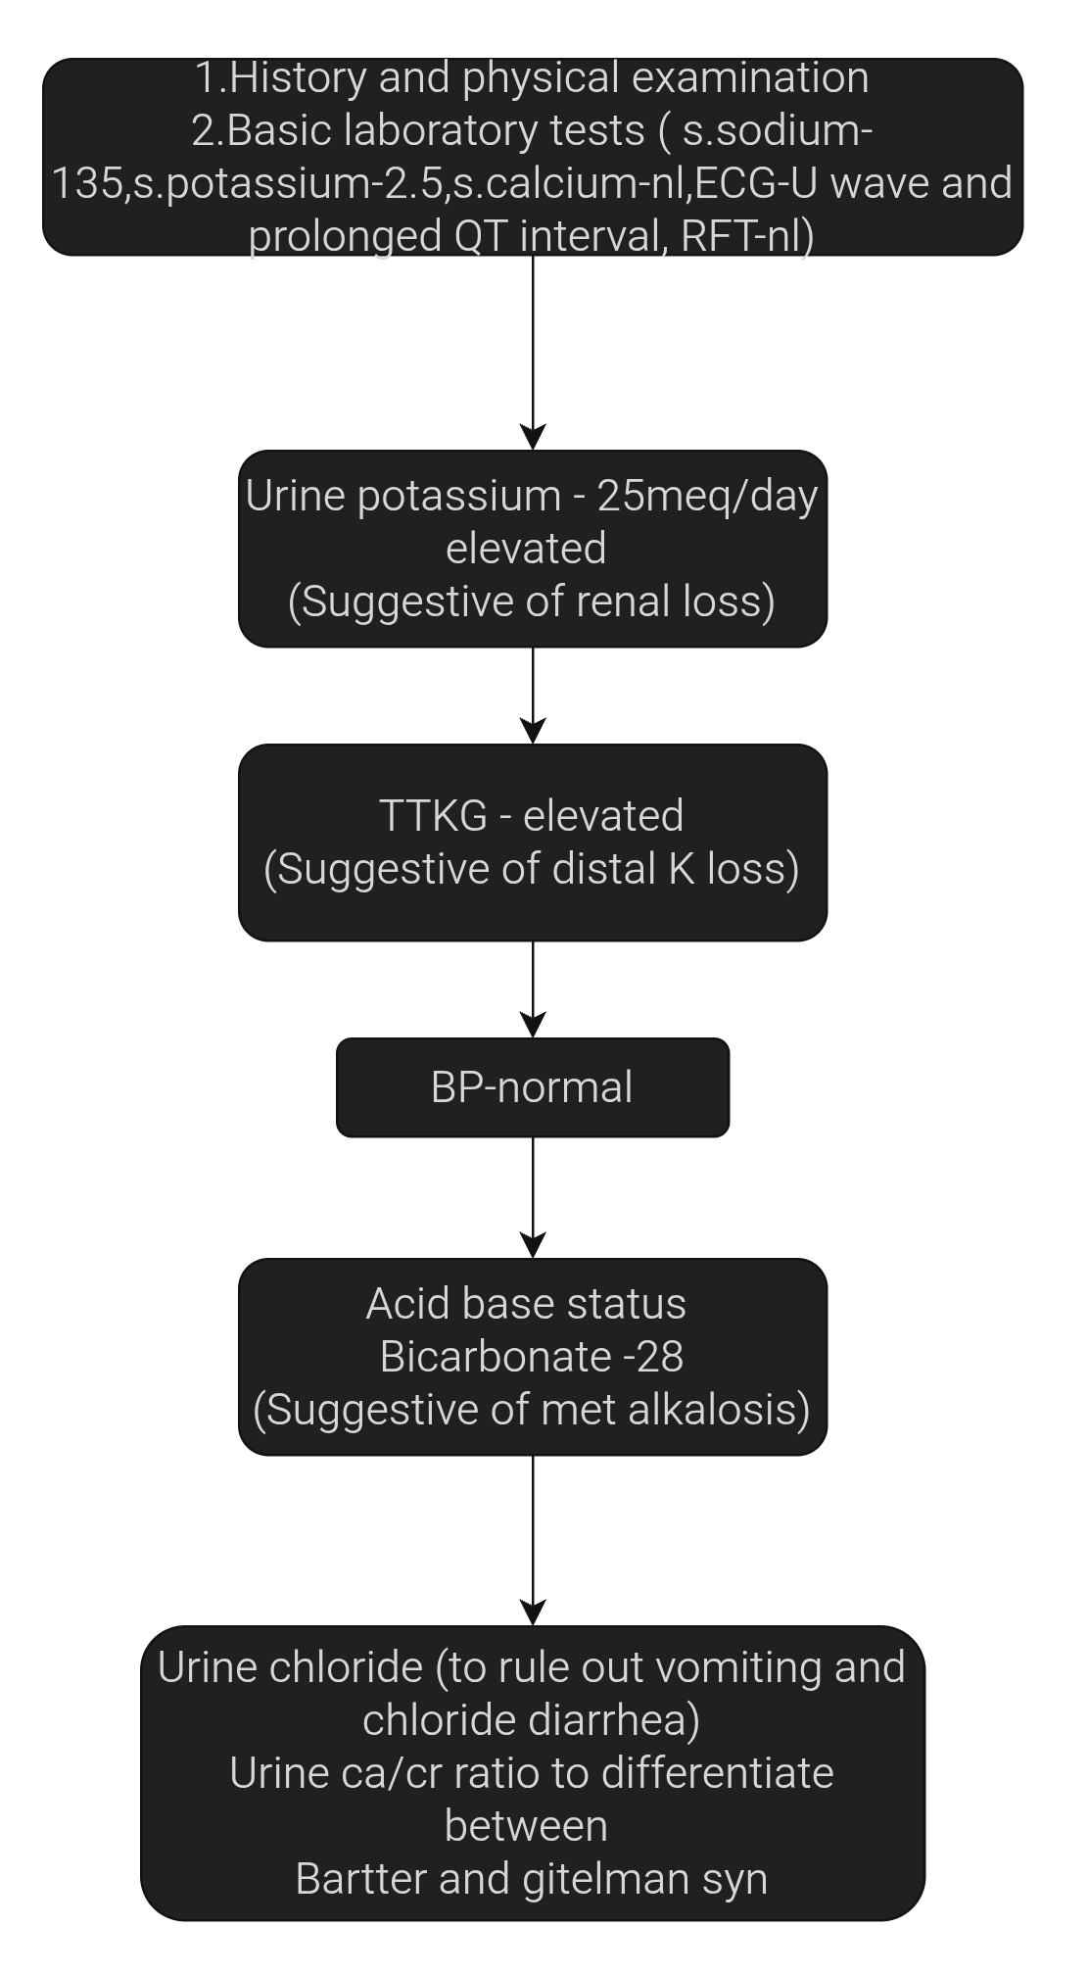

Slide 30
Diagnosis and management
Diagnosis: Gitelman Syndrome
Management:
1. Oral potassium supplementation to correct hypokalemia
2. Oral magnesium supplementation to correct hypomagnesemia
3. Sodium chloride supplementation (if necessary) to correct salt wasting
4. Avoid thiazide diuretics and other drugs that may worsen electrolyte imbalances
5. Monitor electrolytes regularly to prevent recurrence of hypokalemia and hypomagnesemia

Slide 31
Case scenario
3. 42year old female presents with progressive fatigue, muscle weakness, dry eyes and mouth since 6 months. No relevant padt history. No h/o medications.
Physical examination
Bp-110/70
PR - 78/min
Dry oral mucosa , schimer’ test - positive
Neurological - mild proximal muscle weakness

Slide 32
Lab investigation
Serum potassium - 2.7mmol/L
Serum phosphate - 2.8mmol/L
Urine potassium - 50mEq/day
pH - 7.3 , bicarbonate - 16
Urine pH - > 6.5
ANA IF - positive

Slide 33
Diagnosis and management
Diagnosis: Primary sjogren’s syndrome , distal or type 1 RTA
Management:
Potassium supplementation (oral potassium citrate or potassium bicarbonate)
Alkali therapy (sodium bicarbonate)
Artificial tears and saliva substitutes
Immunomodulatory therapy if systemic symptoms progress

Slide 34
Case scenario
36 year old male patient presents with persistent high BP for past 2 years despite on 2 antihypertensive medications.He also experienced intermittent muscle cramps,generalised fatigue and palpitations. He has no history of diabetes or kidney disease. His father had hypertension and died of a stroke at age 50.
O/e - BP - 170/100 mm hg
- HR - 76/min
- CNS - mild proximal muscle Weakness

Slide 35
Lab tests
S.potassium - 3.1 mmol/L
S .sodium - 144 mmol/L
24 hr urine potassium - 50mEq/day
S.bicarbonate - 29 mmol/ L
PAC - High
PRA - suppressed
ARR - High
TTKG - 7

Slide 36
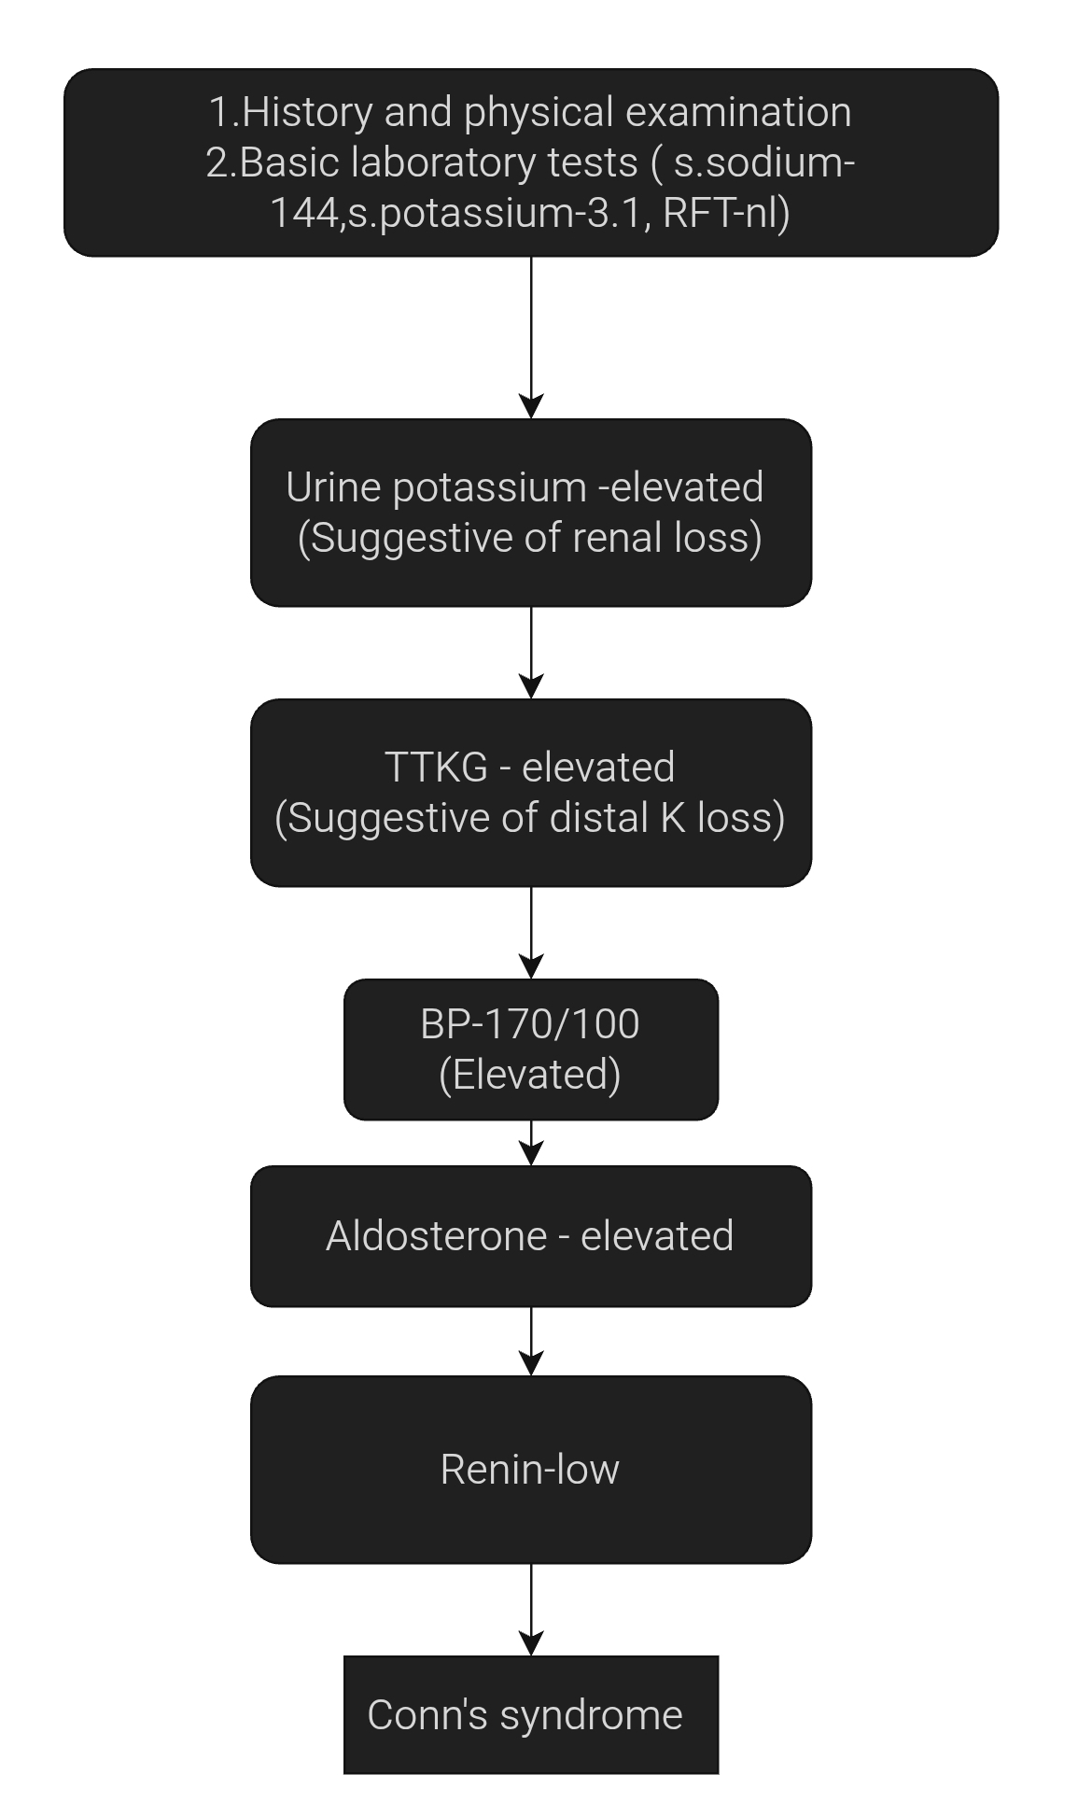

Slide 37
Diagnosis and management
Diagnosis: Primary hyperaldosteronism (Conn’s syndrome) due to aldosterone-producing adrenal adenoma
Management Plan:
1. Spironolactone or eplerenone (aldosterone receptor antagonists) to manage hypokalemia and blood pressure
2. Potassium supplementation if needed initially
3. Surgical referral for adrenalectomy (definitive treatment for
Unilateral Adrenal adenoma
4. Monitor BP, serum electrolytes, and renin/aldosterone levels post-op

Slide 38
Hyperkalemia

Slide 39
Definition
Plasma potassium level of >5.5mM
Severe hyperkalemia >6.0mM (associated with significant mortality)

Slide 40
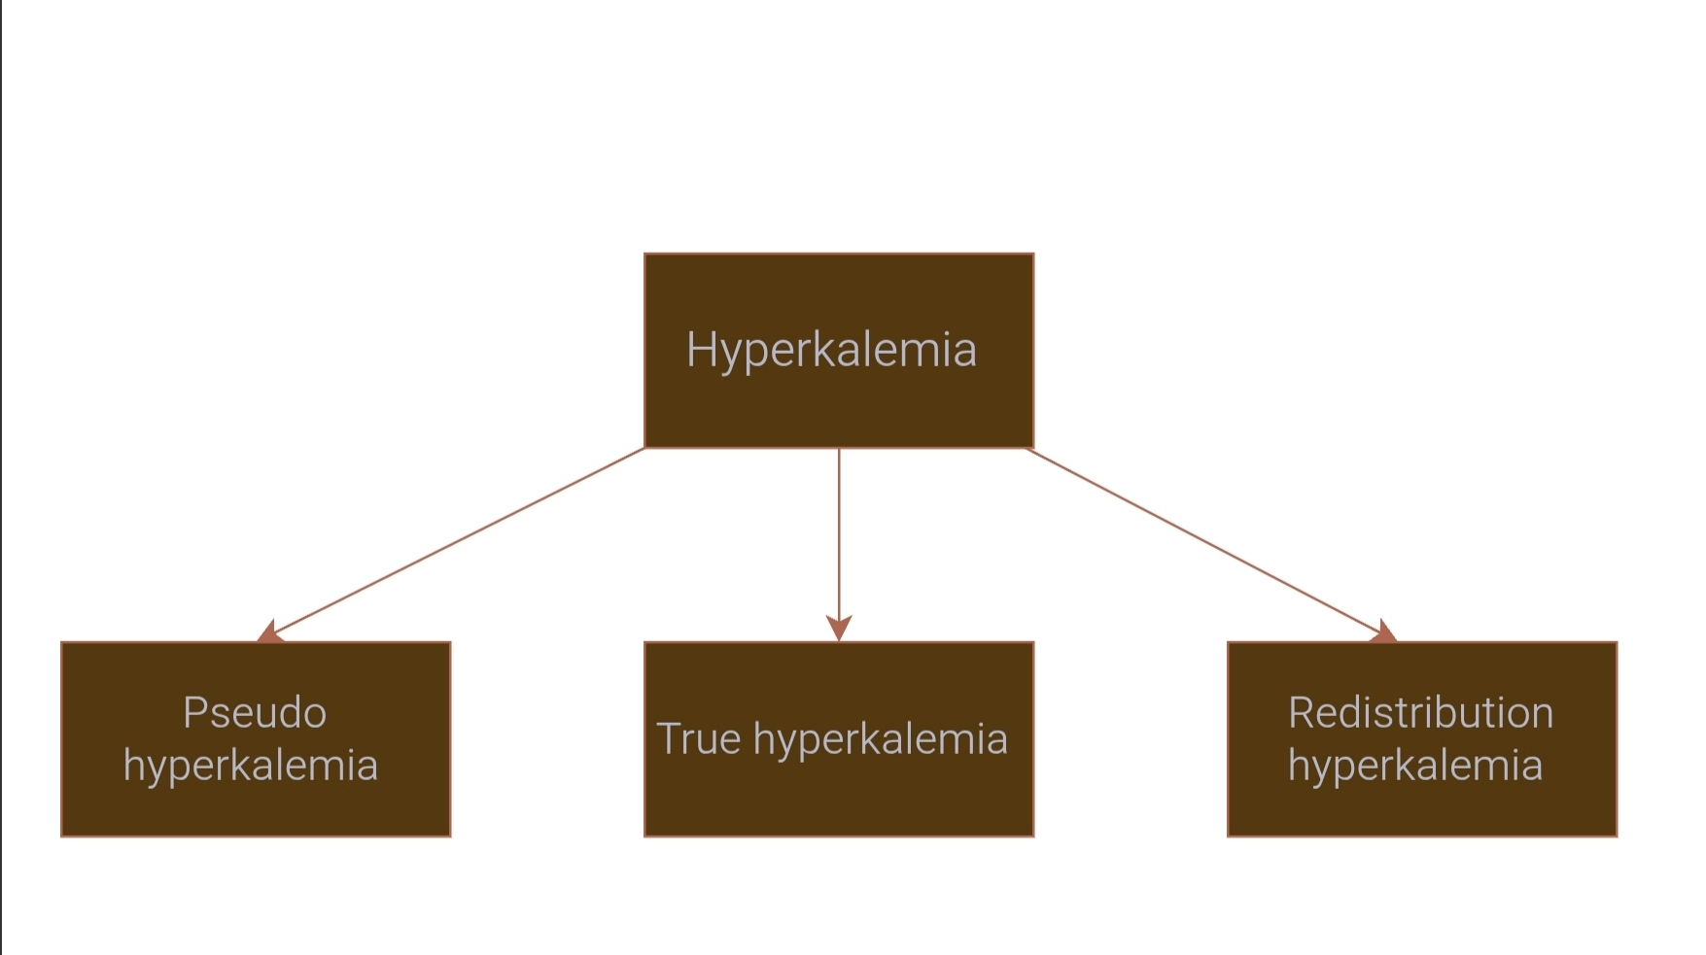
Causes

Slide 41
Pseudohyperkalemia
Due to an increase in potassium during or after venipuncture
Excessive muscle activity during venipuncture ( clenching of fist )
Acute anxiety during venipuncture - leading to respiratory alkalosis and redistribution hyperkalemia.
Cooling of blood following venipuncture
Hereditary pseudohyperkalemia (due to mutation in red cell anion exchanger leading to hemolytic anemia, reduced red cell anion transport and k+ leak).

Slide 42
Redistribution hyperkalemia
Acidemia
Hypertonic saline, mannitol and IVIG –solvent drag
Intravenous administration of glucose in diabetic patients without adequate amount of insulin
Cationic aminoacids
Digoxin and fluoride poisoning inhibit Na+K+ATPase

Slide 43
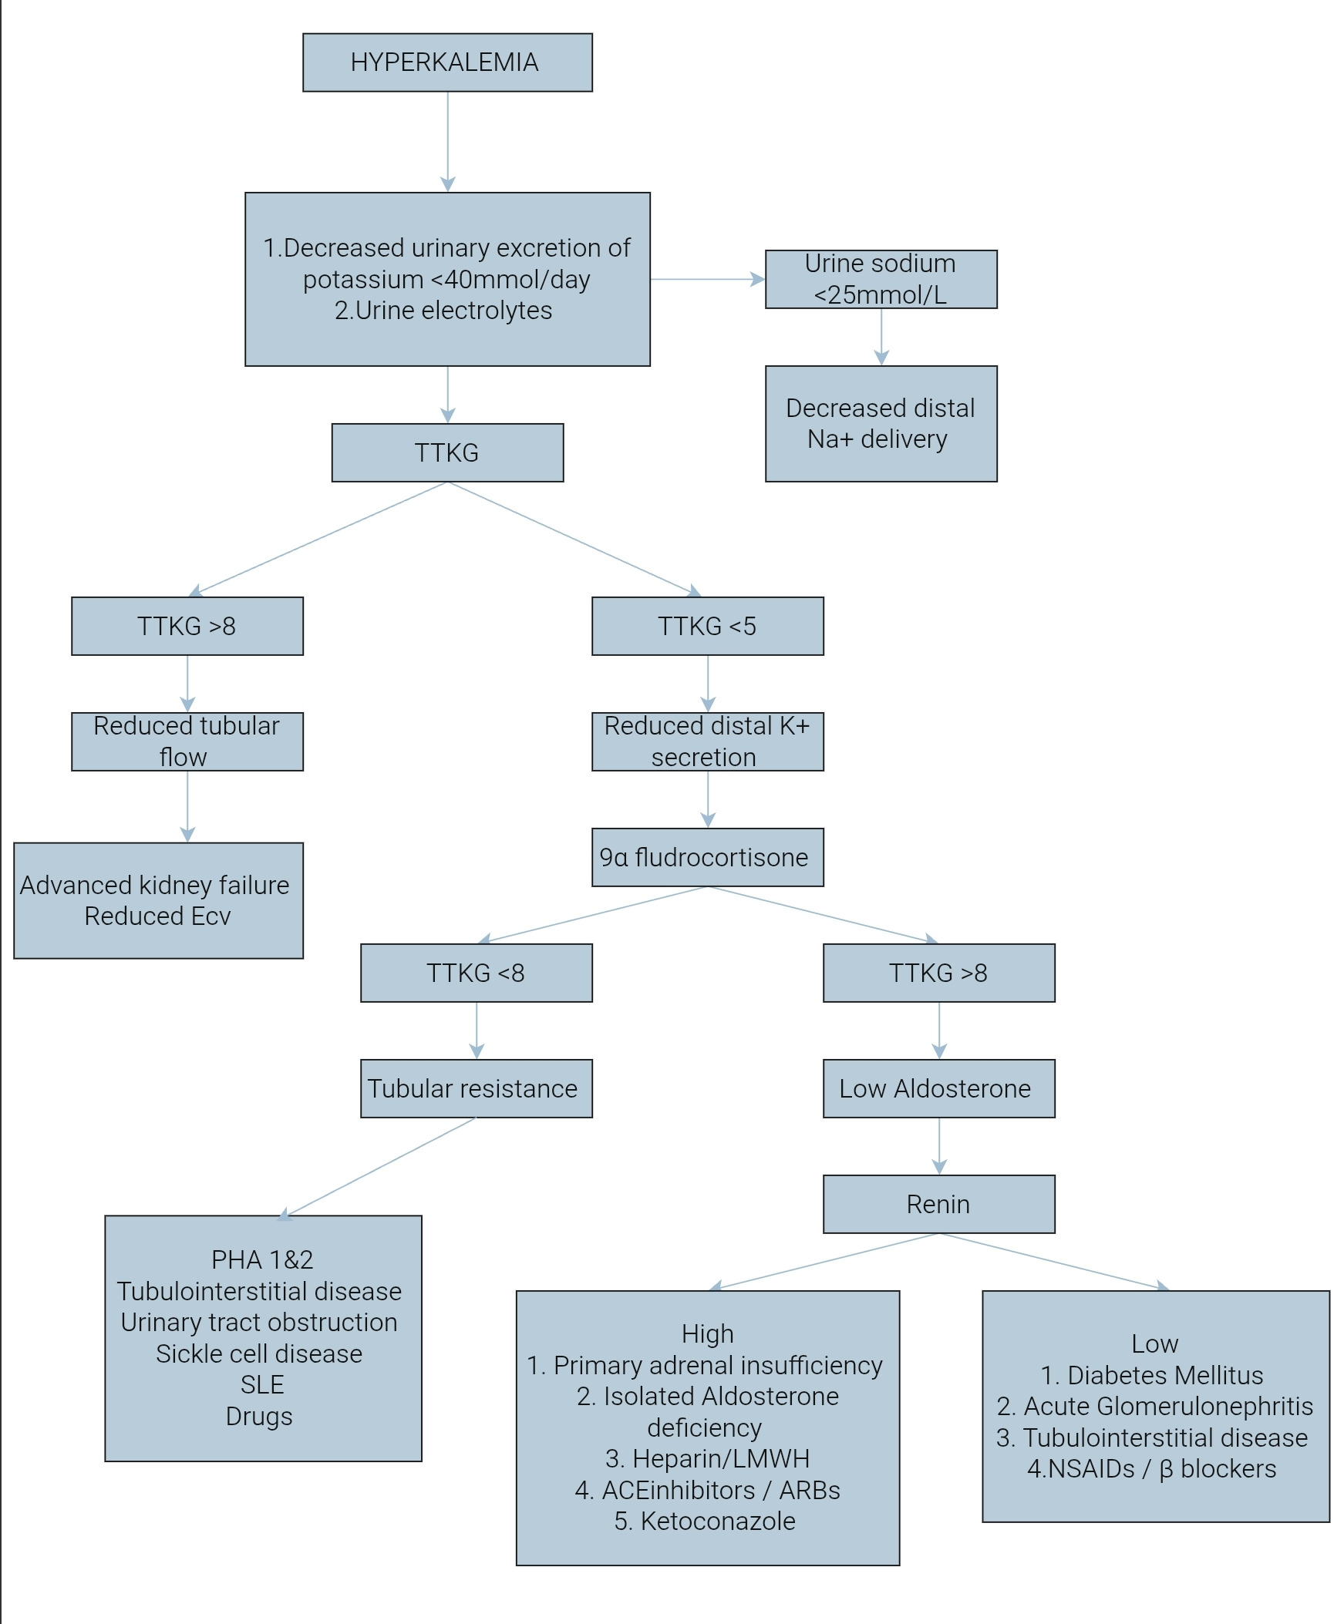

Slide 44
Normal = 8-10
>8- hyperkalemia is due to reduced renal blood flow
<5 - aldosterone disturbance - give 0.05mg fludrocortisone
If TTKG >8 - True hypoaldosteronism
TTKG <8 - Pseudohypoaldosteronism
TTKG

Slide 45
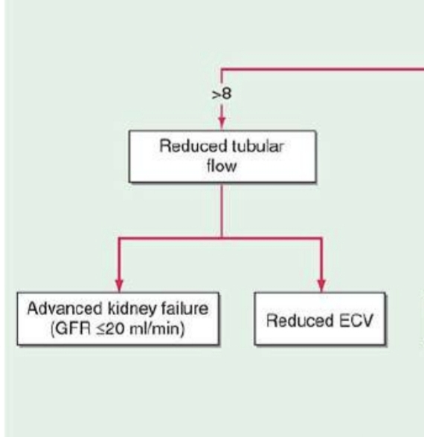
CKD and ESRD are very common cause of hyperkalemia
Hyperkalemia is common in oliguric acute kidney injury
eGFR - will be decreased
TTKG > 8 since tubules are normal

Slide 46
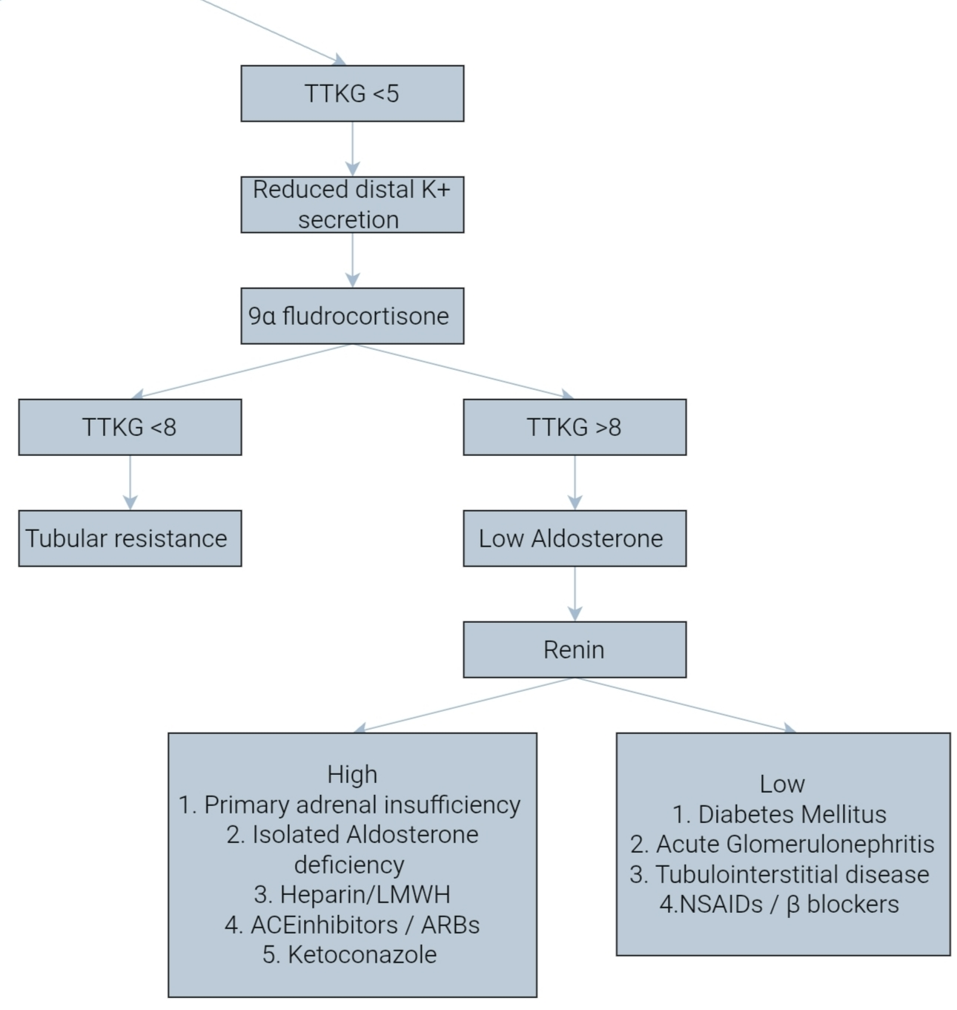

Slide 47
Medication associated hyperkalemia
ACE inhibitors
ARBs
Renin inhibitors
Mineralocorticoid receptor inhibitors
ENaC inhibitors
(Particularly when given in combination)
Drospirenone in yasmin (OCP) can cause hyperkalemia by inhibiting MLR
Cyclosporine, Tacrolimus, NSAIDS and COX-2 Inhibitors hyporeninemic hypoaldosteronism and there by hyperkalemia
TMP and pentamidine blocks ENaC

Slide 48
Other causes
Tumor lysis syndrome
Rhabdomyolysis
Iatrogenic
Increased intake of potassium in susceptible individuals
1. Banana
2. Tomatoes
3. Citrus fruits

Slide 49
Clinical features
Cardiac arrythmia
1. Sinus bradycardia
2. Sinus arrest
3. Slow idioventricular rhythms
4. Ventricular tachycardia
5. Ventricular fibrillation
6. Type 1 brugada pattern - with pseudo RBB
7. Asystole

Slide 51
Severe muscle weakness or paralysis
Familial hyperkalemic paralysis - autosomal dominant inactivating
mutation of a skeletal muscle Na channel called SCN4 ,which will be
unmasked during hyperkalemia.
Hyperkalemia also causes metabolic acidosis by impairing the renal secretion of H+ ions

Slide 52
Acute management
Severe hyperkalemia with ECG change is a medical emergency
Calcium gluconate 10ml 10% IV over 2-3mins with cardiac monitoring . Dose should be repeated if no change in ECG findings after 5 - 10 min or if they recur after initial treatment.
IV Calcium should be used cautiously in patients taking digoxin ( if necessary 10ml 10% calcium gluconate in 100ml 5% dextrose over 20-30mins ).

Slide 53
Regular Insulin 10 - 20 units and 50 ml 50% of dextrose administration.
Hyperglycemic patients should be given insulin alone (>200-250mg/dl)
NaHCO3 in 1L 5% Dextrose- used in severe hyperkalemia with metabolic acidosis
Beta adrenergic agonists- lowers plasma K+ by 0.5-1.5 meq/L
Action starts within 30 min and effects last for 2- 4 hrs
Albuterol 10-20 mg as continuous nebulisation over 30-60 min

Slide 54
LONG TERM MANAGEMENT
1. Patiromer - non absorbable polymer as powder for suspension
- Exchange Ca for K
- Hypomagnesemia is the major side effect.
2. Sodium zirconium cyclosilicate (ZS-9) - non absorbable crystalline
- inorganic compound
- Exchange Na and H for K .
3. Sodium polystyrene sulphonate (SPS) - Exchange Na for K
- Given as a premade suspension with sorbitol
- Intestinal necrosis ( rare complication )

Slide 55
Loop diuretics and thiazide diuretics can be given in hypervolemic patients with sufficient renal function to reduce plasma potassium.
Hemodialysis is the most effective and reliable method to reduce plasma potassium.Reserved in renal failure and severe unresponsive hyperkalemia
Peritoneal dialysis is considerably less effective.

Slide 56
Case scenario
1.Mr. Samuel ,67year old male , presents to the emergency department with complaints of generalized weakness and occasional palpitations for 2 days. He is a K/C/O Type 2 diabetes mellitus (15 years), hypertension, stage 4 chronic kidney disease (CKD), ischemic heart disease on lisinopril , furosemide , metformin and Amlodipine.
No vomiting or diarrhea.Recently increased his intake of bananas and orange juice due to dietary advice from a neighbor.Admits to missing several dialysis education appointments
No chest pain, but feels "sluggish" and has noticed muscle heaviness

Slide 57
Physical Examination:
BP: 142/88 mmHg
HR: 60 bpm
RR: 20 breaths/min
General: Alert but mildly lethargic
Cardiovascular: Bradycardia, no murmurs
Neurological: Mild muscle weakness, especially in lower limbs
No edema

Slide 58
Laboratory Results:
Serum potassium: 6.8 mmol/L
Serum creatinine: 4.2 mg/dL (baseline: 3.8)
Urine potassium - 15mEq/day
eGFR: ~17 mL/min/1.73m²
BUN: 48 mg/dL
Bicarbonate: 19 mmol/L
ECG: Peaked T waves, widened QRS complexes
TTKG - 9

Slide 59
Diagnosis and management
-Hyperkalemia secondary to advanced CKD
- Managed by IV Calcium gluconate ,insulin and glucose infusion,nebulised albuterol ,pottasium binders , and in refractory cases dialysis

Slide 60
Case scenario
2.Maryam 42 year old presents with generalized weakness, muscle cramps, and lightheadedness over the past week. She complaints of Cramping worsens with physical activity . She had frequent episodes of lightheadedness, especially when standing up
No diarrhea, vomiting, or diuretic use
No changes in diet

Slide 61
Physical examination:
BP: 88/54 mmHg (orthostatic drop present)
HR: 94 bpm
General: Thin build, appears fatigued
Skin: Generalized hyperpigmentation, particularly on knuckles and buccal
mucosa.
Neurological: Mild proximal muscle weaknes
Laboratory Investigations:
Serum potassium: 6.7 mmol/L
Urine potassium - 15mEq/ day
Serum sodium: 129 mmol/L
Bicarbonate: 17 mmol/L
Serum creatinine: Normal
TTKG <5, Fludrocortisone given TTKG>8
Plasma renin activity: Elevated
Serum aldosterone: Very low
Cortisol (AM): Low , ACTH: Markedly elevated

Slide 62
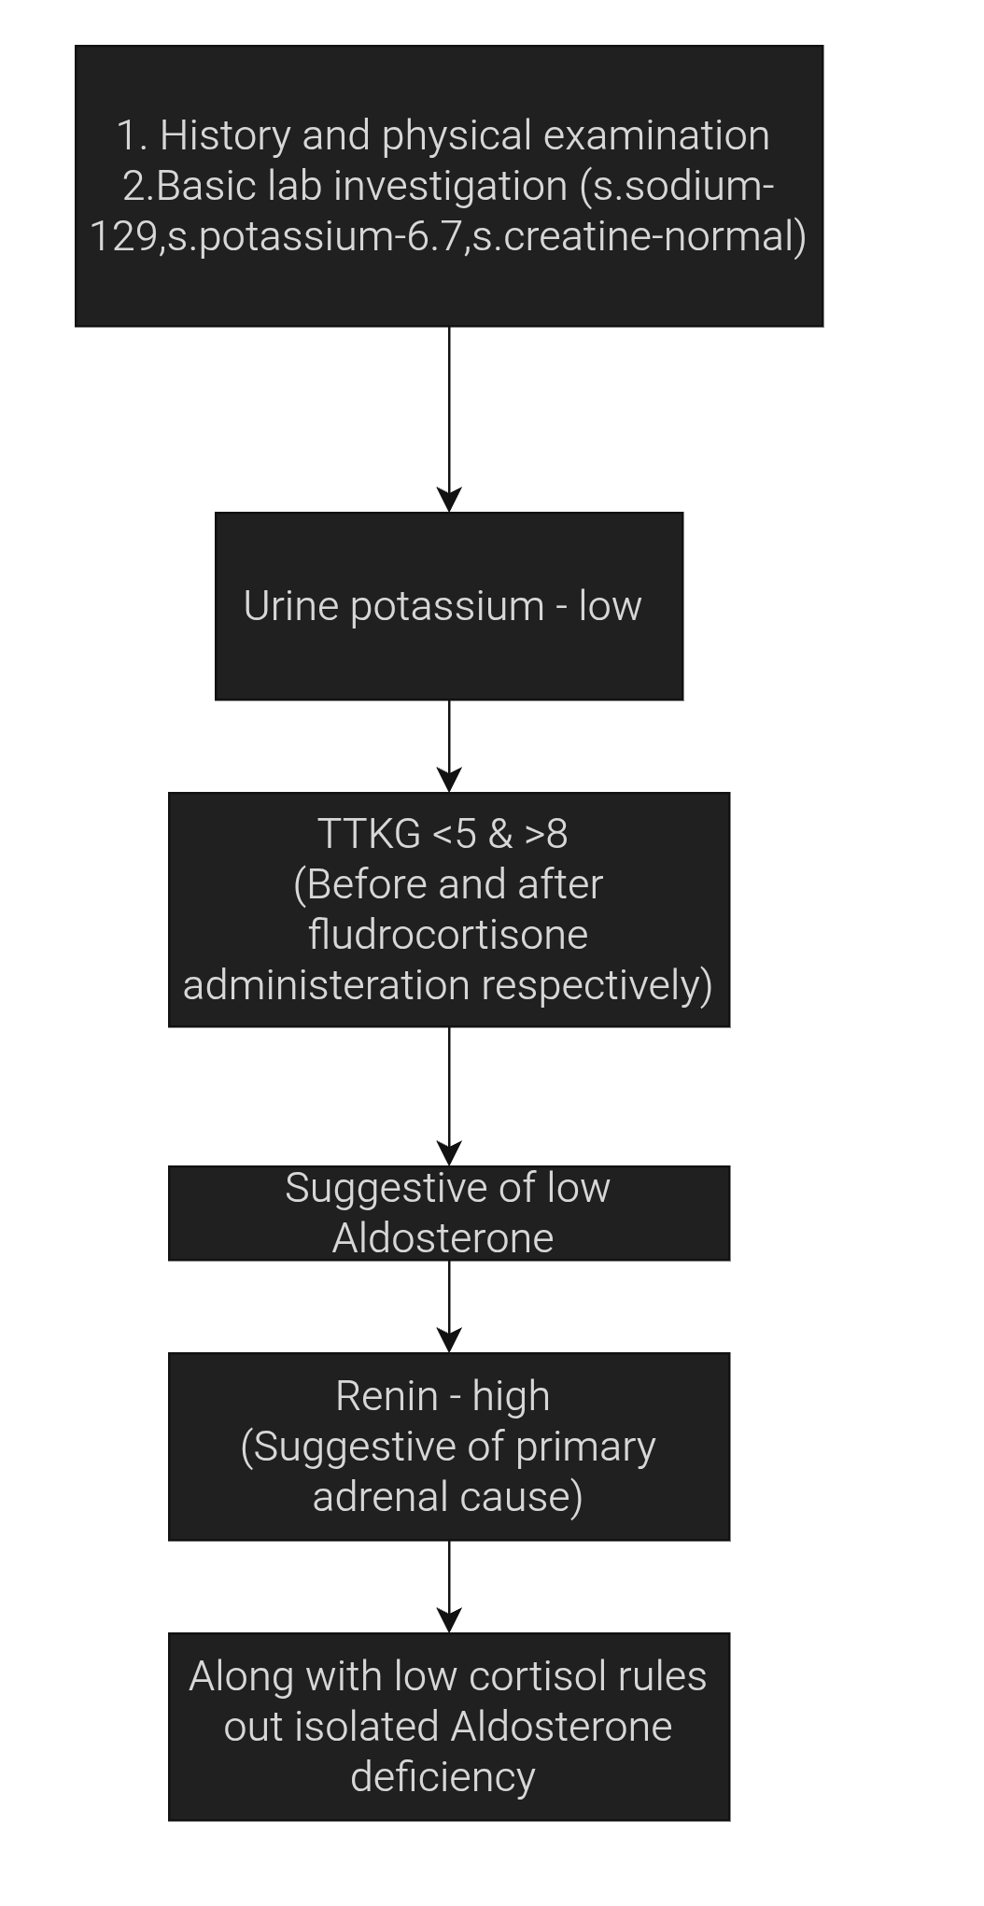

Slide 63
Diagnosis:
Primary adrenal insufficiency (Addison’s disease) with primary hypoaldosteronism leading to hyperkalemia, hyponatremia, and hypotension
Management:
1. Acute management of hyperkalemia
2. Volume resuscitation - IV normal saline
3. Hormonal replacement:
Hydrocortisone IV initially, then oral
Fludrocortisone (mineralocorticoid) once stabilized

Slide 64
THANK YOU

