Slide 1
A RARE PRESENTATION OF HYPOTHYROIDISM
DR.KADHIRVEL .S -VI MU

Slide 2
66Y /M presented with
c/o abdominal pain ,distension -3 days
Obstipation -3days
Decreased urine output -2days
h/o increasing breathlessness over the past 2 days
h/o mild pedal edema

Slide 3
No h/o fever
No h/o cough with expectoration
No h/o loose stools /bloody stools in recent past
Past history:
k/c/o SHT , old CVA on Rx -3 yrs
k/c/o hypothyroidism on L thyroxine 100 mic.gram 1OD -13 yrs
Not a k/c/o DM/PT/BA/CAD

Slide 4
Personal history:
Not an alcoholic/ smoker
Mixed diet
Chronic constipation(+)

Slide 5
General examination
O/E
Pt conscious ,Oriented
Afebrile
Pallor(+)
No cyanosis/clubbing
B/L non pitting pedal edema
Dry skin(+)
Sparse facial hair
No generalised lymphadenopathy
Hydration-fair
No goitre

Slide 6
Systemic examination
CVS: S1S2(+), No murmurs
RS: Mildly dyspnoeic
BAE(+), NVBS+
No added sounds
P/A : Distended
Umbilicus flushed with surface
Bowel sounds increased
CNS: Residual left hemiparesis

Slide 7
Provisional diagnosis
Hypothyroidism
Subacute Intestinal obstruction
Residual left hemiparesis

Slide 8
vitals
BP:150/110MMHG
Pulse:61/min
Regular
Normal volume
Felt in all periph. vessels
RR:21/min
SPO2:95% with room air
TEMP: Afebrile

Slide 9
Investigations
RBS:134
RFT:
UREA-40
CREATININE-1.0
Na+ 140
K+ 4.9
Cl- 101
CBC
HB:8.2
TC:9700
DC:83/12/05
ESR:18mm/hr
PCV:24%
PLAT:3.38LACS/CU.MM
URINE
ALBUMIN:Trace
SUGAR:Nil
DEPOSITS:0-2Pus cells
LFT
S.BILIRUBIN:0.9
SGOT:32
SGPT:36
ALP:76
S.PROTEINS:5.9
ALBUMIN:3.5
GLOBULIN:2.4

Slide 10
USG-Abdomen
Large and small bowel loops grossly dilated with to and fro peristalsis
Moderate free fluid in abdomen and pelvis
Other solid organs normal in size and echoes
p/o subacute intestinal obstruction
(Suboptimal study due to excessive bowel gas)

Slide 12
Surgery opinion:
PR: Sphincter tone – normal
Mucosa free
No mass palpable
Subacute intestinal obstruction
Plan : Laprotomy and proceed

Slide 13
Pt became drowsy
Was transfused with 2units of B+ve packed cells and taken up for surgery

Slide 14
Operative findings
Diagnosis: Sigmoid volvulus with obstruction
Procedure: Resection and hartmann’s colostomy
Intra op findings: Sigmoid colon - long and redundant
Loaded with hard faecal matter
Sigmoid,descending,ascending colon and caecum were grossly distended
Pt was shifted to IRCU and recovery monitored.
2 more units of packed cells were transfused.

Slide 15
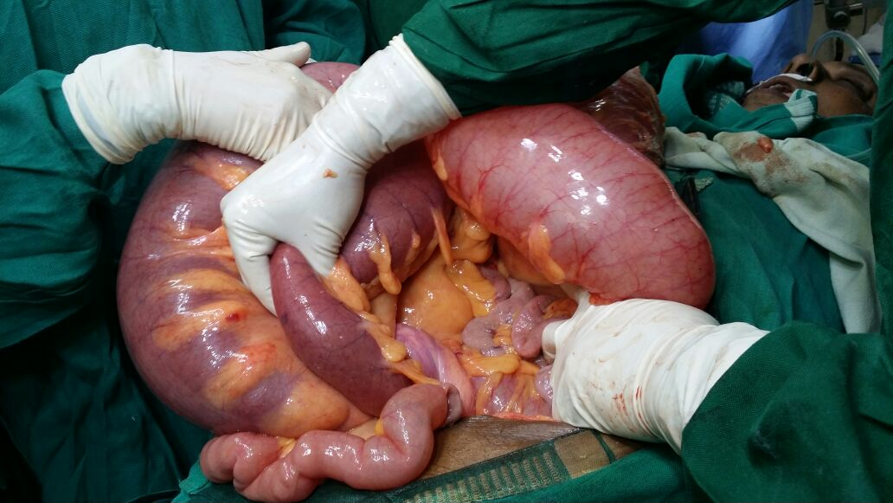

Slide 16
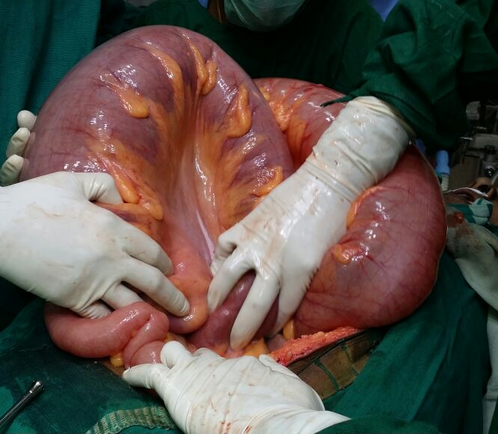

Slide 17
Endocrinologist opinion
A c/o primary hypothyroidism
Free T4 and TSH were advised
TSH- 57.17(0.3-5.5uIU/ml)
FreeT4- 0.8(0.8-1.8 ng/dl)
Poorly controlled hypothyroidism
T.thyroxine increased to 250 micrograms OD

Slide 18
AIM OF PRESENTATION
To highlight the rare complication hypothyroidoism
Hypothyroidism presenting as surgical emergency (Sigmoid volvulus)

