Slide 1
FIXING THE PLATELET KILLER
I MEDICAL UNIT
CHIEF: PROF. Dr . M. Natarajan M.D.
ASSISTANT PROFESSORS: Dr . V. Palani Kumaran M.D. , D.Diab
Dr. D. VasanthaKalyani M.D.
Dr. M. SureshKumar M.D.
PRESENTOR: A. KISHORE

Slide 2
A 67 year old male came with c/o blood in urine for 2 days c/o bleeding from mouth for 2 days
h/o hematuria for 2 days
h/o bleeding from mouth
No h/o fever
No h/o cough with breathlessness
No h/o abdominal pain
No h/o vomiting
No h/o chest pain
No h/o headache, seizure, LOC

Slide 3
PAST HISTORY
k/c/o CAD/AWMI- thrombolysed 2 weeks back with streptokinase.Heparinised for 3 days. Discharged with T. Aspirin, T. Clopidogrel, T. Atorvastatin, T. Enalapril, T. Metoprolol, T. ISDN)
N/K/C/O T2DM/HTN/BA/TB/epilepsy/CVA
4 units platelet transfused in a private hospital outside for bleeding manifestations.

Slide 4
PERSONAL HISTORY
Mixed diet.
Normal bowel and bladder habits.
Non smoker
Occasional alcoholic

Slide 5
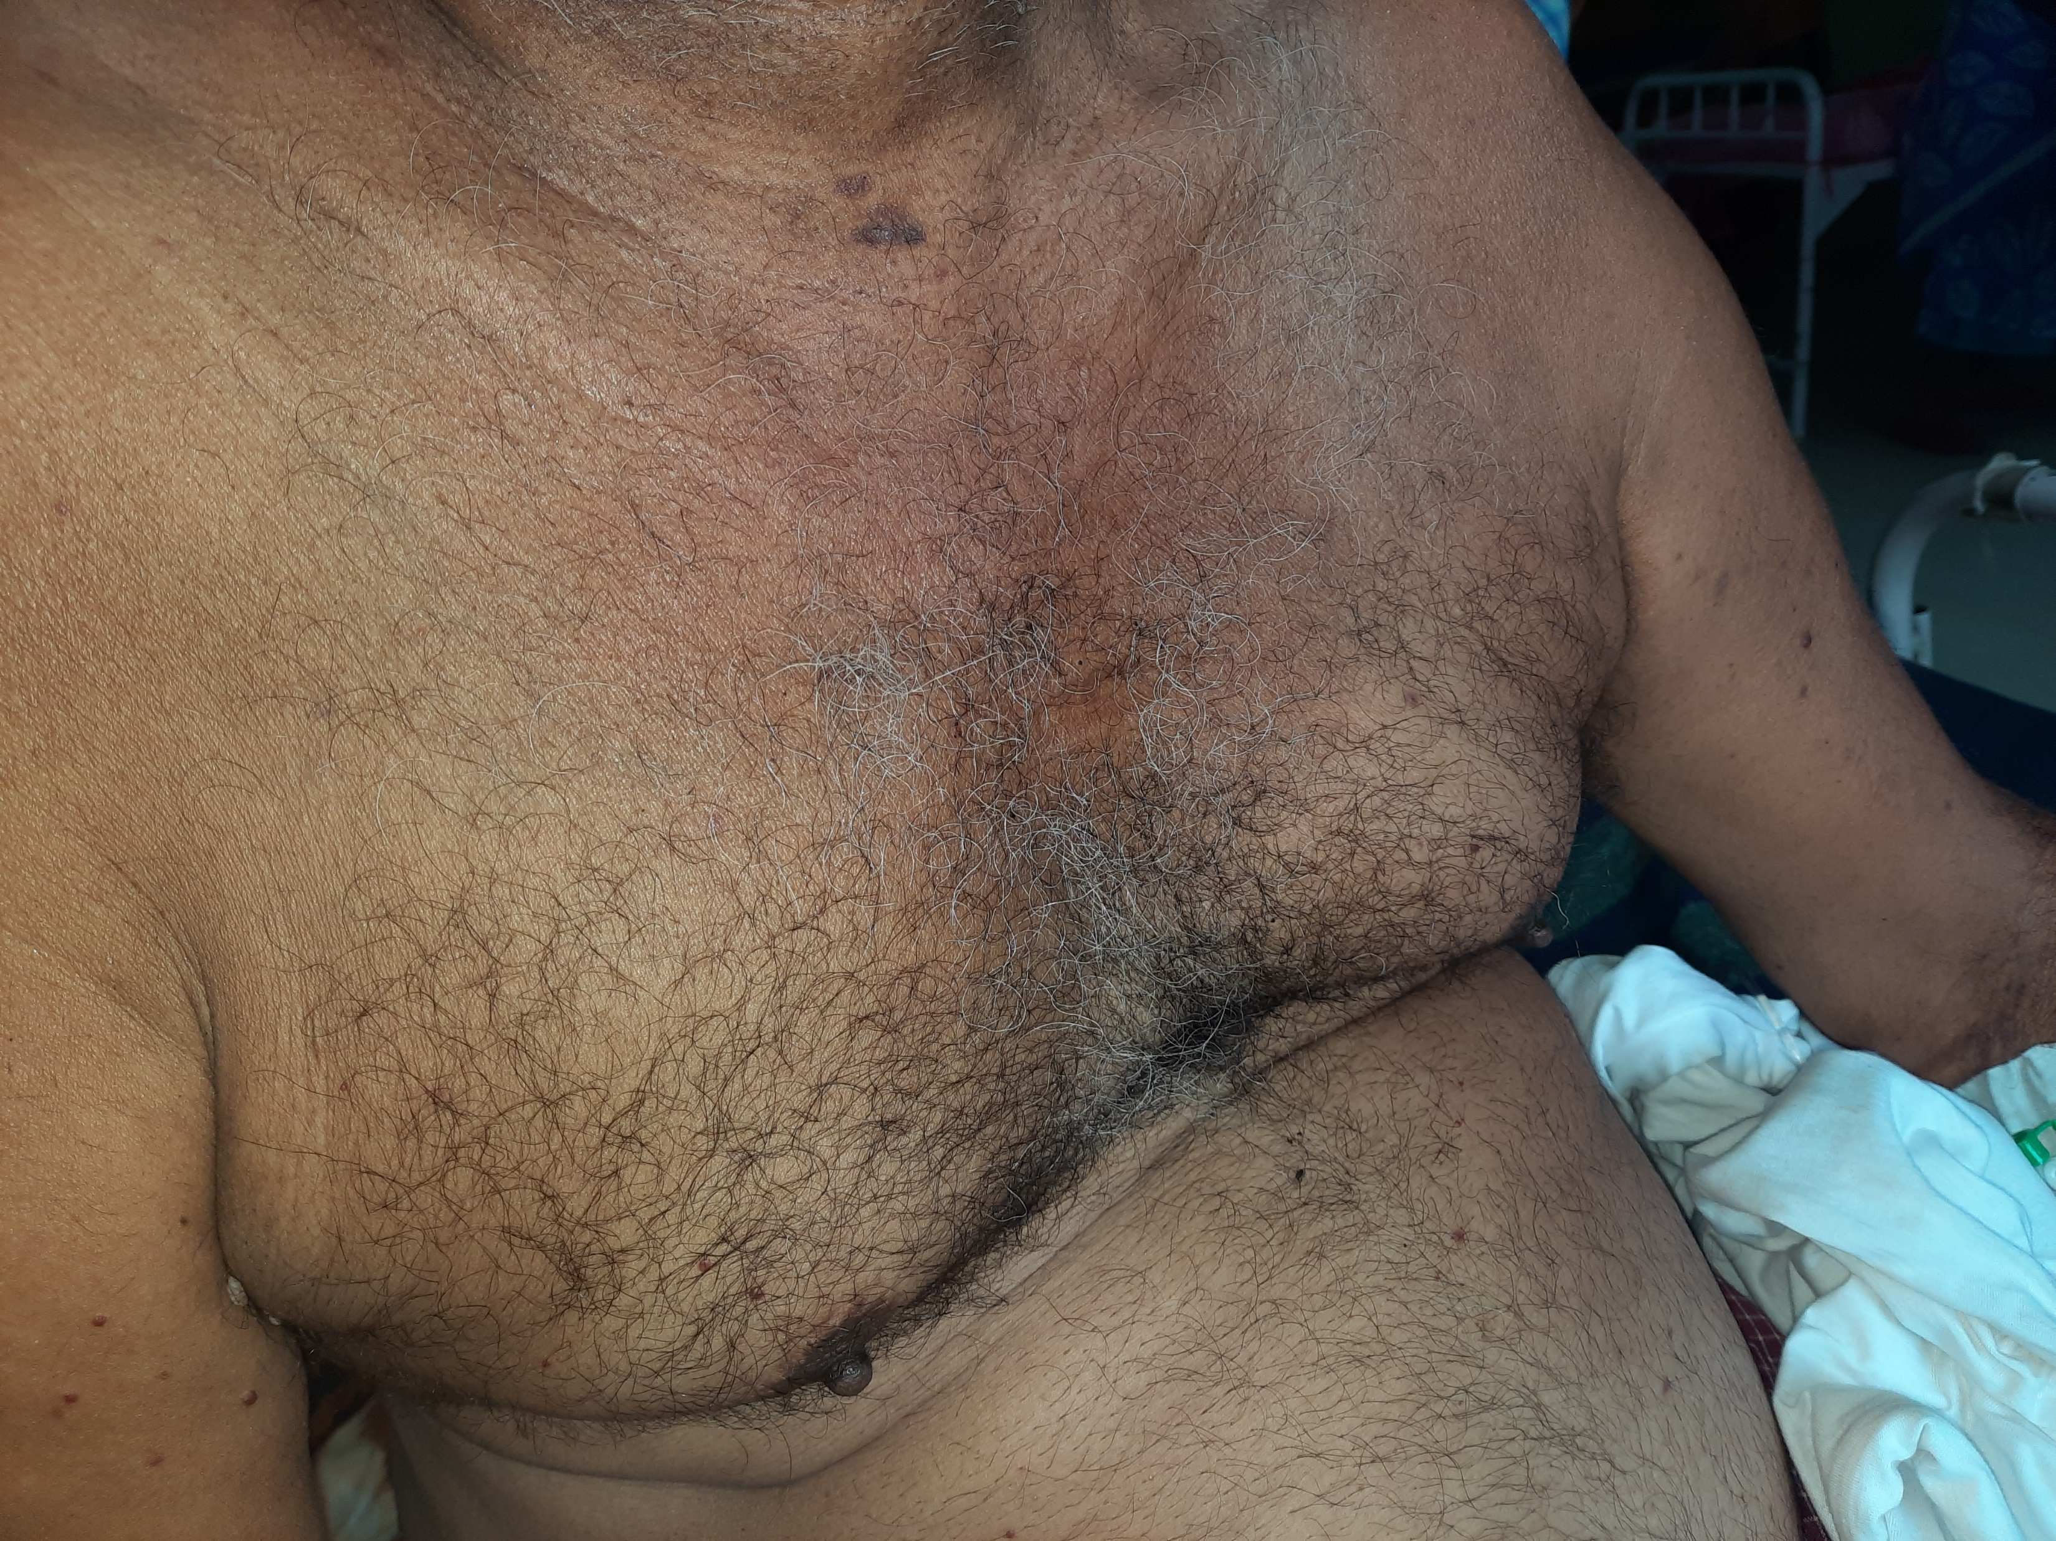
GENERAL EXAMINATION
Conscious
Oriented to time, place, person
Afebrile
Pallor+
No icterus
No cyanosis
No clubbing
No pedal edema
No lymphadenopathy

Slide 6
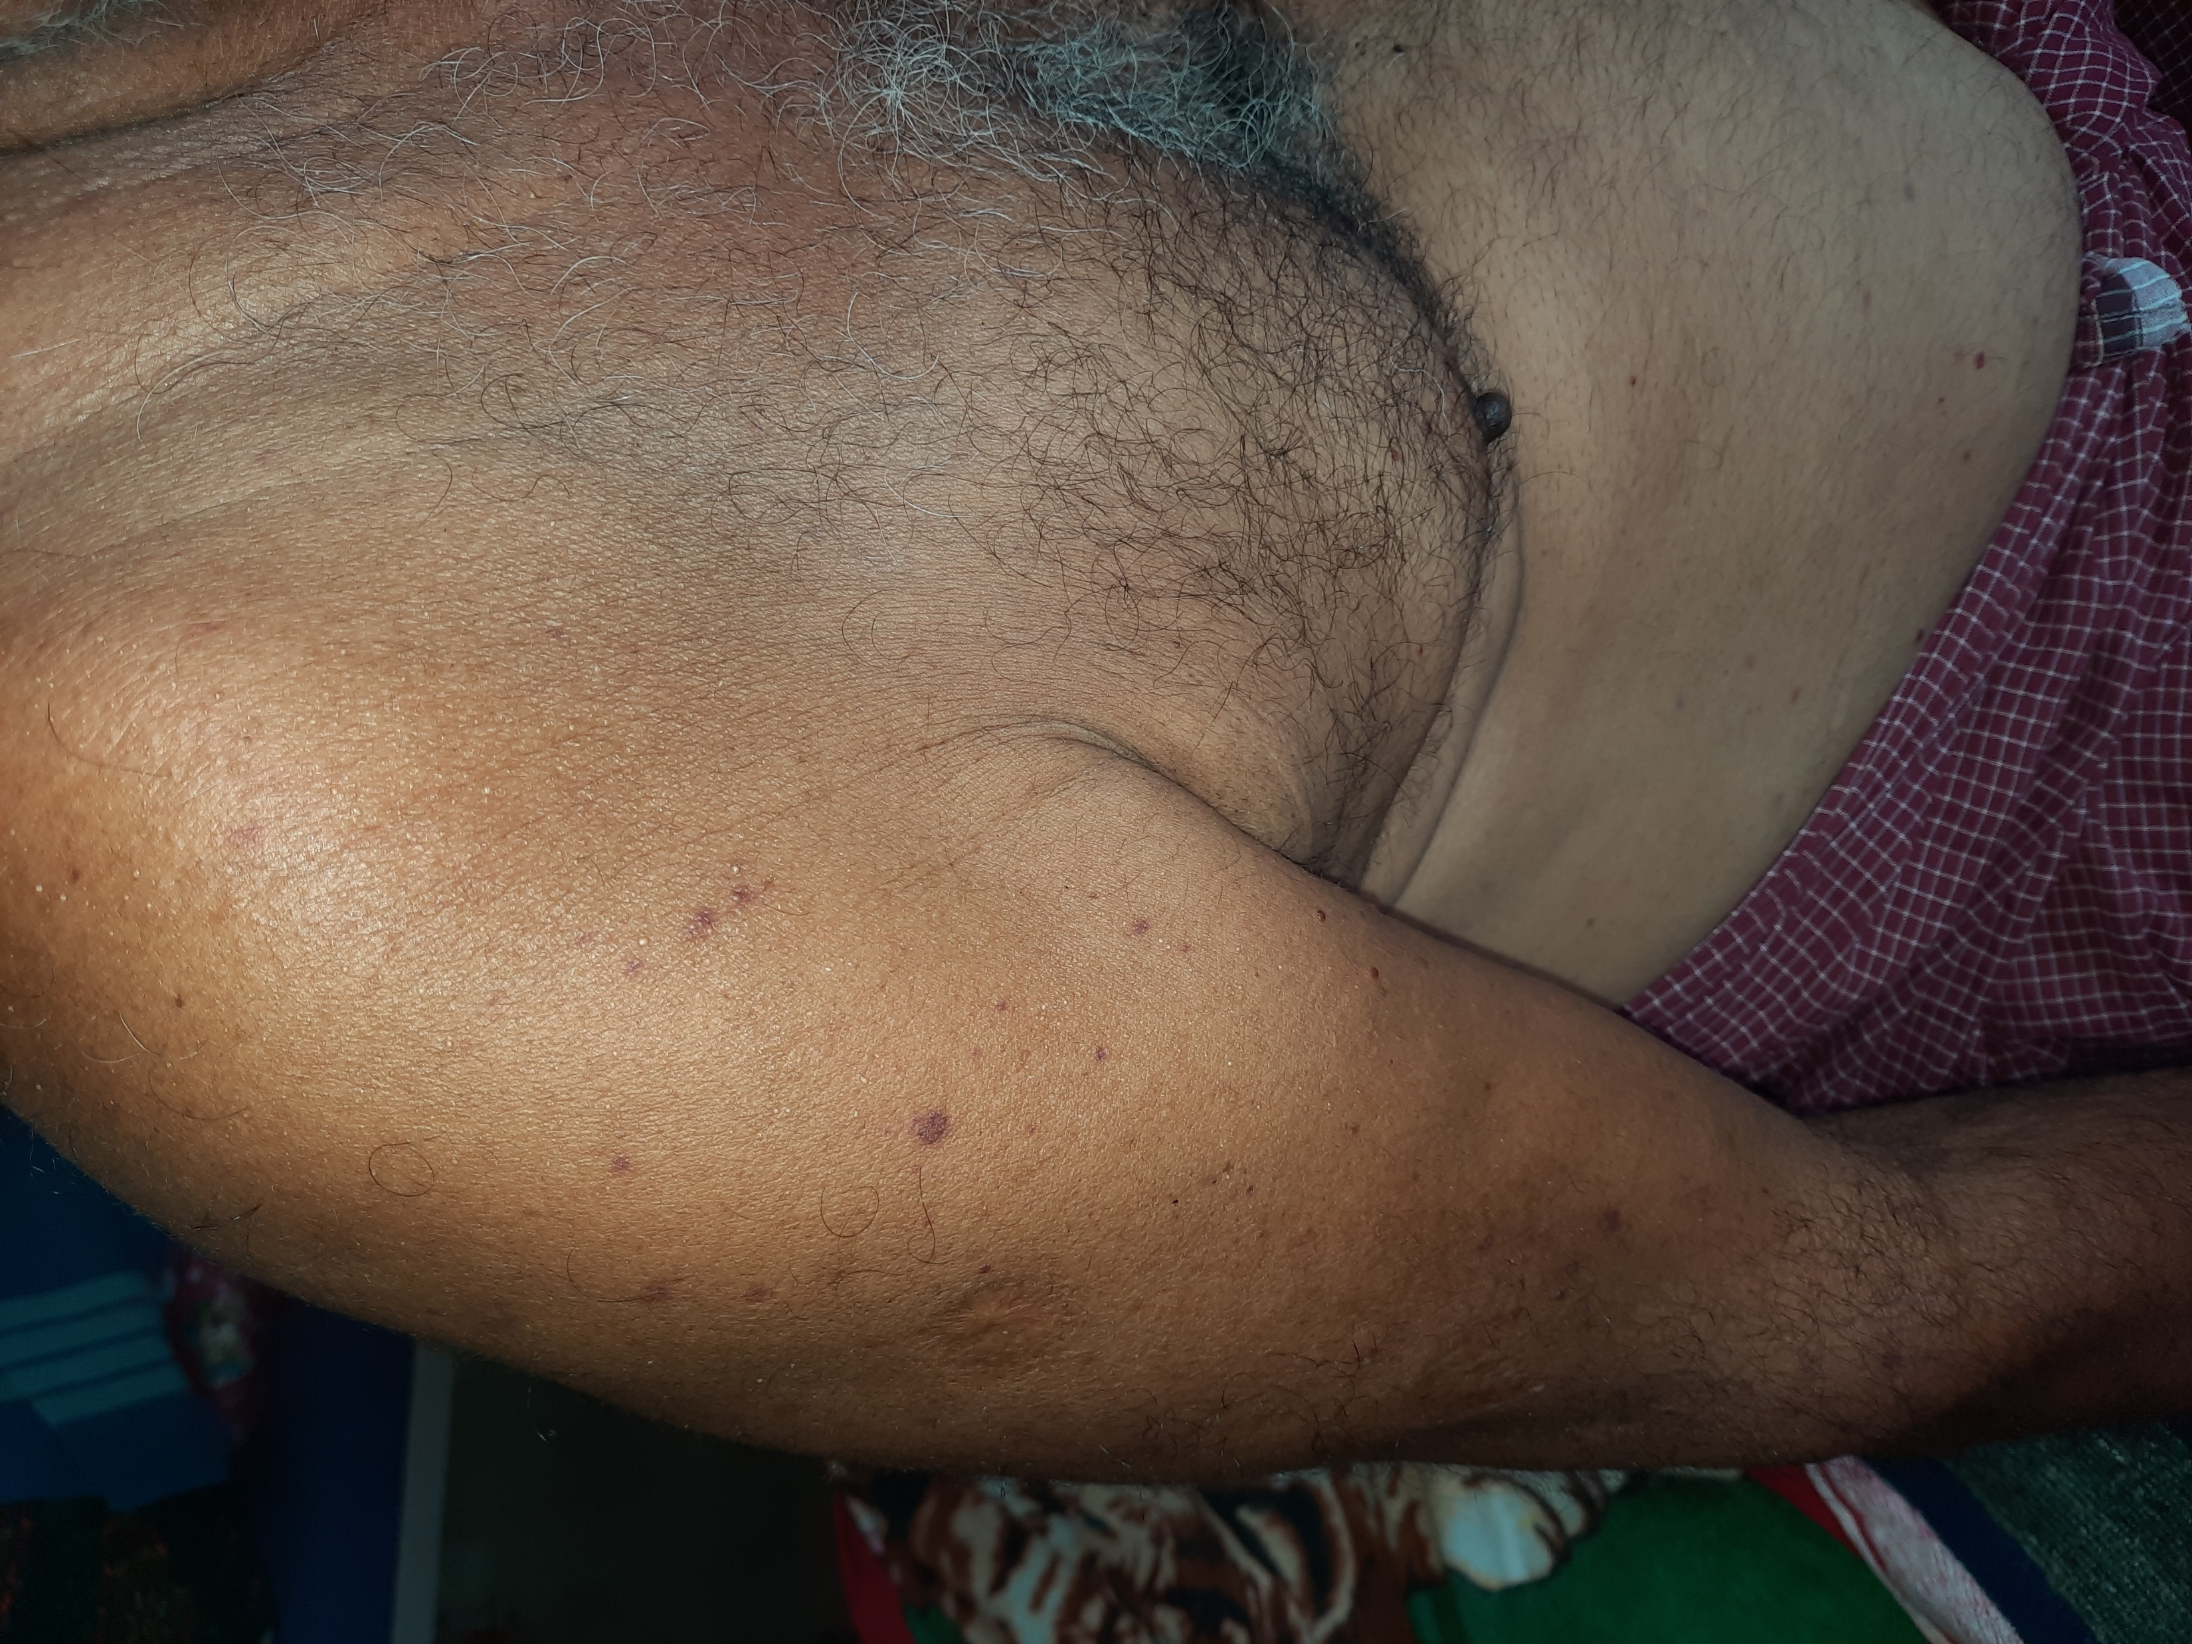
ON EXAMINATION
Multiple petechiae and ecchymoses over oral mucosa and borders of tongue
Multiple petechiae and ecchymoses over the abdomen and upper limbs
VITALS
Blood pressure=140/80 mm Hg
Pulse Rate=88/minute
SpO2=98% in RA

Slide 7
SYSTEMIC EXAMINATION
CVS- S1 S2 heard, no murmur.
RS- BAE present, no added sounds.
CNS- conscious, oriented, NFND.
P/A- soft, bowel sounds heard, no organomegaly.

Slide 8
 | 28/3 | 29/3 | 30/3
TC | 15300 | 12500 | 12100
DC | 87/8/5 | 69/17/14 | 79/13/8
Hb | 10.5 | 8.7 | 10.2
PCV | 30 | 25 | 30
PLATELET | 7000 | 7000 | 2000

Slide 9
INVESTIGATIONS
PT- 18.42 s
APTT- 29.40 s
INR- 1.56
Plasma Fibrinogen- 355.2 mg/ dl (200- 400)

Slide 10
INVESTIGATIONS
Peripheral Smear on 29/3/2022- mild microcytic hypochromic anaemia with neutrophilia and thrombocytopenia
COMPLETE HEMOGRAM- TC 18700
DC- N90/L5/E1/M4
Hb 9.8
Hct 30
RBC 3.6
Platelet 2000
MCV 83, MCH 27, MCHC 33, RDW 14.1
MPV 11.6

Slide 11
INVESTIGATIONS
Urine albumin nil
Urine sugar nil
Urine deposits- field full of RBCs
Urea 16
Creatinine 1.1
CPK 63
LDH 230

Slide 12
INVESTIGATIONS
Total bilirubin-0.6
Direct bilirubin-0.3
Indirect bilirubin-0.3
SGOT-23
SGPT-42
ALP-66
VCTC- Non reactive
HBsAg- negative
Anti HCV- negative

Slide 13
INVESTIGATIONS
USG Abdomen & Pelvis- Grade 2 Medical Renal Disease, Cholelithiasis

Slide 14
TREATMENT GIVEN
Day 1- 4 platelet, 3 FFP
Day 2- 4 platelet
Day 3- 4 platelet
Aspirin and Clopidogrel stopped.

Slide 15
PERSISTING HEMATURIA AND WET PURPURA
IPF- 51
Patient started on Inj. DEXAMETHASONE 40 mg IV OD, Inj. Pantoprazole 40 mg iv BD, Syrup Vitamin D3 60000 IU once weekly, T. Calcium 300 mg BD

Slide 16
SERIAL CBCs AFTER DEXAMETHASONE
 | CBC AFTER D1 OF DEXA | CBC AFTER D2 OF DEXA | CBC AFTER D3 OF DEXA
TC | 13500 | 16500 | 17300
DC | 95/4/1 | 90/5/5 | 81/6/13
Hb | 10.2 | 8.7 | 9.2
PCV | 29 | 24 | 26
PLATELET | 12000 | 21000 | 40000

Slide 17
WHAT NEXT ?

Slide 18
THANK YOU

