Slide 1
A great mimicker in a sweet person
IIIrd MEDICAL UNIT
CHIEF : DEAN PROF Dr.J.SANGUMANI M.D, D.Diab.,
Assistant Professors : Dr.PALANIKUMARAN M.D, D.Diab.,
Dr.SUDHA.,M.D.,
Dr.SENTHIL.,M.D.,
PRESENTOR : Dr.NOORUL AMEEN

Slide 2
Case to be discussed
A 61 year old male patient k/c/o T2DM for 10 years came with complaints of
Fever for 20 days
Yellowish discoloration of skin for 14 days

Slide 3
Hopi
Fever for 20 days-intermittent , low grade associated with chills and rigor
Jaundice for 20 days associated with high coloured urine
Abdominal pain –right sided, dull aching, continuos, not radiating
Cough with expectoration-mucoid, no odour, not blood stained
H/O Loss of weight & Loss of appetite +

Slide 4
Past history Personal history
K/c/o TYPE 2 DIABETES MELLITUS on treatment for past 10 yrs , discontinued for past 2 weeks
H/O Bilateral hernia repair done 10 yrs before
Not a K/C/O HT, TB, BA, Heart disease
Farmer by occupation
Known smoker -30 pack years
Mixed diet
Not an alcoholic
No known allergen

Slide 5
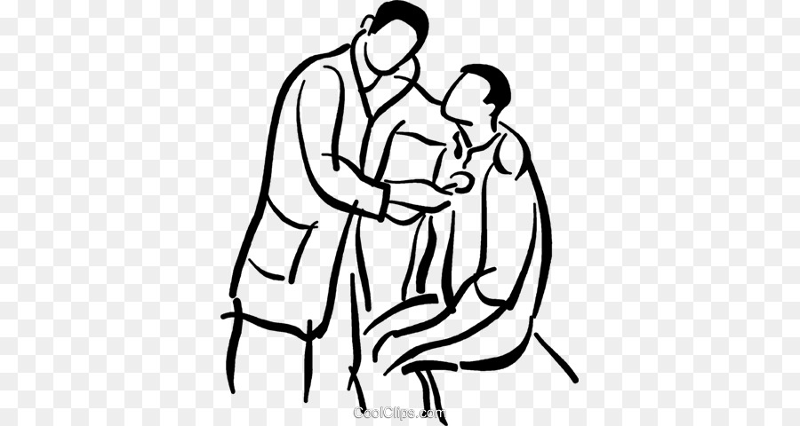
Physical examination
Patient conscious,oriented
Febrile
Thin built ,ill nourished
Icteric
Pallor₊
No pedal edema
VITALS
BP-100/70 mmhg
PR-88/min
Temp-99.8F
SPO2 – 98% Room Air
RR-16/min

Slide 6
Systemic examination
CVS-S1S2+ no murmur
RS-BAE+ Trachea midline,coarse crackles in left Infraclavicular area
P/A-soft, not distended, no organomegaly
Right hypochondrial tenderness
Scar + in inguinal regions
CNS- conscious oriented, moves all 4 limbs
B/L pupil 3mm equally reacting to light

Slide 7
investigations
LFT
TB | 4.5
DB | 1.7
IB | 2.8
SGOT | 62
SGPT | 80
ALP | 597
CBC
TC | 1500
DC | 54/41/5
HB | 9.8
HCT | 28
PLT | 1.07
RFT
UREA | 32
CREATININE | 0.9
NA | 124
K | 3
URINE ROUTINE
Alb - +
Sug - +
Cells – 2-3

Slide 8
ECG
HR-100/min
NSR
normal axis
PR-0.12
QRS-0.06
QT-0.28
No ST T changes
CRP - + VE
ESR – 28 mm / hr
RBS – 247 mg/dl
FBS – 194
PPBS - 254
FLP
Total cholesterol – 167
TGL – 353
HDL – 22
VLDL – 71
LDL - 74

Slide 9
PLAIN CT CHEST
LEFT UL
CONSOLIDATION

Slide 10
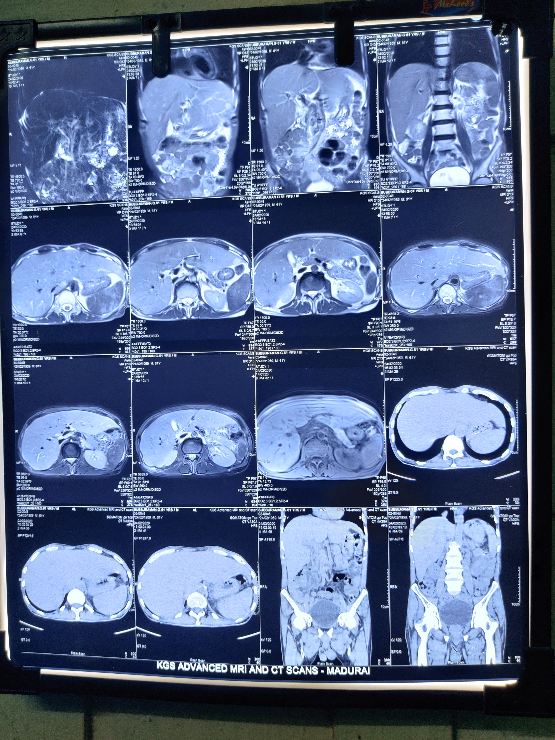
MRI/MRCP ABDOMEN
Hepatomegaly with Periportral hyperintensity
GB is partially collapsed
IHBR/EHBR Normal
NO evidence of stones noted in CBD
No evidence of biliary pancreatitis seen
Thin rim of fluid collection noticed in abdominal and pelvic peritoneal spaces.
No obvious demonstrable pathology noted in rest of the abdominopelvic organs
POSSIBILITY OF NON OBSTRUCTIVE JAUNDICE (HEPATITIS) IS MORE LIKELY

Slide 11
First provisional diagnosis
T2DM
ACUTE HEPATITIS
LEFT UPPER LOBE CONSOLIDATION
PANCYTOPENIA F/E

Slide 12
VARIOUS DOTS TO BE CONNECTED

Slide 13
FIRST DOT- elevated liver parameters
Fever + rigor+ right upper quadrant tenderness
Elevated bilirubin both direct and indirect + significant elevated ALP
USG shows GB distended with no evidence of calculus
MRCP shows hepatomegaly with periportal hyperintensity with no feature of obstruction
Viral markers found to be negative
Considered to be ACUTE CHOLANGITIS

Slide 14
SECOND DOT- left upper lobe consolidation
Fever + loss of weight + loss of appetite + cough with expectoration
K/c/o T2DM
CECT shows patchy air space opacity in apicoposterior segment of LEFT UPPER LOBE
Sputum AFB-NEGATIVE,Sputum CBNAAT-NO MTB DETECTED
Consider to be INFECTIVE/TB etiology
BAL C/S and CBNAAT sent

Slide 15
Third dot- pancytopenia f/E
CBC | DAY1 | DAY2 | DAY4 | DAY6
TC | 1500 | 1300 | 1200 | 1600
DC | 54/41/5 | 60/34/3 | 63/30/7 | 74/19/7
HB | 9.8 | 9.2 | 9.4 | 9.3
HCT | 28 | 25 | 27 | 27
PLT | 1.07L | 81000 | 1.00L | 1.06L
Fever +jaundice
PS shows
RBC -Normochromic Normocytic
WBC normal in number, no immature cells
Platelet normal in number and morphology
BONE MARROW ASPIRATION- normoblastic erythropoeisis, no atypical cells seen
Considered to be infective etiology
MCV | 81
MCH | 28.4
MCHC | 35.1
RDW CV | 15.4
RBC | 3.59
DCT - - VE
VCTC – non reactive
Viral markers - -ve
RC – 0.5 %

Slide 16
Work up panel
Urine C/S-No growth
Blood C/S-No growth
IGM Lepto- negative
IGM Scrub- negative
VCTC-non reactive
HCV Ab- neg,
HBs Ag- neg,
IgM HAV- neg,IgM HEV-neg

Slide 17
Connecting the dots
Constitutional symptoms
Associated type 2 Diabetes
Left upper lobe pneumonia
Pancytopenia
SEPSIS with cholangitis

Slide 18
the new dot
USG abdomen shows multiple hypoechoic cysts noted in splenic parenchyma
CECT Abdomen shows multiple well defined hypo densities noted in all poles of spleen
Expert radiologist opinion obtained to be MULTIPLE SPLENIC ABSCESS

Slide 19
Splenic abscess

Slide 20
FURTHER WORKUP
ECHO –
LVEF-55%
Grade 1 lv diastolic dysfunction
No vegetations seen
Blood culture /sensitivity is repeated

Slide 21
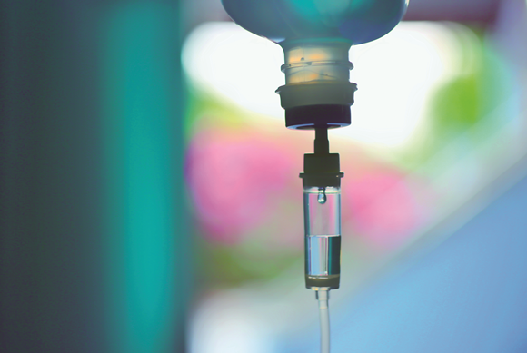
Treatment
Earlier treated with broad spectrum antibiotics-ceftriaxone+metronidazole
Glycemic control maintained by subcutaneous insulin regimen
Other supportive care

Slide 22
In the view of clinical suspicion of melioidosis, antibiotic ceftazidime has been started.
Patient went into septic shock, In spite of inotropes & medical management ,Patient succumbed.

Slide 23
Later Blood culture report revealed the growth of BURKHOLDERIA PSEUDOMALLEI

Slide 24
Final diagnosis
T2DM / SEPTICEMIC MELIOIDOSIS

Slide 25
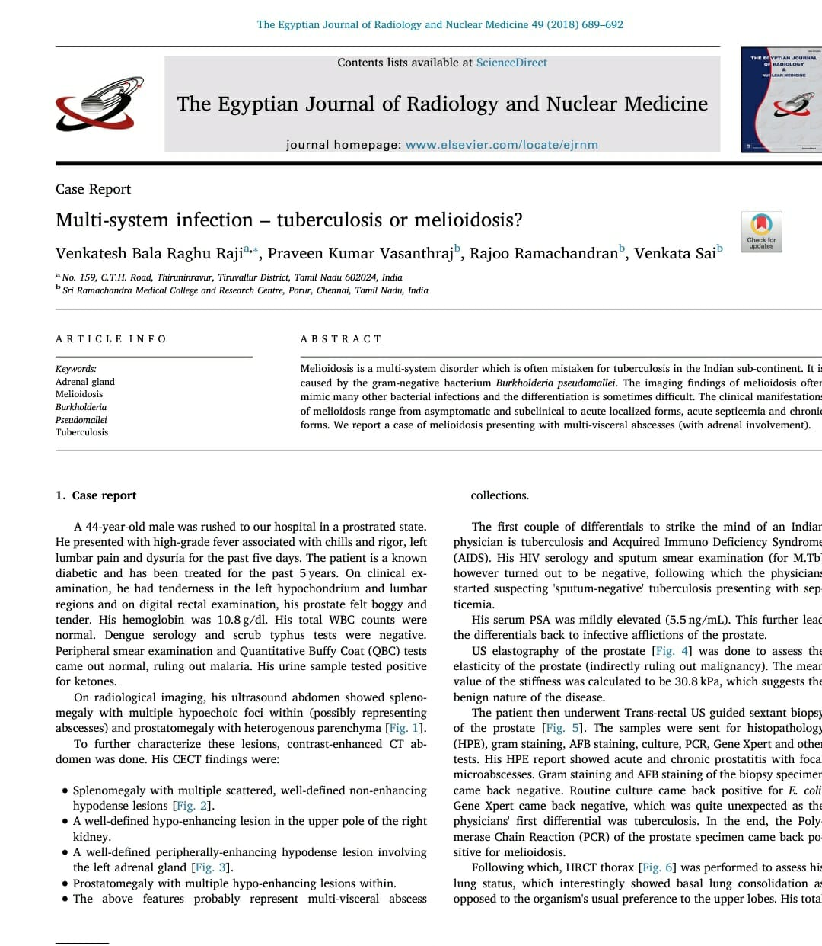
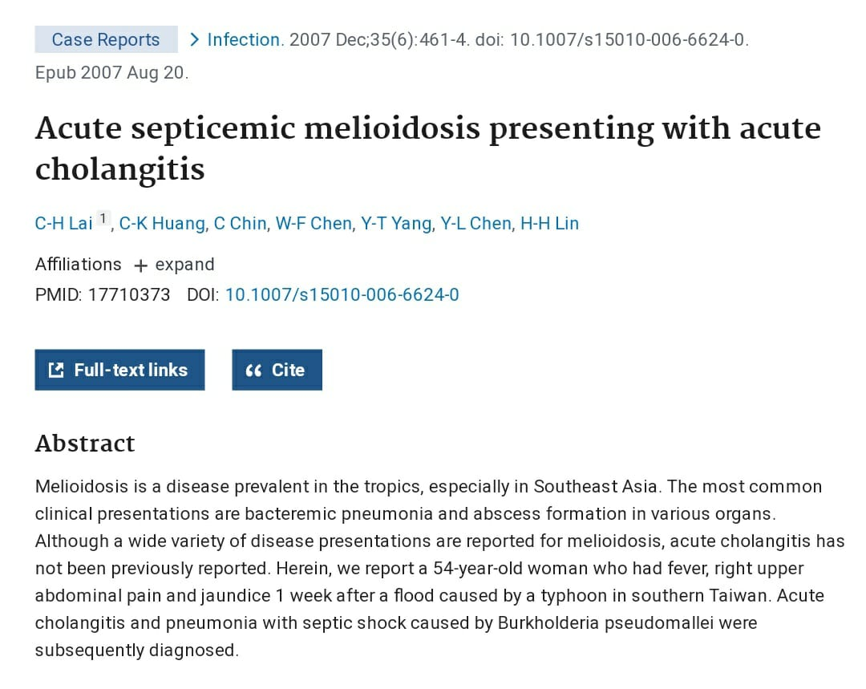
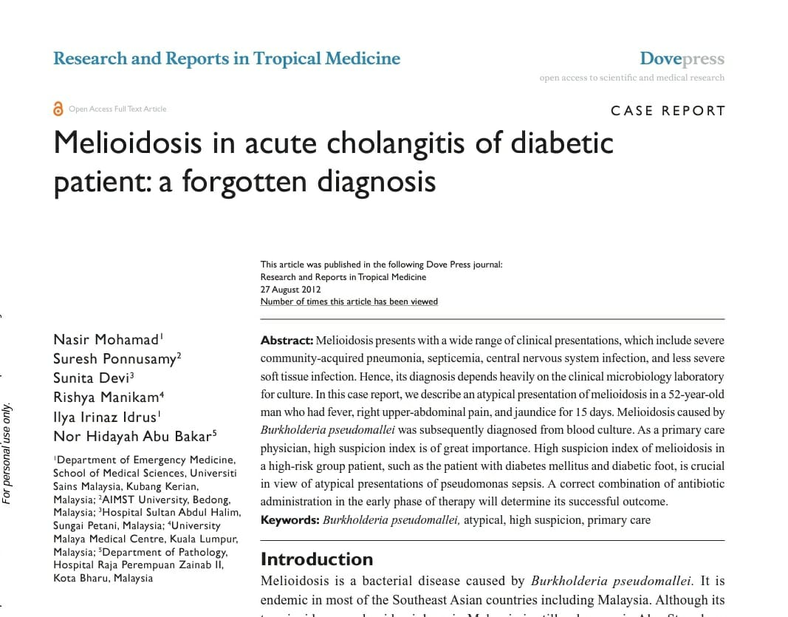
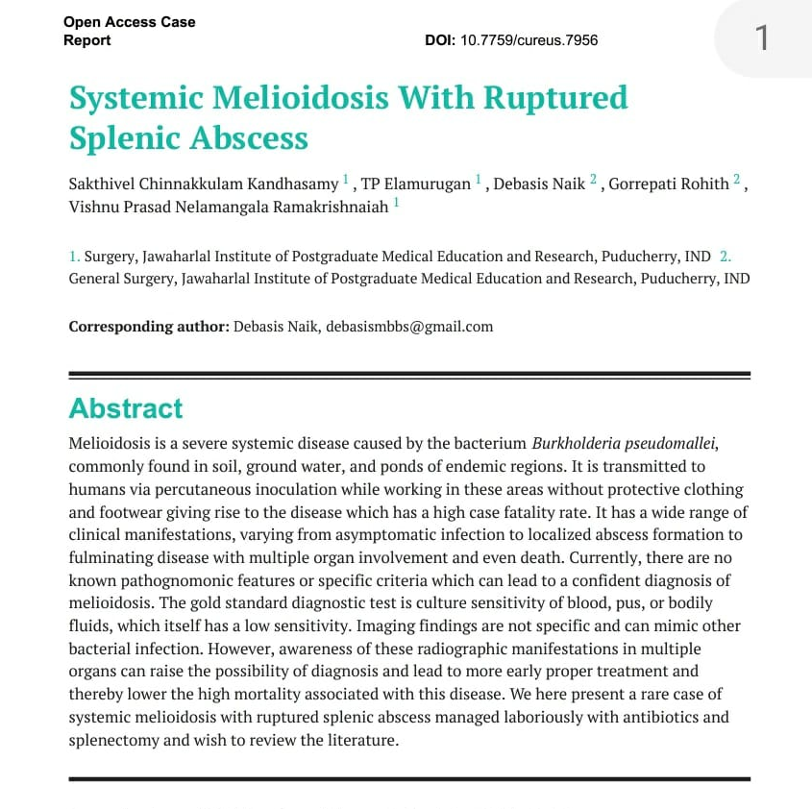
journals

Slide 26
Thank you

